Slide 1
COSC 1437.01
PROGRAMMING FUNDAMENTALS II
LECTURE 3. ALGORITHM EFFICIENCY AND RECURSION

Slide 2
Why Efficient Code?
Computers are faster, have larger memories
  So why worry about efficient code?
And … how do we measure efficiency?

Slide 3
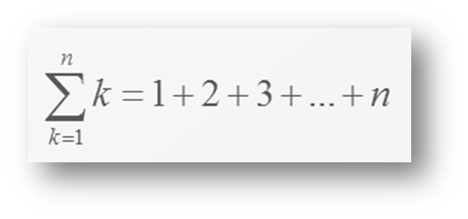
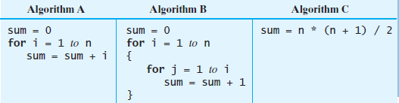
Example
Consider the problem of summing
FIGURE 4-1 Three algorithms for computing the sum
1 + 2 + . . . + n for an integer n > 0

Slide 4
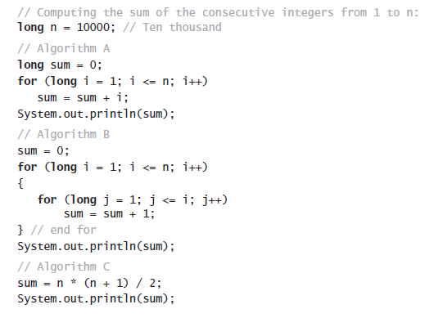
Example
Java code for the three algorithms

Slide 5
What is “best”?
An algorithm has both time and space constraints – that is complexity
  Time complexity
  Space complexity
This study is called analysis of algorithms

Slide 6
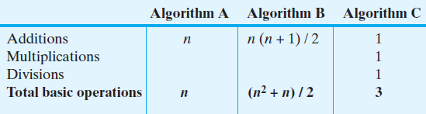
Counting Basic Operations
A basic operation of an algorithm
  The most significant contributor to its total time requirement
FIGURE 4-2 The number of basic operations
required by the algorithms in Figure 4-1

Slide 7
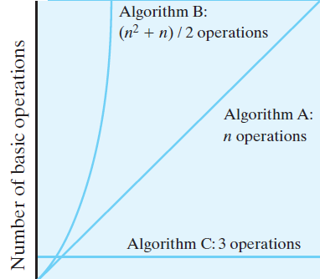
Counting Basic Operations
FIGURE 4-3 The number of basic operations required by the algorithms in Figure 4-1 as a function of n

Slide 8
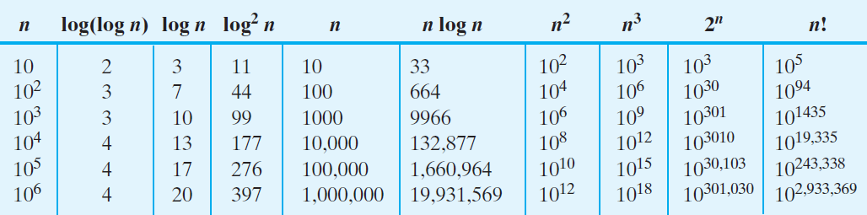
Counting Basic Operations
FIGURE 4-4 Typical growth-rate functions evaluated
at increasing values of n

Slide 9
Best, Worst, and Average Cases
For some algorithms, execution time depends only on size of data set
Other algorithms depend on the nature of the data itself
  Here we seek to know best case, worst case, average case

Slide 10
Big Oh Notation
A function f(n) is of order at most g(n)
That is, f(n) is O(g(n))—if
  A positive real number c and positive integer N exist …
  Such that f(n) ≤ c x g(n) for all n ≥ N
  That is, c x g(n) is an upper bound on f(n) when n is sufficiently large

Slide 11
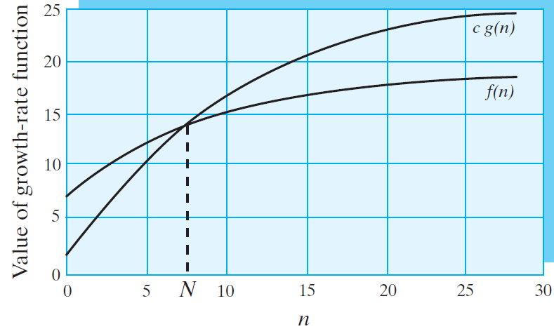
Big Oh Notation
FIGURE 4-5 An illustration of the definition of Big Oh

Slide 12
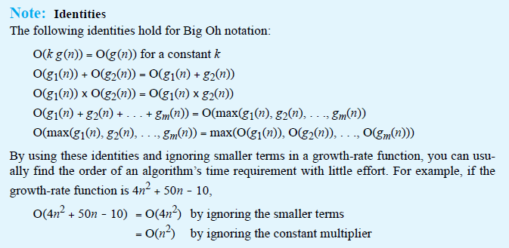
Big Oh Notation
Identities for Big Oh Notation

Slide 13
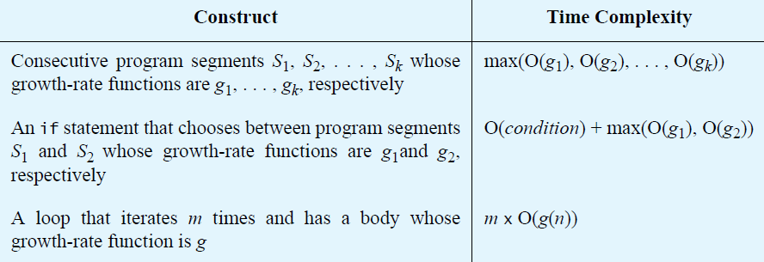
Complexities of Program Constructs

Slide 14
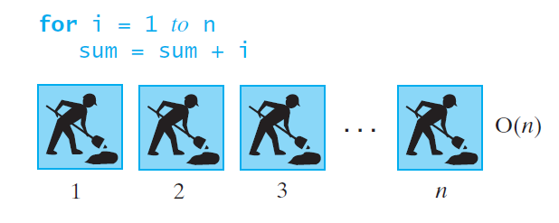
Picturing Efficiency
FIGURE 4-6 An O(n) algorithm

Slide 15
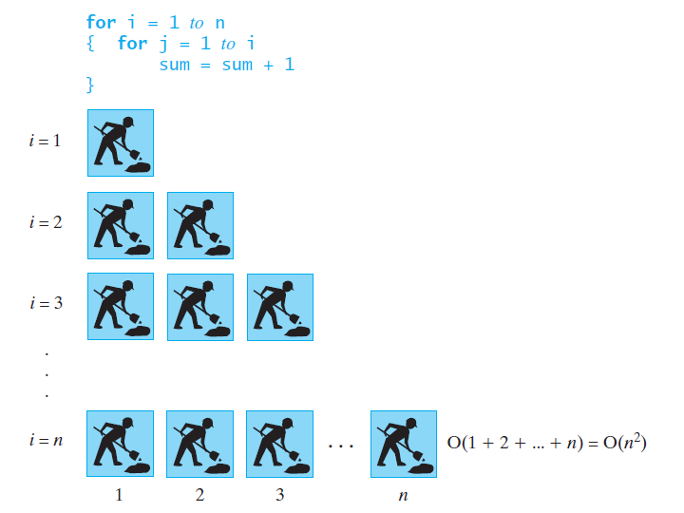
Picturing Efficiency
FIGURE 4-7 An O(n²) algorithm

Slide 16
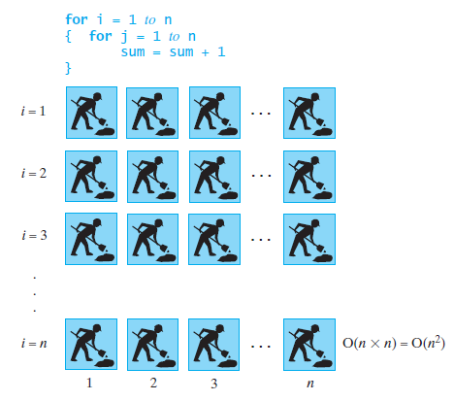
Picturing Efficiency
FIGURE 4-8 Another O(n²) algorithm

Slide 17
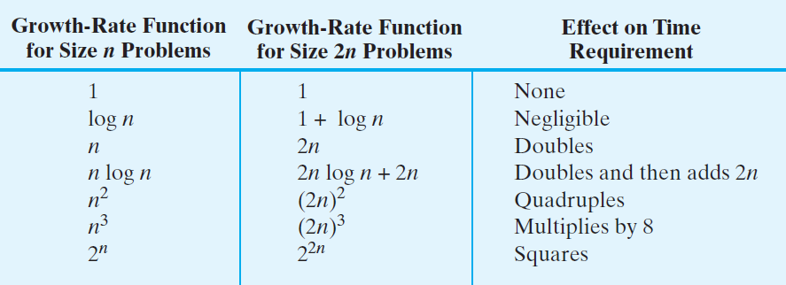
Picturing Efficiency
FIGURE 4-9 The effect of doubling the problem
size on an algorithm’s time requirement

Slide 18
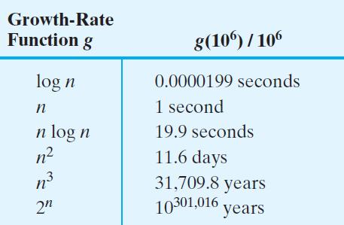
Picturing Efficiency
FIGURE 4-10 The time required to process one million items by algorithms of various orders at the rate of one million operations per second

Slide 19
What Is Recursion?
The idea of calling one function from another immediately suggests the possibility of a function calling itself.
The function-call mechanism in Java supports this possibility, which is known as recursion.

Slide 20
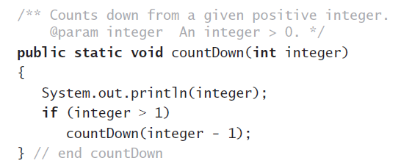
Example: The Countdown
Recursive Java method to do countdown.

Slide 21
Definition
Recursion is a problem-solving process
  Breaks a problem into identical but smaller problems.
A method that calls itself is a recursive method.
  The invocation is a recursive call or recursive invocation.

Slide 22
Design Guidelines
Method must be given an input value
Method definition must contain logic that involves this input, leads to different cases
One or more cases should provide solution that does not require recursion
  Else infinite recursion
One or more cases must include a recursive invocation

Slide 23
Programming Tip
Iterative method contains a loop
Recursive method calls itself
Some recursive methods contain a loop and call themselves
  If the recursive method with loop uses while, make sure you did not mean to use an if statement

Slide 24
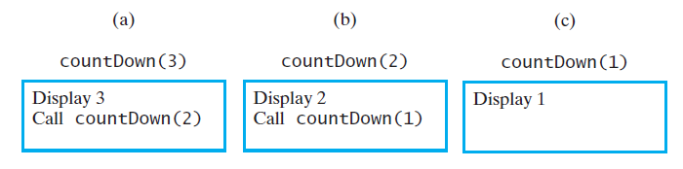
Tracing a Recursive Method
FIGURE 7-2 The effect of the method call countDown(3)

Slide 25
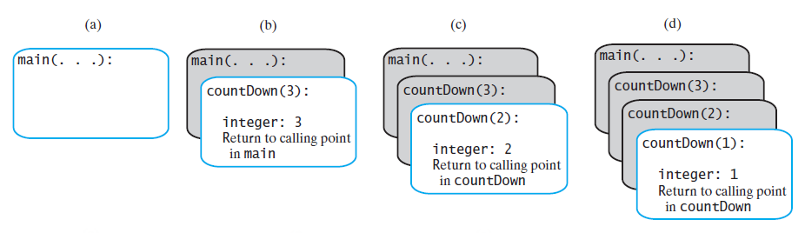
Tracing a Recursive Method
FIGURE 7-4 The stack of activation records during the execution of the call countDown(3)

Slide 26
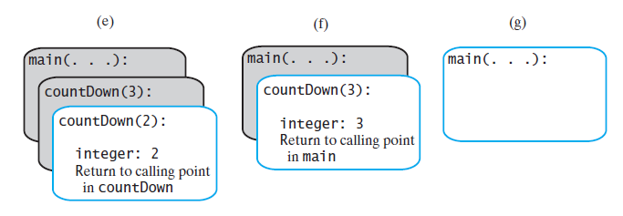
Tracing a Recursive Method
FIGURE 7-4 The stack of activation records during the execution of the call countDown(3)

Slide 27
Stack of Activation Records
Each call to a method generates an activation record
Recursive method uses more memory than an iterative method
  Each recursive call generates an activation record
If recursive call generates too many activation records, could cause stack overflow

Slide 28
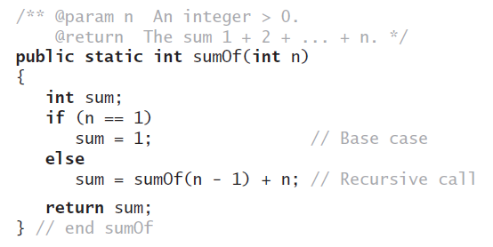

Recursive Methods
That Return a Value
Recursive method to calculate

Slide 29
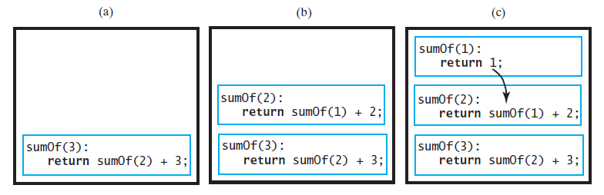
Tracing a Recursive Method
FIGURE 7-5 Tracing the execution of sumOf(3)

Slide 30
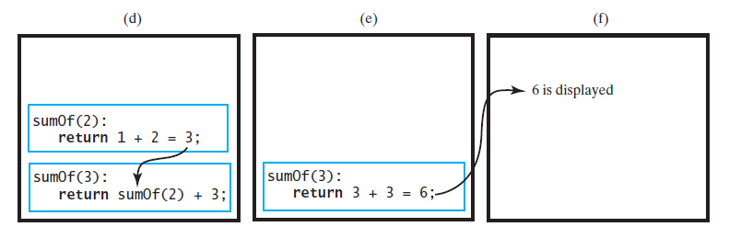
Tracing a Recursive Method
FIGURE 7-5 Tracing the execution of sumOf(3)

Slide 31
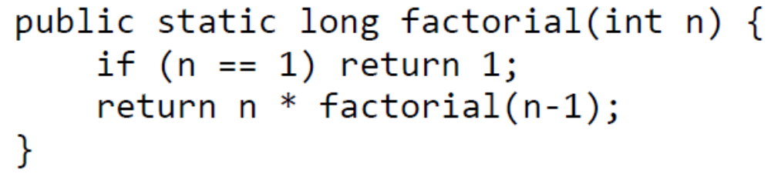
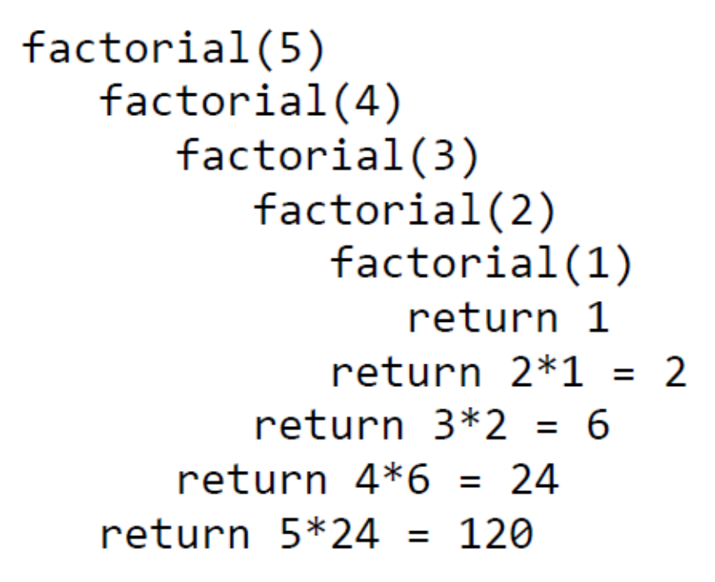
Factorial Example

Slide 32
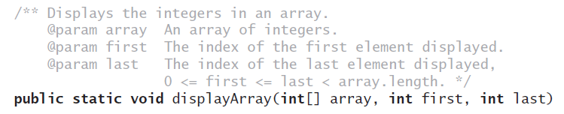
Recursively
Processing an Array
Given definition of a recursive method to display array.

Slide 33
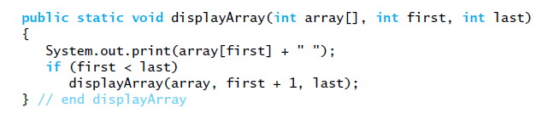
Recursively
Processing an Array
Starting with array[first]

Slide 34
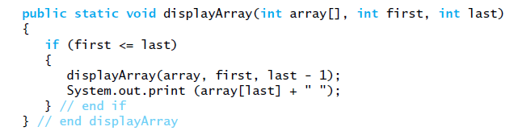
Recursively
Processing an Array
Starting with array[last]

Slide 35

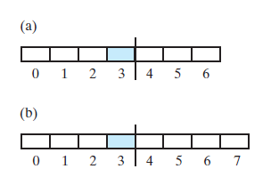
Recursively
Processing an Array
FIGURE 7-6 Two arrays with their middle elements within their left halves

Slide 36
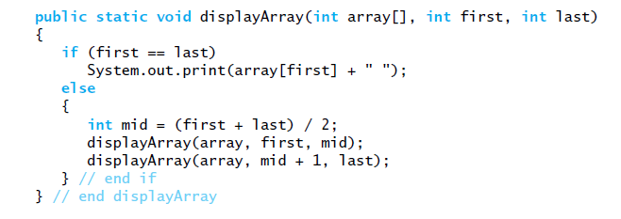
Recursively
Processing an Array
Processing array from middle.

Slide 37
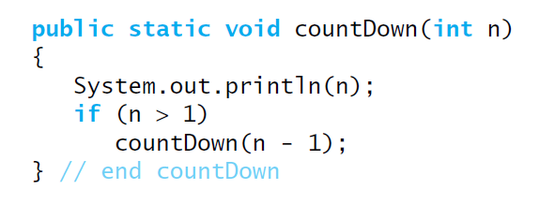
Time Efficiency of Recursive Methods
Using proof by induction, we conclude method is O(n).

Slide 38
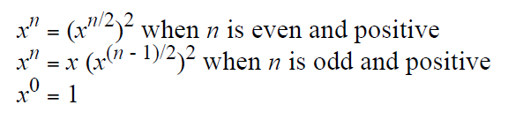
Time Efficiency of Computing x^{n}
Efficiency of algorithm is O(log n)

Slide 39
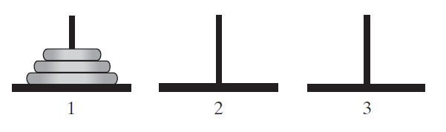
Simple Solution to a
Difficult Problem
FIGURE 7-7 The initial configuration of the
Towers of Hanoi for three disks.

Slide 40
Simple Solution to a
Difficult Problem
Rules:
Move one disk at a time. Each disk moved must be topmost disk.
No disk may rest on top of a disk smaller than itself.
You can store disks on the second pole temporarily, as long as you observe the previous two rules.

Slide 41
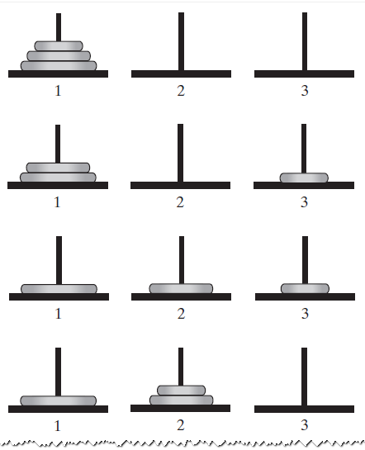
Solutions
FIGURE 7-8 The sequence of moves for solving the Towers of Hanoi problem with three disks

Slide 42
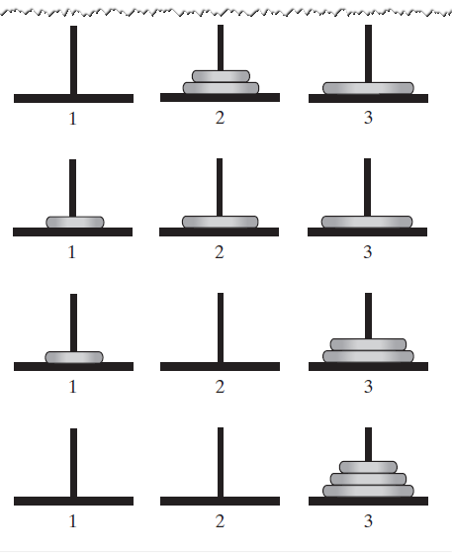
Solutions
FIGURE 7-8 The sequence of moves for solving the Towers of Hanoi problem with three disks

Slide 43
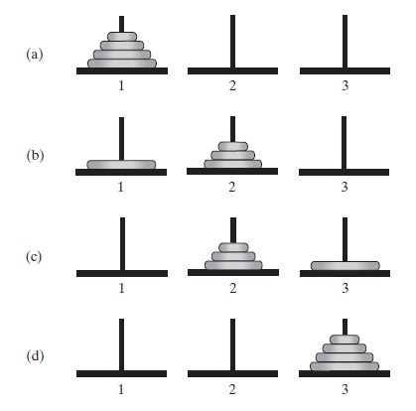
Solutions
FIGURE 7-9 The smaller problems in a recursive solution for four disks

Slide 44
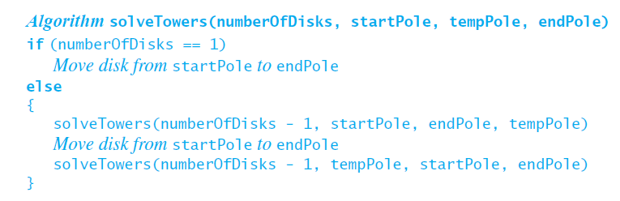
Solutions
Recursive algorithm to solve any number of disks.
Note: for n disks, solution will be 2^{n} – 1 moves

Slide 45
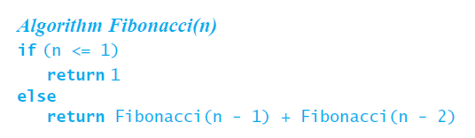
Poor Solution to a Simple Problem
Algorithm to generate Fibonacci numbers.
Why is this inefficient?

Slide 46
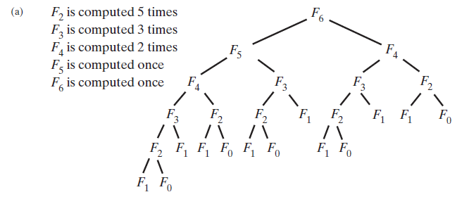
Poor Solution to a Simple Problem
FIGURE 7-10 The computation of the Fibonacci
number F₆ using (a) recursion … F_{n} = Ω(a^{n})

Slide 47
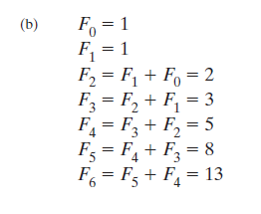
Poor Solution to a Simple Problem
FIGURE 7-10 The computation of the Fibonacci
number F₆ using (b) iteration.

Slide 48
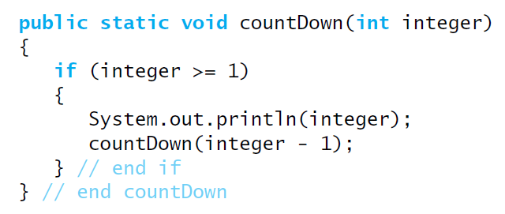
Tail Recursion
When the last action performed by a recursive
method is a recursive call.

Slide 49
Tail Recursion
In a tail-recursive method, the last action is a recursive call
This call performs a repetition that can be done by using iteration.
Converting a tail-recursive method to an iterative one is usually a straightforward process.

Slide 50
Indirect Recursion
Example
  Method A calls Method B
  Method B calls Method C
  Method C calls Method A
Difficult to understand and trace
  But does happen occasionally

Slide 51
Indirect Recursion
Consider evaluation of validity of an algebraic expression
  Algebraic expression is either a term or two terms separated by a + or – operator
  Term is either a factor or two factors separated by a * or / operator
  Factor is either a variable or an algebraic expression enclosed in parentheses
  Variable is a single letter

Slide 52
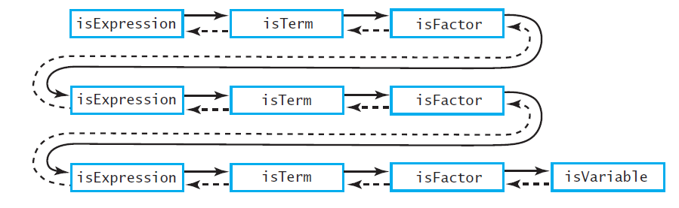
Indirect Recursion
FIGURE 7-11 An example of indirect recursion

Slide 53
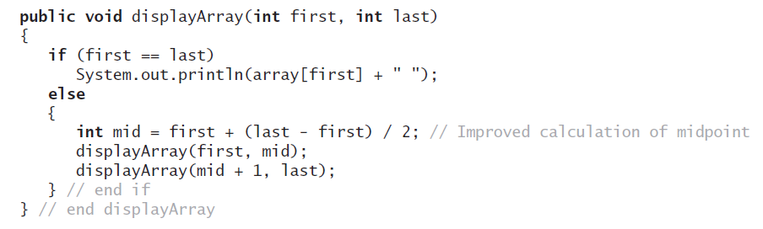
Using a Stack
Instead of Recursion
An example of converting a
recursive method to an iterative one

Slide 54
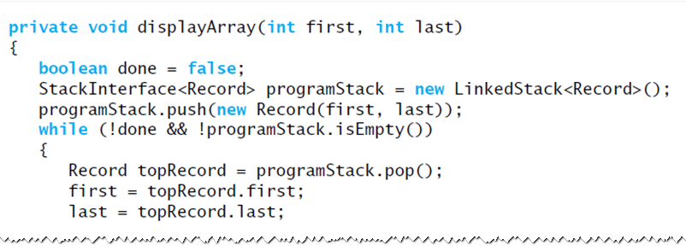
Using a Stack
Instead of Recursion
An iterative displayArray to maintain its own stack

Slide 55
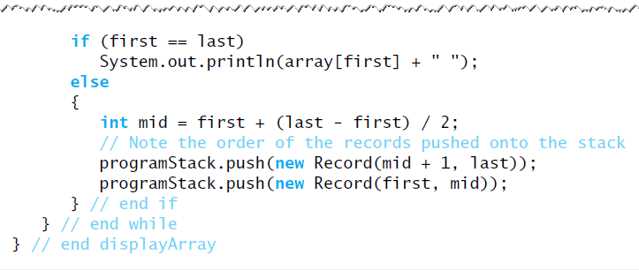
Using a Stack
Instead of Recursion
An iterative displayArray to maintain its own stack

