Slide 1
COSC 1437.01
PROGRAMMING FUNDAMENTALS II
LECTURE 7. A LIST IMPLEMENTATION THAT USES LINKS (REFERENCE BASED IMPLEMENTATION ADT LIST)
1-<number>

Slide 2
Linking Objects Together
References are particularly important in computer science because they make it possible to represent the relationship among objects by linking them together in various ways.
In a linked list, each object in a sequence contains a reference to the one that follows it:
data
data
data
data
link
link
link
link
null
Java marks the end of linked list using the constant null, which signifies a reference that does not actually point to an actual object.
1-<number>

Slide 3
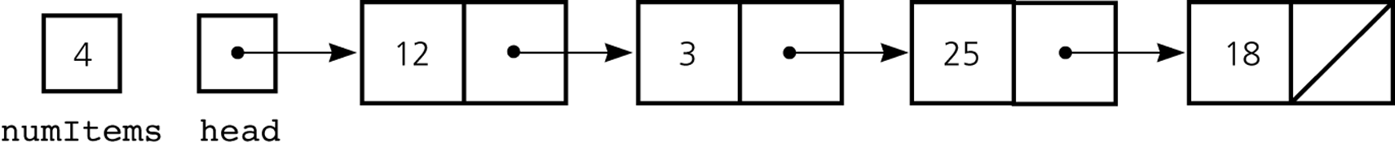
A Reference-Based Implementation of the ADT List
A reference-based implementation of the ADT list
  Does not shift items during insertions and deletions
  Does not impose a fixed maximum length on the list
Figure 5-18
A reference-based implementation of the ADT list
5 B-<number>

Slide 4
A Reference-Based Implementation of the ADT List
Default constructor
  Initializes the data fields numItems and head
List operations
  Public methods
    isEmpty
    size
    add
    remove
    get
    removeAll
  Private method
    find
5 B-<number>

Slide 5
Comparing Array-Based and Referenced-Based Implementations
Size
  Array-based
    Fixed size
      Issues
        Can you predict the maximum number of items in the ADT?
        Will an array waste storage?
      Resizable array
        Increasing the size of a resizable array can waste storage and time
5 B-<number>

Slide 6
Comparing Array-Based and Referenced-Based Implementations
Size (Continued)
  Reference-based
    Do not have a fixed size
      Do not need to predict the maximum size of the list
      Will not waste storage
Storage requirements
  Array-based
    Requires less memory than a reference-based implementation
      There is no need to store explicitly information about where to find the next data item
5 B-<number>

Slide 7
Comparing Array-Based and Referenced-Based Implementations
Storage requirements (Continued)
  Reference-based
    Requires more storage
      An item explicitly references the next item in the list
Access time
  Array-based
    Constant access time
  Reference-based
    The time to access the i^{th} node depends on i
5 B-<number>

Slide 8
Comparing Array-Based and Referenced-Based Implementations
Insertion and deletions
  Array-based
    Require you to shift the data
  Reference-based
    Do not require you to shift the data
    Require a list traversal
5 B-<number>

Slide 9
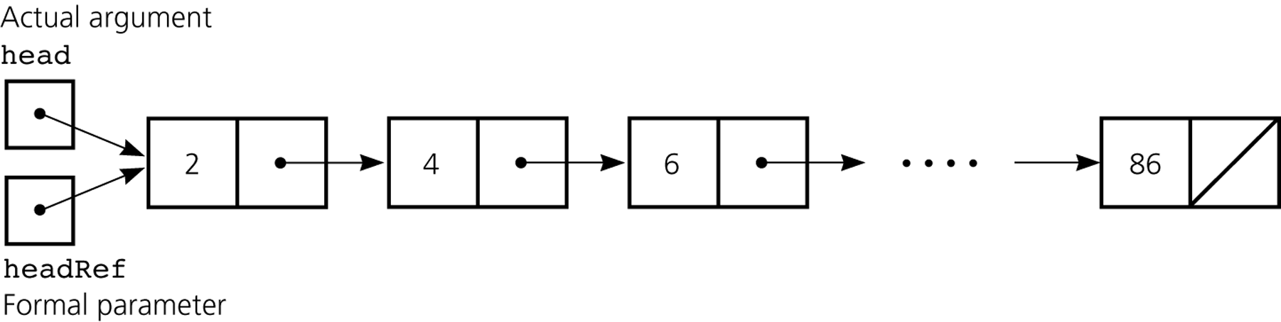
Passing a Linked List to a Method
A method with access to a linked list’s head reference has access to the entire list
When head is an actual argument to a method, its value is copied into the corresponding formal parameter
Figure 5-19
A head reference as an argument
5 B-<number>

Slide 10
Processing Linked Lists Recursively
Traversal
  Recursive strategy to display a list
    Write the first node of the list
    Write the list minus its first node
  Recursive strategies to display a list backward
    writeListBackward strategy
      Write the last node of the list
      Write the list minus its last node backward
    writeListBackward2 strategy
      Write the list minus its first node backward
      Write the first node of the list
5 B-<number>

Slide 11
Processing Linked Lists Recursively
Insertion
  Recursive view of a sorted linked list
    The linked list that head references is a sorted linked list if
    head is null (the empty list is a sorted linked list)
    or
    head.getNext() is null (a list with a single node is a
    sorted linked list)
    or
    head.getItem() < head.getNext().getItem(),
    and head.getNext() references a sorted linked list
5 B-<number>

Slide 12
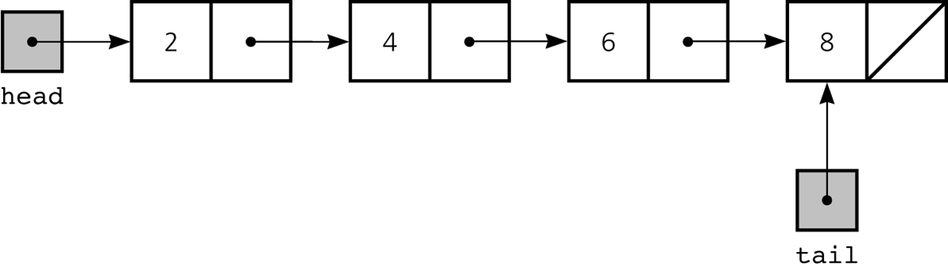
Variations of the Linked List:
Tail References
tail references
  Remembers where the end of the linked list is
  To add a node to the end of a linked list
    tail.setNext(new Node(request, null));
Figure 5-22
A linked list with head and tail references
5 B-<number>

Slide 13
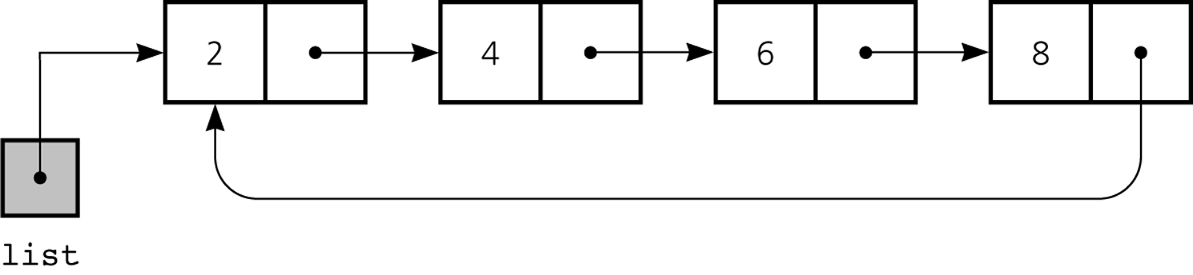
Circular Linked List
Last node references the first node
Every node has a successor; check if getNext().equals(list) to determine when entire list is traversed
Figure 5-23
A circular linked list
5 B-<number>

Slide 14
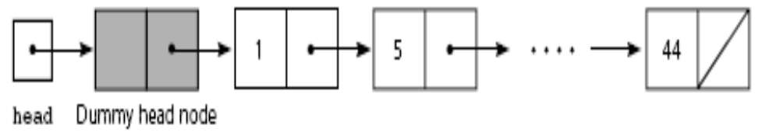
Dummy Head Nodes
Dummy head node
  Always present, even when the linked list is empty
  Insertion and deletion algorithms initialize prev to reference the dummy head node, rather than null
Figure 5-25
A dummy head node
5 B-<number>

Slide 15
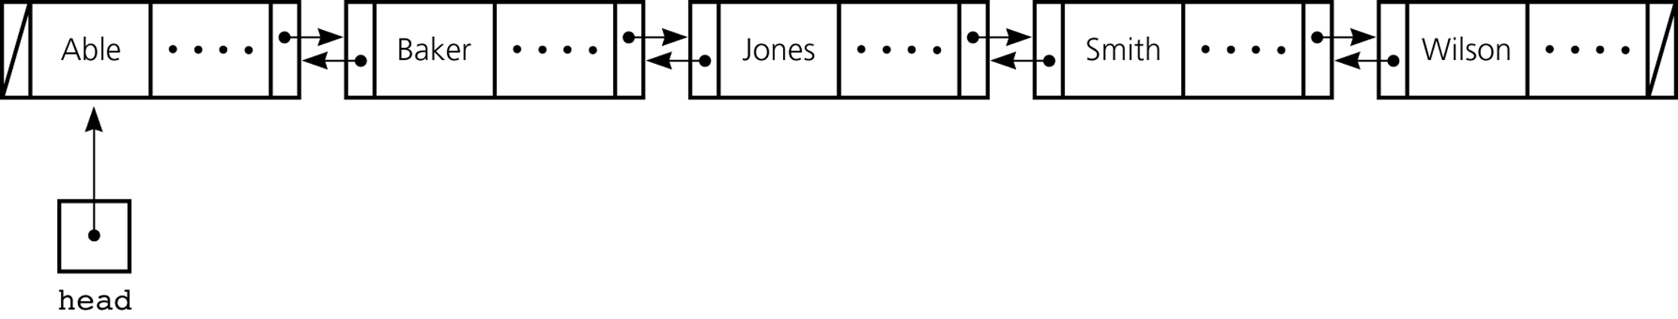
Doubly Linked List
Each node references both its predecessor and its successor
Dummy head nodes are useful in doubly linked lists
Figure 5-26
A doubly linked list
5 B-<number>

Slide 16
Doubly Linked List
Circular doubly linked list
  prev reference of the dummy head node references the last node
  next reference of the last node references the dummy head node
  Eliminates special cases for insertions and deletions
5 B-<number>

Slide 17
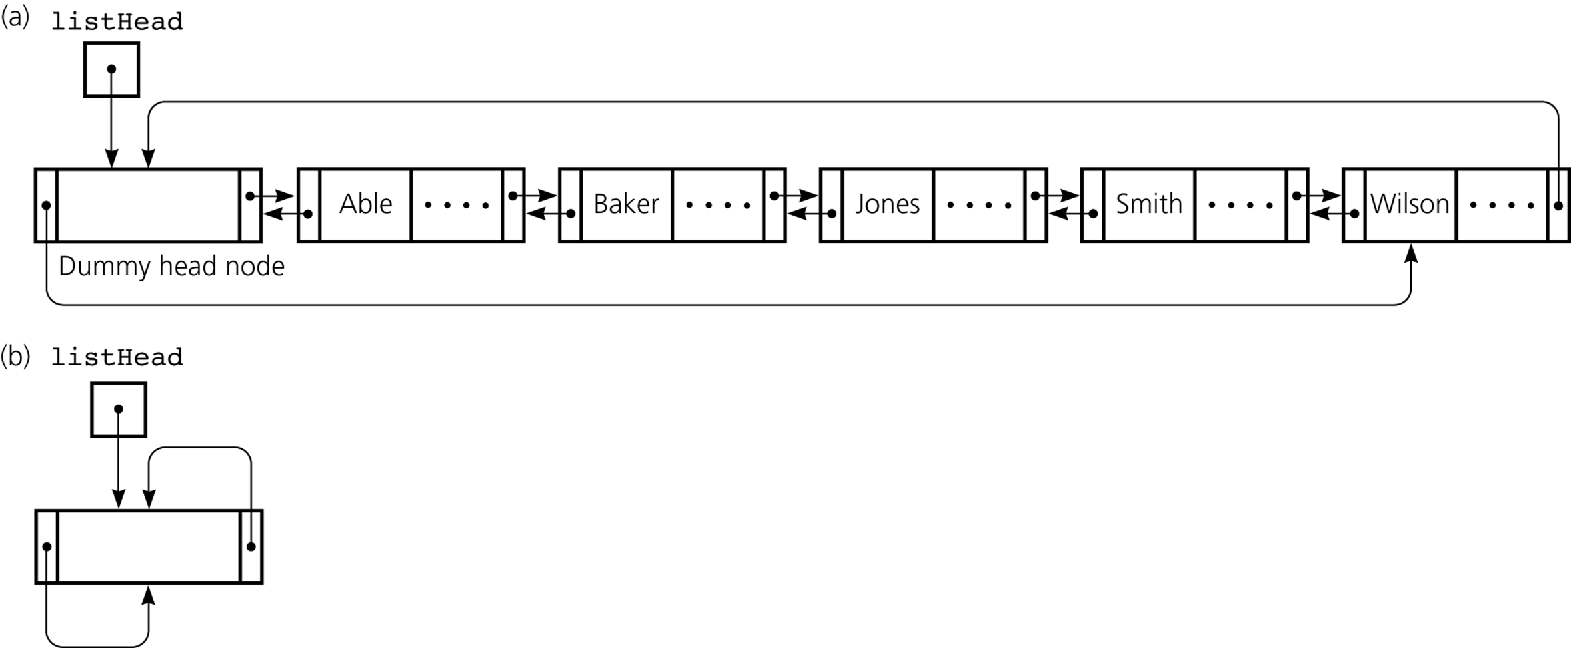
Doubly Linked List
Figure 5-27
a) A circular doubly linked list with a dummy head node; b) an empty list with a dummy head node
5 B-<number>

Slide 18
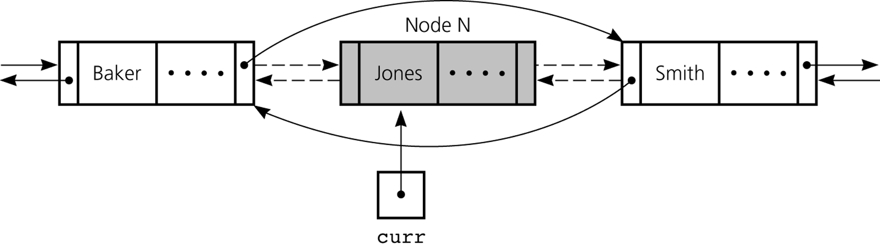
Doubly Linked List
To delete the node that curr references
  curr.getPrev().setNext(curr.getNext());
  curr.getNext().setPrev(curr.getPrev());
Figure 5-28
Reference changes for deletion
5 B-<number>

Slide 19
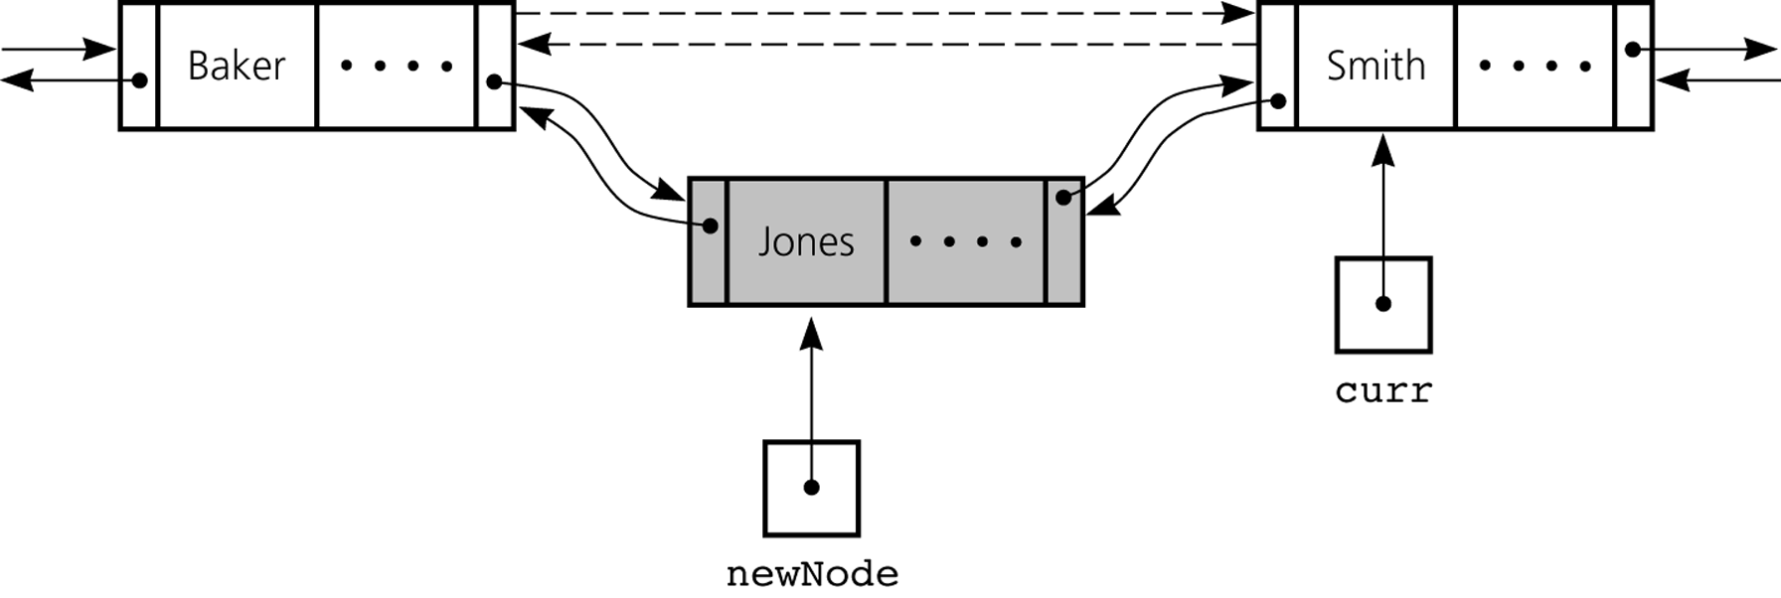
Doubly Linked List
To insert a new node that newNode references before the node referenced by curr
  newNode.setNext(curr);
  newNode.setPrev(curr.getPrev());
  curr.setPrev(newNode);
  newNode.getPrev().setNext(newNode);
Figure 5-29
Reference changes for insertion
5 B-<number>

Slide 20
Adding a Node at Various Positions
Possible cases:
Chain is empty
Adding node at chain’s beginning
Adding node between adjacent nodes
Adding node to chain’s end

Slide 21

Adding a Node
This pseudocode establishes a new node for the given data

Slide 22
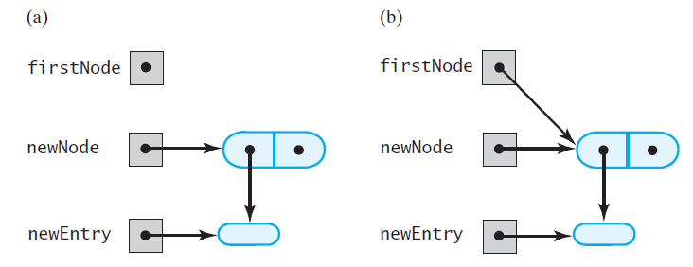
Adding a Node
FIGURE 14-1 (a) An empty chain and a new node; (b) after adding the new node to a chain that was empty

Slide 23
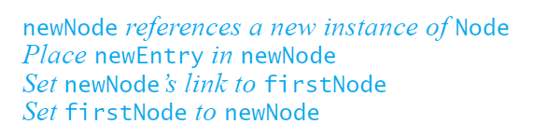
Adding a Node
This pseudocode describes the steps needed to
add a node to the beginning of a chain.

Slide 24
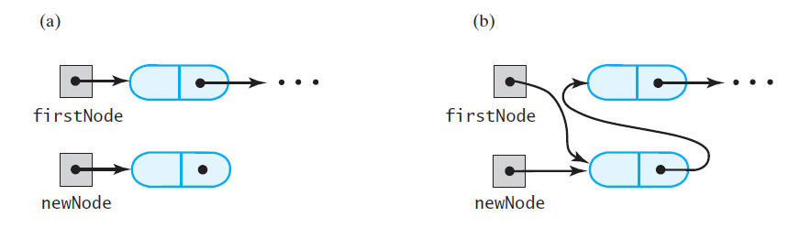
Adding a Node
FIGURE 14-2 A chain of nodes (a) just prior to adding a node at the beginning; (b) just after adding a node at the beginning

Slide 25
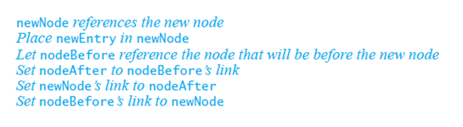
Adding a Node
Pseudocode to add a node to a chain between
two existing, consecutive nodes

Slide 26
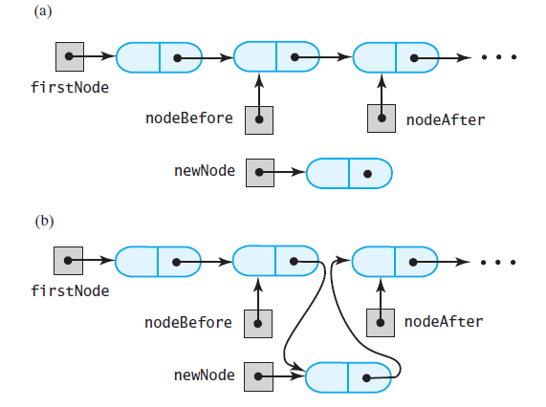
Adding a Node
FIGURE 14-3 A chain of nodes (a) just prior to adding a node between two adjacent nodes; (b) just after adding a node between two adjacent nodes

Slide 27
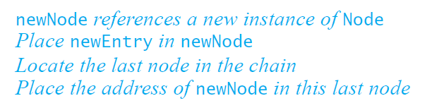
Adding a Node
Steps to add a node at the end of a chain.

Slide 28
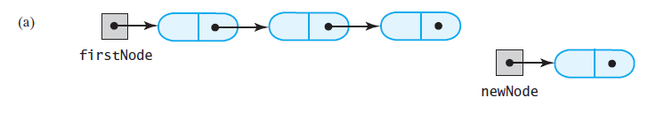
Adding a Node
FIGURE 14-4 A chain of nodes
(a) prior to adding a node at the end

Slide 29
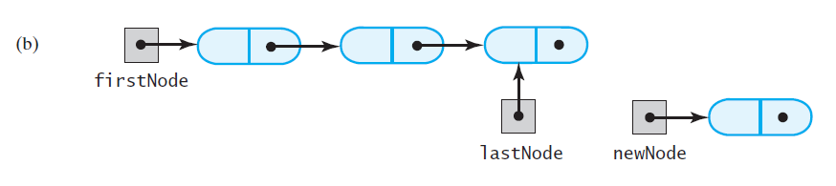
Adding a Node
FIGURE 14-4 A chain of nodes
(b) after locating its last node;

Slide 30
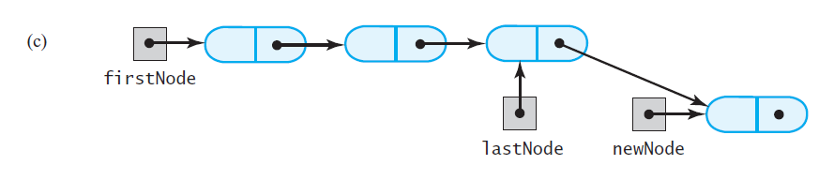
Adding a Node
FIGURE 14-4 A chain of nodes
(c) after adding a node at the end

Slide 31
Removing a Node from Various Positions
Possible cases
Removing the first node
Removing a node other than first one

Slide 32

Removing a Node
Steps for removing the first node.

Slide 33
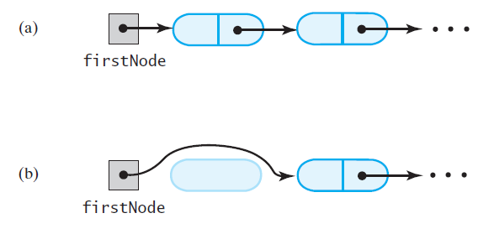
Removing a Node
FIGURE 14-5 A chain of nodes (a) just prior to removing the first node; (b) just after removing the first node

Slide 34
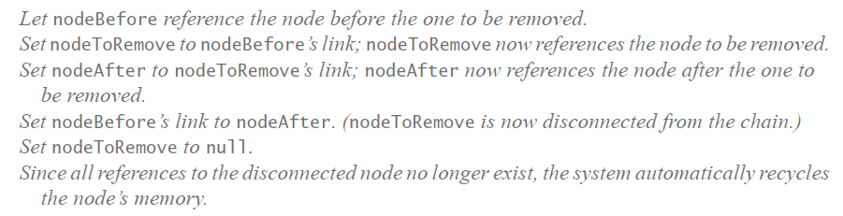
Removing a Node
Removing a node other than the first one.

Slide 35
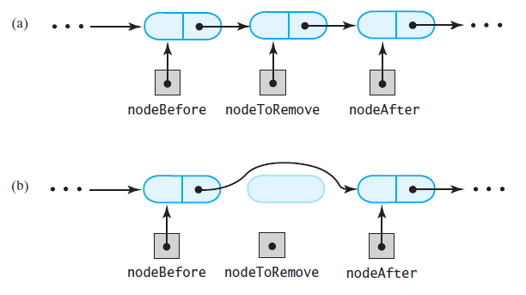
Removing a Node
FIGURE 14-6 A chain of nodes (a) just prior to removing an interior node; (b) just after removing an interior node

Slide 36
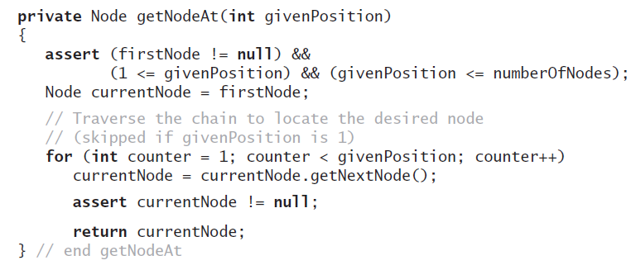
Removing a Node
Operations on a chain depended
on the method getNodeAt

Slide 37
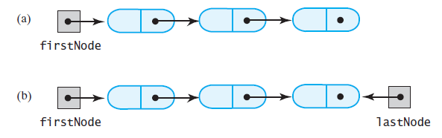
Design Decision
A Link to Last Node
FIGURE 14-7 A linked chain with (a) a head reference;
(b) both a head reference and a tail reference

Slide 38
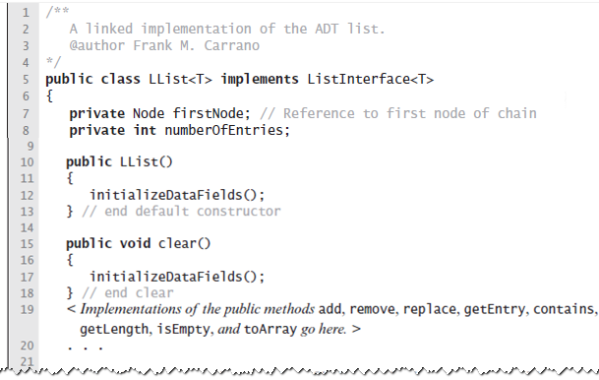
Data Fields and Constructor
LISTING 14-1 An outline of the class LList

Slide 39
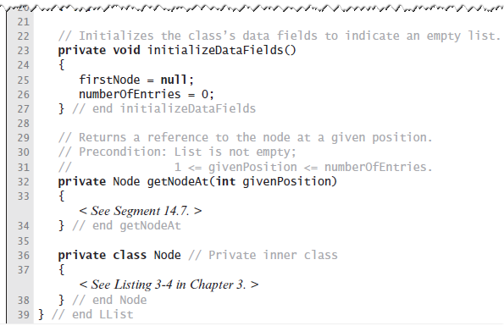
Data Fields and Constructor
LISTING 14-1 An outline of the class LList

Slide 40
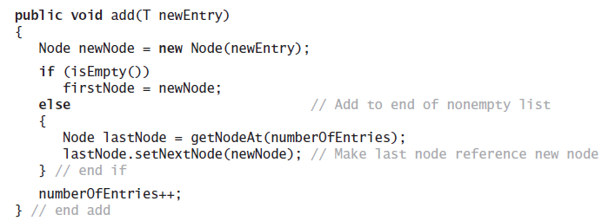
Adding to the End of the List
The method add assumes method getNodeAt

Slide 41
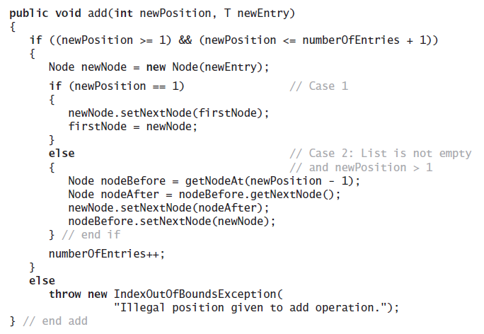
Adding at a Given Position
Java method.

Slide 42
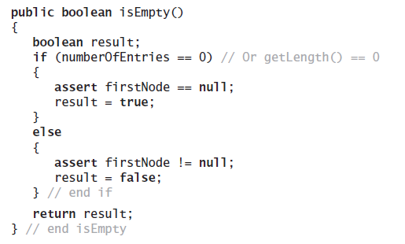
Method isEmpty
Note use of assert statement.

Slide 43
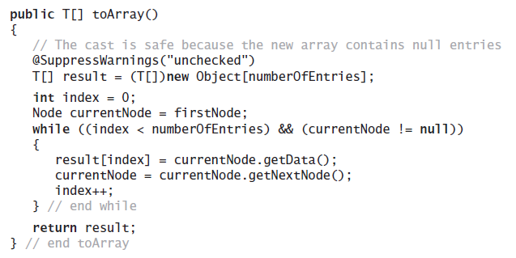
Method toArray
Traverses chain, loads an array.

Slide 44
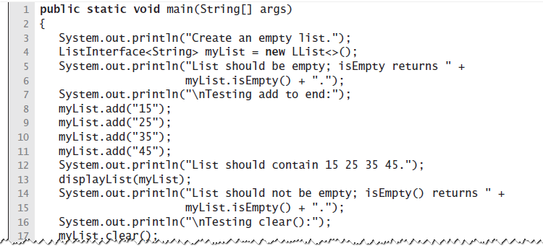
Testing Core Methods
LISTING 14-2 A main method that tests part of the implementation of the ADT list

Slide 45
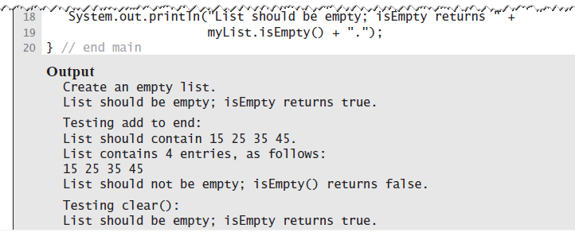
Testing Core Methods
LISTING 14-2 A main method that tests part of the implementation of the ADT list

Slide 46
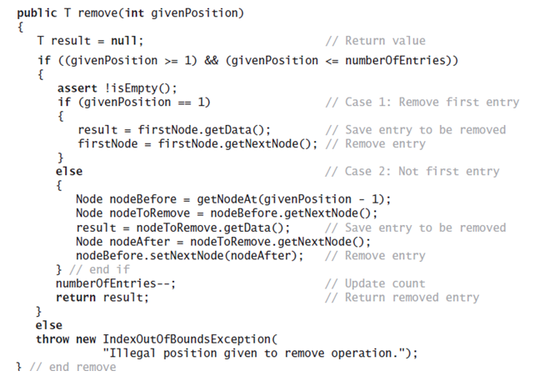
Continuing the Implementation
The remove method returns the entry
that it deletes from the list

Slide 47
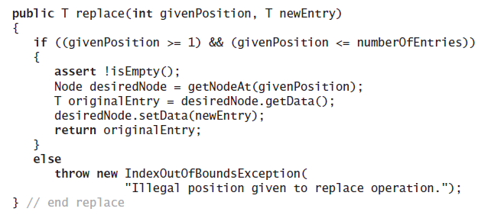
Continuing the Implementation
Replacing a list entry requires us to replace
the data portion of a node with other data.

Slide 48
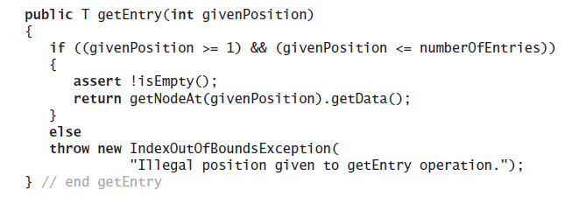
Continuing the Implementation
Retrieving a list entry is straightforward.

Slide 49
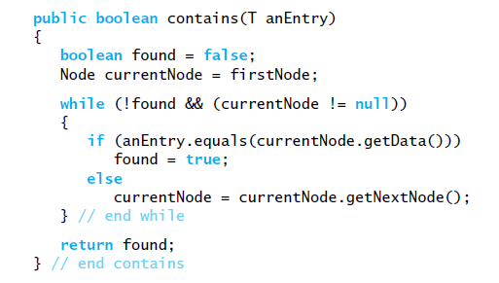
Continuing the Implementation
Checking to see if an entry is in the list,
the method contains.

Slide 50
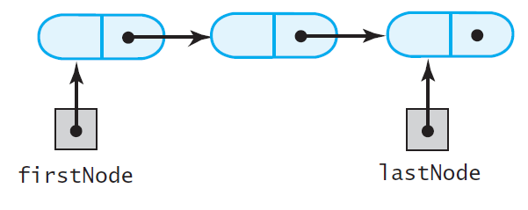
A Refined Implementation
FIGURE 14-8 A linked chain with both a head
reference and a tail reference

Slide 51
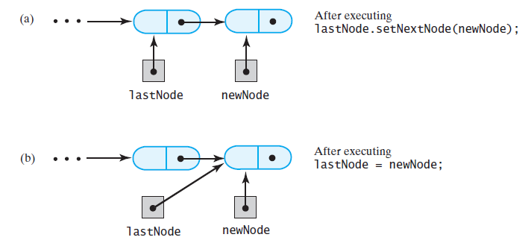
A Refined Implementation
FIGURE 14-9 Adding a node to the end of a
nonempty chain that has a tail reference

Slide 52
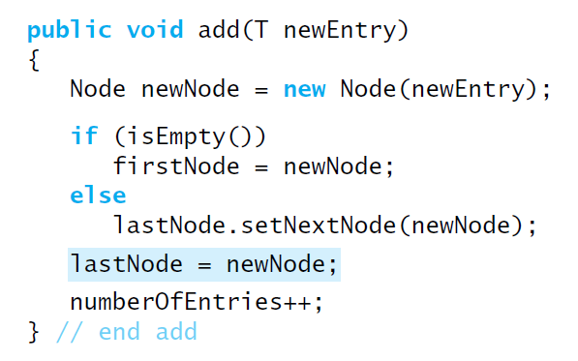
A Refined Implementation
Revision of the first add method

Slide 53
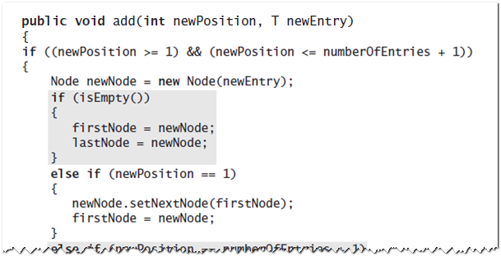
A Refined Implementation
Implementation of the method that adds by position.

Slide 54
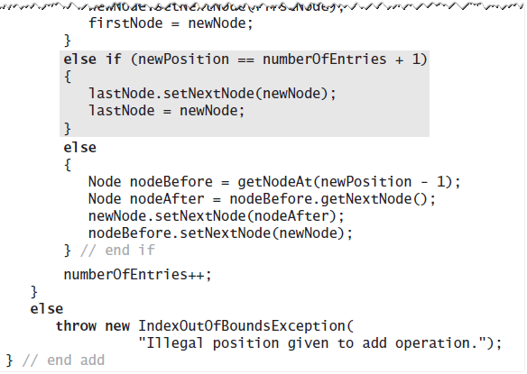
A Refined Implementation
Implementation of the method that adds by position.

Slide 55
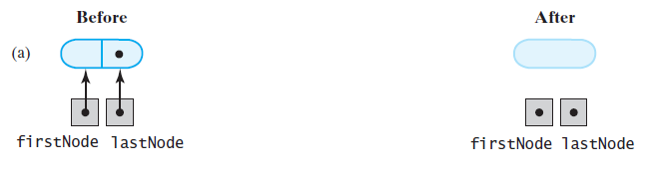
A Refined Implementation
FIGURE 14-10 Removing the last node from a chain that has both head and tail references when
the chain contains (a) one node

Slide 56
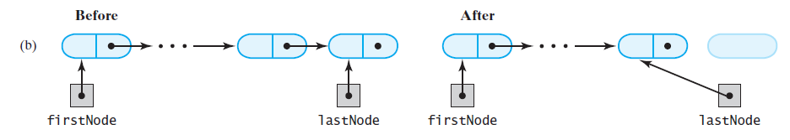
A Refined Implementation
FIGURE 14-10 Removing the last node from a chain that has both head and tail references when the chain contains (b) more than one node

Slide 57
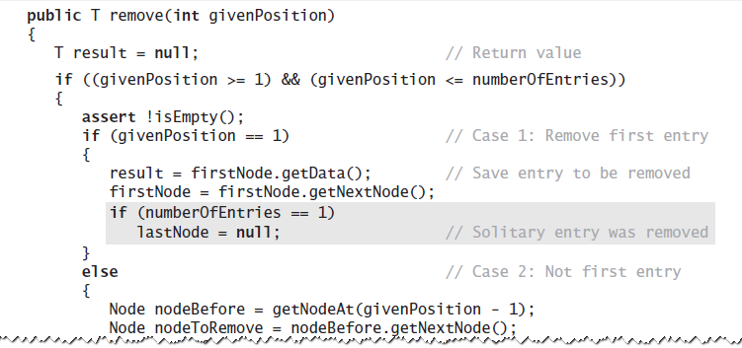
A Refined Implementation
Implementation of the remove operation:

Slide 58
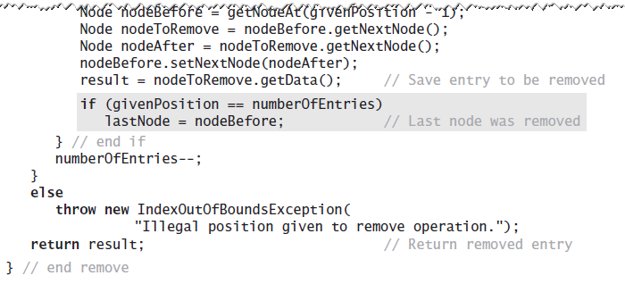
A Refined Implementation
Implementation of the remove operation:

Slide 59
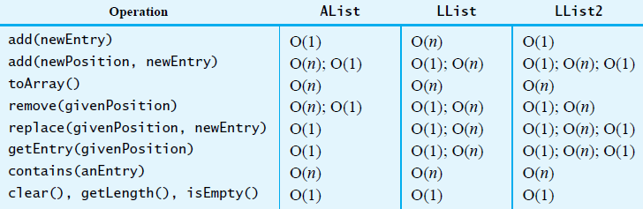
Efficiency of Using a Chain
FIGURE 14-11 The time efficiencies of the ADT list operations for three implementations,
expressed in Big Oh notation

Slide 60
Java Class Library:
The Class LinkedList
Implements the interface List
LinkedList defines more methods than are in the interface List
You can use the class LinkedList as implementation of ADT
  queue
  deque
  or list.

