Slide 1
COSC 1437.01
PROGRAMMING FUNDAMENTALS II
LECTURE 9. STACK: INTRODUCTION AND IMPLEMENTATION

Slide 2
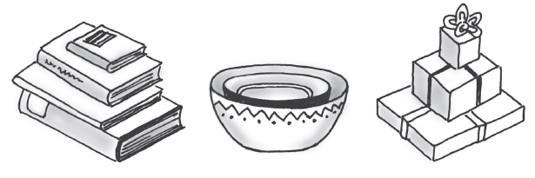
Stacks
Add item on top of stack
Remove item that is topmost
  Last In, First Out … LIFO

Slide 3
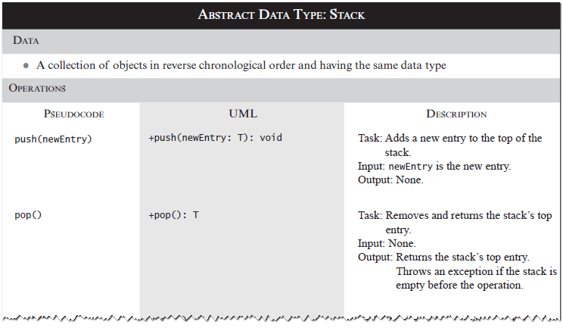
Specifications of the ADT Stack

Slide 4
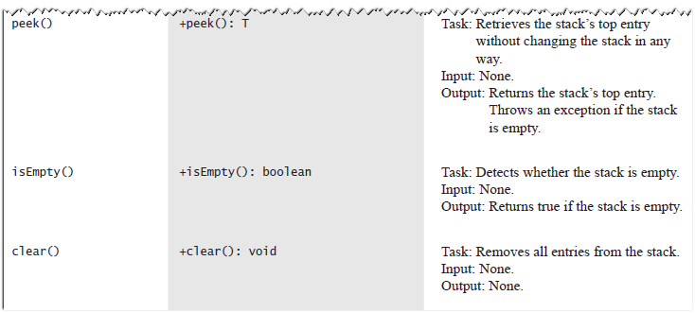
Specifications of the ADT Stack

Slide 5
Design Decision
When stack is empty
  What to do with pop and peek?
Possible actions
  Assume that the ADT is not empty;
  Return null.
  Throw an exception.

Slide 6
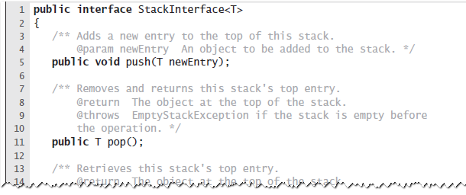
Interface
LISTING 5-1 An interface for the ADT stack

Slide 7
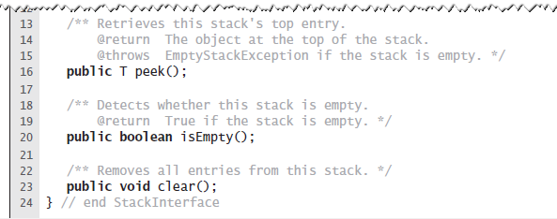
Interface
LISTING 5-1 An interface for the ADT stack

Slide 8
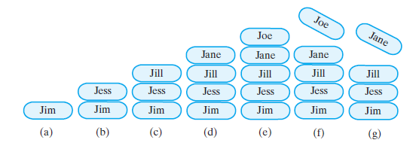
Example
FIGURE 5-2 A stack of strings after (a) push adds Jim; (b) push adds Jess; (c) push adds Jill; (d) push adds Jane; (e) push adds Joe; (f ) pop retrieves and removes Joe; (g) pop retrieves and removes Jane

Slide 9
Security Note
Design guidelines
  Use preconditions and postconditions to document assumptions.
  Do not trust client to use public methods correctly.
  Avoid ambiguous return values.
  Prefer throwing exceptions instead of returning values to signal problem.

Slide 10
Processing Algebraic Expressions
Infix: each binary operator appears between its operands a + b
Prefix: each binary operator appears before its operands + a b
Postfix: each binary operator appears after its operands a b +
Balanced expressions: delimiters paired correctly

Slide 11
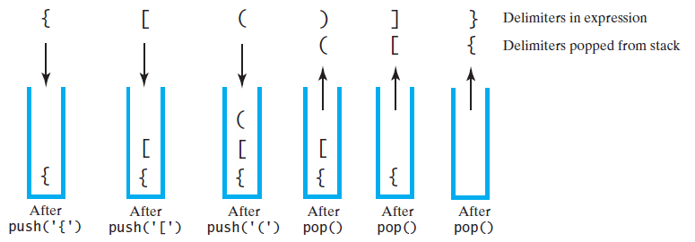
Processing Algebraic Expressions
FIGURE 5-3 The contents of a stack during the
scan of an expression that contains
the balanced delimiters { [ ( ) ] }

Slide 12
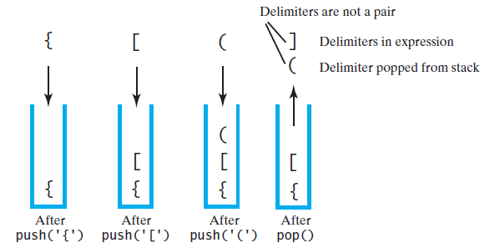
Processing Algebraic Expressions
FIGURE 5-4 The contents of a stack during the
scan of an expression that contains
the unbalanced delimiters { [ ( ] ) }

Slide 13
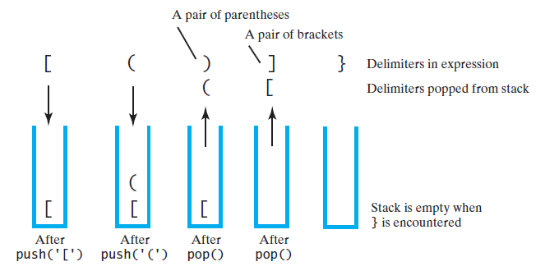
Processing Algebraic Expressions
FIGURE 5-5 The contents of a stack during the
scan of an expression that contains
the unbalanced delimiters [ ( ) ] }

Slide 14
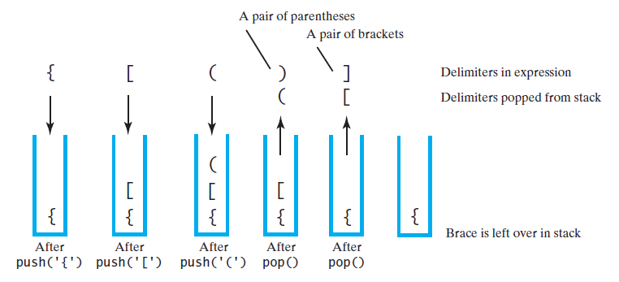
Processing Algebraic Expressions
FIGURE 5-6 The contents of a stack during the
scan of an expression that contains
the unbalanced delimiters { [ ( ) ]

Slide 15
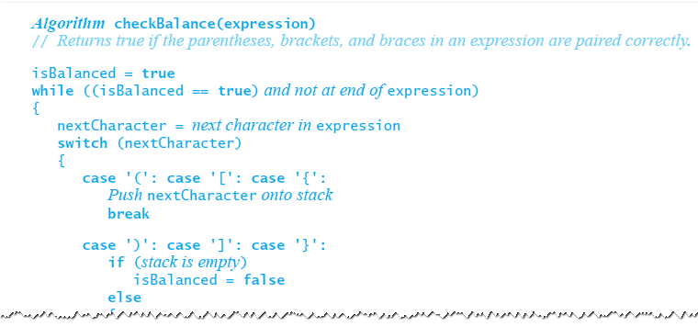
Processing Algebraic Expressions
Algorithm to process for balanced expression.

Slide 16
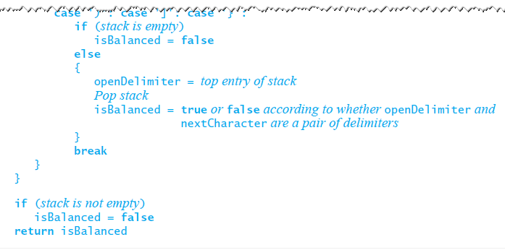
Processing Algebraic Expressions
Algorithm to process for balanced expression.

Slide 17
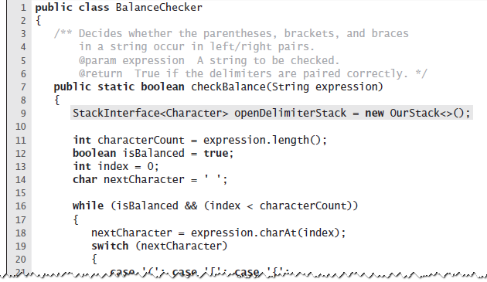
Java Implementation
LISTING 5-2 The class BalanceChecker

Slide 18
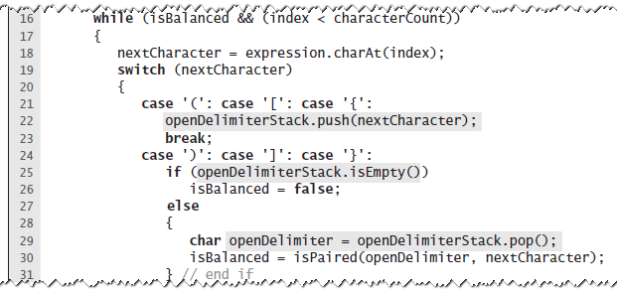
Java Implementation
LISTING 5-2 The class BalanceChecker

Slide 19
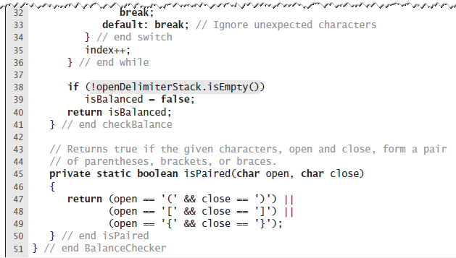
Java Implementation
LISTING 5-2 The class BalanceChecker

Slide 20
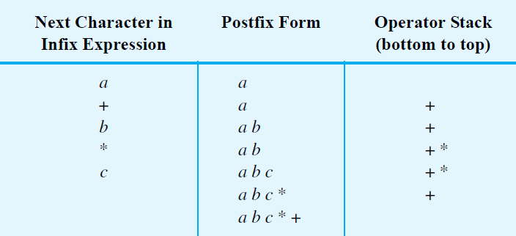
Infix to Postfix
FIGURE 5-7 Converting the infix expression
a + b * c to postfix form

Slide 21
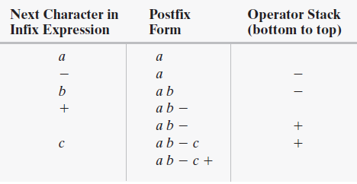
Successive Operators with Same Precedence
FIGURE 5-8 Converting an infix expression
to postfix form: (a) a - b + c;

Slide 22
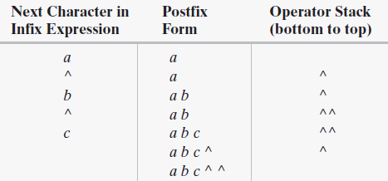
Successive Operators with Same Precedence
FIGURE 5-8 Converting an infix expression
to postfix form: a ^ b ^ c

Slide 23
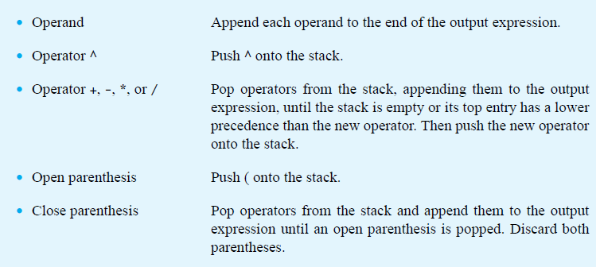
Infix-to-postfix Conversion

Slide 24
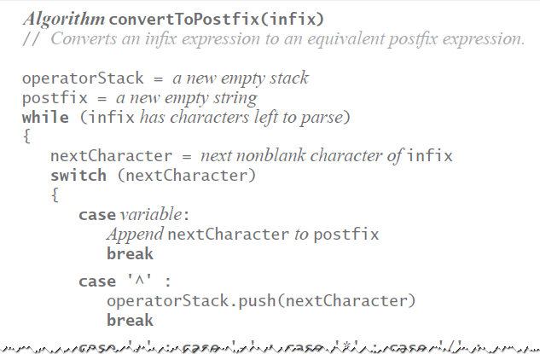
Infix-to-postfix Algorithm

Slide 25
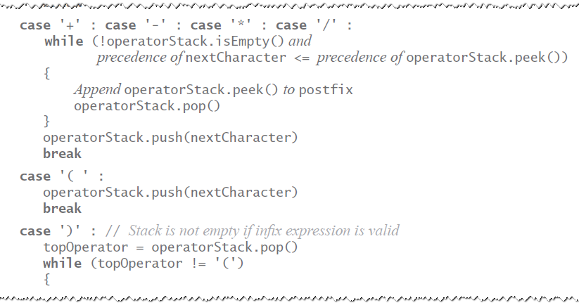
Infix-to-postfix Algorithm

Slide 26
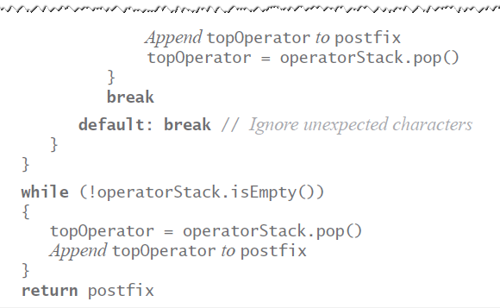
Infix-to-postfix Algorithm

Slide 27
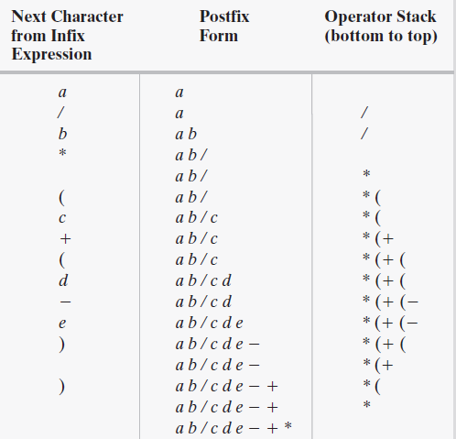
Infix to Postfix
FIGURE 5-9 The steps in converting the infix expression
a / b * (c + (d - e)) to postfix form

Slide 28
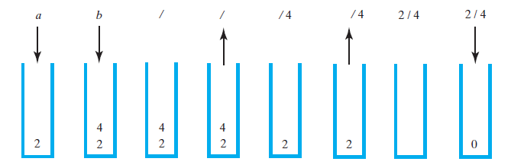
Evaluating Postfix Expressions
FIGURE 5-10 The stack during the evaluation of the postfix expression a b / when a is 2 and b is 4

Slide 29
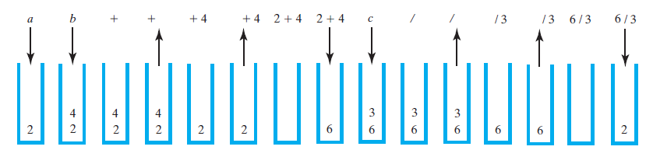
Evaluating Postfix Expressions
FIGURE 5-11 The stack during the evaluation of the postfix expression a b + c / when a is 2, b is 4, and c is 3

Slide 30
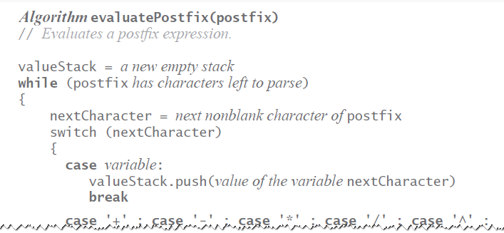
Evaluating Postfix Expressions
Algorithm for evaluating postfix expressions.

Slide 31
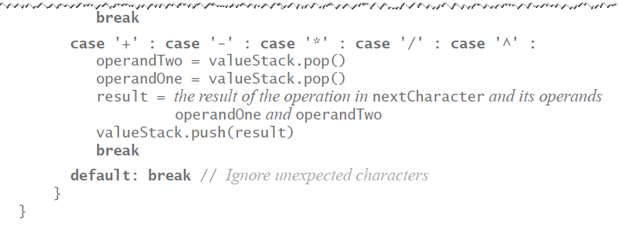
Evaluating Postfix Expressions
Algorithm for evaluating postfix expressions.

Slide 32
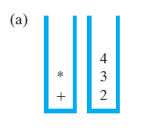
Evaluating Infix Expressions
FIGURE 5-12 Two stacks during the evaluation of
a + b * c when a is 2, b is 3, and c is 4:
(a) after reaching the end of the expression;

Slide 33
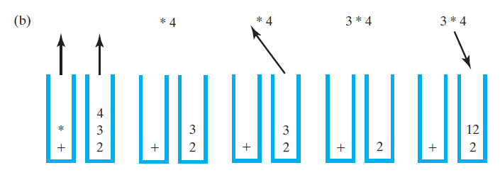
Evaluating Infix Expressions
FIGURE 5-12 Two stacks during the evaluation of
a + b * c when a is 2, b is 3, and c is 4:
(b) while performing the multiplication;

Slide 34
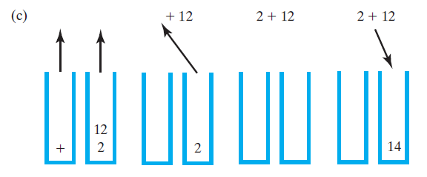
Evaluating Infix Expressions
FIGURE 5-12 Two stacks during the evaluation of
a + b * c when a is 2, b is 3, and c is 4:
(c) while performing the addition

Slide 35
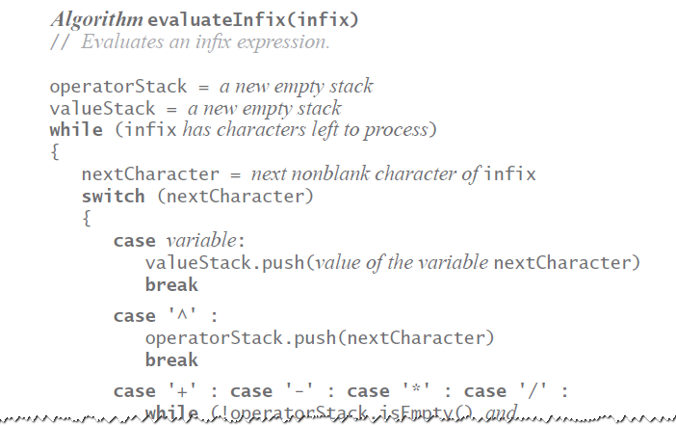
Evaluating Infix Expressions
Algorithm to evaluate infix expression.

Slide 36
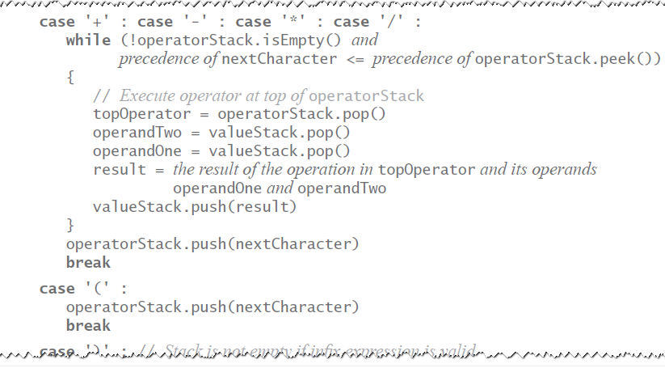
Evaluating Infix Expressions
Algorithm to evaluate infix expression.

Slide 37
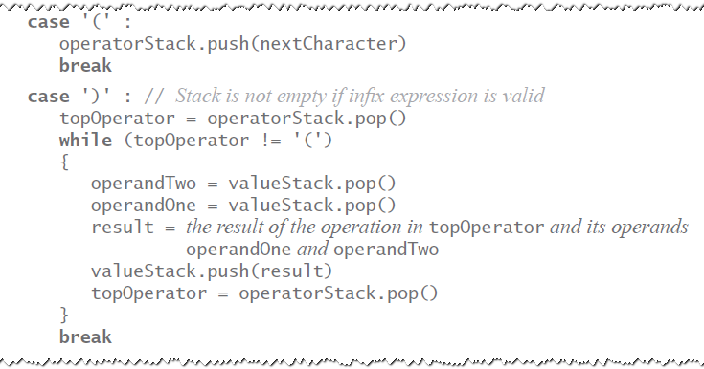
Evaluating Infix Expressions
Algorithm to evaluate infix expression.

Slide 38
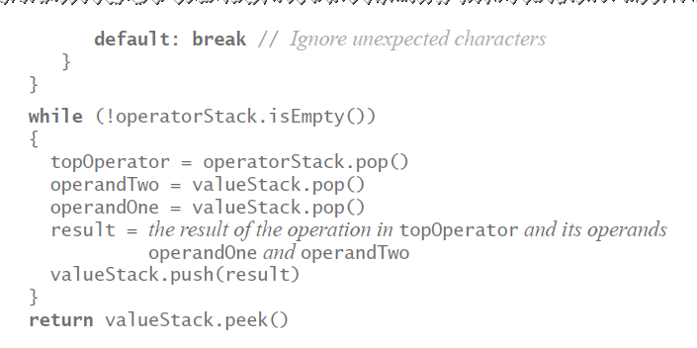
Evaluating Infix Expressions
Algorithm to evaluate infix expression.

Slide 39
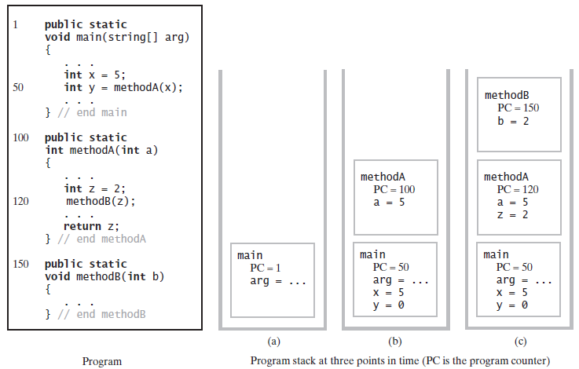
The Program Stack
FIGURE 5-13 The program stack at three points in time: (a) when main begins execution; (b) when methodA begins execution; (c) when methodB begins execution

Slide 40
Java Class Library:
The Class Stack
  Found in java.util
Methods
  A constructor – creates an empty stack
  public T push(T item);
  public T pop();
  public T peek();
  public boolean empty();

Slide 41
Stack Implementations

Slide 42
Linked Implementation
Each operation involves top of stack
  push
  pop
  peek
Head of linked list easiest, fastest to access
  Let this be the top of the stack

Slide 43
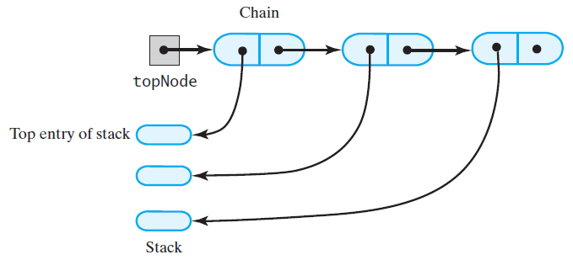
Linked Implementation
FIGURE 6-1 A chain of linked nodes
that implements a stack

Slide 44
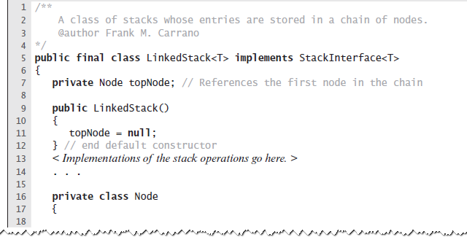
Linked Implementation
LISTING 6-1 An outline of a linked implementation
of the ADT stack

Slide 45
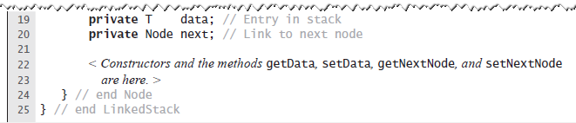
Linked Implementation
LISTING 6-1 An outline of a linked implementation
of the ADT stack

Slide 46
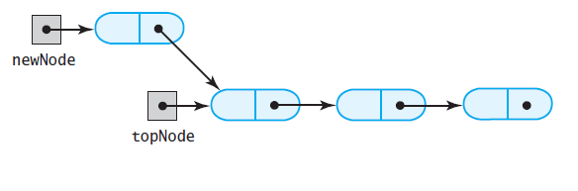
Linked Implementation
(a)
FIGURE 6-2 (a) A new node that references
the node at the top of the stack;

Slide 47
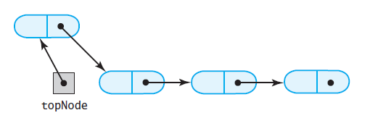
Linked Implementation
(b)
FIGURE 6-2 (b) the new node is now at the top of the stack

Slide 48
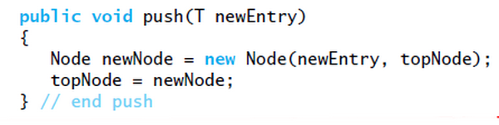
Linked Implementation
Definition of push

Slide 49
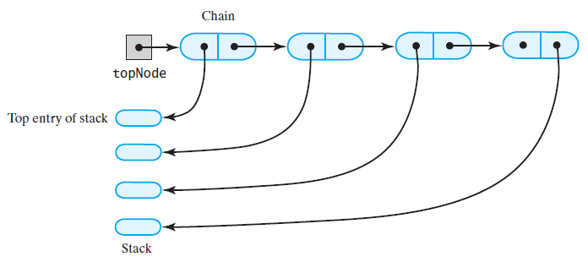
Linked Implementation
(a)
FIGURE 6-3 The stack (a) before the
first node in the chain is deleted

Slide 50
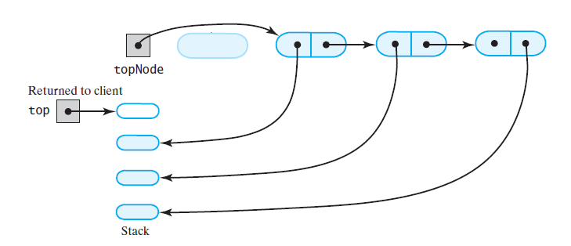
Linked Implementation
(b)
FIGURE 6-3 The stack (b) after the
first node in the chain is deleted

Slide 51
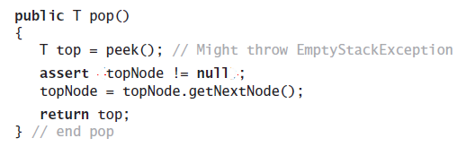
Linked Implementation
Definition of pop

Slide 52
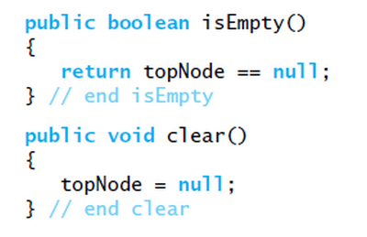
Linked Implementation
Definition of rest of class.

Slide 53
Array-Based Implementation
Each operation involves top of stack
  push
  pop
  peek
End of the array easiest to access
  Let this be top of stack
  Let first entry be bottom of stack

Slide 54
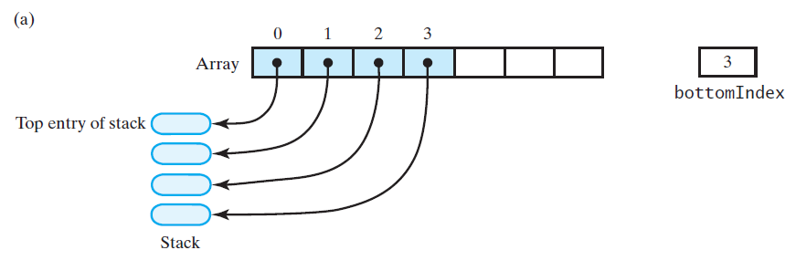
Array-Based Implementation
FIGURE 6-4 An array that implements a stack; its first location references (a) the top entry in the stack;

Slide 55
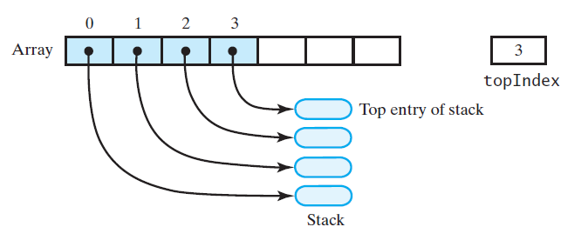
Array-Based Implementation
(b)
FIGURE 6-4 An array that implements a stack; its first location references (b) the bottom entry in the stack

Slide 56
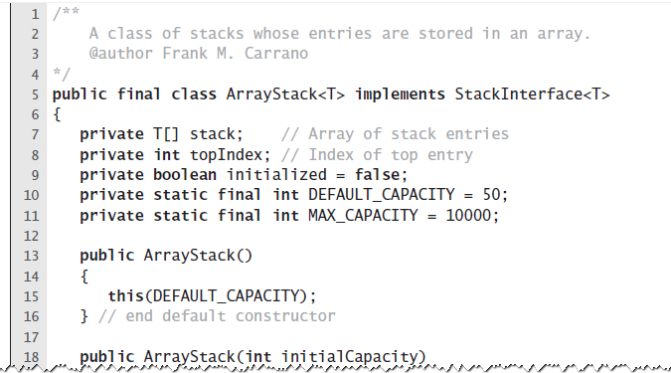
Array-Based Implementation
LISTING 6-2 An outline of an array-based
implementation of the ADT stack

Slide 57
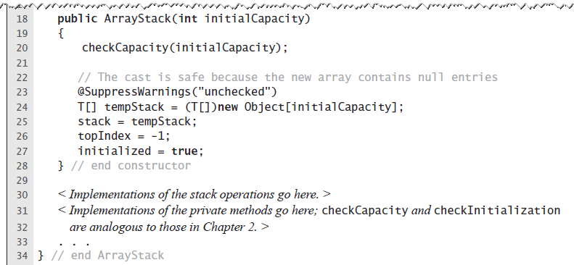
Array-Based Implementation
LISTING 6-2 An outline of an array-based
implementation of the ADT stack

Slide 58
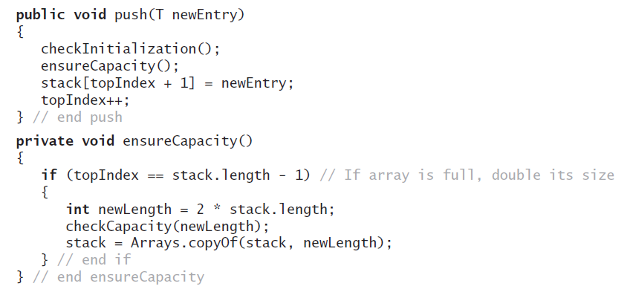
Array-Based Implementation
Adding to the top.

Slide 59

Array-Based Implementation
Retrieving the top, operation is O(1)

Slide 60

Array-Based Implementation
FIGURE 6-5 An array-based stack after its top entry is removed by (a) decrementing topIndex;

Slide 61

Array-Based Implementation
FIGURE 6-5 An array-based stack after its top entry is removed by (b) setting stack[topIndex] to null and then decrementing topIndex

Slide 62

Array-Based Implementation
Removing the top

Slide 63
Vector Based Implementation
Vector: an object that behaves like a high-level array
  Index begins with 0
  Methods to access or set entries
  Size will grow as needed
Use vector’s methods to manipulate stack

Slide 64

Vector Based Implementation
FIGURE 6-6 A client using the methods given in StackInterface; these methods interact with a vector’s methods to perform stack operations

Slide 65
The Class Vector
Constructors
Has methods to add, remove, clear
Also methods to determine
  Last element
  Is the vector empty
  Number of entries

Slide 66

Vector Based Implementation
LISTING 6-3 An outline of a vector-based
implementation of the ADT stack

Slide 67

Vector Based Implementation
LISTING 6-3 An outline of a vector-based
implementation of the ADT stack

Slide 68

Vector Based Implementation
Adding to the top

Slide 69

Vector Based Implementation
Retrieving the top

Slide 70

Vector Based Implementation
Removing the top

Slide 71

Vector Based Implementation
The rest of the class.

Slide 72
The End

