Slide 1
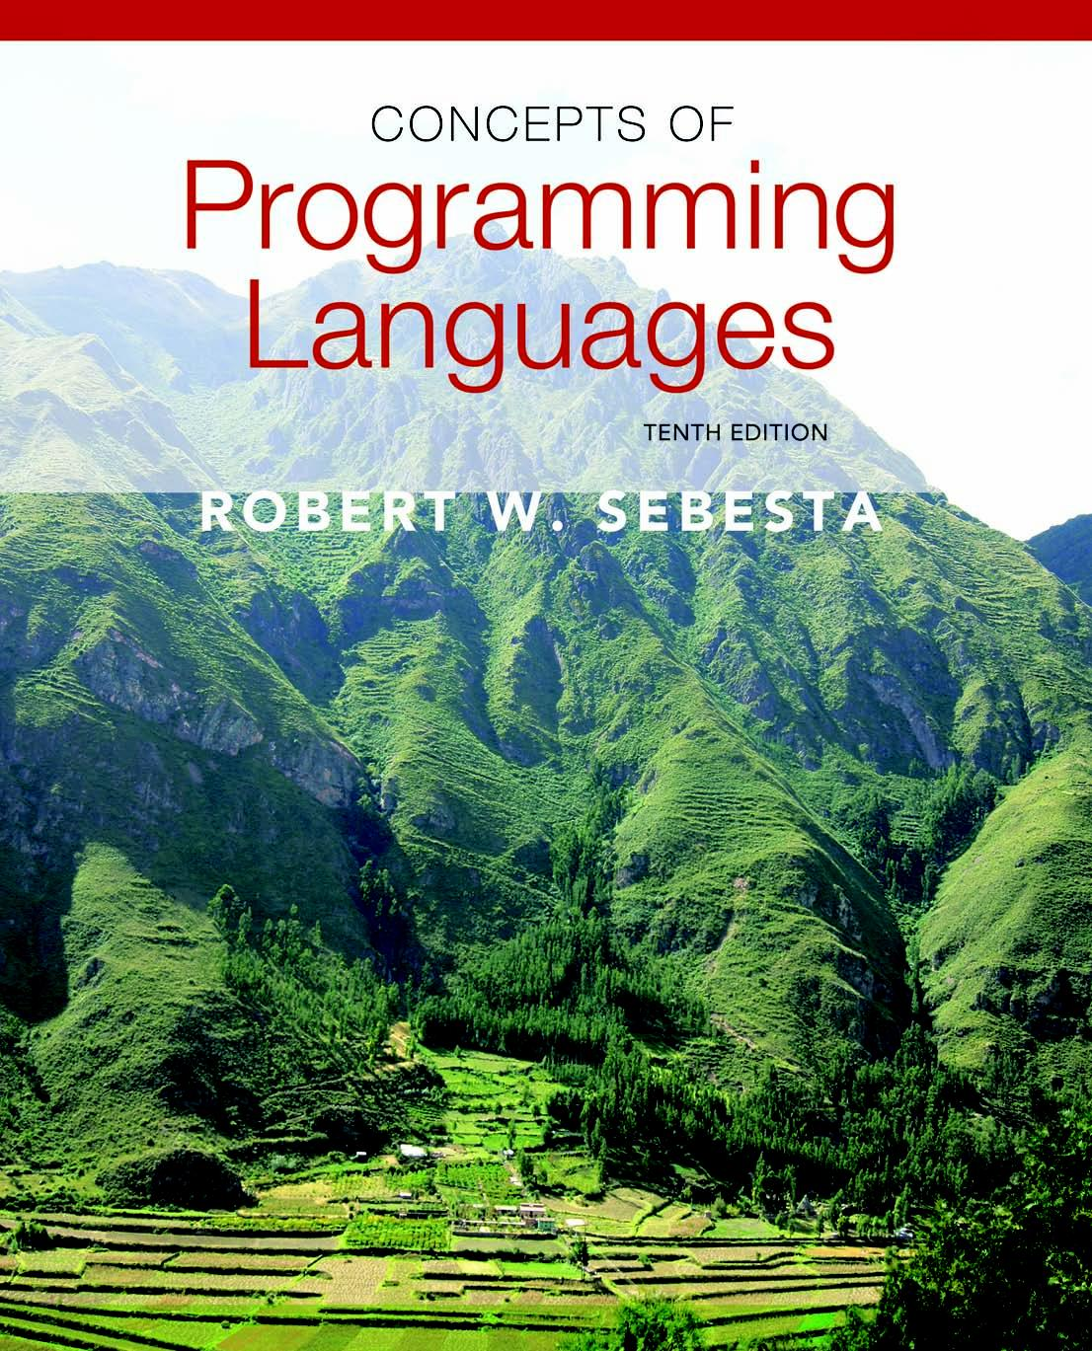
Chapter 12
Support for
Object-Oriented Programming

Slide 2
Introduction
Many object-oriented programming (OOP) languages
  Some support procedural and data-oriented programming (e.g., Ada 95+ and C++)
  Some support functional program (e.g., CLOS)
  Newer languages do not support other paradigms but use their imperative structures (e.g., Java and C#)
  Some are pure OOP language (e.g., Smalltalk & Ruby)
  Some functional languages support OOP, but they are not discussed in this chapter
Copyright © 2012 Addison-Wesley. All rights reserved.
1-<number>

Slide 3
Object-Oriented Programming
Three major language features:
  Abstract data types (Chapter 11)
  Inheritance
    Inheritance is the central theme in OOP and languages that support it
  Polymorphism
Copyright © 2012 Addison-Wesley. All rights reserved.
1-<number>

Slide 4
Inheritance
Productivity increases can come from reuse
  ADTs are difficult to reuse—always need changes
  All ADTs are independent and at the same level
Inheritance allows new classes defined in terms of existing ones, i.e., by allowing them to inherit common parts
Inheritance addresses both of the above concerns--reuse ADTs after minor changes and define classes in a hierarchy
Copyright © 2012 Addison-Wesley. All rights reserved.
1-<number>

Slide 5
Object-Oriented Concepts
ADTs are usually called classes
Class instances are called objects
A class that inherits is a derived class or a subclass
The class from which another class inherits is a parent class or superclass
Subprograms that define operations on objects are called methods
Copyright © 2012 Addison-Wesley. All rights reserved.
1-<number>

Slide 6
Object-Oriented Concepts (continued)
Calls to methods are called messages
The entire collection of methods of an object is called its message protocol or message interface
Messages have two parts--a method name and the destination object
In the simplest case, a class inherits all of the entities of its parent
Copyright © 2012 Addison-Wesley. All rights reserved.
1-<number>

Slide 7
Object-Oriented Concepts (continued)
Inheritance can be complicated by access controls to encapsulated entities
  A class can hide entities from its subclasses
  A class can hide entities from its clients
  A class can also hide entities for its clients while allowing its subclasses to see them
Besides inheriting methods as is, a class can modify an inherited method
  The new one overrides the inherited one
  The method in the parent is overriden
Copyright © 2012 Addison-Wesley. All rights reserved.
1-<number>

Slide 8
Object-Oriented Concepts (continued)
Three ways a class can differ from its parent:
  1. The parent class can define some of its variables or methods to have private access, which means they will not be visible in the subclass
  2. The subclass can add variables and/or methods to those inherited from the parent
  3. The subclass can modify the behavior of one or more of its inherited methods.
Copyright © 2012 Addison-Wesley. All rights reserved.
1-<number>

Slide 9
Object-Oriented Concepts (continued)
There are two kinds of variables in a class:
  Class variables - one/class
  Instance variables - one/object
There are two kinds of methods in a class:
  Class methods – accept messages to the class
  Instance methods – accept messages to objects
Single vs. Multiple Inheritance
One disadvantage of inheritance for reuse:
  Creates interdependencies among classes that complicate maintenance
Copyright © 2012 Addison-Wesley. All rights reserved.
1-<number>

Slide 10
Dynamic Binding
A polymorphic variable can be defined in a class that is able to reference (or point to) objects of the class and objects of any of its descendants
When a class hierarchy includes classes that override methods and such methods are called through a polymorphic variable, the binding to the correct method will be dynamic
Allows software systems to be more easily extended during both development and maintenance
Copyright © 2012 Addison-Wesley. All rights reserved.
1-<number>

Slide 11
Dynamic Binding Concepts
An abstract method is one that does not include a definition (it only defines a protocol)
An abstract class is one that includes at least one virtual method
An abstract class cannot be instantiated
Copyright © 2012 Addison-Wesley. All rights reserved.
1-<number>

Slide 12
Design Issues for OOP Languages
The Exclusivity of Objects
Are Subclasses Subtypes?
Single and Multiple Inheritance
Object Allocation and Deallocation
Dynamic and Static Binding
Nested Classes
Initialization of Objects
Copyright © 2012 Addison-Wesley. All rights reserved.
1-<number>

Slide 13
The Exclusivity of Objects
Everything is an object
  Advantage - elegance and purity
  Disadvantage - slow operations on simple objects
Add objects to a complete typing system
  Advantage - fast operations on simple objects
  Disadvantage - results in a confusing type system (two kinds of entities)
Include an imperative-style typing system for primitives but make everything else objects
  Advantage - fast operations on simple objects and a relatively small typing system
  Disadvantage - still some confusion because of the two type systems
Copyright © 2012 Addison-Wesley. All rights reserved.
1-<number>

Slide 14
Are Subclasses Subtypes?
Does an “is-a” relationship hold between a parent class object and an object of the subclass?
  If a derived class is-a parent class, then objects of the derived class must behave the same as the parent class object
A derived class is a subtype if it has an is-a relationship with its parent class
  Subclass can only add variables and methods and override inherited methods in “compatible” ways
Copyright © 2012 Addison-Wesley. All rights reserved.
1-<number>

Slide 15
Single and Multiple Inheritance
Multiple inheritance allows a new class to inherit from two or more classes
Disadvantages of multiple inheritance:
  Language and implementation complexity (in part due to name collisions)
  Potential inefficiency - dynamic binding costs more with multiple inheritance (but not much)
Advantage:
  Sometimes it is quite convenient and valuable
Copyright © 2012 Addison-Wesley. All rights reserved.
1-<number>

Slide 16
Allocation and DeAllocation of Objects
From where are objects allocated?
  If they behave like the ADTs, they can be allocated from anywhere
    Allocated from the run-time stack
    Explicitly create on the heap (via new)
  If they are all heap-dynamic, references can be uniform thru a pointer or reference variable
    Simplifies assignment - dereferencing can be implicit
  If objects are stack dynamic, there is a problem with regard to subtypes – object slicing
Is deallocation explicit or implicit?
Copyright © 2012 Addison-Wesley. All rights reserved.
1-<number>

Slide 17
Dynamic and Static Binding
Should all binding of messages to methods be dynamic?
  If none are, you lose the advantages of dynamic binding
  If all are, it is inefficient
Maybe the design should allow the user to specify
Copyright © 2012 Addison-Wesley. All rights reserved.
1-<number>

Slide 18
Nested Classes
If a new class is needed by only one class, there is no reason to define so it can be seen by other classes
  Can the new class be nested inside the class that uses it?
  In some cases, the new class is nested inside a subprogram rather than directly in another class
Other issues:
  Which facilities of the nesting class should be visible to the nested class and vice versa
Copyright © 2012 Addison-Wesley. All rights reserved.
1-<number>

Slide 19
Initialization of Objects
Are objects initialized to values when they are created?
  Implicit or explicit initialization
How are parent class members initialized when a subclass object is created?
Copyright © 2012 Addison-Wesley. All rights reserved.
1-<number>

Slide 20
Support for OOP in Smalltalk
Smalltalk is a pure OOP language
  Everything is an object
  All objects have local memory
  All computation is through objects sending messages to objects
  None of the appearances of imperative languages
  All objected are allocated from the heap
  All deallocation is implicit
Copyright © 2012 Addison-Wesley. All rights reserved.
1-<number>

Slide 21
Support for OOP in Smalltalk (continued)
Inheritance
  A Smalltalk subclass inherits all of the instance variables, instance methods, and class methods of its superclass
  All subclasses are subtypes (nothing can be hidden)
  All inheritance is implementation inheritance
  No multiple inheritance
Copyright © 2012 Addison-Wesley. All rights reserved.
1-<number>

Slide 22
Support for OOP in Smalltalk (continued)
Evaluation of Smalltalk
  The syntax of the language is simple and regular
  Good example of power provided by a small language
  Slow compared with conventional compiled imperative languages
  Dynamic binding allows type errors to go undetected until run time
  Introduced the graphical user interface
  Greatest impact: advancement of OOP
Copyright © 2012 Addison-Wesley. All rights reserved.
1-<number>

Slide 23
Support for OOP in C++
General Characteristics:
  Evolved from C and SIMULA 67
  Among the most widely used OOP languages
  Mixed typing system
  Constructors and destructors
  Elaborate access controls to class entities
Copyright © 2012 Addison-Wesley. All rights reserved.
1-<number>

Slide 24
Support for OOP in C++ (continued)
Inheritance
  A class need not be the subclass of any class
  Access controls for members are
    Private (visible only in the class and friends) (disallows subclasses from being subtypes)
    Public (visible in subclasses and clients)
    Protected (visible in the class and in subclasses, but not clients)
Copyright © 2012 Addison-Wesley. All rights reserved.
1-<number>

Slide 25
Support for OOP in C++ (continued)
In addition, the subclassing process can be declared with access controls (private or public), which define potential changes in access by subclasses
  Private derivation - inherited public and protected members are private in the subclasses
  Public derivation public and protected members are also public and protected in subclasses
Copyright © 2012 Addison-Wesley. All rights reserved.
1-<number>

Slide 26
Inheritance Example in C++
class base_class {
private:
int a;
float x;
protected:
int b;
float y;
public:
int c;
float z;
};
class subclass_1 : public base_class { … };
// In this one, b and y are protected and
// c and z are public
class subclass_2 : private base_class { … };
// In this one, b, y, c, and z are private,
// and no derived class has access to any
// member of base_class
Copyright © 2012 Addison-Wesley. All rights reserved.
1-<number>

Slide 27
Reexportation in C++
A member that is not accessible in a subclass (because of private derivation) can be declared to be visible there using the scope resolution operator (::), e.g.,
  class subclass_3 : private base_class {
  base_class :: c;
  …
  }
Copyright © 2012 Addison-Wesley. All rights reserved.
1-<number>

Slide 28
Reexportation (continued)
One motivation for using private derivation
  A class provides members that must be visible, so they are defined to be public members; a derived class adds some new members, but does not want its clients to see the members of the parent class, even though they had to be public in the parent class definition
Copyright © 2012 Addison-Wesley. All rights reserved.
1-<number>

Slide 29
Support for OOP in C++ (continued)
Multiple inheritance is supported
  If there are two inherited members with the same name, they can both be referenced using the scope resolution operator (::)
  class Thread { ... }
  class Drawing { ... }
  class DrawThread : public Thread, public Drawing { … }
Copyright © 2012 Addison-Wesley. All rights reserved.
1-<number>

Slide 30
Support for OOP in C++ (continued)
Dynamic Binding
  A method can be defined to be virtual, which means that they can be called through polymorphic variables and dynamically bound to messages
  A pure virtual function has no definition at all
  A class that has at least one pure virtual function is an abstract class
Copyright © 2012 Addison-Wesley. All rights reserved.
1-<number>

Slide 31
Support for OOP in C++ (continued)
class Shape {
public:
virtual void draw() = 0;
...
};
class Circle : public Shape {
public:
void draw() { ... }
...
};
class Rectangle : public Shape {
public:
void draw() { ... }
...
};
class Square : public Rectangle {
public:
void draw() { ... }
...
};
Square* sq = new Square;
Rectangle* rect = new Rectangle;
Shape* ptr_shape;
ptr_shape = sq; // points to a Square
ptr_shape ->draw(); // Dynamically
// bound to draw in Square
rect->draw(); // Statically bound to
// draw in Rectangle
Copyright © 2012 Addison-Wesley. All rights reserved.
1-<number>

Slide 32
Support for OOP in C++ (continued)
If objects are allocated from the stack, it is quite different
Square sq; // Allocates a Square object from the stack
Rectangle rect; // Allocates a Rectangle object from the stack
rect = sq; // Copies the data member values from sq object
rect.draw(); // Calls the draw from Rectangle
Copyright © 2012 Addison-Wesley. All rights reserved.
1-<number>

Slide 33
Support for OOP in C++ (continued)
Evaluation
  C++ provides extensive access controls (unlike Smalltalk)
  C++ provides multiple inheritance
  In C++, the programmer must decide at design time which methods will be statically bound and which must be dynamically bound
    Static binding is faster!
  Smalltalk type checking is dynamic (flexible, but somewhat unsafe)
  Because of interpretation and dynamic binding, Smalltalk is ~10 times slower than C++
Copyright © 2012 Addison-Wesley. All rights reserved.
1-<number>

Slide 34
Support for OOP in Java
Because of its close relationship to C++, focus is on the differences from that language
General Characteristics
  All data are objects except the primitive types
  All primitive types have wrapper classes that store one data value
  All objects are heap-dynamic, are referenced through reference variables, and most are allocated with new
  A finalize method is implicitly called when the garbage collector is about to reclaim the storage occupied by the object
Copyright © 2012 Addison-Wesley. All rights reserved.
1-<number>

Slide 35
Support for OOP in Java (continued)
Inheritance
  Single inheritance supported only, but there is an abstract class category that provides some of the benefits of multiple inheritance (interface)
  An interface can include only method declarations and named constants, e.g.,
  public interface Comparable <T> {
  public int comparedTo (T b);
  }
  Methods can be final (cannot be overriden)
Copyright © 2012 Addison-Wesley. All rights reserved.
1-<number>

Slide 36
Support for OOP in Java (continued)
Dynamic Binding
  In Java, all messages are dynamically bound to methods, unless the method is final (i.e., it cannot be overriden, therefore dynamic binding serves no purpose)
  Static binding is also used if the methods is static or private both of which disallow overriding
Copyright © 2012 Addison-Wesley. All rights reserved.
1-<number>

Slide 37
Support for OOP in Java (continued)
Evaluation
  Design decisions to support OOP are similar to C++
  No support for procedural programming
  No parentless classes
  Dynamic binding is used as “normal” way to bind method calls to method definitions
  Uses interfaces to provide a simple form of support for multiple inheritance
Copyright © 2012 Addison-Wesley. All rights reserved.
1-<number>

Slide 38
Support for OOP in C#
General characteristics
  Support for OOP similar to Java
  Includes both classes and structs
  Classes are similar to Java’s classes
  structs are less powerful stack-dynamic constructs (e.g., no inheritance)
Copyright © 2012 Addison-Wesley. All rights reserved.
1-<number>

Slide 39
Support for OOP in C# (continued)
Inheritance
  Uses the syntax of C++ for defining classes
  A method inherited from parent class can be replaced in the derived class by marking its definition with new
  The parent class version can still be called explicitly with the prefix base:
      base.Draw()
Copyright © 2012 Addison-Wesley. All rights reserved.
1-<number>

Slide 40
Support for OOP in C#
Dynamic binding
  To allow dynamic binding of method calls to methods:
    The base class method is marked virtual
    The corresponding methods in derived classes are marked override
  Abstract methods are marked abstract and must be implemented in all subclasses
  All C# classes are ultimately derived from a single root class, Object
Copyright © 2012 Addison-Wesley. All rights reserved.
1-<number>

Slide 41
Support for OOP in C#
Evaluation
  C# is a relatively recently designed C-based OO language
  The differences between C#’s and Java’s support for OOP are relatively minor
Copyright © 2012 Addison-Wesley. All rights reserved.
1-<number>

Slide 42
Support for OOP in Ada 95+
General Characteristics
  OOP was one of the most important extensions to Ada 83
  Encapsulation container is a package that defines a tagged type
  A tagged type is one in which every object includes a tag to indicate during execution its type (the tags are internal)
  Tagged types can be either private types or records
  No constructors or destructors are implicitly called
Copyright © 2012 Addison-Wesley. All rights reserved.
1-<number>

Slide 43
Support for OOP in Ada 95 (continued)
Inheritance
  Subclasses can be derived from tagged types
  New entities are added to the inherited entities by placing them in a record definition
  All subclasses are subtypes
  No support for multiple inheritance
    A comparable effect can be achieved using generic classes
Copyright © 2012 Addison-Wesley. All rights reserved.
1-<number>

Slide 44
Example of a Tagged Type
package Person_Pkg is
type Person is tagged private;
procedure Display(P : in out Person);
private
type Person is tagged
record
Name : String(1..30);
Address : String(1..30);
Age : Integer;
end record;
end Person_Pkg;
with Person_Pkg; use Person_Pkg;
package Student_Pkg is
type Student is new Person with
record
Grade_Point_Average : Float;
Grade_Level : Integer;
end record;
procedure Display (St: in Student);
end Student_Pkg;
// Note: Display is being overridden from Person_Pkg
Copyright © 2012 Addison-Wesley. All rights reserved.
1-<number>

Slide 45
Support for OOP in Ada 95 (continued)
Dynamic Binding
  Dynamic binding is done using polymorphic variables called classwide types
    For the tagged type Person, the classwide type is Person‘ class
  Other bindings are static
  Any method may be dynamically bound
  Purely abstract base types can be defined in Ada 95 by including the reserved word abstract
Copyright © 2012 Addison-Wesley. All rights reserved.
1-<number>

Slide 46
Support for OOP in Ada 95 (continued)
procedure Display_Any_Person(P: in Person) is
begin
Display(p);
end Display_Any_Person;
…
with Person_Pkg; use Person_Pkg;
with Student_Pkg; use Student_Pkg;
P : Person;
S : Student;
Pcw : Person’class; -- A classwide variable
…
Pcw := P;
Display_Any_Person(Pcw); -- Calls the Display in Person
Pcw := S;
Display_Any_Person(Pcw); -- Calls the Display in Student
Copyright © 2012 Addison-Wesley. All rights reserved.
1-<number>

Slide 47
Support for OOP in Ada 95 (continued)
Child Packages
  A child package is logically (possibly physically) nested inside another package; if separate, they are called child library packages
  Solves the problem of packages becoming physically too large
  Even the private parts of the parent package are visible to the child package
  A child package is an alternative to class derivation
  A child library package can be added any time to a program
Copyright © 2012 Addison-Wesley. All rights reserved.
1-<number>

Slide 48
Support for OOP in Ada 95 (continued)
Evaluation
  Ada offers complete support for OOP
  C++ offers better form of inheritance than Ada
  Ada includes no initialization of objects (e.g., constructors)
  Dynamic binding in C-based OOP languages is restricted to pointers and/or references to objects; Ada has no such restriction and is thus more orthogonal
Copyright © 2012 Addison-Wesley. All rights reserved.
1-<number>

Slide 49
Implementing OO Constructs
Two interesting and challenging parts
  Storage structures for instance variables
  Dynamic binding of messages to methods
Copyright © 2012 Addison-Wesley. All rights reserved.
1-<number>

Slide 50
Instance Data Storage
Class instance records (CIRs) store the state of an object
  Static (built at compile time)
If a class has a parent, the subclass instance variables are added to the parent CIR
Because CIR is static, access to all instance variables is done as it is in records
  Efficient
Copyright © 2012 Addison-Wesley. All rights reserved.
1-<number>

Slide 51
Dynamic Binding of Methods Calls
Methods in a class that are statically bound need not be involved in the CIR; methods that will be dynamically bound must have entries in the CIR
  Calls to dynamically bound methods can be connected to the corresponding code thru a pointer in the CIR
  The storage structure is sometimes called virtual method tables (vtable)
  Method calls can be represented as offsets from the beginning of the vtable
Copyright © 2012 Addison-Wesley. All rights reserved.
1-<number>

Slide 52
Summary
OO programming involves three fundamental concepts: ADTs, inheritance, dynamic binding
Major design issues: exclusivity of objects, subclasses and subtypes, type checking and polymorphism, single and multiple inheritance, dynamic binding, explicit and implicit de-allocation of objects, and nested classes
Smalltalk is a pure OOL
C++ has two distinct type systems (hybrid)
Java is not a hybrid language like C++; it supports only OOP
C# is based on C++ and Java
Ruby is a relatively recent pure OOP language; provides some new ideas in support for OOP
Implementing OOP involves some new data structures
Copyright © 2012 Addison-Wesley. All rights reserved.
1-<number>

