Slide 1
SQL and Relational Algebra
Dr. Bing Zhou

Slide 2
Basics of Relational Algebra
Four types of operators:
  Select/Show parts of a single relation: projection and selection.
  Usual set operations (union, intersection, difference).
  Combine the tuples of two relations, such as cartesian product and joins.
  Renaming.

Slide 3
Projection
The projection operator produces from a relation R a new relation containing only some of R’s columns.
“Delete” (i.e. not show) attributes not in projection list.
Duplicates eliminated
To obtain a relation containing only the columns A1,A2, . . . An of R
RA: π A1,A2, . . . An (R)
SQL: SELECT A1,A2, . . . An FROM R;

Slide 4
Selection
The selection operator applied to a relation R produces a new relation with a subset of R’s tuples.
The tuples in the resulting relation satisfy some condition C that involves the attributes of R.
  with duplicate removal
RA: σ (R)
SQL: SELECT *FROM R WHERE C;
The WHERE clause of a SQL command corresponds to σ( ).
c

Slide 5
Union
The union of two relations R and S is the set of tuples that are in R or in S or in both.
  R and S must have identical sets of attributes and the types of the attributes must be the same.
  The attributes of R and S must occur in the same order.
What is the schema of the result ?
RA: R U S
SQL: (SELECT * FROM R)
UNION
(SELECT * FROM S);

Slide 6
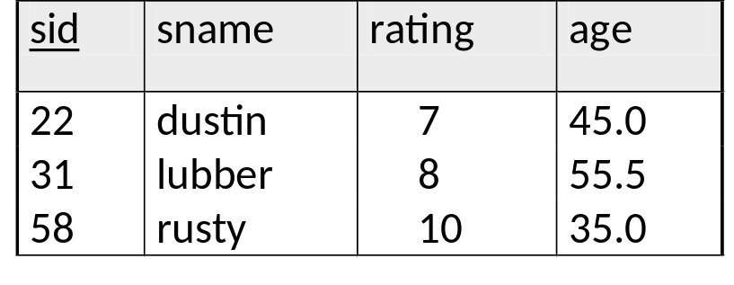
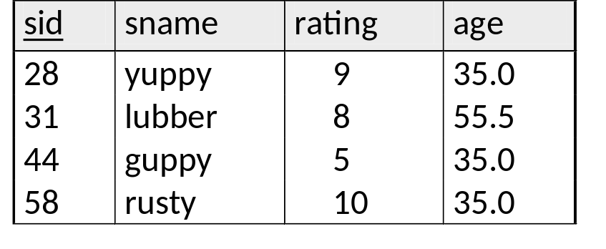

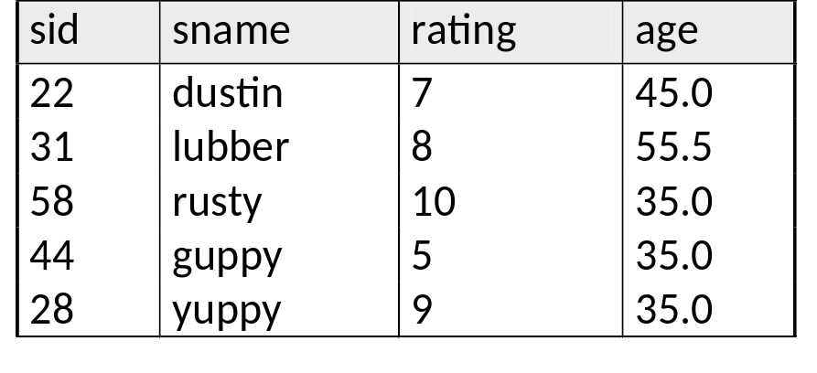
Union
S1
S2

Slide 7
Intersection
The intersection of two relations R and S is the set of tuples that are in both R and S.
Same conditions hold on R and S as for the union operator.
  R and S must have identical sets of attributes and the types of the attributes must be the same.
  The attributes of R and S must occur in the same order.
RA: R ∩ S
SQL: (SELECT * FROM R)
INTERSECT
(SELECT * FROM S);

Slide 8
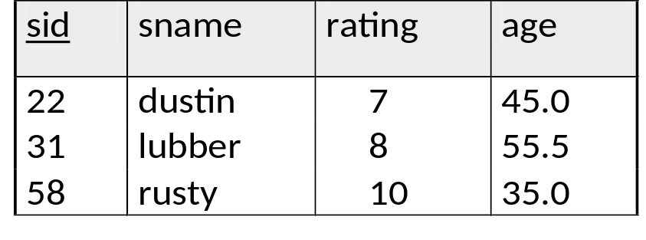
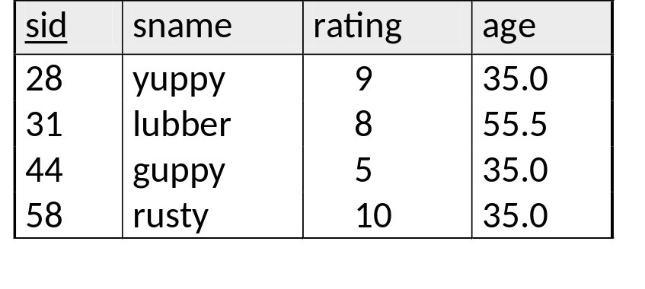
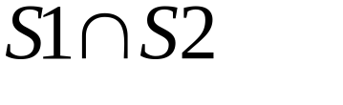
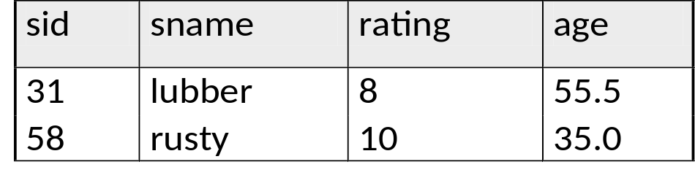
Intersection
S1
S2

Slide 9
Difference
The difference of two relations R and S is the set of tuples that are in R but not in S.
Same conditions hold on R and S as for the union operator.
  R and S must have identical sets of attributes and the types of the attributes must be the same.
  The attributes of R and S must occur in the same order.
RA: R - S
SQL: (SELECT * FROM R)
EXCEPT
(SELECT * FROM S);
R – (R – S) = R ∩ S

Slide 10
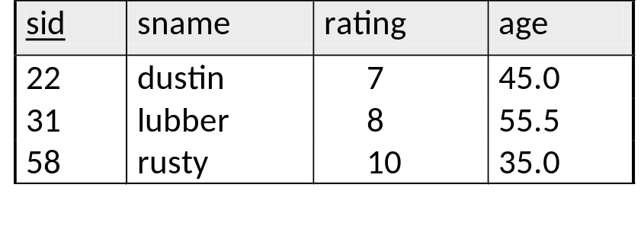
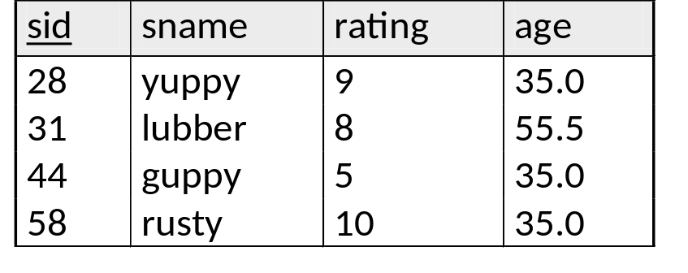

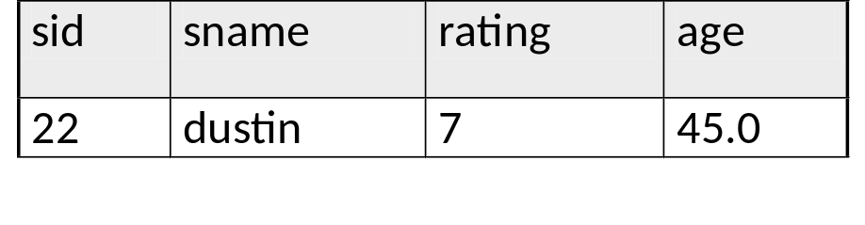
Difference
S1
S2

Slide 11
Cartesian Product
The Cartesian product (or cross-product or product) of two relations R and S is a the set of pairs that can be formed by pairing each tuple of R with each tuple of S.
  The result is a relation whose schema is the schema for R followed by the schema for S.
RA: R X S
SQL: SELECT * FROM R , S ;

Slide 12
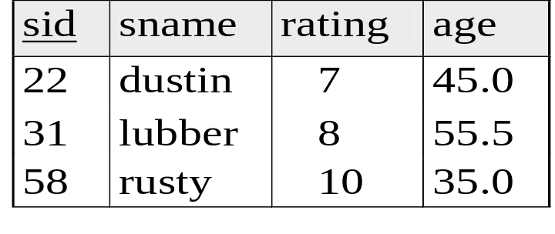
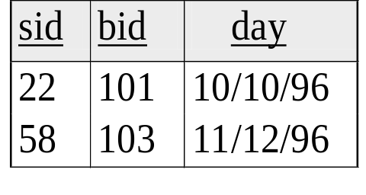
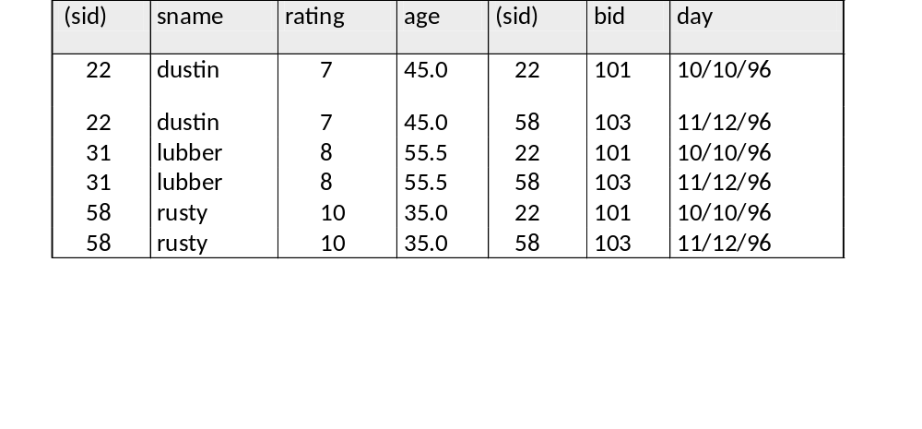
Cartesian Product
S1
R1
?
S1 x R1
We rename attributes to avoid ambiguity or we prefix attribute with the name of the relation it belongs to.

Slide 13
Theta-Join
The theta-join of two relations R and S is the set of tuples in the Cartesian product of R and S that satisfy some condition C.
RA: R ∞ S
SQL: SELECT *
FROM R , S
WHERE C;
R ∞ S =
C
σ (R x S)
C
C

Slide 14
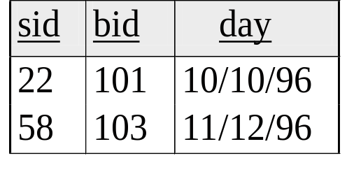
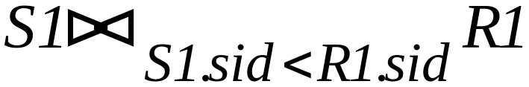
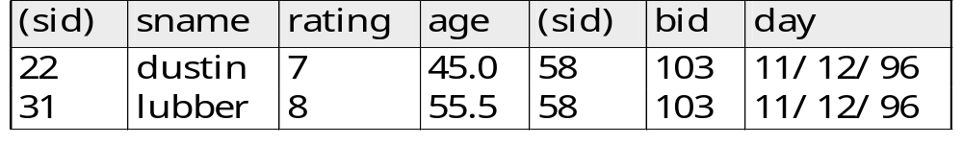

Theta-Join
S1
R1

Slide 15
Natural Join
The natural join of two relations R and S is a set of pairs of tuples, one from R and one from S, that agree on whatever attributes are common to the schemas of R and S.
The schema for the result contains the union of the attributes of R and S.
Assume the schemas R(A,B, C) and S(B, C,D)
RA: R ∞ S
SQL: SELECT *
FROM R , S
WHERE R.B = S.B AND R.C = S.C;

Slide 16
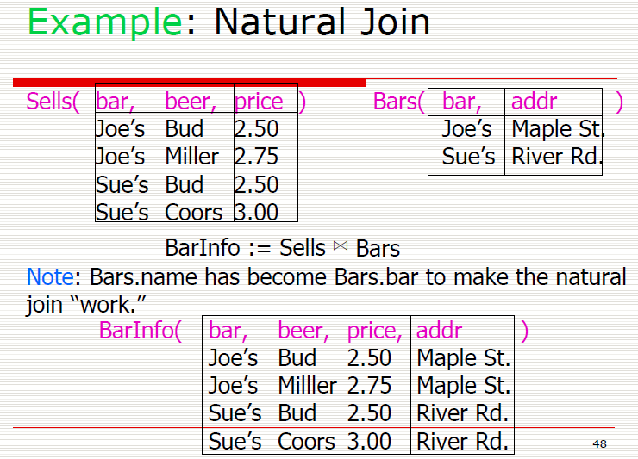

Slide 17
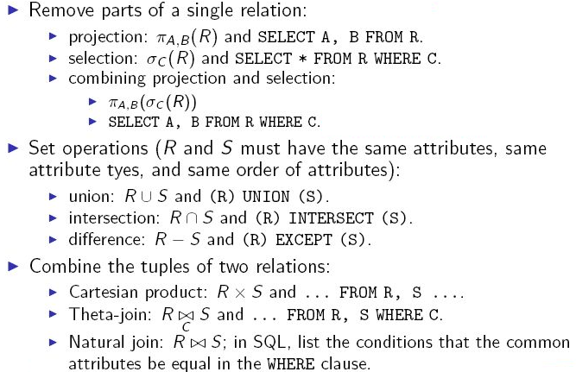
Operators Covered So far

Slide 18

Renaming
If two relations have the same attribute, disambiguate the attributes by prefixing the attribute with the name of the relation it belongs to.
How do we answer the query “Name pairs of students who live at the same address”? Students(Name, Address)
  We need to take the cross-product of Students with itself?
  How do we refer to the two “copies” of Students?
  Use the rename operator.
RA: : give R the name S; R has n attributes, which are called A1,A2, . . . ,An in S
SQL: Use the AS keyword in the FROM clause: Students AS Students1 renames Students to Students1
(R)
S (A1,A2, . . . An)

Slide 19
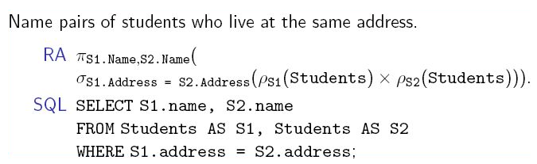
Renaming
Are these correct ?
No !!! the result includes tuples where a student is paired with himself/herself
Solution: Add the condition S1.name <> S2.name.

Slide 20
Practicing Relational Algebra

Slide 21
Q1: Find names of sailors who have reserved boat #103
Reserves(sid, bid, day)
Sailors(sid, sname, rating, age)
Solution 1:
  π_{sname}(σ_{bid = 103} (Reserves ∞ Sailors))
Solution 2 (more efficient)
  π_{sname}((σ_{bid = 103} Reserves) ∞ Sailors)
Solution 3 (using rename operator)
  P(Temp1 (σ_{bid = 103} Reserves))
  P(Temp2 (Temp1 ∞ Sailors))
  π_{sname}(Temp2)

Slide 22
Q2: Find names of sailors who have reserved a red boat
Reserves(sid, bid, day) Sailors(sid, sname, rating, age)
Boats(bid, bname, color)
Solution 1:
π_{sname}((σ_{color = ‘red’} Boats) ∞ Reserves ∞ Sailors )
Solution 2 (more efficient)
π_{sname}(π_{sid} ((π_{bid}σ_{color = ‘red’} Boats)∞ Reserves )∞ Sailors )

Slide 23
Q3: Find the colors of boats reserved by Lubber
Reserves(sid, bid, day) Sailors(sid, sname, rating, age)
Boats(bid, bname, color)
Reserves(sid, bid, day) Sailors(sid, sname, rating, age)
Boats(bid, bname, color)
Solution:
π_{color}((σ_{sname = ‘Lubber’} Sailor)∞ Reserves ∞ Boats )

Slide 24
Q4: Find the names of sailors who have reserved at least one boat
Reserves(sid, bid, day) Sailors(sid, sname, rating, age)
Boats(bid, bname, color)
Reserves(sid, bid, day) Sailors(sid, sname, rating, age)
Boats(bid, bname, color)
Solution:
π_{sname}(Sailor∞ Reserves)

Slide 25
Q5: Find the names of sailors who have reserved a red or a green boat
Reserves(sid, bid, day) Sailors(sid, sname, rating, age)
Boats(bid, bname, color)
Reserves(sid, bid, day) Sailors(sid, sname, rating, age)
Boats(bid, bname, color)
Solution:
π_{sname}(σ_{color=‘red’ or color = ‘green’} Boats ∞ Reserves ∞ Sailors)

Slide 26
Q6: Find the names of sailors who have reserved a red and a green boat
Reserves(sid, bid, day) Sailors(sid, sname, rating, age)
Boats(bid, bname, color)
Reserves(sid, bid, day) Sailors(sid, sname, rating, age)
Boats(bid, bname, color)
Solution:
π_{sname}(σcolor=‘red’ and color = ‘green’ Boats ∞ Reserves ∞ Sailors)
A ship cannot have TWO colors at the same time
π_{sname}(σ_{color=‘red’} Boats ∞ Reserves ∞ Sailors)
∩
π_{sname}(σ_{color = ‘green’} Boats ∞ Reserves ∞ Sailors)

Slide 27
Q7: Find the sids of sailors with age over 20 who have not reserved a red boat
Reserves(sid, bid, day) Sailors(sid, sname, rating, age)
Boats(bid, bname, color)
Strategy ? ? ?
  Find all sailors (sids) with age over 20
  Find all sailors (sids) who have reserved a red boat
  Take their set difference
Solution:
π_{sid} (σ_{age>20} Sailors) – π_{sid} ((σ_{color=‘red’} Boats) ∞ Reserves)

Slide 28
Product (make, model, type)
PC (model, speed, ram, hd, price)
Laptop (model, speed, ram, hd, screen, price)
Printer (model, color, type, price)

