Slide 1
Extended Operators in SQL and Relational Algebra
Dr. Bing Zhou

Slide 2
Bags
A bag (or multi-set ) is like a set, but an element may appear more than once.
Example: {1,2,1,3} is a bag.
Example: {1,2,3} is also a bag that happens to be a set.

Slide 3
Why Bags?
So far, we have said that relational algebra and SQL operate on relations that are sets of tuples.
Real RDBMSs treat relations as bags of tuples.
  SQL, the most important query language for relational databases, is actually a bag language.
Performance is one of the main reasons; duplicate elimination is expensive since it requires sorting.
  Some operations, like projection, are much more efficient on bags than sets.
  The union of two relations as bags is more efficient that the union of sets
If we use bag semantics, we may have to redefine the meaning of each relation algebra operator.

Slide 4
Operations on Bags
Selection applies to each tuple, but as a bag operator, we do not eliminate duplicates.
Projection also applies to each tuple, but as a bag operator, we do not eliminate duplicates.
Products and joins are done on each pair of tuples, so duplicates in bags have no effect on how we operate, but when constructing the answer, we do not eliminate duplicates

Slide 5
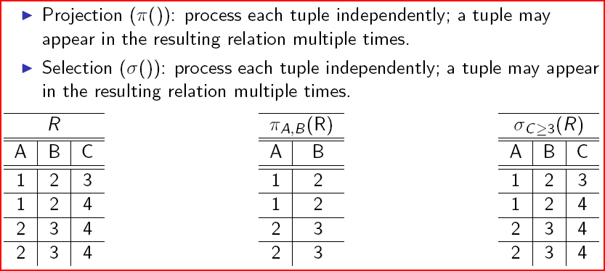
Bag Semantics: Projection and Selection

Slide 6
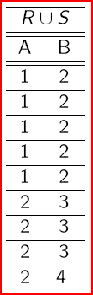
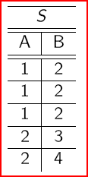
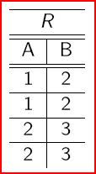
Bag Union
An element appears in the union of two bags the sum of the number of times it appears in each bag.
R U S: if tuple t appears k times in R and l times in S, t
appears in R U S k + l times.

Slide 7
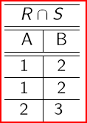
Bag Intersection
An element appears in the intersection of two bags the minimum of the number of times it appears in either.
R ∩ S: if tuple t appears k times in R and l times in S, t appears min {k, l} times in R ∩ S

Slide 8
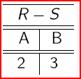
Bag Difference
An element appears in the difference R - S of bags as many times as it appears in R, minus the number of times it appears in S.
  But never less than 0 times.
R −S: if tuple t appears k times in R and l times in S, t appears in R − S max{0, k − l} times.

Slide 9
Bag Semantics: Products and Joins
Product (×): If a tuple r appears k times in a relation R and tuple s appears l times in a relation S, then the tuple rs appears kl times in R × S.
Theta-join and Natural join (∞): Since both can be expressed as applying a selection followed by a projection to a product, use the semantics of selection, projection, and the product.

Slide 10
Example: Product
R = ( A B )
1 2
1 2
S = ( B C )
2 3
4 5
4 5
R x S =
A | R.B | S.B | C
1 | 2 | 2 | 3
1 | 2 | 4 | 5
1 | 2 | 4 | 5
1 | 2 | 2 | 3
1 | 2 | 4 | 5
1 | 2 | 4 | 5

Slide 11
Example: Natural Join
R = ( A B )
1 2
1 2
S = ( B C )
2 3
4 5
4 5
R ∞ S =
A | B | C
1 | 2 | 3
1 | 2 | 3

Slide 12
Example: Theta Join
R = ( A B )
1 2
1 2
S = ( B C )
2 3
4 5
4 5
R ∞R.B<S.B S =
A | R.B | S.B | C
1 | 2 | 4 | 5
1 | 2 | 4 | 5
1 | 2 | 4 | 5
1 | 2 | 4 | 5

Slide 13
Extended Operators
Powerful operators based on basic relational operators and bag semantics.
Sorting: convert a relation into a list of tuples.
Duplicate elimination: turn a bag into a set by eliminating duplicate tuples.
Grouping: partition the tuples of a relation into groups, based on their values among specified attributes.
Aggregation: used by the grouping operator and to manipulate/combine attributes.
Extended projections: projection on steroids.
Outerjoin: extension of joins that make sure every tuple is in the output.

Slide 14
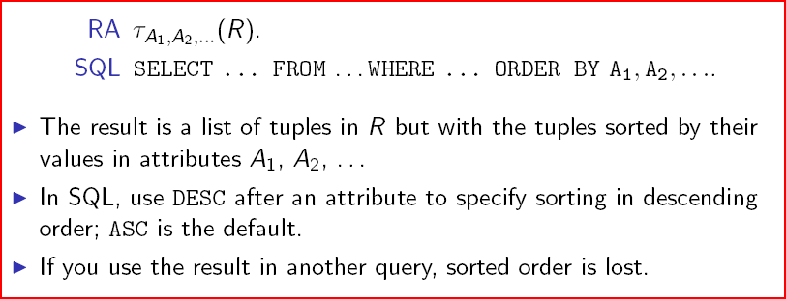
Sorting

Slide 15
Example: Sorting
R = ( A B )
1 2
3 4
5 2
TAU_{B} (R) = [(5,2), (1,2), (3,4)]

Slide 16
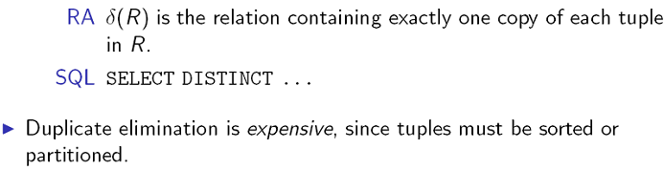
Duplicate Elimination

Slide 17
Example: Duplicate Elimination
R = ( A B )
1 2
3 4
1 2
= A B
1 2
3 4

Slide 18
Extended Projection
Using the same π _{L} operator, we allow the list L to contain arbitrary expressions involving attributes, for example:
    Arithmetic on attributes, e.g., A+B.
    Duplicate occurrences of the same attribute.

Slide 19
Example: Extended Projection
R = ( A B )
1 2
3 4
π _{A+B,A,A} (R) = A+B A1 A2
3 1 1
7 3 3

Slide 20
Aggregation Operators
Operators that summarize or aggregate the values in a single attribute of a relation.
Operators are the same in relational algebra and SQL.
All operators treat a relation as a bag of tuples.
SUM: computes the sum of a column with numerical values.
AVG: computes the average of a column with numerical values.
MIN and MAX:
  for a column with numerical values, computes the smallest or larges value, respectively.
  for a column with string or character values, computes the lexicographically smallest or largest values, respectively.
COUNT: computes the number of tuples in a column.
In SQL, can use COUNT (*) to count the number of tuples in a relation.

Slide 21
Example: Aggregation
R = ( A B )
1 3
3 4
3 2
SUM(A) = 7
COUNT(A) = 3
MAX(B) = 4
AVG(B) = 3

Slide 22
Grouping Operator
How do we answer the query “Count the number of classes and the total enrollment of the classes each department teaches”?
Can we answer the query using the operators discussed so far?
We need to group the tuples of Teach by DeptName and then
aggregate within each group.
Use the grouping operator.

Slide 23

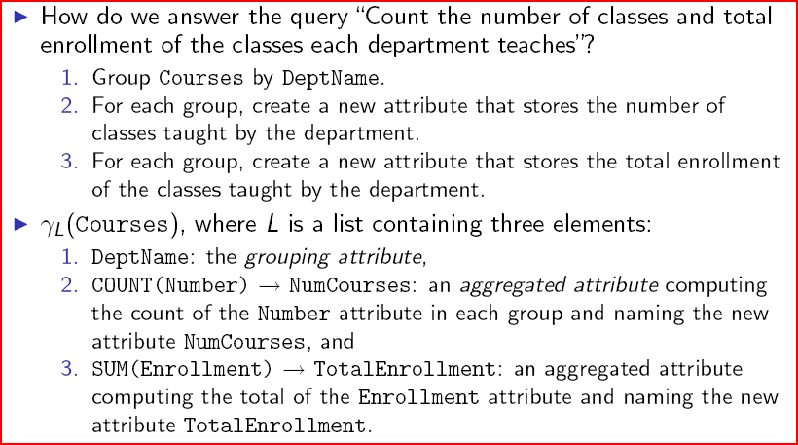
Applying _{L}(R)

Slide 24
Example: Grouping/Aggregation
R = ( A B C )
1 2 3
4 5 6
1 2 5
_{A,B,AVG(C)} (R) = ??
Then, average C within
groups:
A B AVG(C)
1 2 4
4 5 6
First, group R by A and B :
A B C
1 2 3
1 2 5
4 5 6

Slide 25
Outerjoin
Suppose we join R ∞_{C} S.
A tuple of R that has no tuple of S with which it joins is said to be dangling.
  Similarly for a tuple of S.
Outerjoin preserves dangling tuples by padding them with a special NULL symbol in the result.

Slide 26
Example: Outerjoin
R = ( A B ) S = ( B C )
1 2 2 3
4 5 6 7
(1,2) joins with (2,3), but the other two tuples are dangling.
R OUTERJOIN S = A B C
1 2 3
4 5 NULL
NULL 6 7

Slide 27
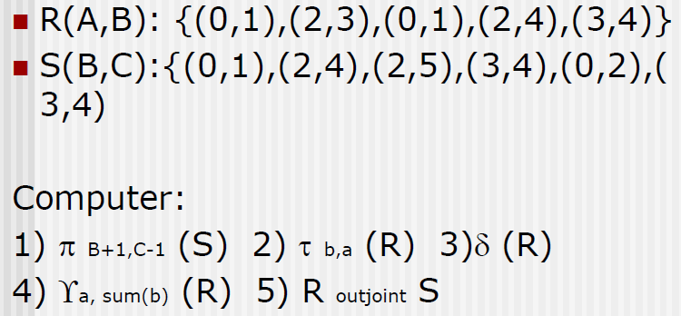
Exercise

Slide 28
Transactions, Views, Indexes

Slide 29
Why Transactions?
Concurrent database access
  Execute sequence of SQL statements so they appear to be running in isolation
Resilience to system failures
  Guarantee all-or-nothing execution, regardless of failures

Slide 30
Why Transactions?
Database systems are normally being accessed by many users or processes at the same time.
  Both queries and modifications.
Unlike operating systems, which support interaction of processes, a DMBS needs to keep processes from troublesome interactions.

Slide 31
Example: Bad Interaction
Joint account holders each take $100 from different ATM’s at about the same time.
  The DBMS better make sure one account deduction doesn’t get lost.
Compare: An OS allows two people to edit a document at the same time. If both write, one’s changes get lost.

Slide 32
Introduction to Transactions
Transaction = a sequence of one or more SQL statements treated as one unit.
Normally with some strong properties regarding concurrency.
Formed in SQL from single statements or explicit programmer control.
Depending on the implementation, a transaction may start:
  Implicitly, with the execution of a SELECT, UPDATE, … statement, or
  Explicitly, with a BEGIN TRANSACTION statement
Transaction finishes with a COMMIT or ROLLBACK statement

Slide 33
ACID Properties
ACID Properties are:
  Atomic : Whole transaction or none is done.
  Consistent : Database constraints preserved.
  Isolated : It appears to the user as if only one process executes at a time.
  Durable : Effects of a process survive a crash.

Slide 34
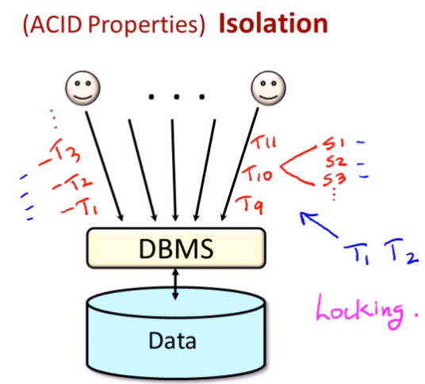
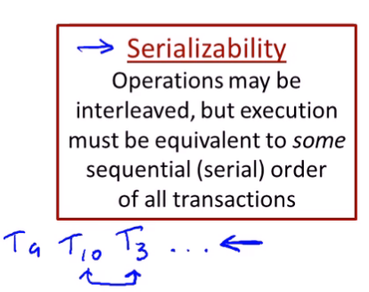

Slide 35
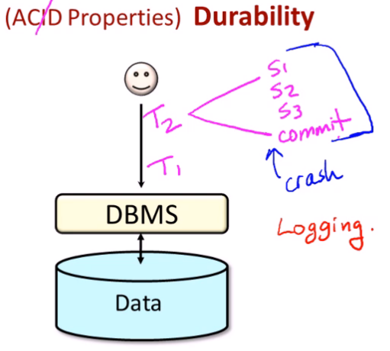
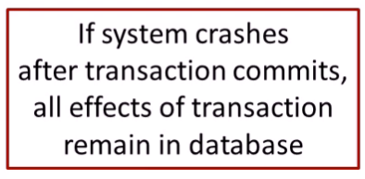

Slide 36
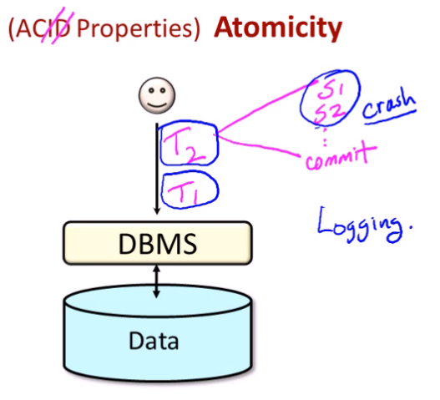
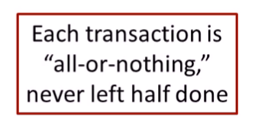

Slide 37
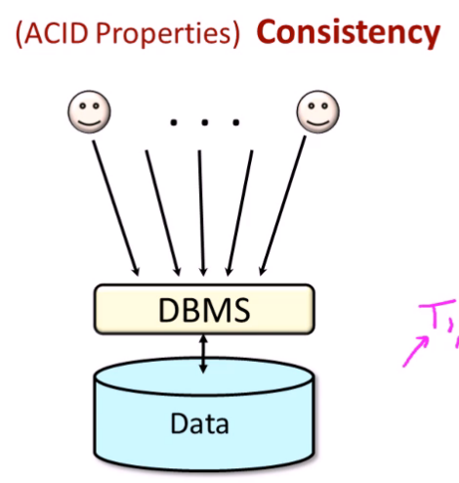
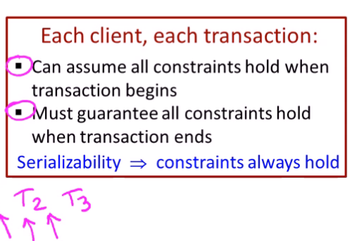

Slide 38
COMMIT
The SQL statement COMMIT causes a transaction to complete.
  Its database modifications are now permanent in the database.

Slide 39
ROLLBACK
The SQL statement ROLLBACK also causes the transaction to end, but by aborting.
  No effects on the database.
Failures like division by 0 or a constraint violation can also cause rollback, even if the programmer does not request it.

Slide 40
Example: Interacting Processes
Assume a Sells(bar,beer,price) relation, and suppose that Joe’s Bar sells only Export for $2.50 and Sleeman for $3.00.
Sally is querying Sells for the highest and lowest price Joe charges.
Joe decides to stop selling Export and Sleeman, and to sell only Heineken at $3.50.

Slide 41
Sally’s Program
Sally executes the following two SQL statements called (min) and (max) to help us remember what they do.
(max) SELECT MAX(price) FROM Sells
WHERE bar = ’Joe’’s Bar’;
(min) SELECT MIN(price) FROM Sells
WHERE bar = ’Joe’’s Bar’;

Slide 42
Joe’s Program
At about the same time, Joe executes the following steps: (del) and (ins).
(del) DELETE FROM Sells
WHERE bar = ’Joe’s Bar’;
(ins) INSERT INTO Sells
VALUES(’Joe’s Bar’, ’Heineken’, 3.50);

Slide 43
Interleaving of Statements
Although (max) must come before (min), and (del) must come before (ins), there are no other constraints on the order of these statements, unless we group Sally’s and/or Joe’s statements into transactions.

Slide 44
Example: Strange Interleaving
Suppose the steps execute in the order (max)(del)(ins)(min).
Joe’s Prices:
Statement:
Result:
Sally sees MAX < MIN!
{2.50,3.00}
{2.50,3.00}
{3.50}
{3.50}
(max)
(del)
(ins)
(min)
3.00
3.50

Slide 45
Fixing the Problem by Using Transactions
If we group Sally’s statements (max)(min) into one transaction, then she cannot see this inconsistency.
She sees Joe’s prices at some fixed time.
  Either before or after he changes prices, or in the middle, but the MAX and MIN are computed from the same prices.

Slide 46
Another Problem: Rollback
Suppose Joe executes (del)(ins), not as a transaction, but after executing these statements, thinks better of it and issues a ROLLBACK statement.
If Sally executes her statements after (ins) but before the rollback, she sees a value, 3.50, that never existed in the database.

Slide 47
Solution
If Joe executes (del)(ins) as a transaction, its effect cannot be seen by others until the transaction executes COMMIT.
  If the transaction executes ROLLBACK instead, then its effects can never be seen.

Slide 48
Isolation Levels
SQL defines four isolation levels
  = choices about what interactions are allowed by transactions that execute at about the same time.
Each DBMS implements transactions in its own way.

Slide 49
Choosing the Isolation Level
Within a transaction, we can say:
SET TRANSACTION ISOLATION LEVEL X
where X =
  SERIALIZABLE
  REPEATABLE READ
  READ COMMITTED
  READ UNCOMMITTED

Slide 50
Serializable Transactions
If Sally = (max)(min) and Joe = (del)(ins) are each transactions, and Sally runs with isolation level SERIALIZABLE, then she will see the database either before or after Joe runs, but not in the middle.

Slide 51
Isolation Level Is Personal Choice
Your choice, e.g., run serializable, affects only how you see the database, not how others see it.
Example: If Joe runs serializable, but Sally doesn’t, then Sally might see no prices for Joe’s Bar.
  i.e., it looks to Sally as if she ran in the middle of Joe’s transaction.

Slide 52
Read-Commited Transactions
If Sally runs with isolation level READ COMMITTED, then she can see only committed data, but not necessarily the same data each time.
Example: Under READ COMMITTED, the interleaving (max)(del)(ins)(min) is allowed, as long as Joe commits.
  Sally sees MAX < MIN.

Slide 53
Repeatable-Read Transactions
Requirement is like read-committed, plus: if data is read again, then everything seen the first time will be seen the second time.
  But the second and subsequent reads may see more tuples as well.

Slide 54
Example: Repeatable Read
Suppose Sally runs under REPEATABLE READ, and the order of execution is (max)(del)(ins)(min).
  (max) sees prices 2.50 and 3.00.
  (min) can see 3.50, but must also see 2.50 and 3.00, because they were seen on the earlier read by (max).

Slide 55
Read Uncommitted
A transaction running under READ UNCOMMITTED can see data in the database, even if it was written by a transaction that has not committed (and may never).
Example: If Sally runs under READ UNCOMMITTED, she could see a price 3.50 even if Joe later aborts.

Slide 56
Views
A view is a relation defined in terms of stored tables (called base tables ) and other views.
Two kinds:
  Virtual = not stored in the database; just a query for constructing the relation.
  Materialized = actually constructed and stored.
Just like a table, a view can be queried.
Unlike a table, a view cannot be updated unless it satisfies certain conditions.

Slide 57
Declaring Views
Declare by:
CREATE [MATERIALIZED] VIEW <name> AS <query>;
Default is virtual.

Slide 58
Example: View Definition
Suppose we want to perform a set of queries on those students who have taken courses both in the computer science and the mathematics departments.
Let us create a view to store the PIDs of these students and the
CS-Math course pairs they took.
CREATE VIEW CSMath AS
SELECT T1.StudentPID, T1.Number, T2.Number FROM Take AS T1, Take AS T2
WHERE (T1.StudentPID = T2.StudentPID)
AND (T1.DeptName = ’CS’)
AND (T2.DeptName = ’Math’);

Slide 59
Example: View Definition
CanDrink(drinker, beer) is a view “containing” the drinker-beer pairs such that the drinker frequents at least one bar that serves the beer:
CREATE VIEW CanDrink AS
SELECT drinker, beer
FROM Frequents, Sells
WHERE Frequents.bar = Sells.bar;

Slide 60
Example: Accessing a View
Query a view as if it were a base table.
  Also: a limited ability to modify views if it makes sense as a modification of one underlying base table.
Example query:
SELECT beer FROM CanDrink
WHERE drinker = ’Sally’;

Slide 61
Indexes
Index = data structure used to speed access to tuples of a relation, given values of one or more attributes.
Could be a hash table, but in a DBMS it is always a balanced search tree with giant nodes called a B-tree.

Slide 62
Declaring Indexes
No standard!
Typical syntax:
CREATE INDEX BeerInd ON Beers(manf);
CREATE INDEX SellInd ON Sells(bar, beer);

Slide 63
Using Indexes
Given a value v, the index takes us to only those tuples that have v in the attribute(s) of the index.
Example: use BeerInd and SellInd to find the prices of beers manufactured by Pete’s and sold by Joe. (next slide)

Slide 64
Using Indexes --- (2)
SELECT price FROM Beers, Sells
WHERE manf = ’Pete’s’ AND
Beers.name = Sells.beer AND
bar = ’Joe’s Bar’;
Use BeerInd to get all the beers made by Pete’s.
Then use SellInd to get prices of those beers, with bar = ’Joe’’s Bar’

Slide 65
Database Tuning
A major problem in making a database run fast is deciding which indexes to create.
Pro: An index speeds up queries that can use it.
Con: An index slows down all modifications on its relation because the index must be modified too.

