Slide 1
CHAPTER 3:
Managing Design Processes
Designing the User Interface:
Strategies for Effective Human-Computer Interaction
Fifth Edition
Ben Shneiderman & Catherine Plaisant
in collaboration with
Maxine S. Cohen and Steven M. Jacobs

Slide 2
Organizational Design and
Support Usability
Design is inherently creative and unpredictable. Interactive system designers must blend knowledge of technical feasibility with a mystical esthetic sense of what attracts users. hared language
Carroll and Rosson design characterization:
  Design is a process, not a state.
  The design process is nonhierarchical.
  The process is radically transformational.
  Design intrinsically involves the discovery of new goals.
3-<number>

Slide 3
Organizational Design and
Support Usability (cont.)
“Usability engineering” has evolved into a recognized discipline with maturing practices and a growing set of standards
Usability engineers and user-interface architects, sometimes called the user experience (UX) team are gaining experience in organizational change
There are numerous papers and reporting addressing return on investment (ROI) for usability testing
The Usability Professional's Association (UPA) holds annual meetings called the “World Usability Day”
3-<number>

Slide 4
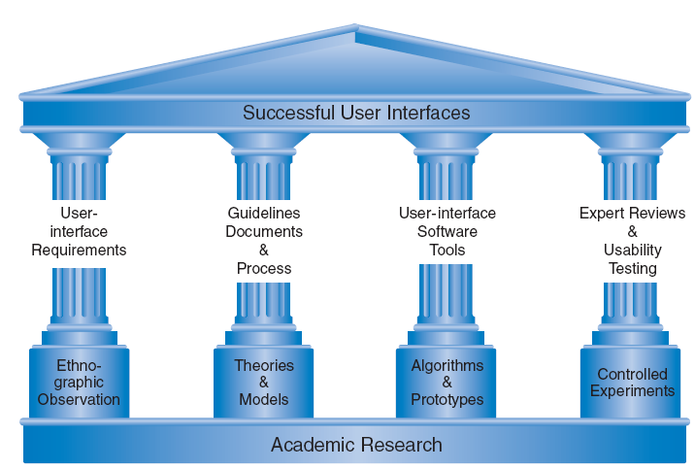
The Four Pillars of Design
3-<number>

Slide 5
The Four Pillars of Design
User Interface Requirements
  Soliciting and clearly specifying user requirements is a major key to success in any development activity
  Laying out the user-interface requirements is part of the overall requirements development and management process
  User interface requirements describe system behavior
Ethnographic Observation
  Identifying and observing the user community in action
  Discussed later
3-<number>

Slide 6
The Four Pillars of Design
Guidelines documents and processes
Each project has different needs, but guidelines should be considered for:
Words, icons, and graphics
  Terminology (objects and actions), abbreviations, and capitalization
  Character set, fonts, font sizes, and styles (bold, italic, underline)
  Icons, graphics, line thickness, and
  Use of color, backgrounds, highlighting, and blinking
3-<number>

Slide 7
The Four Pillars of Design (cont.)
Screen-layout issues
  Menu selection, form fill-in, and dialog-box formats
  Wording of prompts, feedback, and error messages
  Justification, white space, and margins
  Data entry and display formats for items and lists
  Use and contents of headers and footers
Input and output devices
  Keyboard, display, cursor control, and pointing devices
  Audible sounds, voice feedback, touch input, and other special devices
  Response time for a variety of tasks
3-<number>

Slide 8
The Four Pillars of Design (cont.)
Action sequences
  Direct-manipulation clicking, dragging, dropping, and gestures
  Command syntax, semantics, and sequences
  Programmed function keys
  Error handling and recovery procedures
Training
  Online help and tutorials
  Training and reference materials
  Command syntax, semantics, and sequences
3-<number>

Slide 9
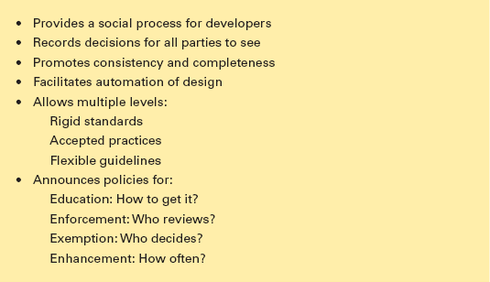
The Four Pillars of Design (cont.)
Guidelines creation should be a social process within an organization
to help it gain visibility and build support
3-<number>

Slide 10
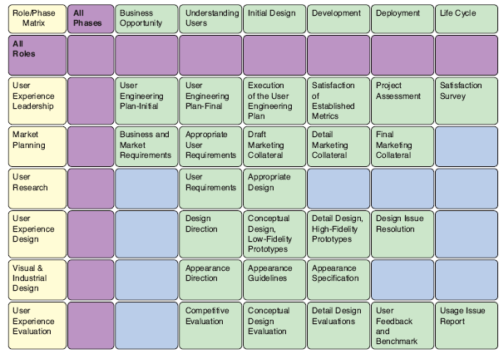
Developmental Methodologies
IBM’s Ease of Use development methodology
specifies activities by roles and phases
3-<number>

Slide 11
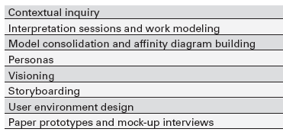
Rapid Contextual Design
From Holtzblatt, et al., Rapid Contextual Design:
A How-To Guide to Key Techniques for User-Centered Design
3-<number>

Slide 12
Ethnographic Observation
Preparation
  Understand organization policies and work culture.
  Familiarize yourself with the system and its history.
  Set initial goals and prepare questions.
  Gain access and permission to observe/interview.
Field Study
  Establish rapport with managers and users.
  Observe/interview users in their workplace and collect subjective/objective quantitative/qualitative data.
  Follow any leads that emerge from the visits.
3-<number>

Slide 13
Ethnographic Observation (cont.)
Analysis
  Compile the collected data in numerical, textual, and multimedia databases.
  Quantify data and compile statistics.
  Reduce and interpret the data.
  Refine the goals and the process used.
Reporting
  Consider multiple audiences and goals.
  Prepare a report and present the findings.
3-<number>

Slide 14

Participatory Design
3-<number>

Slide 15
Participatory Design (cont.)
Controversial
More user involvement brings:
  more accurate information about tasks
  more opportunity for users to influence design decisions
  a sense of participation that builds users' ego investment in successful implementation
  potential for increased user acceptance of final system
3-<number>

Slide 16
Participatory Design (cont.)
On the negative side, extensive user involvement may:
  be more costly
  lengthen the implementation period
  build antagonism with people not involved or whose suggestions rejected
  force designers to compromise their design to satisfy incompetent participants
  build opposition to implementation
  exacerbate personality conflicts between design-team members and users
  show that organizational politics and preferences of certain individuals are more important than technical issues
3-<number>

Slide 17
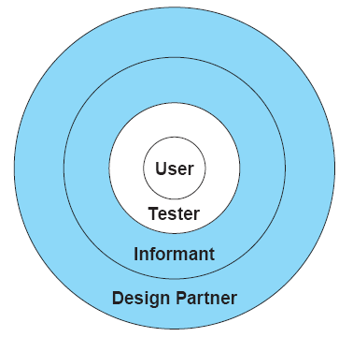
Participatory Design (cont.)
Four level of user participation, the blue area represent stages of participation design
3-<number>

Slide 18
Scenario Development
Day-in-the-life scenarios:
characterize what happens when users perform typical tasks
can be acted out as a form of walkthrough
may be used as basis for videotape
useful tools
  table of user communities across top, tasks listed down the side
  table of task sequences
  flowchart or transition diagram
3-<number>

Slide 19
Social Impact Statement for
Early Design Review
Describe the new system and its benefits
Convey the high level goals of the new system.
Identify the stakeholders.
Identify specific benefits
3-<number>

Slide 20
Social Impact Statement for Early Design Review (cont.)
Address concerns and potential barriers
Anticipate changes in job functions and potential layoffs.
Address security and privacy issues.
Discuss accountability and responsibility for system misuse and failure.
Avoid potential biases.
Weigh individual rights vs. societal benefits.
Assess trade-offs between centralization and decentralization.
Preserve democratic principles.
Ensure diverse access.
promote simplicity and preserve what works.
3-<number>

Slide 21
Social Impact Statement for Early Design Review (cont.)
Outline the development process
Present and estimated project schedule.
Propose process for making decisions.
Discuss expectations of how stakeholders will be involved.
Recognize needs for more staff, training, and hardware.
Propose plan for backups of data and equipment.
Outline plan for migrating to the new system.
3-<number>

Slide 22
Legal Issues
Potential Controversies
What material is eligible for copyright?
Are copyrights or patents more appropriate for user interfaces?
What constitutes copyright infringement?
Should user interfaces be copyrighted?
Evolving public policies related to:
  Privacy
  Liability related to system safety/reliability
  Freedom of speech
3-<number>

