Slide 1
Getting Started
Hello World!

Slide 2
Outline
Install JDK
Install Eclipse
Install Android SDK
Install Eclipse Plug-ins for Android
Sample Project: Hello, Android
Notes:
2

Slide 3
Installing the SDK and IDE

Slide 4
Install Java
If you have not already installed the Java JDK, you must install it first
http://www.oracle.com/technetwork/java/javase/downloads/java-se-jdk-7-download-432154.html

Slide 5
Installation - Android SDK
Android SDK Source Tree
SDK ROOT
Development Tools
System Images
Sample Code and Applications
Documentation
Directory | Description
Development Tools | A variety of tools for developing and debugging application code and designing an application UI
System Images | Android 1.1 system images
Sample Code and Applications | A variety of tutorials and samples
Documentation | A full set of local documentation
Notes:
C:\Users\UserName\AppData\Local\Android\sdk (replace UserName as corresponds, in my case AppData is also a hidden folder)

Slide 6
Android SDK
Download the ADT Bundle. It includes
Eclipse + ADT plugin
Android SDK Tools
Android Platform-tools
The latest Android platform
The latest Android system image for the emulator
Link: http://developer.android.com/sdk/installing/bundle.html

Slide 7
Use an Existing IDE
You can use your current Eclipse installation by following these instructions:http://developer.android.com/sdk/installing/index.html

Slide 8
Android SDK Manager(Eclipse)
Launch by selecting Window > Android SDK
Or click
The SDK Manager is used to update the SDK and to add additional packages

Slide 9
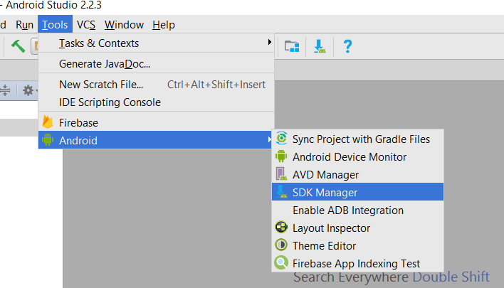
Android SDK Manager(Android Studio)

Slide 10
Creating an Emulator

Slide 11
Android Virtual Device (AVD)
The SDK includes a mobile device emulator
Allows you to run Android apps in a simulated environment
To run an app you must create an AVD
Define
Target Platform
CPU
SD Card
Display
Hard keyboards
Etc.

Slide 12
Defining an AVD
For Eclipse: Select Window>Android SDK>AVD Manager
Or click
Select New
For Android Studio: Tools>Android>AVD Manager

Slide 13
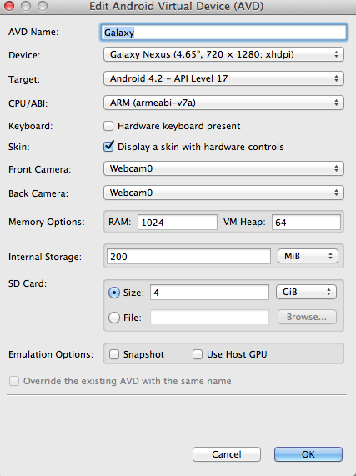
Galaxy AVD

Slide 14
Starting the AVD
Select the AVD in the AVD manager
Press Start

Slide 15
Hello World App
Creating the Project

Slide 16
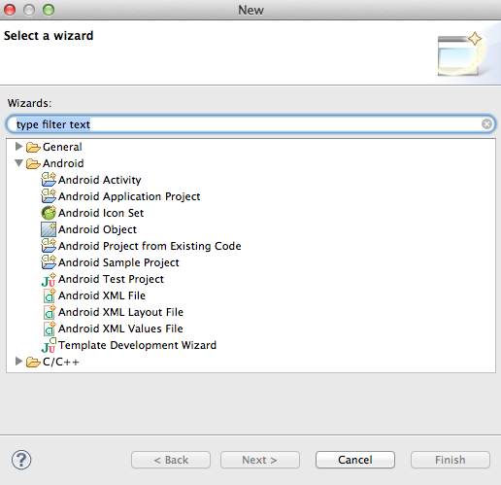
Creating an Android Project
Select File-New-Android Application Project OR
Click in the toolbar.
In the window that appears, open the Android folder, select Android Application Project

Slide 17
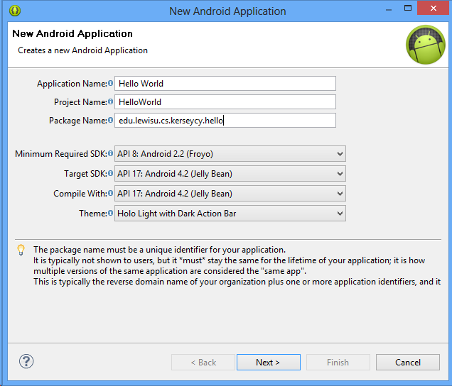
New Android Application
Application Name: Hello World
Project Name: HelloWorld
Package Name: edu.shsu.yourname.hello

Slide 18
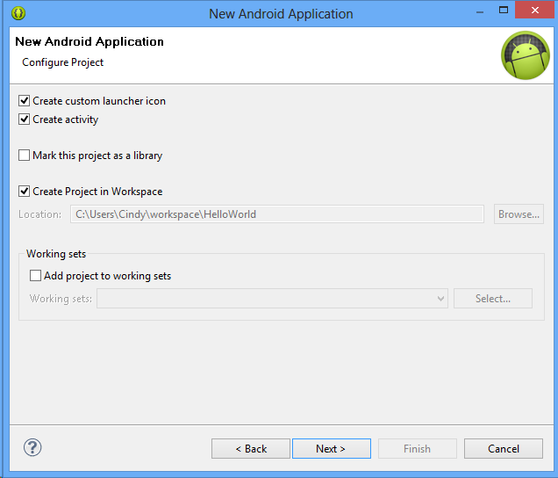
New Android Application

Slide 19
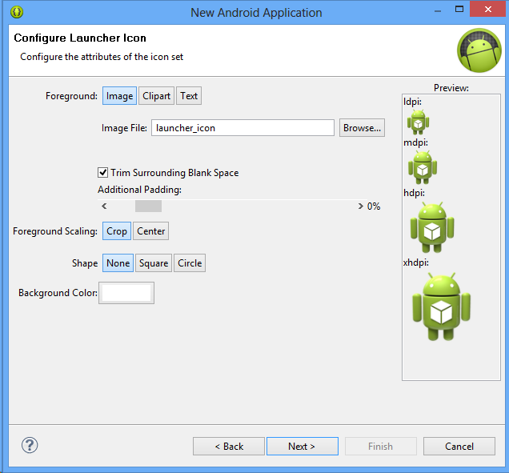
Configure Launcher Icon

Slide 20
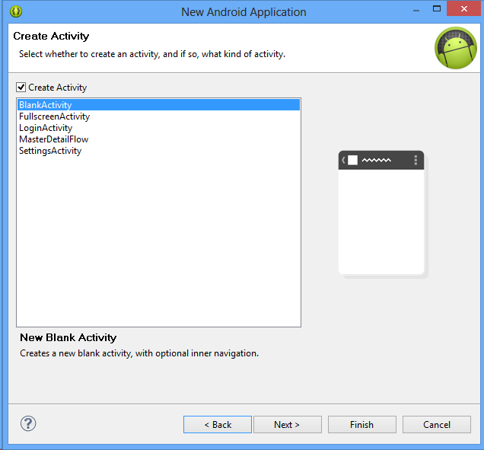
Create Activity
Select Blank Activity
Make Sure Create Activity is checked

Slide 21
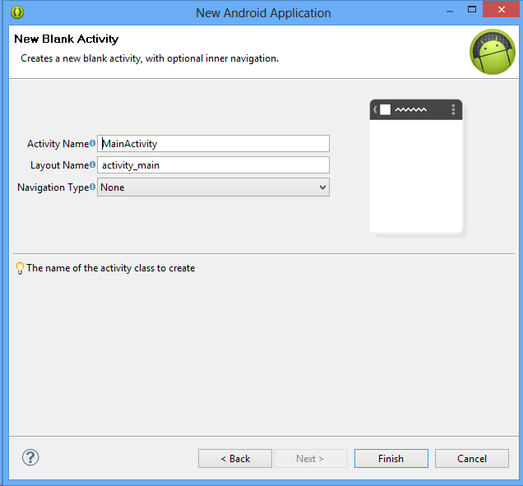
New Blank Activity
Leave all details
Press Finish

Slide 22
Running an Android App
Select Project
Run As > Android Application
OR
Right click project
Run As > Android Application
Must have defined a virtual device in order to test

Slide 23
Modify the application
Take a look at MainActivity.java (HelloWorld > src) and modify the code like:
import android.app.Activity;
import android.os.Bundle;
import android.widget.TextView;
public class HelloWorld extends Activity {
/** Called when the activity is first created. */
@Override
public void onCreate(Bundle savedInstanceState) {
super.onCreate(savedInstanceState);
TextView tv = new TextView(this);
tv.setText("Hello, Android");
setContentView(tv);
}
}

Slide 24
Modify the application(Cont)
Source Description (Cont)
Tell the TextView object to display a String:
tv.setText("Hello, Android");
Connect the TextView object with on-screen display:
setContentView(tv);

Slide 25
Modifying the Application
In the following slides we will
Modify the UI by adding an EditText component and a Button
Add to code to make something happen when the button is pressed

Slide 26
UI Updates
Switch to to the XML by selecting the tab labeled activity_main.xml
Modify the XML to
Add an EditText component
Add a Button

Slide 27
EditText
<EditText
android:id="@+id/editText1"
android:layout_width="match_parent"
android:layout_height="wrap_content"
android:ems="10"
android:hint="Enter your name"
android:inputType="textPersonName" >
<requestFocus />
</EditText>

Slide 28
Button
<Button
android:id="@+id/button1"
android:layout_width="wrap_content"
android:layout_height="wrap_content"
android:layout_gravity="center_horizontal"
android:gravity="center_vertical|center_horizontal"
android:text="ok" />

Slide 29
TextView
<TextView android:id="@+id/textView1"
android:layout_width="match_parent"
android:layout_height="wrap_content"
android:gravity="center_horizontal"
android:text="@string/hello_world" />

Slide 30
Complete Layout and Run
Switch back to graphical view to examine the layout
Run the application

Slide 31
Modify the Activity
Find and open MainActivity.java in the src folder
Make the following changes
Add attributes that refer to the EditText, TextView and Button
Add a listener that reads the text from the EditText and displays that text in the TextView when the Button is pressed

Slide 32
Declare Attributes
Immediately below the class declaration declare the following attributes: TextView textView;
EditText editText;
Button button;
Have Eclipse add the appropriate import statements by pressing Ctrl-Shift-O

Slide 33
Refer to Layout Components
At the end of onCreate method add the following code:
textView = (TextView)findViewById(R.id.textView1);
editText = (EditText)findViewById(R.id.editText1);
button = (Button)findViewById(R.id.button1);

Slide 34
Private Listener Class
Below the onCreateMenu method add the following private inner class private class ButtonListener implements OnClickListener{
public void onClick(View V){
String name = editText.getText().toString();
if(!name.equals("")){
textView.setText("Hello " + name + "!");
}else{
textView.setText("Hello World!");
}
}
}
Use Ctrl-shift-O to add the appropriate imports. You will want to import Android.view.View.onClickListener;

Slide 35
Register the Listener with the button
Add the bottom of the onCreate method add the following code button.setOnClickListener(new ButtonListener());

Slide 36
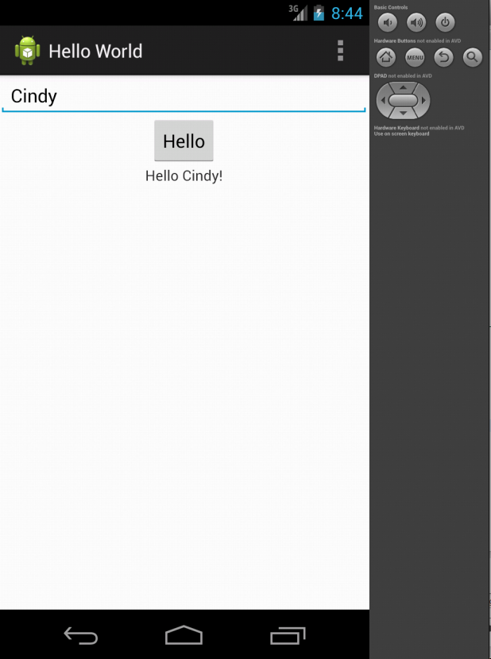
Run the Application

Slide 37
Application Fundamentals

Slide 38
Building and Running Applications
Android SDK tools compile the code and any data and resource file into an Android package
An archive file with an .apk suffix.
All the code in an Android package is considered to be one application
Android devices use the .apk file to install the application

Slide 39
Security Sandbox
Each Android application lives in its own security sandbox
Android is a multi-user Linux system in which each application is a different user.
The system assigns each application a unique Linux user ID
by default files of that application are only visible to that application

Slide 40
Security Sandbox (cont.)
The system sets permissions for all the files in an application
Only processes with the appropriate ID can access the file
Each process has its own virtual machine
Code is isolated
Every application runs in its own Linux process

