Slide 1
Outline
Graph
Tree
Applications of Graphs
Minimum Spanning Tree
Prim’s algorithm, Kruskal’s algorithm
Shortest paths
Dijkstra’s algorithm

Slide 2
Definition of Graph
Graph G = (V, E) where V is the set of vertices (nodes) and E is the set of edges
Subgraph
A subset of a graph’s vertices and edges
Two vertices are adjacent if they are joined by an edge
The two vertices are neighbors.

Slide 3
Terminology
Path
A sequence of connected edges
Cycle
A path whose starting vertex and ending vertex are the same
Simple path
A path that contains no cycle
Simple cycle
A cycle that contains no cycle in it

Slide 4
Terminology
Connected graph
Each pair of distinct vertices has a path between them
Complete graph
Each pair of distinct vertices has an edge between them
Directed graph (digraph) vs. undirected graph
Whether edges have direction?
Weighted graph vs. unweighted graph
Whether edges have weights ?

Slide 5
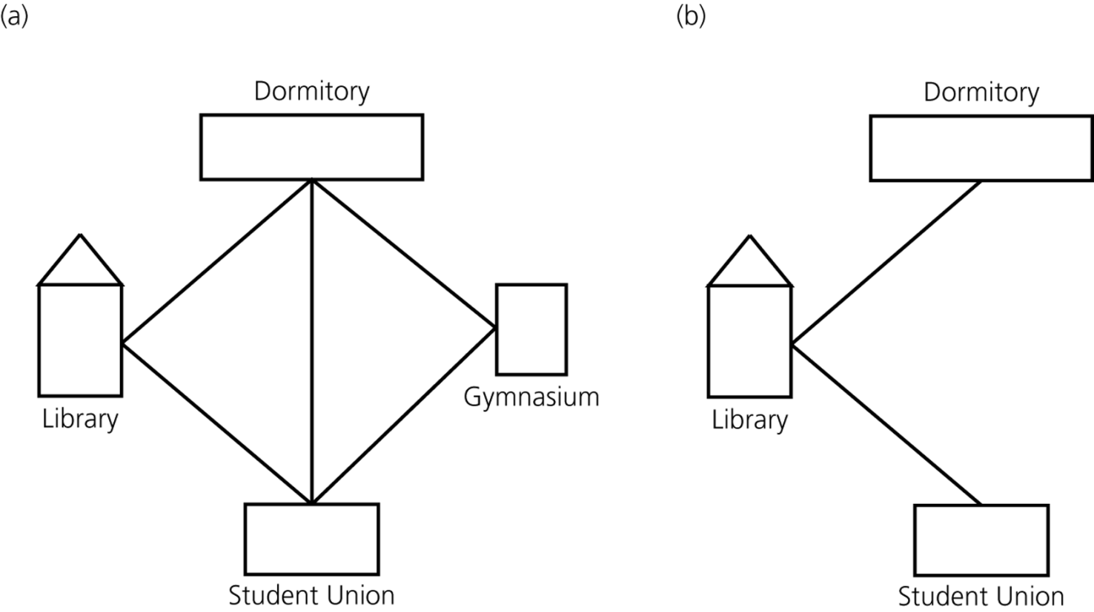
Graph Examples
(a) A campus map as a graph; (b) a subgraph

Slide 6
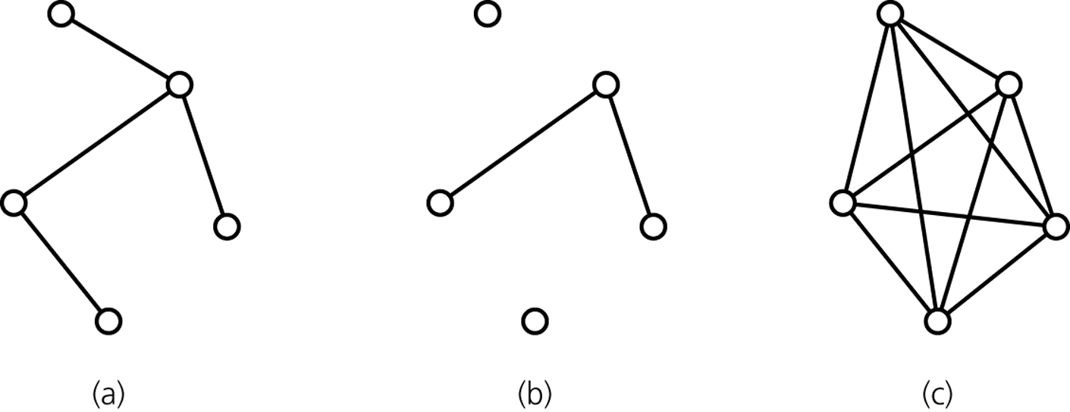
Graph Examples
(a) connected; (b) disconnected; and (c) complete

Slide 7
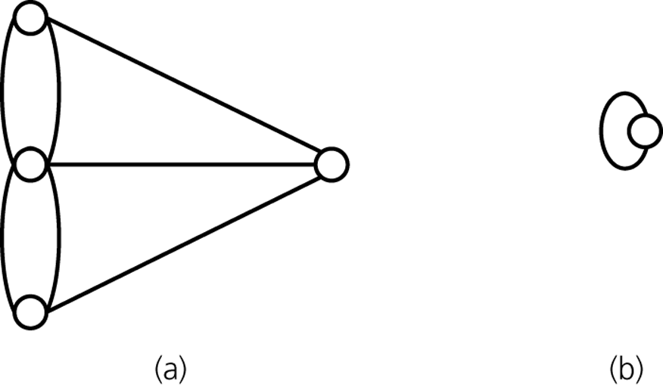
Graph Examples
(a) A multigraph is not a graph; (b) a self edge is not allowed in a graph

Slide 8
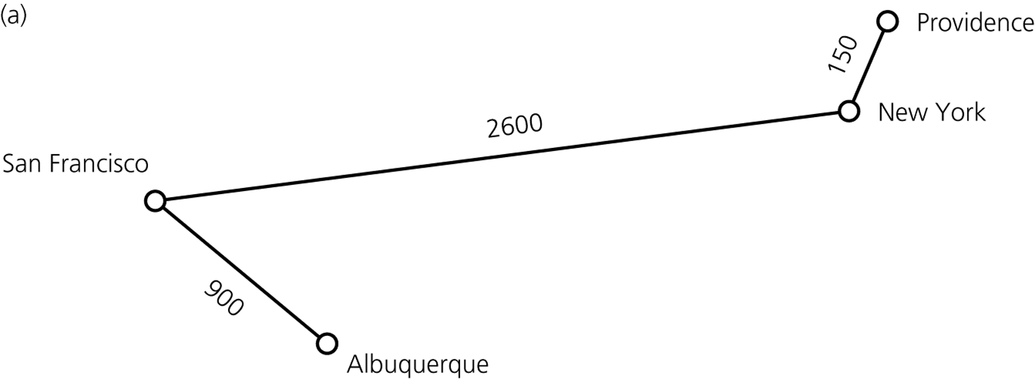
Graph Examples
(a) A weighted graph

Slide 9
Shortest Paths
Shortest path between two vertices in a weighted graph
The path that has the smallest sum of its edge weights

Slide 10
Outline
Graph
Tree
Applications of Graphs
Minimum Spanning Tree
Prim’s algorithm, Kruskal’s algorithm
Shortest paths
Dijkstra’s algorithm

Slide 11
Definition of Tree
General tree T is partitioned into disjoint subsets:
A single node r, the root
Sets of general trees, called subtrees of r

Slide 12
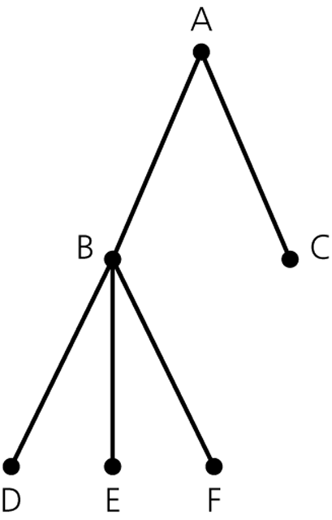
Tree
General Tree
Terminology
node or vertex
edge
parent
child
siblings
root
leaf
ancestor
descendant
subtree

Slide 13
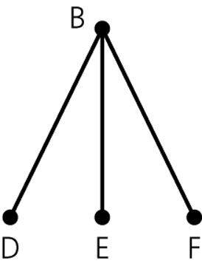
Subtree
A subtree

Slide 14
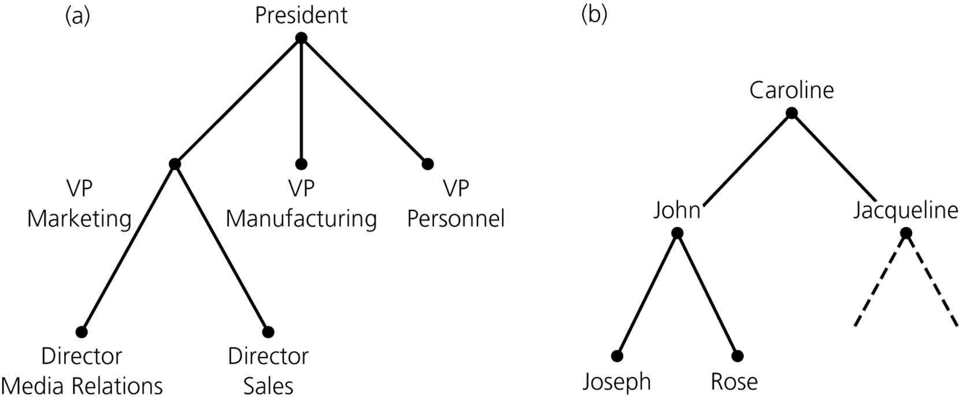
Tree Examples
An organization chart
A family tree

Slide 15
Outline
Graph
Tree
Applications of Graphs
Minimum Spanning Tree
Prim’s algorithm, Kruskal’s algorithm
Shortest paths
Dijkstra’s algorithm

Slide 16
Spanning Trees
Condition
Undirected connected graph
Tree
A connected graph with no cycles
A tree with n vertices always has n-1 edges.
Spanning tree of graph G
A tree as a subgraph of G that contains all of G’s vertices

Slide 17
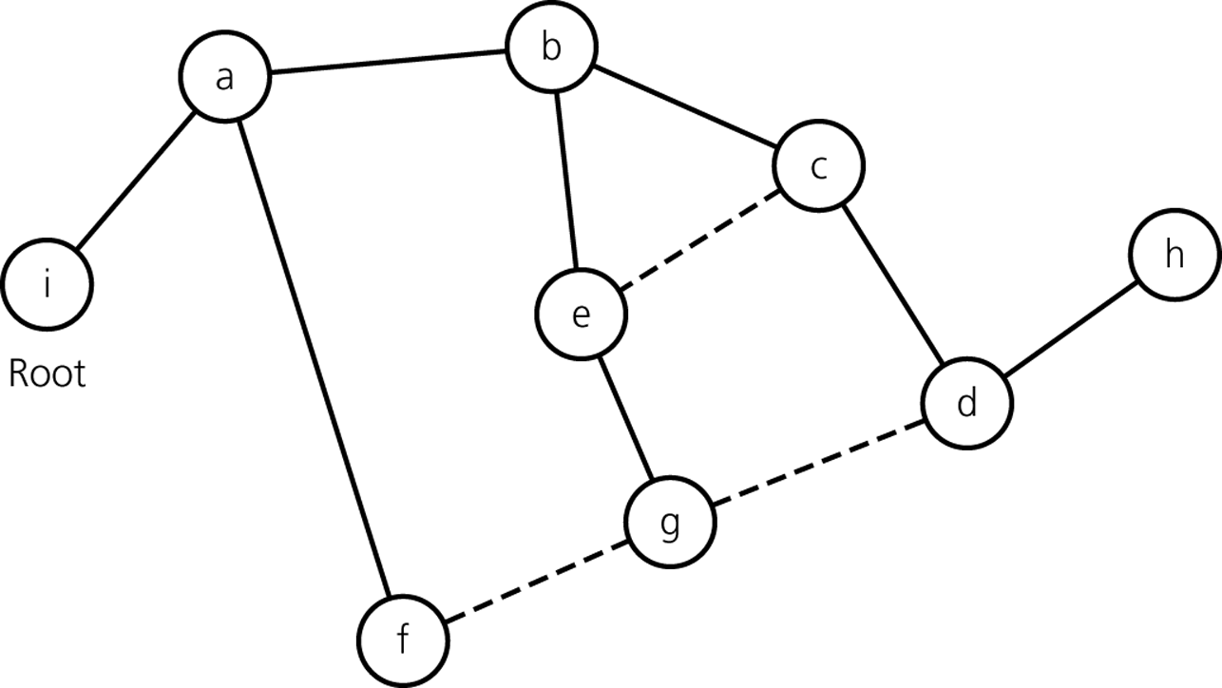
Spanning Trees

Slide 19
Minimum Spanning Trees
Condition
Weighted undirected graph
The cost of a spanning tree
The sum of the edge weights in the spanning tree
Minimum spanning tree
A spanning tree with the minimum cost

Slide 20
Outline
Graph
Tree
Applications of Graphs
Minimum Spanning Tree
Prim’s algorithm, Kruskal’s algorithm
Shortest paths
Dijkstra’s algorithm

Slide 21
Minimum Spanning Trees
Prim’s algorithm
Kruskal’s algorithm

Slide 22
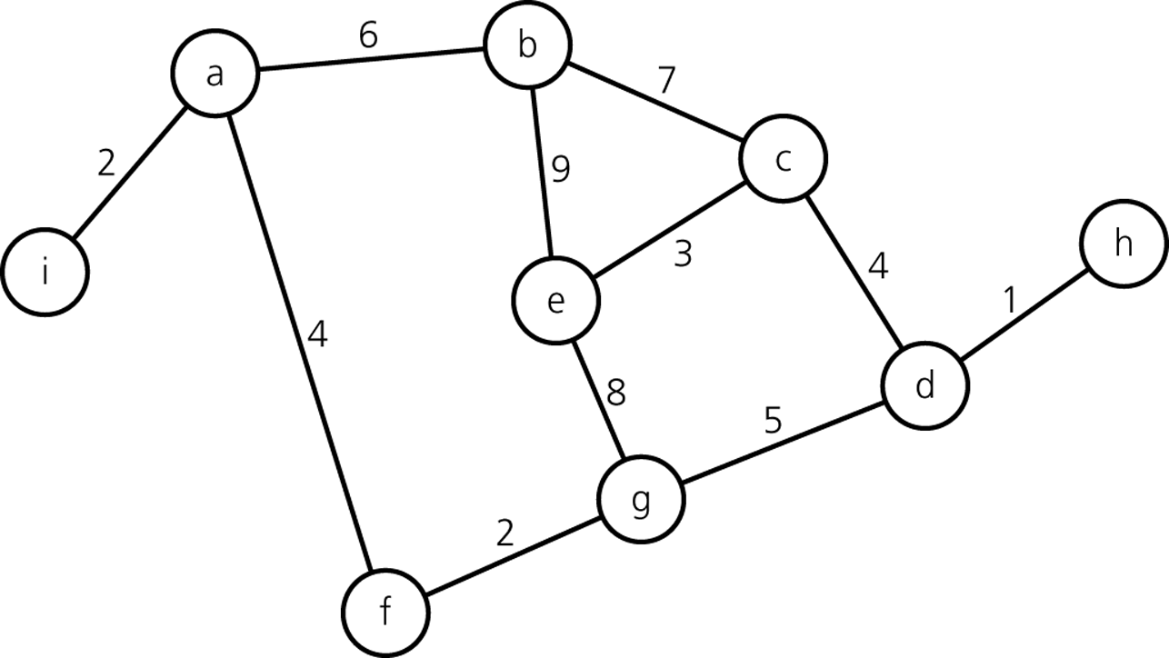
Prim’s algorithm
A weighted, connected, undirected graph

Slide 23
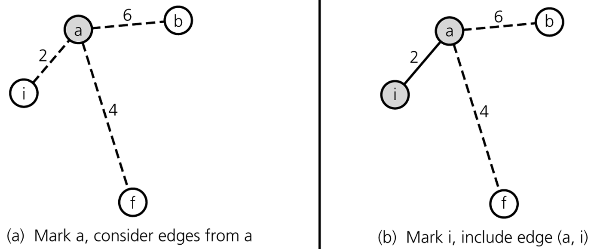
Prim’s algorithm

Slide 24
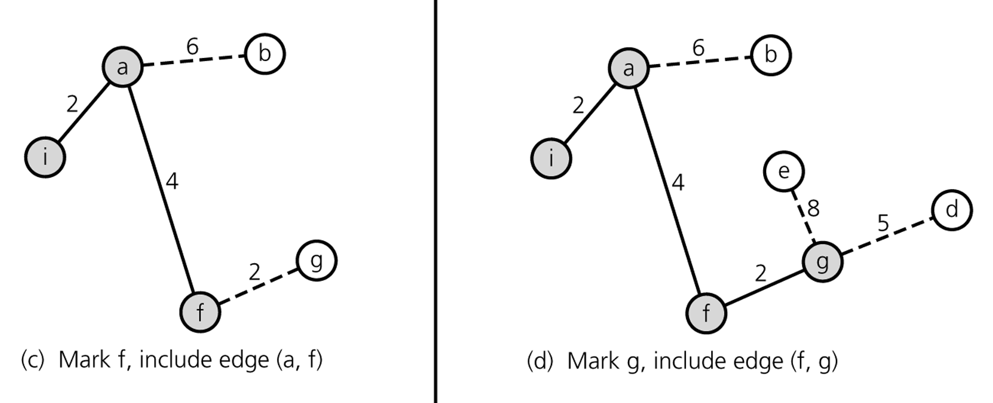
Prim’s algorithm

Slide 25
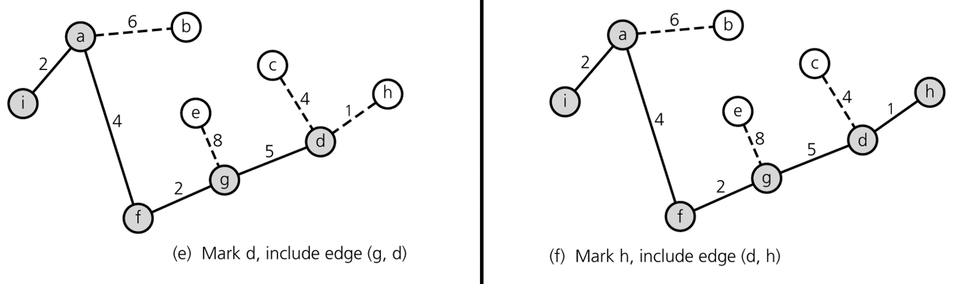
Prim’s algorithm

Slide 26
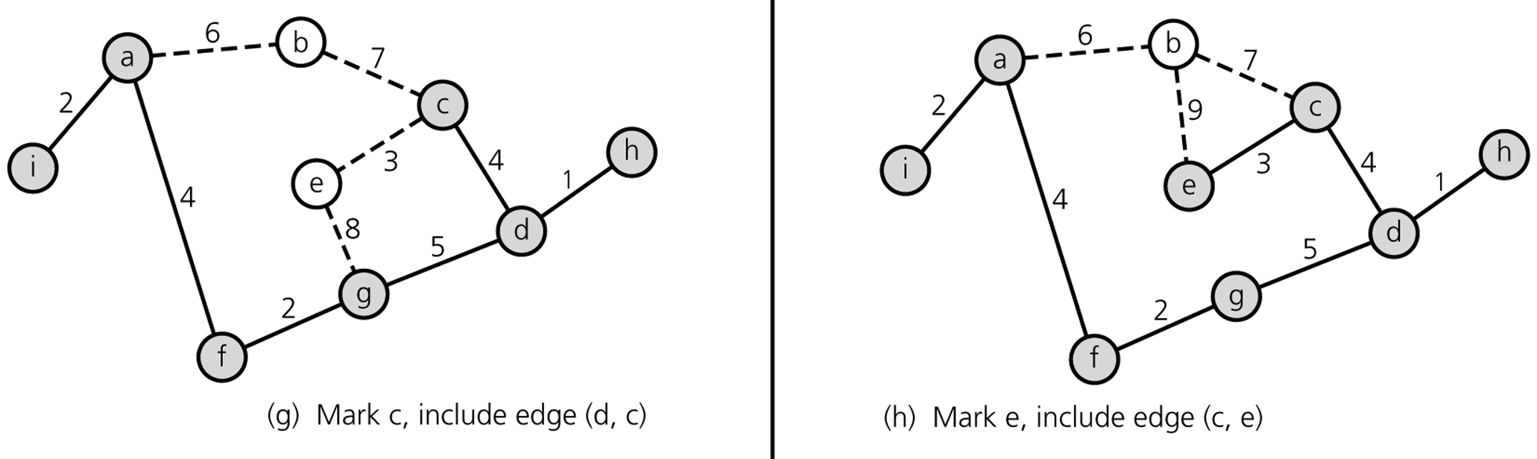
Prim’s algorithm

Slide 27
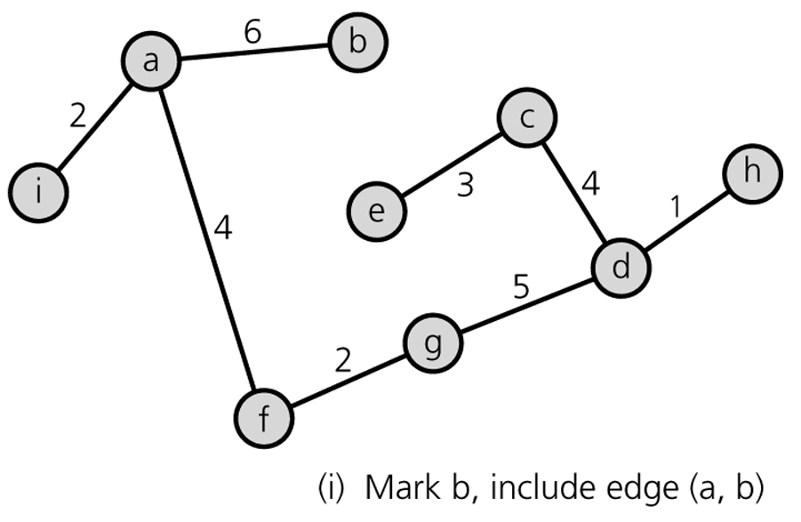
Prim’s algorithm

Slide 28
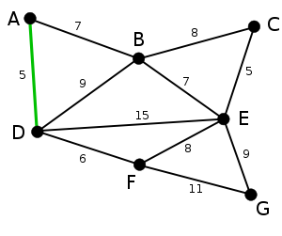
Kruskal’s algorithm

Slide 29
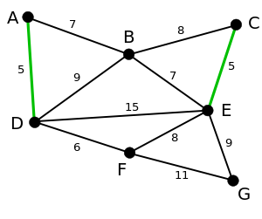
Kruskal’s algorithm

Slide 30
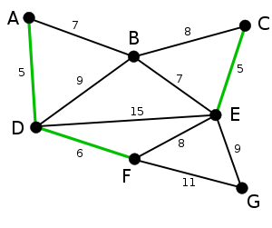
Kruskal’s algorithm

Slide 31
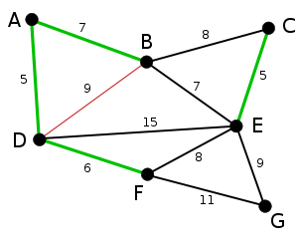
Kruskal’s algorithm

Slide 32
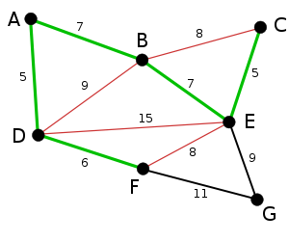
Kruskal’s algorithm

Slide 33
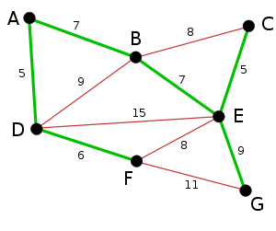
Kruskal’s algorithm

Slide 34
Outline
Graph
Tree
Applications of Graphs
Minimum Spanning Tree
Prim’s algorithm, Kruskal’s algorithm
Shortest paths
Dijkstra’s algorithm

Slide 35
Shortest Paths
Condition
Weighted digraph
Undirected graph can be also thought to be a digraph in which undirected edge (u,v) means two directed edges (u,v) and (v,u).
Shortest path between two vertices
A path that has the smallest sum of edge weights

Slide 36
Outline
Graph
Tree
Applications of Graphs
Minimum Spanning Tree
Prim’s algorithm, Kruskal’s algorithm
Shortest paths
Dijkstra’s algorithm

Slide 37
Dijkstra’s algorithm
8
∞
10
8
8
10
8
10
0
6
∞
2
0
6
∞
2
0
18
9
1
1
6
2
11
∞
∞
11
9
9
∞
1
∞
3
12
5
3
12
5
3
9
12
5
∞
8
∞
11
8
∞
11
∞
8
7
4
8
7
4
8
∞
∞
8
∞
7
4
8
8
8
0
6
10
0
10
2
0
6
10
2
9
1
∞
9
12
5
12
9
12
5
12
3
12
5
11
19
11
∞
11
8
∞
8
8
7
8
7
4
8
∞
7
4
8
∞
4
19

Slide 38
Dijkstra’s algorithm
8
8
0
6
10
0
10
9
12
5
12
9
12
11
8
19
11
19
8
19
7
4
16
8
8
10
8
0
10
2
10
9
1
0
11
3
9
12
5
12
19
8
8
10
9
12
5
12
11
11
19
16
7
4
0
10
2
11
9
9
1
12
16
3
12
5
11
19
16
7
4

