Slide 1
COSC 1437.01
PROGRAMMING FUNDAMENTALS II
LECTURE 11. TREES

Slide 2
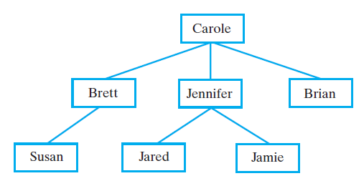
Hierarchical Organizations
Example: Family Trees
FIGURE 23-1 Carole’s children and grandchildren

Slide 3
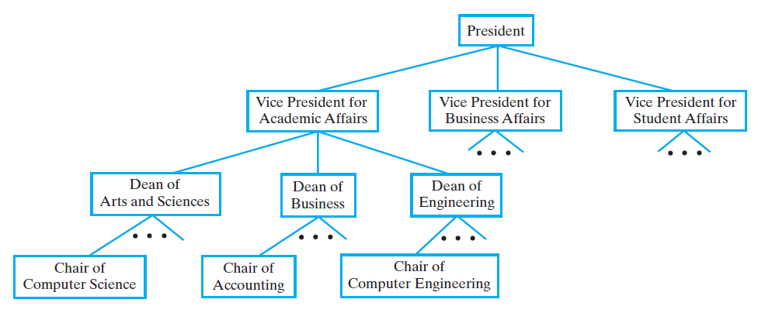
Hierarchical Organizations
FIGURE 23-3 A portion of a university’s
administrative structure

Slide 4
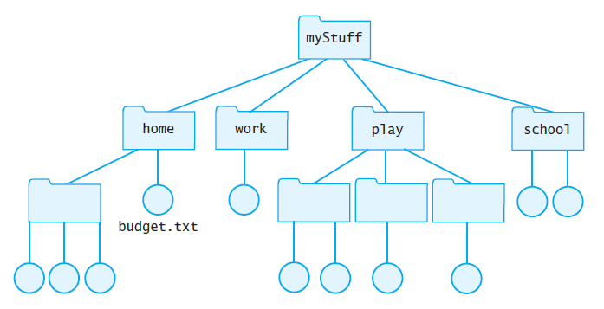
Hierarchical Organizations
FIGURE 23-4 Computer files organized into folders

Slide 5
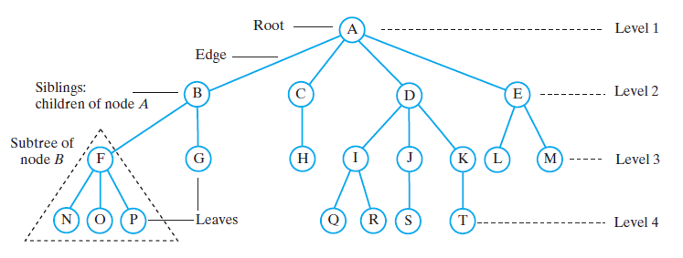
Tree Terminology
FIGURE 23-5 A tree equivalent to the tree in Figure 23-4

Slide 6
Tree Terminology
Contrast plants with root at bottom
  ADT tree with root at top
  Root is only node with no parent
A tree can be empty
Any node and its descendants form a subtree of the original tree
The height of a tree is the number of levels in the tree

Slide 7
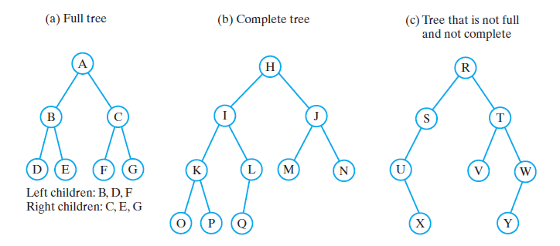
Binary Trees
FIGURE 23-6 Three binary trees

Slide 8
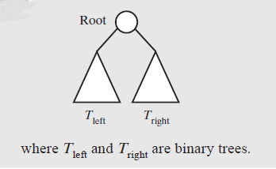
Binary Trees
A binary tree is empty or has the above form
a binary tree is a tree data structure in which each node has at most two children,

Slide 9
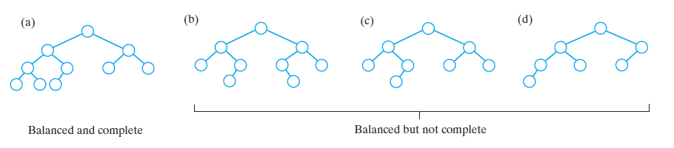
Binary Trees
FIGURE 23-7 Some binary trees that are height balanced

Slide 10
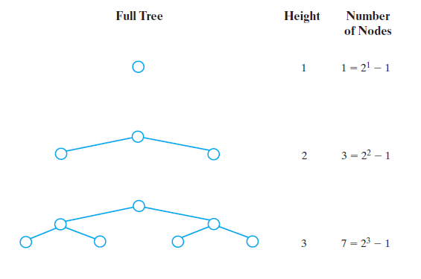
Binary Trees
FIGURE 23-8 The number of nodes in a full binary
tree as a function of the tree’s height

Slide 11
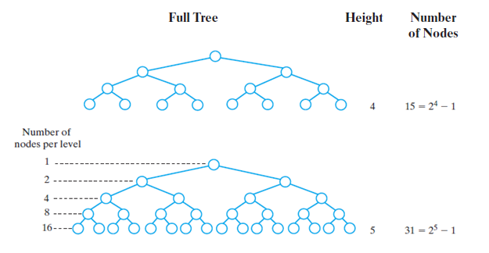
Binary Trees
FIGURE 23-8 The number of nodes in a full binary
tree as a function of the tree’s height

Slide 12
Types of binary trees
Tree terminology is not well-standardized and so varies in the literature.
A rooted binary tree has a root node and every node has at most two children.
A full binary tree is a tree in which every node in the tree has either 0 or 2 children
A perfect binary tree is a binary tree in which all interior nodes have two children and all leaves have the same depth or same level.

Slide 13
Types of binary trees
In a complete binary tree every level, except possibly the last, is completely filled, and all nodes in the last level are as far left as possible. It can have between 1 and 2^{h} nodes at the last level h.
An alternative definition is a perfect tree whose rightmost leaves (perhaps all) have been removed.
A bal­anced tree is a tree in which dif­fer­ence between heights of sub-trees of any node in the tree is not greater than one.

Slide 14
Traversals of A Tree
Definition: visit, or process, each data item exactly once
Order in which we visit items is not unique
Traversals of a binary tree are somewhat easier to understand
  We consider these first

Slide 15
Traversals of a Binary Tree
We use recursion
To visit all the nodes in a binary tree, we must
  Visit the root
  Visit all the nodes in the root’s left subtree
  Visit all the nodes in the root’s right subtree

Slide 16
Traversals of a Binary Tree
Preorder traversal
  Visit root before we visit root’s subtrees
Inorder traversal
  Visit root of a binary tree between visiting nodes in root’s subtrees.
Postorder traversal
  Visit root of a binary tree after visiting nodes in root’s subtrees
Level-order traversal
  Begin at root and visit nodes one level at a time

Slide 17
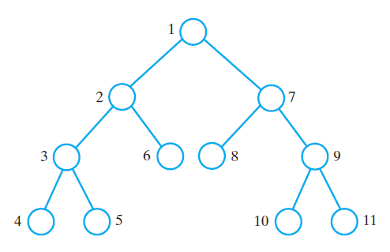
Traversals of a Binary Tree
FIGURE 23-9 The visitation order of a preorder traversal

Slide 18
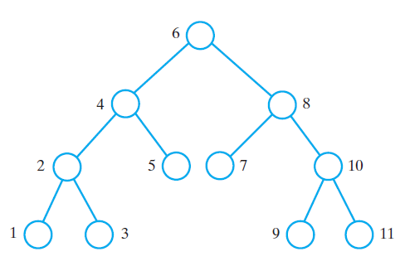
Traversals of a Binary Tree
FIGURE 23-10 The visitation order of an inorder traversal

Slide 19
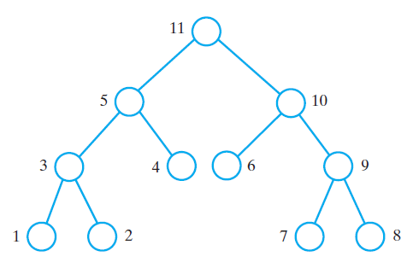
Traversals of a Binary Tree
FIGURE 23-11 The visitation order of a postorder traversal

Slide 20
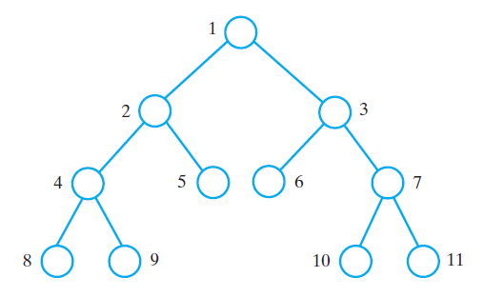
Traversals of a Binary Tree
FIGURE 23-12 The visitation order of a level-order traversal

Slide 21
Traversals of a General Tree
Types of traversals for general tree
  Level order
  Preorder
  Postorder
Not suited for general tree traversal
  Inorder

Slide 22
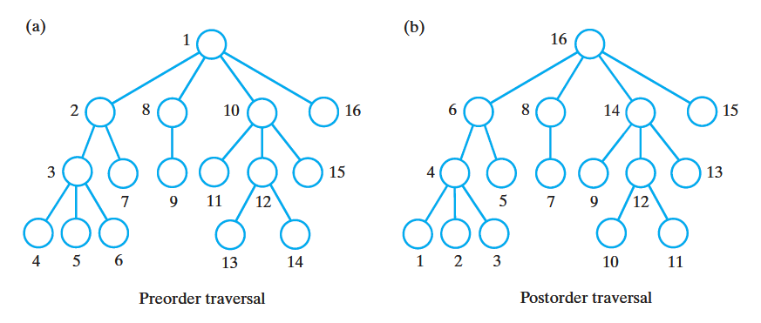
Traversals of a General Tree
FIGURE 23-13 The visitation order of two traversals of a general tree: (a) preorder; (b) postorder

Slide 23
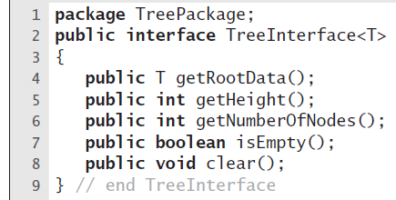
Interfaces for All Trees
LISTING 23-1 An interface of methods
common to all trees

Slide 24
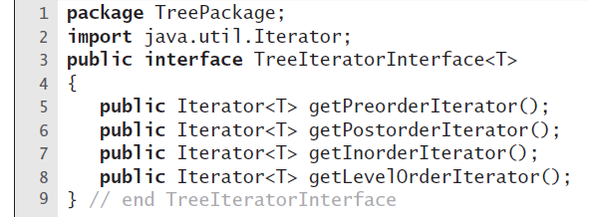
Traversals
LISTING 23-2 An interface of traversal
methods for a tree

Slide 25
Iterator
Allows a user to step through each item in a data structure
  array, vector, linked list, tree, etc.
Two basic components
  hasNext()
    returns true if the iterator has any more items
  next()
    returns the next item in the iterator

Slide 26
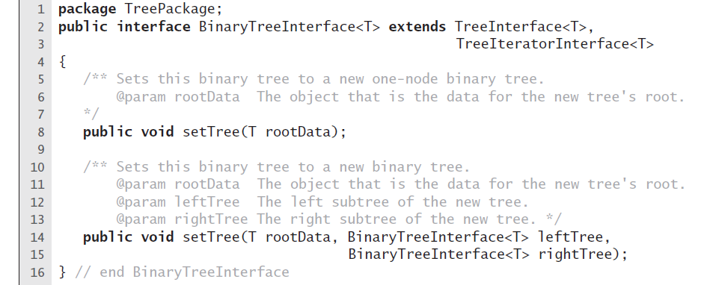
Interface for Binary Trees
LISTING 23-3 An interface for a binary tree

Slide 27
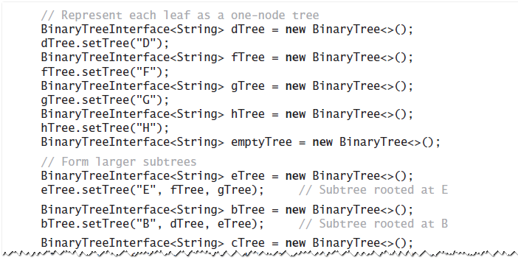
Example
Java statements that build a tree and then
display some of its characteristics:

Slide 28
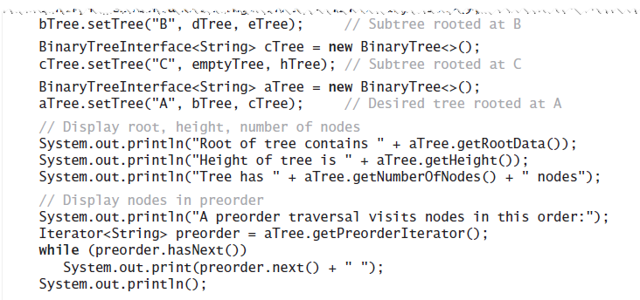
Example
Java statements that build a tree and then
display some of its characteristics:

Slide 29
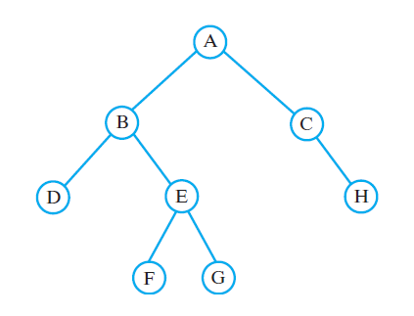
Example
FIGURE 23-14 A binary tree whose nodes
contain one-letter strings

Slide 30
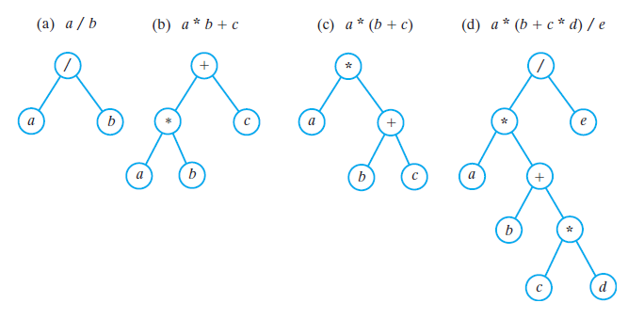
Expression Trees
FIGURE 23-15 Expression trees for four algebraic expressions

Slide 31
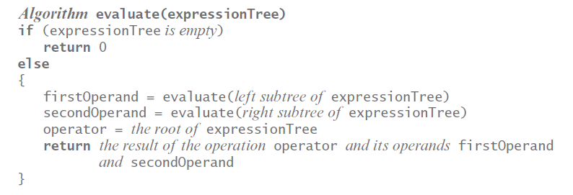
Expression Trees
Algorithm for postorder traversal of an expression tree.

Slide 32
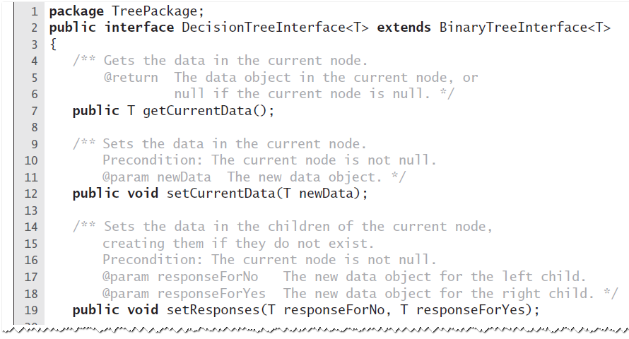
Expert System
Uses A Decision Tree
LISTING 23-4 An interface for a binary decision tree

Slide 33
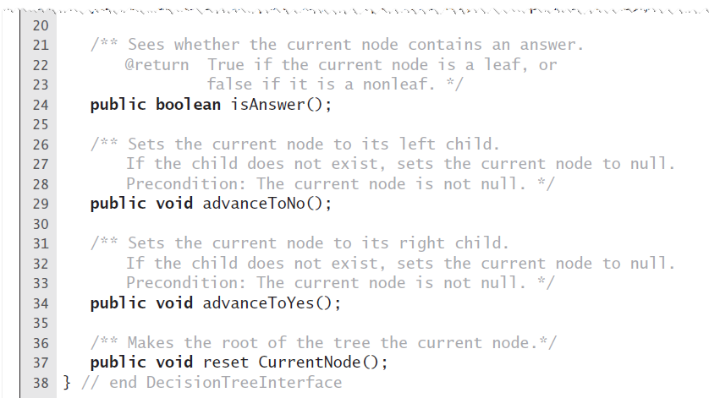
Expert System
Uses A Decision Tree
LISTING 23-4 An interface for a binary decision tree

Slide 34
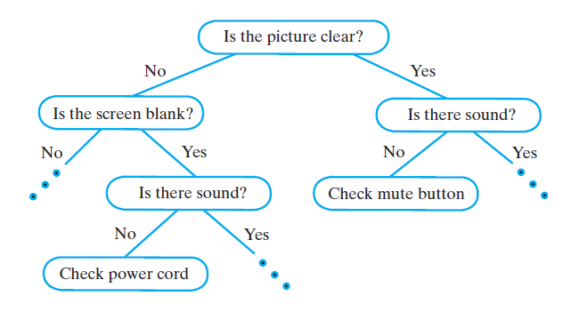
Expert System
Uses A Decision Tree
FIGURE 23-16 A portion of a binary decision tree

Slide 35
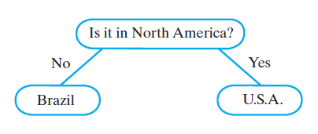
Expert System
Uses A Decision Tree
FIGURE 23-17 An initial decision tree for a guessing game

Slide 36
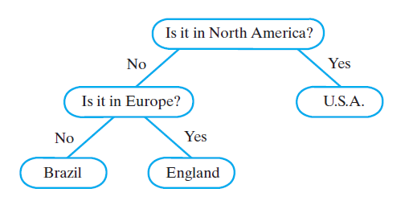
Expert System
Uses A Decision Tree
FIGURE 23-18 The decision tree for a guessing
game after acquiring another fact

Slide 37
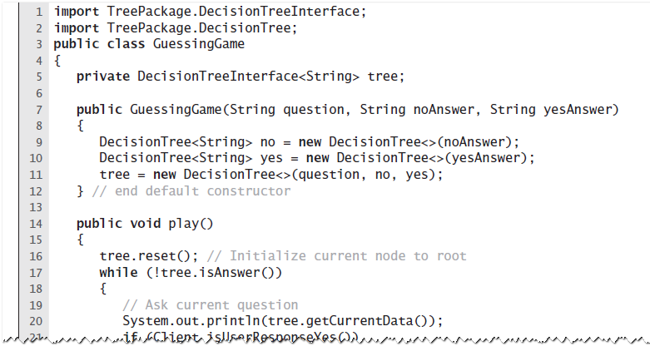
Expert System
Uses A Decision Tree
LISTING 23-5 The class GuessingGame

Slide 38
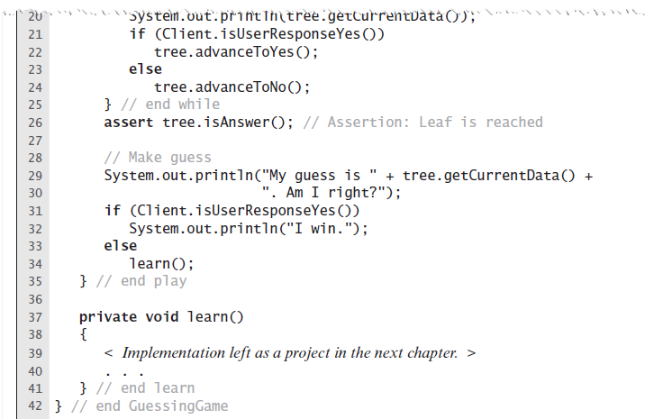
Expert System
Uses A Decision Tree
LISTING 23-5 The class GuessingGame

Slide 39
Binary Search Tree
For each node in a binary search tree
  Node’s data is greater than all data in node’s left subtree
  Node’s data is less than all data in node’s right subtree
Every node in a binary search tree is the root of a binary search tree

Slide 40
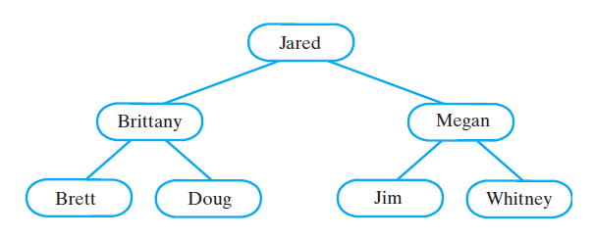
Binary Search Tree
FIGURE 23-19 A binary search tree of names

Slide 41
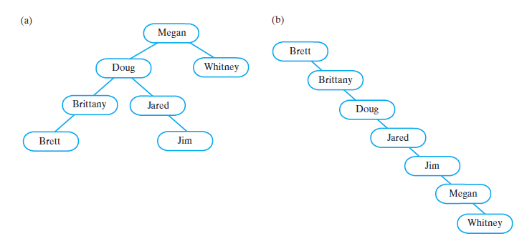
Binary Search Tree
FIGURE 23-20 Two binary search trees containing the same data as the tree in Figure 23-19

Slide 42
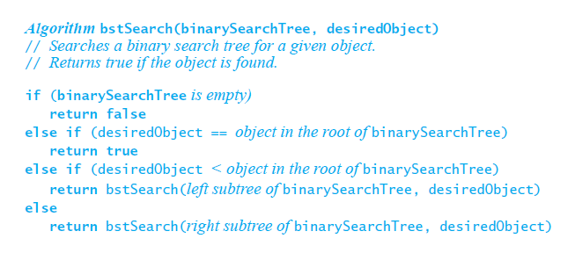
Binary Search Tree
Pseudocode for recursive search algorithm

Slide 43
Binary Search Tree
Efficiency of a search
  Searching a binary search tree of height h is O(h)
To make searching a binary search tree as efficient as possible …
  Tree must be as short as possible.

Slide 44
Heaps
Definition: Complete binary tree whose nodes contain Comparable objects and are organized as follows.
  Each node contains an object no smaller/larger than objects in its descendants
  Maxheap: object in node greater than or equal to its descendant objects
  Minheap: object in node less than or equal to its descendant objects

Slide 45
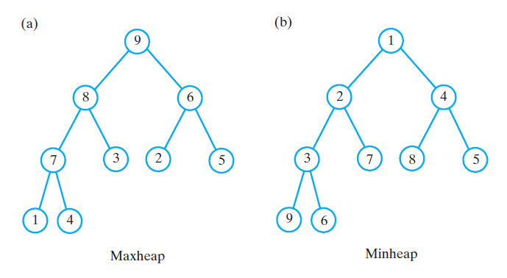
Heaps
FIGURE 23-21 (a) A maxheap and
(b) a minheap that contain the same values

Slide 46
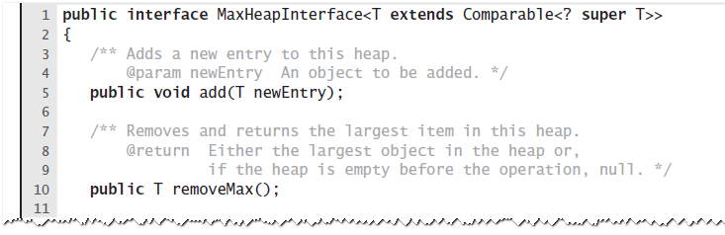
Heaps
LISTING 23-6 An interface for a maxheap

Slide 47
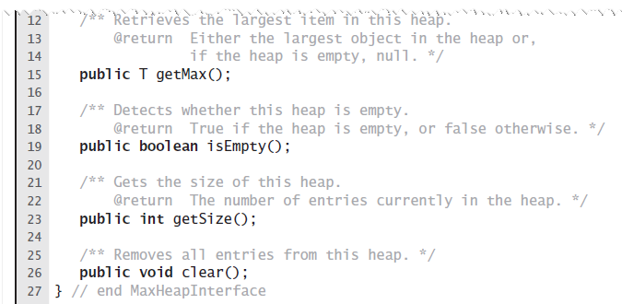
Heaps
LISTING 23-6 An interface for a maxheap

Slide 48
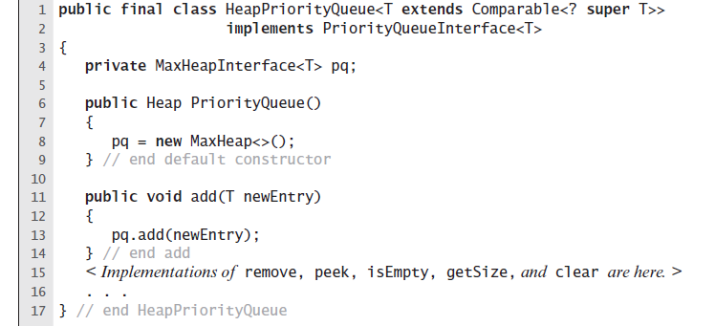
Heaps
LISTING 23-7 The beginning of the class PriorityQueue

Slide 49
Examples of General Trees
Parse tree
  Check syntax of a string for valid algebraic expression
  If valid can be expressed as a parse tree
Parse tree must be a general tree
  So it can accommodate any expression
Compilers use parse trees
  Check syntax, produce code

Slide 50
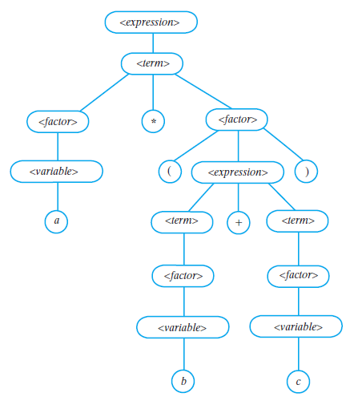
Examples of General Trees
FIGURE 23-22 A parse tree for the algebraic expression
a * (b + c)

Slide 51
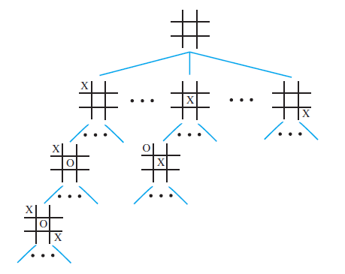
Examples of General Trees
FIGURE 23-23 A portion of a game tree for tic-tac-toe

Slide 52
Tree Implementations

Slide 53
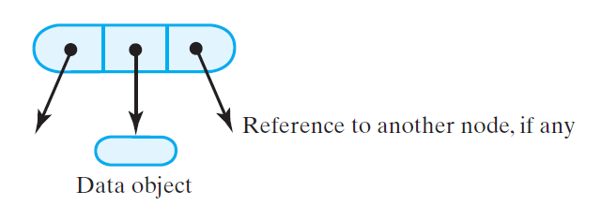
Nodes in a Binary Tree
FIGURE 24-1 A node in a binary tree

Slide 54
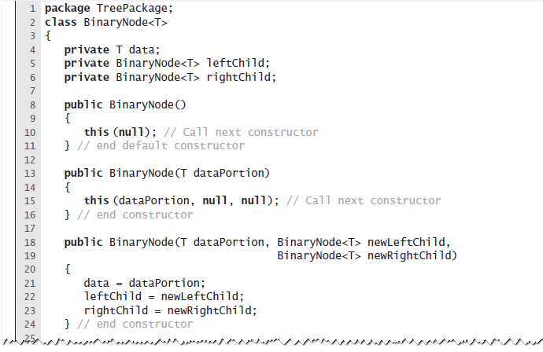
Nodes in a Binary Tree
LISTING 24-1 The class BinaryNode

Slide 55
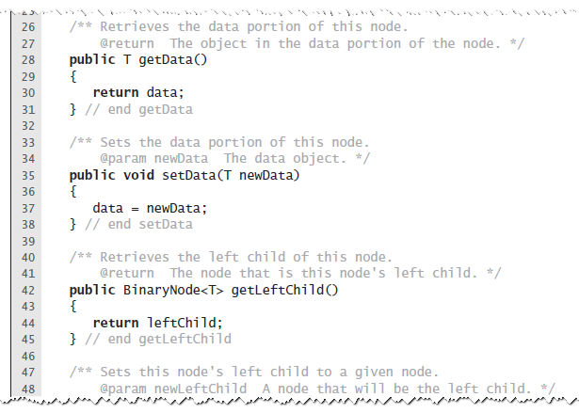
Nodes in a Binary Tree
LISTING 24-1 The class BinaryNode

Slide 56
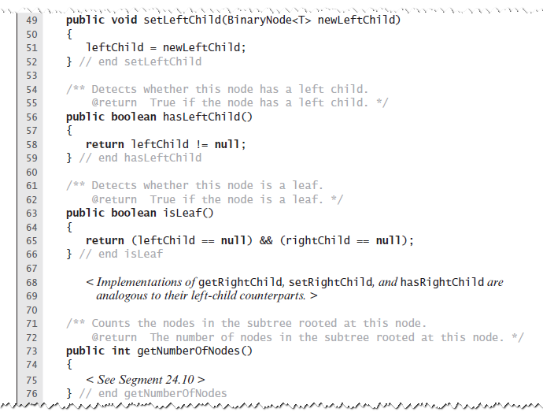
Nodes in a Binary Tree
LISTING 24-1 The class BinaryNode

Slide 57
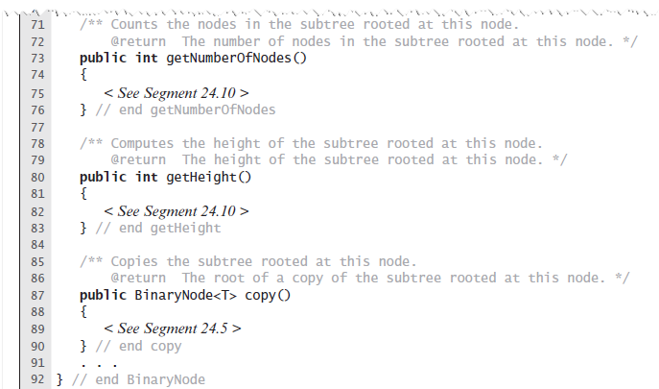
Nodes in a Binary Tree
LISTING 24-1 The class BinaryNode

Slide 58
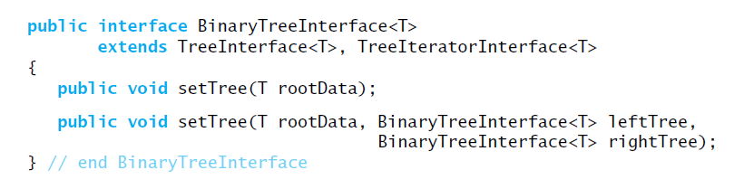
Creating a Basic Binary Tree
Interface for a class of binary trees

Slide 59
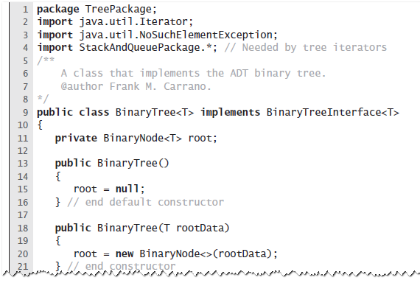
Creating a Basic Binary Tree
LISTING 24-2 A first draft of the class BinaryTree

Slide 60
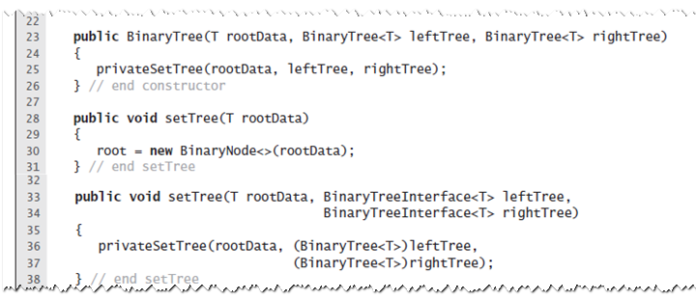
Creating a Basic Binary Tree
LISTING 24-2 A first draft of the class BinaryTree

Slide 61
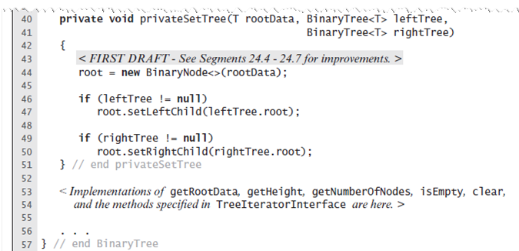
Creating a Basic Binary Tree
LISTING 24-2 A first draft of the class BinaryTree

Slide 62
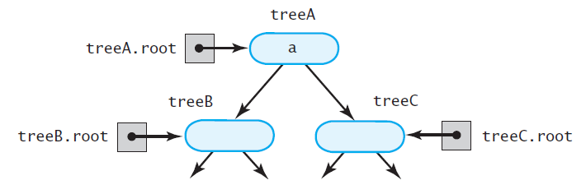
The Method privateSetTree
FIGURE 24-2 The binary tree treeA
shares nodes with treeB and treeC

Slide 63
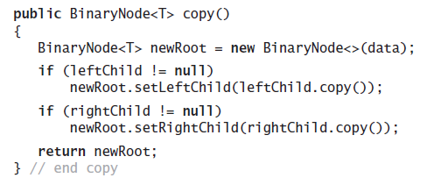
The Method privateSetTree
Definition of the method copy in the class BinaryNode

Slide 64
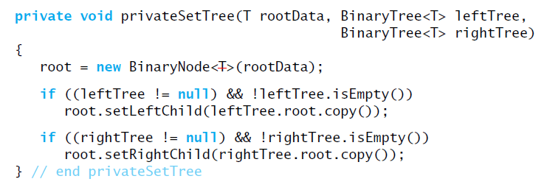
The Method privateSetTree
Method privateSetTree can invoke copy to copy
the nodes from the two given subtrees

Slide 65

The Method privateSetTree
Another approach, more problems
FIGURE 24-3 treeA has identical subtrees

Slide 66
The Method privateSetTree
The second solution:
If left subtree exists and not empty, attach root node to r as left child.
Create root node r containing given data.
If right subtree exists, not empty, and distinct from left subtree, attach root node to r as a right child. But if right and left subtrees are same, attach copy of right subtree to r instead.

Slide 67
The Method privateSetTree
If the left subtree exists and differs from the tree object used to call privateSetTree, set the subtree’s data field root to null.
If right subtree exists and differs from the tree object used to call privateSetTree, set subtree’s data field root to null.

Slide 68

The Method privateSetTree
An implementation of privateSetTree

Slide 69

Accessor and Mutator Methods

Slide 70

Accessor and Mutator Methods

Slide 71

Computing the Height and Counting Nodes

Slide 72

Methods within BinaryNode.

Slide 73

Methods within BinaryNode.

Slide 74

Traversals
Traversing a binary tree recursively

Slide 75

Traversals
FIGURE 24-4 A binary tree

Slide 76

Traversals That Use An Iterator
Method getInorderIterator can be implemented within BinaryTree

Slide 77


Traversals That Use An Iterator
FIGURE 24-5 Using a stack to perform an
inorder traversal of a binary tree

Slide 78

Traversals That Use An Iterator
Iterative version …

Slide 79

Private Class InorderIterator
LISTING 24-3 The private inner class InorderIterator

Slide 80

Private Class InorderIterator
LISTING 24-3 The private inner class InorderIterator

Slide 81


Postorder, and
Level-order Traversals
FIGURE 24-6 Using a stack to traverse a
binary tree in (a) preorder

Slide 82

Postorder, and
Level-order Traversals
FIGURE 24-6 Using a stack to traverse a
binary tree in (b) postorder

Slide 83

Postorder, and
Level-order Traversals
FIGURE 24-7 Using a queue to traverse a binary tree in level order

Slide 84

Implementation of an Expression Tree
LISTING 24-4 An interface for an expression tree

Slide 85

Implementation of an Expression Tree
LISTING 24-5 The class ExpressionTree

Slide 86

Implementation of an Expression Tree
LISTING 24-5 The class ExpressionTree

Slide 87

Implementation of an Expression Tree
LISTING 24-5 The class ExpressionTree

Slide 88

A Node for a General Tree
FIGURE 24-8 A node for a general tree

Slide 89

A Node for a General Tree
LISTING 24-6 An interface for a node in a general tree

Slide 90


Using a Binary Tree to
Represent a General Tree
FIGURE 24-9 (a) A general tree; (b) an equivalent binary tree; (c) a more conventional view of the same binary tree

Slide 91
End

