Slide 1
CHAPTER 4:
Evaluating interface Designs
Designing the User Interface:
Strategies for Effective Human-Computer Interaction
Fifth Edition
Ben Shneiderman & Catherine Plaisant
in collaboration with
Maxine S. Cohen and Steven M. Jacobs

Slide 2
Introduction
Designers can become so entranced with their creations that they may fail to evaluate them adequately.
Experienced designers have attained the wisdom and humility to know that extensive testing is a necessity.
The determinants of the evaluation plan include:
  stage of design (early, middle, late)
  novelty of project (well defined vs. exploratory)
  number of expected users
  criticality of the interface (life-critical medical system vs. museum exhibit support)
  costs of product and finances allocated for testing
  time available
  experience of the design and evaluation team
4-<number>

Slide 3
Introduction (cont.)
Usability evaluators must broaden their methods and be open to non-empirical methods, such as user sketches, consideration of design alternatives, and ethnographic studies.
Recommendations needs to be based on observational findings
The design team needs to be involved with research on the current system design drawbacks
Tools and techniques are evolving
The range of evaluation plans might be anywhere from an ambitious two-year test with multiple phases for a new national air-traffic–control system to a three-day test with six users for a small internal web site
The range of costs might be from 20% of a project down to 5%.
Usability testing has become an established and accepted part of the design process
4-<number>

Slide 4
Expert Reviews
While informal demos to colleagues or customers can provide some useful feedback, more formal expert reviews have proven to be effective
Expert reviews entail one-half day to one week effort, although a lengthy training period may sometimes be required to explain the task domain or operational procedures
There are a variety of expert review methods to chose from:
  Heuristic evaluation
  Guidelines review
  Consistency inspection
  Cognitive walkthrough
  Metaphors of human thinking
  Formal usability inspection
4-<number>

Slide 5
Expert Reviews (cont.)
Expert reviews can be scheduled at several points in the development process when experts are available and when the design team is ready for feedback.
Different experts tend to find different problems in an interface, so 3-5 expert reviewers can be highly productive, as can complementary usability testing.
The dangers with expert reviews are that the experts may not have an adequate understanding of the task domain or user communities.
Even experienced expert reviewers have great difficulty knowing how typical users, especially first-time users will really behave.
4-<number>

Slide 6
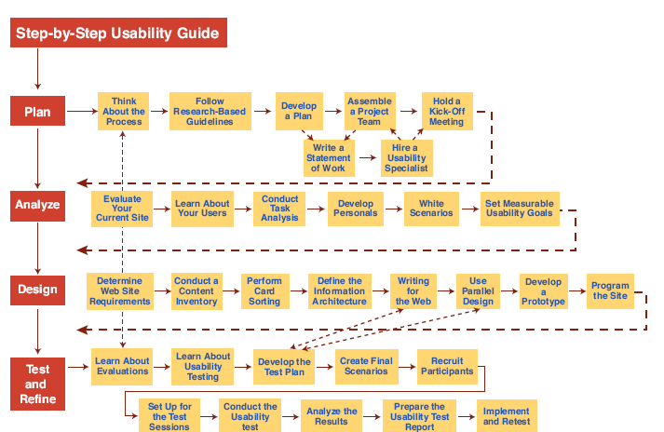
Step-by-Step Usability Guide from http://usability.gov/
4-<number>

Slide 7
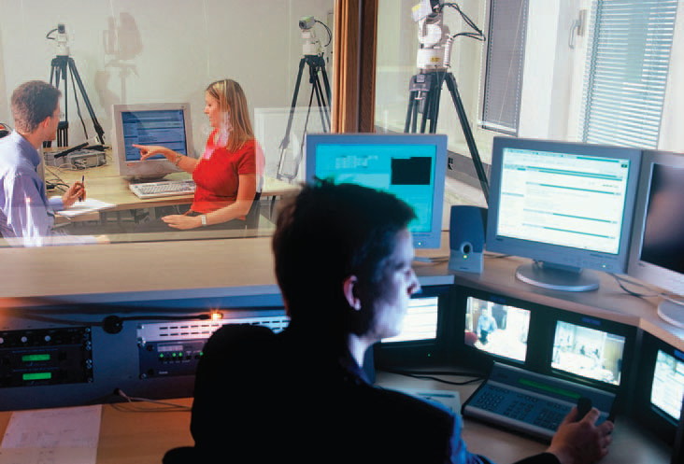
Usability Testing and Laboratories
4-<number>

Slide 8
Usability Testing and
Laboratories (cont.)
The emergence of usability testing and laboratories since the early 1980s
Usability testing not only sped up many projects but that it produced dramatic cost savings.
The movement towards usability testing stimulated the construction of usability laboratories.
A typical modest usability lab would have two 10 by 10 foot areas, one for the participants to do their work and another, separated by a half-silvered mirror, for the testers and observers
Participants should be chosen to represent the intended user communities, with attention to
  background in computing, experience with the task, motivation, education, and ability with the natural language used in the interface.
4-<number>

Slide 9
Usability Testing and
Laboratories (cont.)
Participation should always be voluntary, and informed consent should be obtained.
Professional practice is to ask all subjects to read and sign a statement like this one:
  I have freely volunteered to participate in this experiment.
  I have been informed in advance what my task(s) will be and what procedures will be followed.
  I have been given the opportunity to ask questions, and have had my questions answered to my satisfaction.
  I am aware that I have the right to withdraw consent and to discontinue participation at any time, without prejudice to my future treatment.
  My signature below may be taken as affirmation of all the above statements; it was given prior to my participation in this study.
Institutional Review Boards (IRB) often governs human subject test process
4-<number>

Slide 10
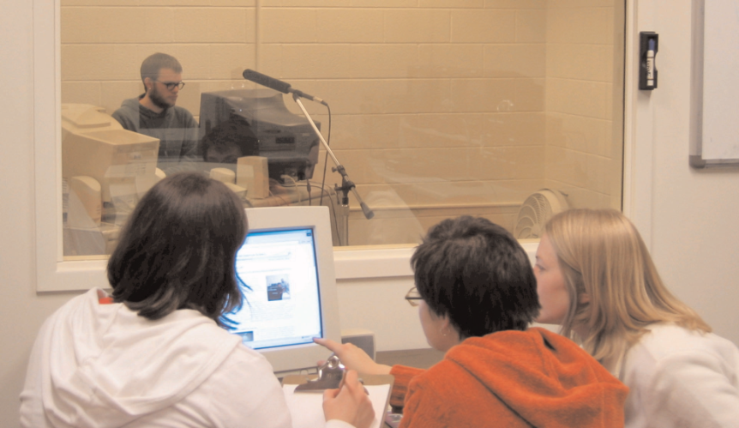
Usability Testing and
Laboratories (cont.)
Videotaping participants performing tasks is often valuable for later review and for showing designers or managers the problems that users encounter.
  Use caution in order to not interfere with participants
  Invite users to think aloud (sometimes referred to as concurrent think aloud) about what they are doing as they are performing the task.
Many variant forms of usability testing have been tried:
  Paper mockups
  Discount usability testing
  Competitive usability testing
  Universal usability testing
  Field test and portable labs
  Remote usability testing
  Can-you-break-this tests
4-<number>

Slide 11
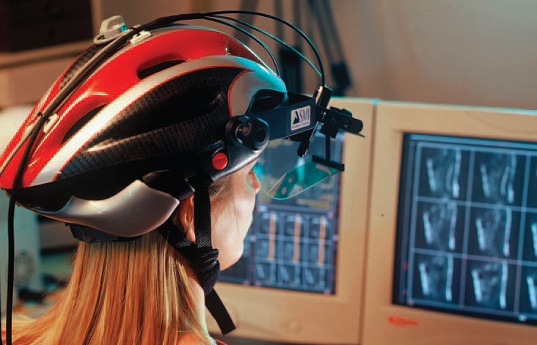
Usability Testing and
Laboratories (cont.)
In this eye-tracking setup, the participant wears a helmet that monitors and records where on the screen the participant is looking
4-<number>

Slide 12
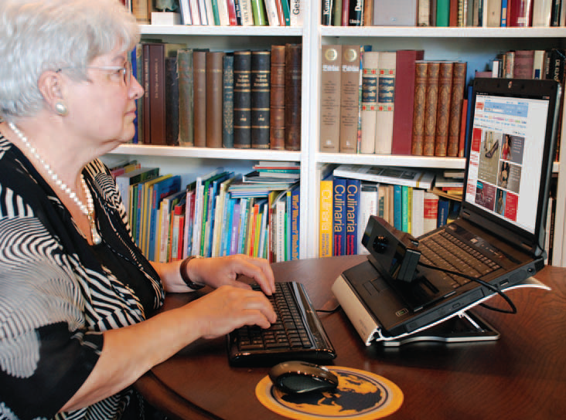
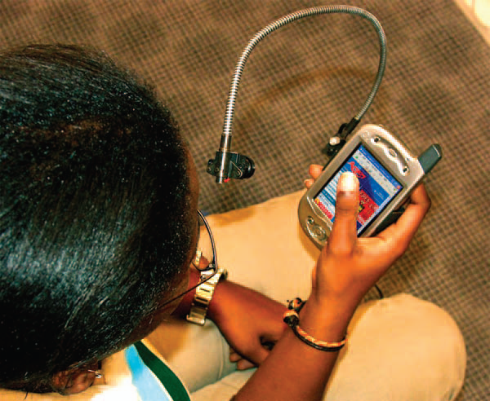
Usability Testing and
Laboratories (cont.)
More portable eye-tracking devices
4-<number>

Slide 13
Survey Instruments
Written user surveys are a familiar, inexpensive and generally acceptable companion for usability tests and expert reviews.
Keys to successful surveys
  Clear goals in advance
  Development of focused items that help attain the goals.
Survey goals can be tied to the components of the Objects and Action Interface model of interface design.
Users could be asked for their subjective impressions about specific aspects of the interface such as the representation of:
  task domain objects and actions
  syntax of inputs and design of displays.
4-<number>

Slide 14
Survey Instruments (cont.)
Other goals would be to ascertain
  users background (age, gender, origins, education, income)
  experience with computers (specific applications or software packages, length of time, depth of knowledge)
  job responsibilities (decision-making influence, managerial roles, motivation)
  personality style (introvert vs. extrovert, risk taking vs. risk aversive, early vs. late adopter, systematic vs. opportunistic)
  reasons for not using an interface (inadequate services, too complex, too slow)
  familiarity with features (printing, macros, shortcuts, tutorials)
  their feeling state after using an interface (confused vs. clear, frustrated vs. in-control, bored vs. excited).
4-<number>

Slide 15
Surveys (cont.)
Online surveys avoid the cost of printing and the extra effort needed for distribution and collection of paper forms.
Many people prefer to answer a brief survey displayed on a screen, instead of filling in and returning a printed form,
  although there is a potential bias in the sample.
A survey example is the Questionnaire for User Interaction Satisfaction (QUIS).
  http://lap.umd.edu/quis/
4-<number>

Slide 16
Acceptance Test
For large implementation projects, the customer or manager usually sets objective and measurable goals for hardware and software performance.
If the completed product fails to meet these acceptance criteria, the system must be reworked until success is demonstrated.
Rather than the vague and misleading criterion of "user friendly," measurable criteria for the user interface can be established for the following:
  Time to learn specific functions
  Speed of task performance
  Rate of errors by users
  Human retention of commands over time
  Subjective user satisfaction
4-<number>

Slide 17
Acceptance Test (cont.)
In a large system, there may be eight or 10 such tests to carry out on different components of the interface and with different user communities.
Once acceptance testing has been successful, there may be a period of field testing before national or international distribution..
4-<number>

Slide 18
Evaluation During Active Use
Successful active use requires constant attention from dedicated managers, user-services personnel, and maintenance staff.
Perfection is not attainable, but percentage improvements are possible.
Interviews and focus group discussions
  Interviews with individual users can be productive because the interviewer can pursue specific issues of concern.
  Group discussions are valuable to ascertain the universality of comments.
4-<number>

Slide 19
Evaluation During Active Use (cont.)
Continuous user-performance data logging
  The software architecture should make it easy for system managers to collect data about
      The patterns of system usage
      Speed of user performance
      Rate of errors
      Frequency of request for online assistance
  A major benefit is guidance to system maintainers in optimizing performance and reducing costs for all participants.
Online or telephone consultants, e-mail, and online suggestion boxes
  Many users feel reassured if they know there is a human assistance available
  On some network systems, the consultants can monitor the user's computer and see the same displays that the user sees
4-<number>

Slide 20
Evaluation During Active Use (cont.)
Online suggestion box or e-mail trouble reporting
  Electronic mail to the maintainers or designers.
  For some users, writing a letter may be seen as requiring too much effort.
Discussion groups, wiki’s and newsgroups
  Permit postings of open messages and questions
  Some are independent, e.g. America Online and Yahoo!
  Topic list
  Sometimes moderators
  Social systems
  Comments and suggestions should be encouraged.
4-<number>

Slide 21
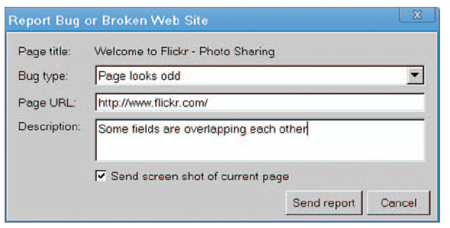
Evaluation During Active Use (cont.)
Bug report using Google’s Chrome browser (http://www.google.com/chrome/)
4-<number>

Slide 22
Controlled Psychologically-oriented Experiments
Scientific and engineering progress is often stimulated by improved techniques for precise measurement.
Rapid progress in the designs of interfaces will be stimulated as researchers and practitioners evolve suitable human-performance measures and techniques.
4-<number>

Slide 23
Controlled Psychologically-oriented Experiments (cont.)
The outline of the scientific method as applied to human-computer interaction might comprise these tasks:
  Deal with a practical problem and consider the theoretical framework
  State a lucid and testable hypothesis
  Identify a small number of independent variables that are to be manipulated
  Carefully choose the dependent variables that will be measured
  Judiciously select subjects and carefully or randomly assign subjects to groups
  Control for biasing factors (non-representative sample of subjects or selection of tasks, inconsistent testing procedures)
  Apply statistical methods to data analysis
  Resolve the practical problem, refine the theory, and give advice to future researchers
4-<number>

Slide 24
Controlled Psychologically-oriented Experiments (cont.)
Controlled experiments can help fine tuning the human-computer interface of actively used systems.
Performance could be compared with the control group.
Dependent measures could include performance times, user-subjective satisfaction, error rates, and user retention over time.
4-<number>

