Slide 1
Introduction to DBMS
Dr. Bing Zhou

Slide 2
Introduction
The history of Database Management System (DBMS)
Overview of DBMS
The relational model

Slide 3
Introduction to Database Systems
What is a Database System?
  Database (data , metadata)
  Hardware (disks)
  Software (DBMS)
  People (users, database designers and database administrators DBA)

Slide 4
What is a DBMS?
Database Management System (DBMS) = a software contains a set of instructions to access/manipulate data
Examples?
  Search engines, banking systems, airline reservations, corporate records, payrolls, sales inventories.
  New applications: Wikis, biological/multimedia/scientific/geographic data.

Slide 5
Features of a DBMS
Support massive amounts of data
  Giga/tera/petabytes
  Far too big for main memory
Persistent storage
  Programs update, query, manipulate data.
  Data continues to live long after program finishes.
Efficient and convenient access
  Efficient: do not search entire database to answer a query.
  Convenient: allow users to query the data as easily as possible (query compiler).
Secure data access
  Allow multiple users to access database simultaneously.
  Allow a user access to only to authorized data.
  Provide some guarantee of reliability against system failures.

Slide 6
A Brief History of DBMS
The earliest databases (1960s) evolved from file systems
  File systems
    Allow storage of large amounts of data over a long period of time
    File systems do not support:
      Efficient access of data items whose location in a particular file is not known
      Logical structure of data is limited to creation of directory structures
      Concurrent access: Multiple users modifying a single file generate non-uniform results
    Navigational and hierarchical
Relational DBMS (1970s to now)
  View database in terms of relations or tables
  High-level query and definition languages such as SQL
  Allow user to specify what (s)he wants, not how to get what (s)he wants
Object-oriented DBMS (1980s)
  Inspired by object-oriented languages

Slide 7
More detailed History
1950s and early 1960s:
  Data processing using magnetic tapes for storage
    Tapes provided only sequential access
  Punched cards for input
Late 1960s and 1970s:
  Hard disks allowed direct access to data
  Network and hierarchical data models in widespread use
  Ted Codd defines the relational data model
    he won the ACM Turing Award for this work
    IBM Research begins System R prototype
    UC Berkeley begins Ingres prototype

Slide 8
More detailed History
1980s:
  Research relational prototypes evolve into commercial systems
    SQL becomes industrial standard
  Parallel and distributed database systems (vs. centralized and client–server database systems)
    A parallel database system seeks to improve performance through parallelization of various operations, such as loading data, building indexes and evaluating queries by using multiple CPUs and disks in parallel.
    A distributed database is a database in which storage devices are not all attached to CPU. It may be stored in multiple computers located in the same physical location, or may be dispersed over a network of computers.

Slide 9
More detailed History
1990s:
  Large decision support and data-mining applications
  Large multi-terabyte data warehouses
  Emergence of Web commerce
2000s:
  XML and XQuery standard

Slide 10
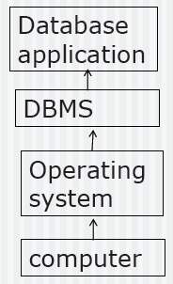
Overview of database systems
Database applications
Database Management System
Operating System (not in this course)

Slide 11
The DBMS Industry
A DBMS is a software system.
Major DBMS vendors: Oracle, Microsoft, IBM, Sybase
Free/Open-source DBMS: MySQL, PostgreSQL, Firebird.
All are “relational” DBMS.

Slide 12
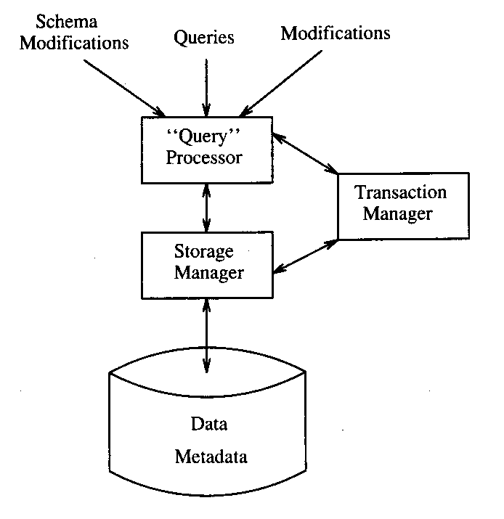
DBMS Architecture

Slide 13
DBMS (Components)
Query processor
  The portion of the DBMS that most affects the performance
  The query compiler: translate query into an internal form called query plan
  execution engine: execute each of the steps in the chosen query plan
Transaction manager
  Logging, concurrency control
Storage manager
  Control the placement of data on disk, and its movement between disk and main memory

Slide 14
The Relational Model

Slide 15
The Relational Model
Simple: Built around a single concept for modeling data: the relation or table.
  A relational database is a collection of relations.
  Each relation is a table with rows and columns.
Supports high-level programming language (SQL).
  Limited but very useful set of operations
  Enables programmers to express their wishes at a very high level
Has an elegant mathematical design theory.
Most current DBMS are relational.

Slide 16
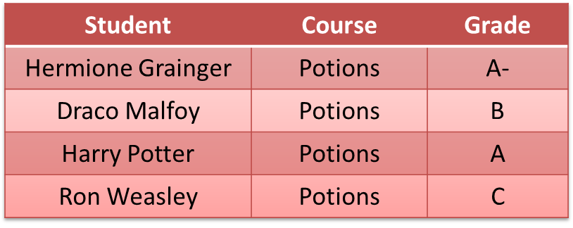
Relations
A relation is a two-dimensional table:
  Relation ≈ table.
  Attribute ≈ column name.
  Tuple ≈ row (not the header row).
Database ≈ collection of relations.
A relation has two parts:
  Schema defines column heads of the table (attributes).
  Instance contains the data rows (tuples, rows, or records) of the table.

Slide 17
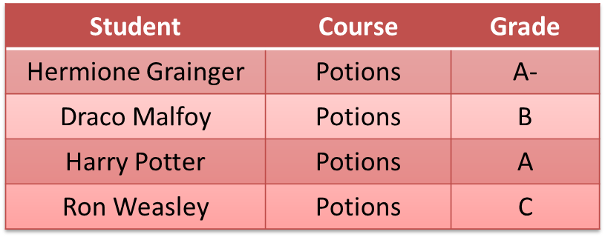
Schema
CoursesTaken :
The schema of a relation is the name of the relation followed by a parenthesized list of attributes.
CoursesTaken(Student, Course, Grade)
A design in a relational model consists of a set of schemas.
Such a set of schemas is called a relational database schema.

Slide 18
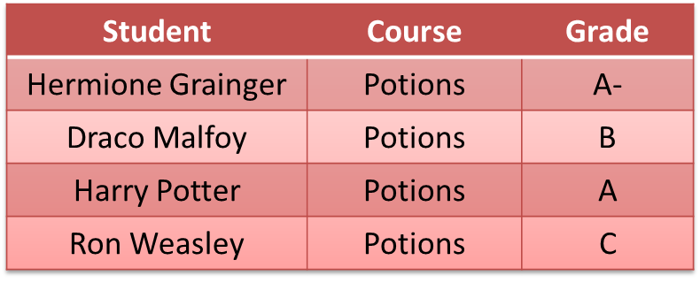
Equivalent Representations of a Relation
CoursesTaken :
CoursesTaken(Student, Course, Grade)
Relation is a set of tuples and not a list of tuples.
  Order in which we present the tuples does not matter.
The attributes in a schema are also a set (not a list).
  Schema is the same irrespective of order of attributes.
  CoursesTaken(Student, Grade, Course)
  We specify a “standard” order when we introduce a schema.
How many equivalent representations are there for a relation with m attributes and n tuples?
m! n!

Slide 19
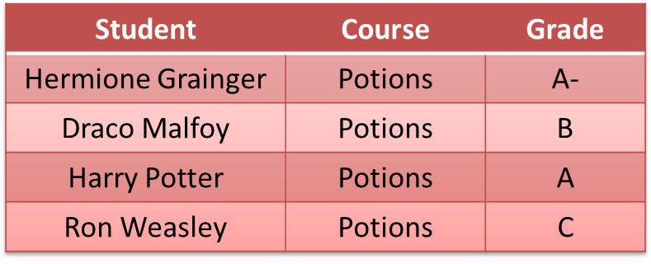
Degree and Cardinality
CoursesTaken :
Degree is the number of fields/attributes in schema (=3 in the table above)
Cardinality is the number of tuples in relation (=4 in the table above)

Slide 20
Example
Create a database for managing class enrollments in a single semester. You should keep track of all students (their names, Ids, and addresses) and professors (name, Id, department). Do not record the address of professors but keep track of their ages. Maintain records of courses also. Like what classroom is assigned to a course, what is the current enrollment, and which department offers it. At most one professor teaches each course. Each student evaluates the professor teaching the course. Note that all course offerings in the semester are unique, i.e. course names and numbers do not overlap. A course can have ≥ 0 pre-requisites, excluding itself. A student enrolled in a course must have enrolled in all its pre-requisites. Each student receives a grade in each course. The departments are also unique, and can have at most one chairperson (or dept. head). A chairperson is not allowed to head two or more departments.

Slide 21
Relational Design for the Example
Students (PID: string, Name: string, Address: string)
Professors (PID: string, Name: string, Office: string, Age: integer, DepartmentName: string)
Courses (Number: integer, DeptName: string, CourseName: string, Classroom: string, Enrollment: integer)
Teach (ProfessorPID: string, Number: integer, DeptName: string)
Take (StudentPID: string, Number: integer, DeptName: string, Grade: string, ProfessorEvaluation: integer)
Departments (Name: string, ChairmanPID: string)
PreReq (Number: integer, DeptName: string, PreReqNumber: integer, PreReqDeptName: string)

Slide 22
Issues to Consider in the Design
Can we merge Courses and Teach if each professor teaches at most one course?
Do we need a separate relation to store evaluations?
How can we handle pre-requisites that are “or”s, e.g., you can take CS 4604 if you have taken either CS 2604 or CS 2606?
How do we generalize this schema to handle data over more than one semester?
What modifications does the schema need if more than one professor can teach a course?

Slide 23
SQL and Relational Algebra

Slide 24
What is SQL
SQL = Structured Query Language (pronounced “sequel”).
a special-purpose programming language designed for managing data in relational database management systems (RDBMS).
SQL is declarative:
  Say what you want to accomplish, without specifying how.
  One of the main reasons for the commercial success of RDMBSs.
SQL has many standards and implementations:
  ANSI SQL
    SQL became a standard of the American National Standards Institute (ANSI) in 1986, and of the International Organization for Standards (ISO) in 1987.
  SQL-92/SQL2 (null operations, outerjoins)
  SQL-99/SQL3 (recursion, triggers, objects)
  Vendor-specific variations.

Slide 25
Relational Algebra
Relational algebra is a notation for specifying queries about the contents of relations.
Notation of relational algebra eases the task of reasoning about queries.
Operations in relational algebra have counterparts in SQL.
Relational Algebra: core of SQL.

Slide 26
What is an Algebra?
An algebra is a set of operators and operands.
  Arithmetic: operands are variables and constants, operators are +,−,×,÷, etc.
  Set algebra: operands are sets and operators are ∩, U,-
An algebra allows us to construct expressions by combining operands and expression using operators and has rules for reasoning about expressions.
    a² + 2 × a × b + 2b, (a + b)².
    R - S, R ∩ S.

Slide 27
Basics of Relational Algebra
Operands are relations, thought of as sets of tuples.
Think of operands as variables, whose tuples are unknown.
Results of operations are also sets of tuples.
Think of expressions in relational algebra as queries, which construct new relations from given relations.
Four types of operators:
  Select/Show parts of a single relation: projection and selection.
  Usual set operations (union, intersection, difference).
  Combine the tuples of two relations, such as cartesian product and joins.
  Renaming.

Slide 28
Projection
The projection operator produces from a relation R a new relation containing only some of R’s columns.
“Delete” (i.e. not show) attributes not in projection list.
Duplicates eliminated
To obtain a relation containing only the columns A1,A2, . . . An of R
RA: π A1,A2, . . . An (R)
SQL: SELECT A1,A2, . . . An FROM R;

Slide 29
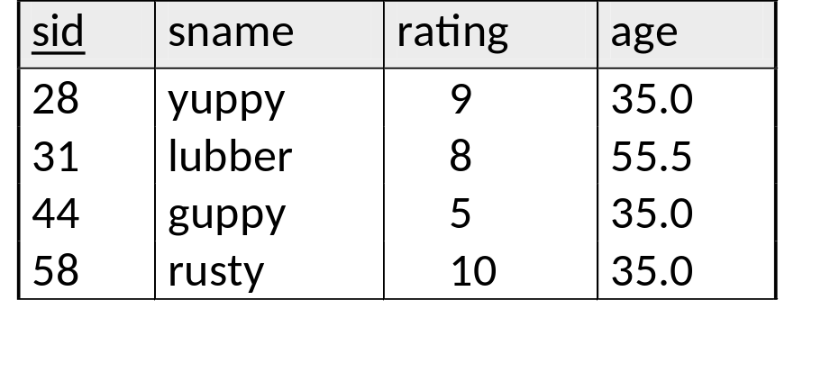
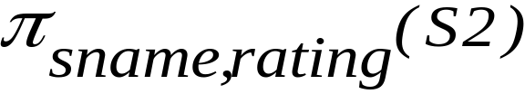
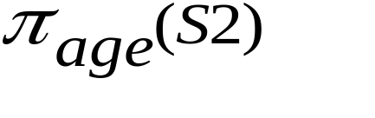
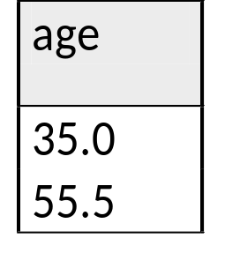
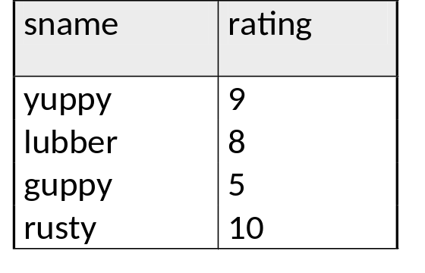
Projection Example
S2

Slide 30
Selection
The selection operator applied to a relation R produces a new relation with a subset of R’s tuples.
The tuples in the resulting relation satisfy some condition C that involves the attributes of R.
  with duplicate removal
RA: σ (R)
SQL: SELECT *FROM R WHERE C;
The WHERE clause of a SQL command corresponds to σ( ).
c

Slide 31
Selection: Syntax of Conditional
Syntax of conditional (C): similar to conditionals in programming languages.
Values compared are constants and attributes of the relations mentioned in the FROM clause.
We may apply usual arithmetic operators to numeric values before comparing them.
RA Compare values using standard arithmetic operators.
SQL Compare values using =, <>, <, >, <=, >=.

Slide 32
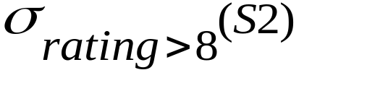
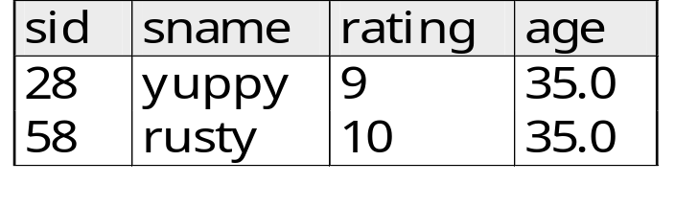

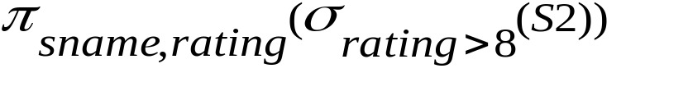
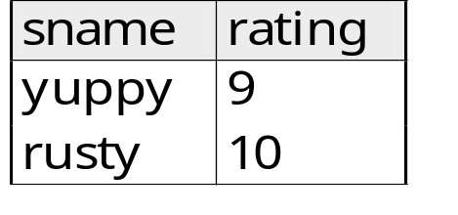
Selection Example
S2
Combining Operators

