Slide 1
Data Definition and Modification in SQL
Dr. Bing Zhou

Slide 2
Data Types in SQL
Character strings:
  CHAR(n): fixed-length string of up to n characters.
  VARCHAR(n): string of length of up to n characters.
Bit strings:
  BIT(n): bit string of length n.
  BIT VARYING(n): bit string of length up to n.
BOOLEAN: possible values are TRUE, FALSE, and UNKNOWN (read Chapter 6.1.7).
integers: INTEGER (INT), SHORTINT.
floats: FLOAT (or REAL), DOUBLE PRECISION.
fixed point numbers: DECIMAL(n, d): a number with n digits, with the decimal point d positions from the right.
dates and times: DATE and TIME (read Chapter 6.1.5).

Slide 3
Creating and Deleting Tables
A table is a relation that is physically stored in a database.
A table is persistent; it exists indefinitely unless dropped or altered in some way.
Creating a table: CREATE TABLE followed by the name of the relation and a parenthesized list of attribute names and their types.
CREATE TABLE Students (PID INT, Name CHAR(20),
Address VARCHAR(255));
Deleting a table: DROP TABLE followed by the name of the table:
  DROP TABLE R;

Slide 4
Modifying Table Schemas
ALTER TABLE followed by the name of the relation followed by:
ADD followed by a column name and its data type.
  Add date of birth (Dob) to Students:
    ALTER TABLE Students ADD Dob DATE;
DROP followed by a column name.
  Delete data of birth (Dob) to Students:
    ALTER TABLE Students DROP Dob;

Slide 5
Null and Default Values
SQL allows NULL for unknown or undefined attribute values. (Read Chapter 6.1.6).
We can specify a default value for an attribute using the DEFAULT keyword.
  ALTER TABLE Students ADD Gender char(1) DEFAULT ’?’;
  ALTER TABLE Students ADD Address char(100) DEFAULT ‘unlisted’;

Slide 6
Inserting Data into a Table
INSERT INTO R(A1,A2, . . . An) VALUES (v1, v2, . . . , vn)
  (A1,A2, . . . ,An) can be a subset of R’s schema.
  Remaining attributes get NULL values
  Can omit names of attributes if we provide values for all attributes and list values in standard order:
    INSERT INTO R VALUES (v1, v2, . . . , vn)
    INSERT INTO R VALUES (v1, v2, . . . ,null, …, vn)
Insertion: Instead of VALUES, can use a SELECT statement.
  Insert into the Professors table all professors who are mentioned in Teach but are not in Professors.
  INSERT INTO Professors(PID)
SELECT ProfessorPID
FROM Teach
WHERE ProfessorPID NOT IN
(SELECT PID FROM Professors);

Slide 7
Deleting Data from a Table
DELETE FROM R WHERE Condition;
Every tuple satisfying the condition C is deleted from R.

Slide 8
Updating Data in a Table
An update in SQL is a change to one of the tuples existing in the database
  UPDATE R SET <new value assignments> WHERE <condition>
Example: change the name of a student so that every male student has ’Mr.’ added to the name and every female student has ’Ms.’ added to the name.SET
  UPDATE Students
SET Name = ’Ms. ’ || Name
WHERE Gender = ’F’;
  UPDATE Students
  SET Name = ’Mr. ’ || Name
WHERE Gender = ’M’;
Can set multiple attributes in the SET clause, separated by commas.
The WHERE clause can involve a subquery.

Slide 9
Loading Data: BULK
Different RDBMs have different syntax.
PostgreSQL: Use the \copy ’filename’ INTO TABLE tablename; at the psql prompt
File format:
  Tab-delimited with columns in the same order as the attributes.
  Use \N to indicate null values.
Do not make assumptions about how the RDBMS will behave!
Check to make sure your data is not corrupted.
Do not delete the original files that contain the raw data.

Slide 10
Constraints in Relational Algebra and SQL

Slide 11
Maintaining Integrity of Data
Data is dirty.
How does an application ensure that a database modification does not corrupt the tables?
  Data entry errors (INSERT, UPDATE)
  Enforce consistency
Integrity constraints
  Impose restrictions on allowable data, beyond those imposed by structure and types
  Example: 0<GPA<=4.0, Enrollment<18000
Two approaches:
  Application programs check that database modifications are consistent.
  Use the features provided by SQL
  .

Slide 12
Integrity Checking in SQL
PRIMARY KEY and UNIQUE constraints.
FOREIGN KEY constraints.
Constraints on attributes and tuples.
Triggers (schema-level constraints).
How do we express these constraints?
How do we check these constraints?
What do we do when a constraint is violated?

Slide 13
Keys in SQL
A set of attributes S is a key for a relation R if every pair of tuples in R disagree on at least one attribute in S.
Select one key (one column or column combination) to be the PRIMARY KEY; declare other keys using UNIQUE
  PID
  DeptName + Course Number: CS4604
A table can have at most one PRIMARY KEY, but more than one unique keys

Slide 14
Primary Keys in SQL
Modify the schema of Students to declare PID to be the key.
  CREATE TABLE Students(
PID INT PRIMARY KEY,
Name CHAR(20), Address VARCHAR(255));
What about Courses, which has two attributes in its key?
  CREATE TABLE Courses(Number integer, DeptName:
  VARCHAR(8), CourseName VARCHAR(255), Classroom
VARCHAR(30), Enrollment integer,
PRIMARY KEY (Number, DeptName)
);

Slide 15
Effect of Declaring PRIMARY KEYs
Two tuples in a relation cannot agree on all the attributes in the key. DBMS will reject any action that inserts or updates a tuple in violation of this rule.
A tuple cannot have a NULL value in a key attribute.

Slide 16
Other Keys in SQL
If a relation has other keys, declare them using the UNIQUE keyword.
Use UNIQUE in exactly the same places as PRIMARY KEY.
There are two differences between PRIMARY KEY and UNIQUE:
  A table may have only one PRIMARY KEY but more than one set of attributes declared UNIQUE.
  A tuple may have NULL values in UNIQUE attributes.

Slide 17
Enforcing Key Constraints
Upon which actions should an RDBMS enforce a key constraint?
Only tuple update and insertion.
RDMBS searches the tuples in the table to find if any tuple exists that agrees with the new tuple on all attributes in the primary key.
To speed this process, an RDBMS automatically creates an efficient search index on the primary key.
User can instruct the RDBMS to create an index on one or more attributes (If interested see Chapter 8.3).

Slide 18

Foreign Key Constraints
Referential integrity constraint: in the relation Teach (that “connects” Courses and Professors), if Teach relates a course to a professor, then a tuple corresponding to the professor must exist in Professors.
How do we express such constraints in Relational Algebra?
Consider the Teach(ProfessorPID, Number, DeptName) relation.
We want to require that every non-NULL value of ProfessorPID in Teach must be a valid ProfessorPID in Professors.
RA πProfessorPID(Teach) π PID(Professors).

Slide 19
Foreign Key Constraints in SQL
We want to require that every non-NULL value of ProfessorPID inTeach must be a valid ProfessorPID in Professors.
In Teach, declare ProfessorPID to be a foreign key.
CREATE TABLE Teach(ProfessorPID INT REFERENCES
Professor(PID), Name VARCHAR(30) ...);
CREATE TABLE Teach(ProfessorPID INT, Name
VARCHAR(30) ..., FOREIGN KEY ProfessorPID REFERENCES
Professor(PID));
If the foreign key has multiple attributes, use the second type of declaration.

Slide 20
Requirements for FOREIGN KEYs
If a relation R declares that some of its attributes refer to foreign keys in another relation S, then these attributes must be declared UNIQUE or PRIMARY KEY in S.
Values of the foreign key in R must appear in the referenced
attributes of some tuple in S.

Slide 21
Enforcing Referential Integrity
Three policies for maintaining referential integrity.
Default policy: reject violating modifications.
Cascade policy: mimic changes to the referenced attributes at the foreign key.
Set-NULL policy: set appropriate attributes to NULL.

Slide 22
Default Policy for Enforcing Referential Integrity
Reject violating modifications. There are four cases (potentially violating modifications).
Insert a new Teach tuple whose ProfessorPID is not NULL and is not the PID of any tuple in Professors.
Update the ProfessorPID attribute in a tuple in Teach to a value that is not the PID value of any tuple in Professors.
Delete a tuple in Professors whose PID value is the ProfessorPID value for one or more tuples in Teach.
Update the PID value of a tuple in Professors when the old PID value is the value of ProfessorPID in one or more tuples of Teach.

Slide 23
Cascade Policy for Enforcing Referential Integrity
Only applies to deletions of or updates to tuples in the referenced relation (e.g., Professors).
If we delete a tuple in Professors, delete all tuples in Teach that refer to that tuple.
If we update the PID value of a tuple in Professors from p1 to p2, update all value of ProfessorPID in Teach that are p1 to p2.

Slide 24
Set-NULL Policy for Enforcing Referential Integrity
Also applies only to deletions of or updates to tuples in the referenced relation (e.g., Professors).
If we delete a tuple in Professors, set the ProfessorPID attributes of all tuples in Teach that refer to the deleted tuple to NULL.
If we update the PID value of a tuple in Professors from p1 to p2, set all values of ProfessorPID in Teach that are p1 to NULL

Slide 25
Specifying Referential Integrity Policies in SQL
SQL allows the database designer to specify the policy for deletes and updates independently.
Optionally follow the declaration of the foreign key with ON DELETE and/or ON UPDATE followed by the policy: SET NULL or CASCADE.
  CREATE TABLE Teach (
  ProfessorPID INT PRIMARY KEY,
  Name VARCHAR(30),
  FOREIGN KEY DeptName REFERENCES Professors(DepartmentName))
  ON DELETE SET NULL
  ON UPDATE CASCADE
  );
For your project, you do not have to consider deferring constraints.

Slide 26
Constraining Attributes and Tuples
SQL also allows us to specify constraints on attributes in a relation and on tuples in a relation.
  Disallow courses with a maximum enrollment greater than 100.
  A chairperson of a department must teach at most one course every semester.
How do we express such constraints in SQL?
How can we change our minds about constraints?
A simple constraint: NOT NULL
  Declare an attribute to be NOT NULL after its type in a CREATE TABLE statement.
  Effect is to disallow tuples in which this attribute is NULL.

Slide 27
Attribute-Based CHECK Constraints
Disallow courses with a maximum enrollment greater than 100.
This constraint only affects the value of a single attribute in each tuple.
Follow the declaration of the Enrollment attribute with the CHECK keyword and a condition.
CREATE TABLE Courses(...
Enrollment INT CHECK (Enrollment <= 100) ...);
The condition can be any condition that can appear in a WHERE clause.
CHECK statement may use a subquery to mention other attributes of the same or other relations.
An attribute-based CHECK constraint is checked only when the value of that attribute changes.

Slide 28


Slide 29
Tuple-Based CHECK Constraints
Tuple-based CHECK constraints are checked whenever a tuple is inserted into or updated in a relation.
Designer may add these constraints after the list of attributes in a CREATE TABLE statement.
A chairperson of a department teach at most one course in any semester.
CREATE TABLE Teach(...
CHECK ProfessorPID NOT IN
((SELECT ProfessorPID FROM Teach)
INTERSECT
(SELECT ChairmanPID FROM Departments)
)
);

Slide 31
Modifying Constraints
SQL allows constraints to be named.
Use CONSTRAINT followed by the name of the constraint in front of PRIMARY KEY, UNIQUE, or CHECK
  Name CHAR(30) CONSTRAINT NameIsKey PRIMARY KEY
Can use constraint names in ALTER TABLE statements to delete constraints: say DROP CONSTRAINT followed by the name of the constraint.
  ALTER TABLE Students DROP CONSTRAINT NameIsKey
Can add constraints in an ALTER TABLE statement using ADD
CONSTRAINT followed by an optional name followed by the (required) CHECK statement.

Slide 32
Triggers
Trigger: procedure that starts automatically if specified changes occur to the DBMS
Example
  Enrollment>18000 → reject all applications
  INSERT app with GPA>3.95 → accept automatically
Why use triggers
  Enforce constraints: more expression power
  Move logic from Apps to DBMS

Slide 33
Triggers
Often called event-condition-action rules
  Event = a class of changes in the DB, e.g., INSERT, DELETE
  Condition = a test as in a where clause for whether or not a trigger applies
  Action = one or more SQL statement
  When Event occurs, check Condition; if true, do Action
Triggers are invoked by certain events specified by the database programmer.
Once awakened, the trigger tests a condition.
Only the condition is satisfied, the actions are performed. The action could be any sequence of database operations.

Slide 34
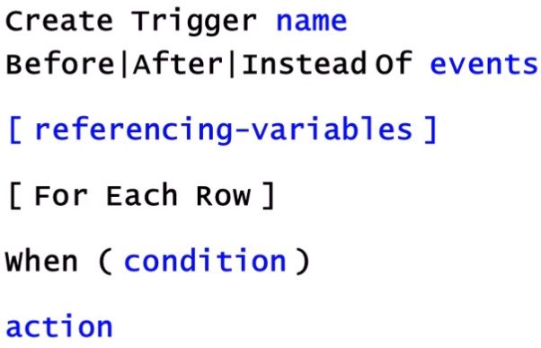
Triggers in SQL

Slide 35
Triggers
A trigger has three parts:
  Event (activates the trigger)
  Condition (tests whether the triggers should run)
  Action (what happens if the trigger runs)
CREATE TRIGGER incr_count AFTER INSERT ON Students // Event
REFERENCING NEW ROW AS new
FOR EACH ROW
WHEN (new.age < 18) // Condition
count := count + 1 // ACTION

Slide 36
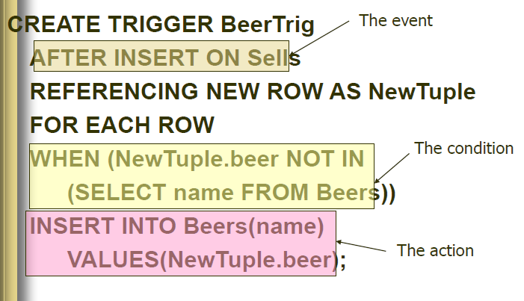
Triggers

Slide 37
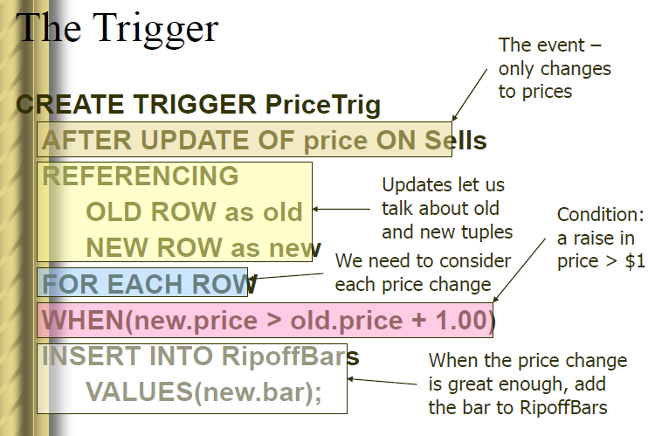
Triggers

