Slide 1
The Entity-Relationship Model
Dr. Bing Zhou

Slide 2
Basic Database Terminology
Data model : describes high-level conceptual structuring of data
  Example: Data is set of student records, each with ID, name, address, and courses
  Example: Data is a graph where nodes represent proteins and edges represent chemical bonds between proteins
Schema describes how data is to be structured and stored in a database
  Defined during creation of the database
  Schemas rarely change
Data is actual “instance” of database
  Updated continuously
  Changes rapidly

Slide 3
Why Learn About Database Modeling?
The way in which data is stored is very important for subsequent access and manipulation by SQL.
Properties of a good data model:
  It is easy to write correct and easy to understand queries.
  Minor changes in the problem domain do not change the schema.
  Major changes in the problem domain can be handled without too much difficulty.
  Can support efficient database access.

Slide 4
Purpose of E/R Model
The E/R model allows us to sketch the design of a database informally.
  Represent different types of data and how they relate to each other
Designs are pictures called entity-relationship diagrams.
Fairly mechanical ways to convert E/R diagrams to real implementations like relational databases exist.

Slide 5
Entity Sets
Entity = “thing” or object.
Entity set = collection of similar entities.
  Similar to a class in object-oriented languages.
Attribute = property of an entity set.
  Generally, all entities in a set have the same properties.
  Attributes are simple values, e.g. integers or character strings.

Slide 6
E/R Diagrams
In an entity-relationship diagram, each entity set is represented by a rectangle.
Each attribute of an entity set is represented by an oval, with a line to the rectangle representing its entity set.

Slide 7
Example
name
manf
Entity set Beers has two attributes, name and manf (manufacturer).
Each Beer entity has values for these two attributes, e.g. (Bud, Anheuser-Busch)
Beers

Slide 8
Relationships
A relationship connects two or more entity sets.
It is represented by a diamond, with lines to each of the entity sets involved.

Slide 9
Example
name
addr
name
manf
Bars sell some
beers.
Bars
Sells
Beers
license
Frequents
Likes
Note:
license =
beer, full,
none
Drinkers like
some beers.
Drinkers
name
addr
Drinkers frequent
some bars.

Slide 10
Relationship Set
The current “value” of an entity set is the set of entities that belong to it.
  Example: the set of all bars in our database.
The “value” of a relationship is a set of lists of currently related entities, one from each of the related entity sets.

Slide 11
Example
A relationship R between entity sets E and F relates some entities in E to some entities in F.
R is a set of pairs of tuples (e, f ) where e is in E and f is in F.
For the relationship Sells, we might have a relationship set like:
Bar Beer
Joe’s Bar Bud
Joe’s Bar Miller
Sue’s Bar Bud
Sue’s Bar Pete’s Ale
Sue’s Bar Bud Lite

Slide 12
Multiway Relationships
Sometimes, we need a relationship that connects more than two entity sets.
Suppose that drinkers will only drink certain beers at certain bars.
  Our three binary relationships Likes, Sells, and Frequents do not allow us to make this distinction.
  But a 3-way relationship would.

Slide 13
Example
name
addr
name
manf
Bars
Beers
license
Preferences
Drinkers
name
addr

Slide 14
A Typical Relationship Set
Bar Drinker Beer
Joe’s Bar Ann Miller
Sue’s Bar Ann Bud
Sue’s Bar Ann Pete’s Ale
Joe’s Bar Bob Bud
Joe’s Bar Bob Miller
Joe’s Bar Cal Miller
Sue’s Bar Cal Bud Lite

Slide 15
Many-Many Relationships
Think of a relationship between two entity sets, such as Sells between Bars and Beers.
In a many-many relationship, an entity of either set can be connected to many entities of the other set.
  E.g., a bar sells many beers; a beer is sold by many bars.

Slide 16
Many-One Relationships
Some binary relationships are many -one from one entity set to another.
Each entity of the first set is connected to at most one entity of the second set.
But an entity of the second set can be connected to zero, one, or many entities of the first set.

Slide 17
Example
Favorite, from Drinkers to Beers is many-one.
A drinker has at most one favorite beer.
But a beer can be the favorite of any number of drinkers, including zero.

Slide 18
One-One Relationships
In a one-one relationship, each entity of either entity set is related to at most one entity of the other set.
Example: Relationship Best-seller between entity sets Manfs (manufacturer) and Beers.
  A beer cannot be made by more than one manufacturer, and no manufacturer can have more than one best-seller (assume no ties).

Slide 19
In Pictures:
Women
Give Birth
Babies
many-many many-one one-one
Men
Befriend
Women
Men
Marry
Women

Slide 20
Representing “Multiplicity”
Show a many-one relationship by an arrow entering the “one” side.
Show a one-one relationship by arrows entering both entity sets.
In some situations, we can also assert “exactly one,” i.e., each entity of one set must be related to exactly one entity of the other set. To do so, we use a rounded arrow.

Slide 21
Example
Likes
Drinkers
Beers
Favorite

Slide 22
Example
Consider Best-seller between Manfs and Beers.
Some beers are not the best-seller of any manufacturer, so a rounded arrow to Manfs would be inappropriate.
But a manufacturer has to have a best-seller (we assume they are beer manufacturers).
Best-
seller
Manfs
Beers

Slide 23
Attributes on Relationships
Sometimes it is useful to attach an attribute to a relationship.
Think of this attribute as a property of tuples in the relationship set.
Sells
Bars
Beers
price
Price is a function of both the bar and the beer,
not of one alone.

Slide 24
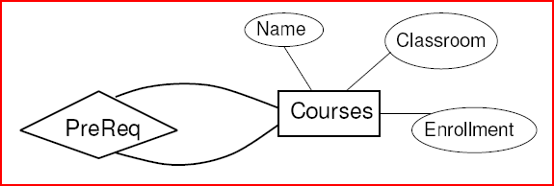
Relationships
Can the same entity set appear more than once in the same relationship?
Prerequisite relationship between two Courses
Which course is the pre-requisite?

Slide 25
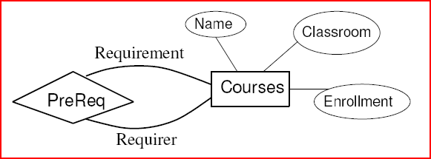
Roles
Label the edges between the relationship and the entity set with names called roles.

Slide 26
Example
Relationship Set
Husband Wife
Bob Ann
Joe Sue
… …
Married
husband
wife
Drinkers

Slide 27
Example
Relationship Set
Buddy1 Buddy2
Bob Ann
Joe Sue
Ann Bob
Joe Moe
… …
Buddies
1
2
Drinkers

Slide 28
Example
Sequel-of
Sequel
Original
Movies

Slide 29
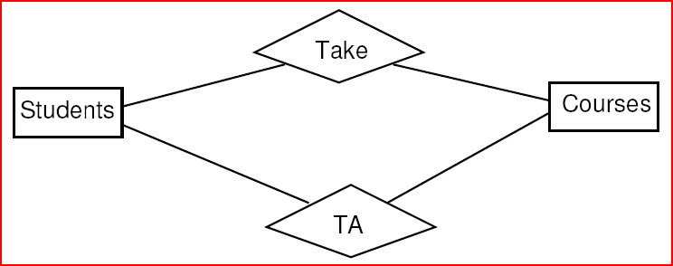
Parallel Relationships
Can there be more than one relationship between the same pair of entities?
TA and Take relationship between Students and Classes

Slide 30
Subclasses
Subclass = special case = fewer entities = more properties.
Example: Ales are a kind of beer.
  Not every beer is an ale, but some are.
  Let us suppose that in addition to all the properties (attributes and relationships) of beers, ales also have the attribute color.

Slide 31
Subclasses in E/R Diagrams
Assume subclasses form a tree.
  i.e., no multiple inheritance.
Isa triangles indicate the subclass relationship.
  Point to the superclass.

Slide 32
Example
name
Beers
manf
isa
Ales
color

Slide 33
Example
length
title
year
genre
Stars
Voices
Movies
isa
isa
weapon
Cartoons
Murder-
Mysteries

