Slide 1
Constraints in Entity-Relationship Models
Dr. Bing Zhou

Slide 2
Types of Constraints
Keys are attributes or sets of attributes that uniquely identify an entity within its entity set.
Referential integrity constrains require that a value referred to actually exists in the database.

Slide 3
Keys
A key is a set of attributes for one entity set such that no two entities in this set agree on all the attributes of the key.
  It is allowed for two entities to agree on some, but not all, of the key attributes.
A key for an entity set E is a set K of one or more attributes such that given any two entities e1 and e2 in E, e1 and e2 cannot have identical values for all the attributes in K.
E can have multiple keys. We usually designate one as the primary key.
We must designate a key for every entity set.

Slide 4
Keys in E/R Diagrams
Underline the key attribute(s).
In an Isa hierarchy, only the root entity set has a key, and it must serve as the key for all entities in the hierarchy.
name
Beers
manf
isa
Ales
color

Slide 5
Example: a Multi-attribute Key
dept
number
hours
room
Courses
Note that hours and room could also serve as a
key, but we must select only one key.

Slide 6
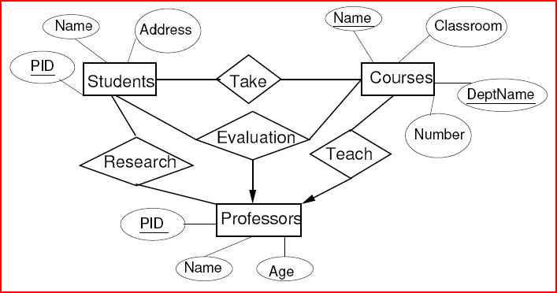
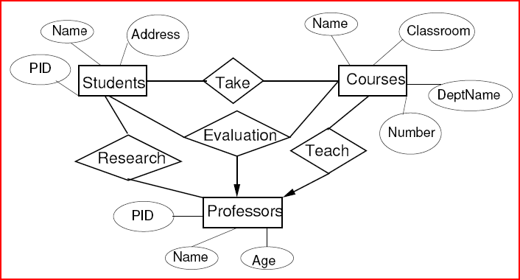
Examples of Keys

Slide 7
Referential Integrity Constraint
Asserts that exactly one value exists in a given context.
Usually used in the context of relationships.
Example: Many-one Advises relationship between Students and Professors.
  Many-one requirement says that no student may have more than one advising professor.
  Referential integrity constraint says that each student must have exactly one advising professor and that professor must be present in the database.
If R is a (many-to-one or one-to-one) relationship from E to F, we use a rounded arrowhead pointing to F to indicate that we require that the entity in F related by R to an entity in E must exist.

Slide 8
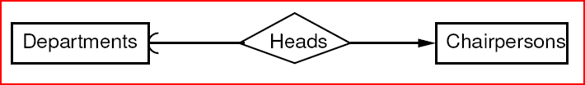
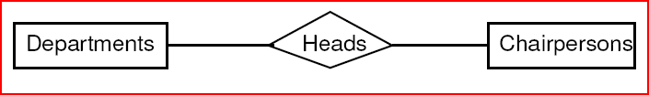
Example
Each department has at most one chairperson who is its head (there are times when a department may not have a chairperson).
Each chairperson can be the head of exactly one department and this department must exist in the database.
Where do we put the arrows?

Slide 9

Enforcing Referential Integrity Constraints
We forbid the deletion of a referenced entity (e.g., a professor) until the professor advises no students.
We require that if we delete a referenced entity, we delete all entities that reference it.
When we insert a student entity, we must specify an existing professor entity connected to the student by the Advises relationship.

Slide 10
Weak Entity Sets
Occasionally, entities of an entity set need “help” to identify them uniquely.
Entity set E is said to be weak if in order to identify entities of E uniquely, we need to follow one or more many-one relationships from E and include the key of the related entities from the connected entity sets.

Slide 11
Example
name is almost a key for football players, but there might be two with the same name.
number is certainly not a key, since players on two teams could have the same number.
But number, together with the Team related to the player by Plays-on should be unique.
name
number
name
Players
Plays-
on
Teams
Double diamond for supporting many-one relationship.
Double rectangle for the weak entity set.

Slide 12
Weak Entity-Set Rules
A weak entity set has one or more many-one relationships to other (supporting) entity sets.
  Not every many-one relationship from a weak entity set need be supporting.
The key for a weak entity set is its own underlined attributes and the keys for the supporting entity sets.
  E.g., player-number and team-name is a key for Players in the previous example.

Slide 13
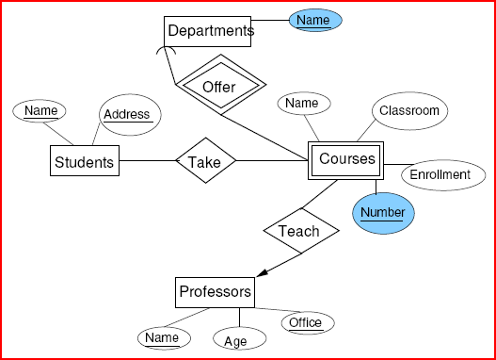
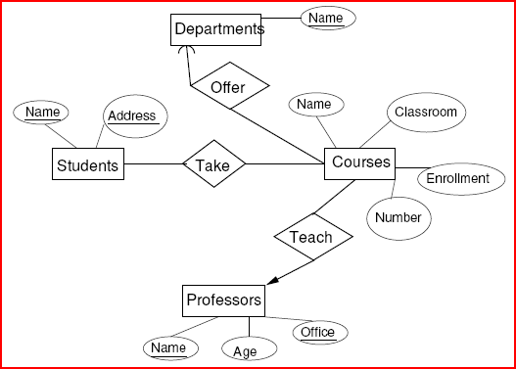
Example of Weak Entity Set
Each department teaches multiple courses. Each course has a number. What is the key for the entity set Courses?

Slide 14
Design Techniques
Be faithful to the specification of the application.
Avoid redundancy.
Keep the entities and relationship simple.
  Don’t use an entity set when an attribute will do.
Select the right relationships.
Select the right type of element.
Limit the use of weak entity sets.

Slide 15
Be Faithful
Do not use meaningless or unecessary attributes.
Define the multiplicity of a relationship appropriately.
  What is the multiplicity of the relationship Take between Students and Courses?
  What is the multiplicity of the relationship Teach between Professors and Courses?

Slide 16
Avoiding Redundancy
Redundancy occurs when we say the same thing in two different ways.
Redundancy wastes space and (more importantly) encourages inconsistency.
  The two instances of the same fact may become inconsistent if we change one and forget to change the other, related version.

Slide 17
Example: Bad
name
name
addr
ManfBy
Beers
Manfs
manf
This design states the manufacturer of a beer twice: as an attribute and as a related entity.

Slide 18
Example: Bad
name
manf
manfAddr
Beers
This design repeats the manufacturer’s address once for each beer; loses the address if there are temporarily no beers for a manufacturer.

Slide 19
Example: Good
name
name
addr
ManfBy
Beers
Manfs
This design gives the address of each manufacturer exactly once.

Slide 20
Entity Sets Versus Attributes
An entity set should satisfy at least one of the following conditions:
  It is more than the name of something; it has at least one nonkey attribute.
  or
  It is the “many” in a many-one or many-many relationship.

Slide 21
Example: Good
name
name
addr
ManfBy
Beers
Manfs
Manfs deserves to be an entity set because of the nonkey attribute addr.
Beers deserves to be an entity set because it is the “many” of the many-one relationship ManfBy.

Slide 22
Example: Bad
name
name
ManfBy
Beers
Manfs
Since the manufacturer is nothing but a name, and is not at the “many” end of any relationship, it should not be an entity set.

Slide 23
Example: Good
name
manf
Beers
There is no need to make the manufacturer an entity set, because we record nothing about manufacturers besides their name.

Slide 24
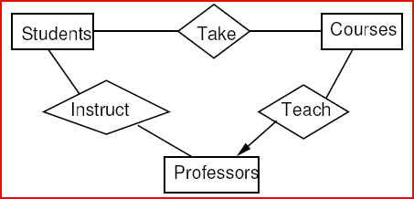
Design
Do not add unnecessary relationships.
It may be possible to deduce one relationship from another.
Do we need the relationship Instruct between Professors and Students?
  No. We can deduce this relationship from Take and Teach.

Slide 25
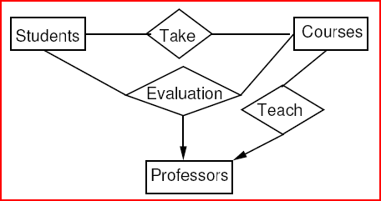
Design
Do not add unnecessary relationships.
It may be possible to deduce one relationship from another.
Do we need the relationships Take and Teach?
  Yes. Why?

Slide 26
Converting an Entity Set into an Attribute
If an entity set E satisfies the following properties:
  All relationships involving E have arrows entering E.
  The attributes of E collectively identify an entity (i.e., no attribute depends on another).
  No relationship involves E more than once
then we can replace E as follows:
  If there is a many-one relationship R from an entity set F to E, remove R and make the attributes of E be attributes of F.
  If there is a multi-way relationship R with an arrow to E, make the attributes of E be new attributes of R and remove the arrow from R to E.

Slide 27
Don’t Overuse Weak Entity Sets
Beginning database designers often doubt that anything could be a key by itself.
  They make all entity sets weak, supported by all other entity sets to which they are linked.
In reality, we usually create unique ID’s for entity sets.
  Examples include social-security numbers, automobile VIN’s etc.

Slide 28
When Do We Need Weak Entity Sets?
The usual reason is that there is no global authority capable of creating unique ID’s.
Example: it is unlikely that there could be an agreement to assign unique player numbers across all football teams in the world.

Slide 29
Binary vs. Non-Binary Relationships
Some relationships that appear to be non-binary may be better represented using binary relationships
  E.g. A ternary relationship parents, relating a child to his/her father and mother, is best replaced by two binary relationships, father and mother
    Using two binary relationships allows partial information (e.g. only mother being known)
  But there are some relationships that are naturally non-binary
    Example: works_on

Slide 30
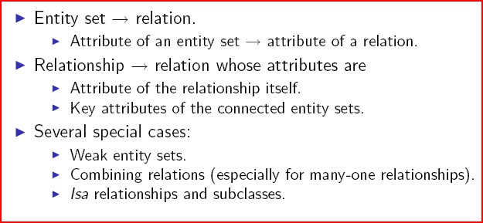
From E/R Diagrams to Relations

Slide 31
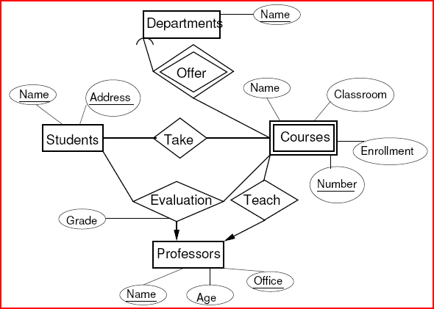
Schemas for Non-Weak Entity Sets
For each entity set, create a relation with the same name and with the same set of attributes.
Students(Name, Address)
Professors(Name, Office, Age)
Departments(Name)

Slide 32
Schemas for Weak Entity Sets
For each weak entity set W, create a relation with the same name whose attributes are
  Attributes of W and
  Key attributes of the other entity sets that help form the key for W.
Courses(Number, DepartmentName, CourseName, Classroom, Enrollment)

Slide 33
Schemas for Non-Supporting Relationships
For each relationship, create a relation with the same name whose attributes are
  Attributes of the relationship itself.
  Key attributes of the connected entity sets (even if they are weak).

Slide 34
Schemas for Non-Supporting Relationships
Take(StudentName, Address, Number, DepartmentName)
Teach(ProfessorName, Office, Number, DepartmentName)
Evaluation(StudentName, Address, ProfessorName, Office, Number, DepartmentName, Grade)

Slide 35
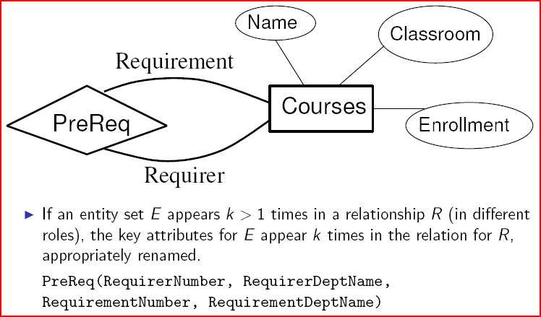
Roles in Relationships

Slide 36
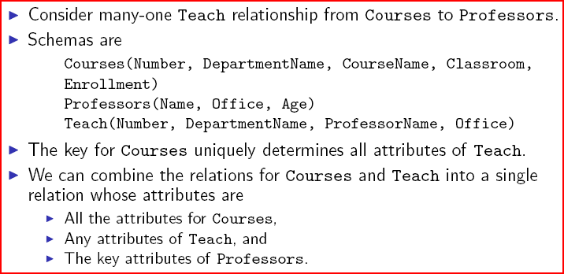
Combining Relations

Slide 37
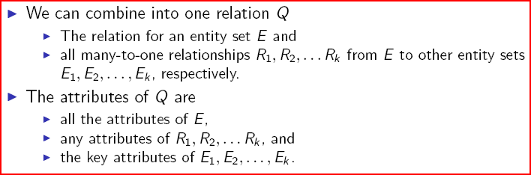
Rules for Combining Relations

Slide 38
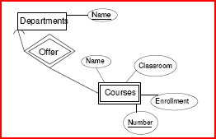
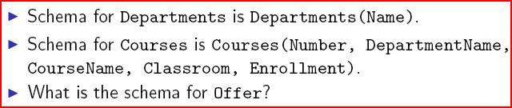
Supporting Relationships

Slide 39
Supporting Relationships
Offer(Number, DepartmentName).
The schema for Offer is a subset of the schema for the weak entity set, so we can dispense with the relation for Offer.

Slide 40
End of E/R Diagrams

