Slide 1
Functional Dependencies
Dr. Bing Zhou

Slide 2
Functional Dependencies:
A well developed design theory for relational database (what makes a good relational database schema)
are building blocks that enable the analysis of data redundancies, and the elimination of anomalies caused by them (through the process of normalization)
A generalization of the idea of a key for a relation

Slide 3
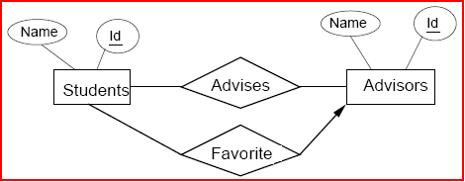
Example
Convert to relations:
  - Students(Id, Name) - Advisors(Id, Name)
  - Advises(StudentId, AdvisorId) - Favorite(StudentId, AdvisorId)
We perversely decide to convert Students, Advisors, and Favorite into one relation.
  Students(Id, Name, AdvisorId, AdvisorName, FavoriteAdvisorId)

Slide 4



Example of a Bad Relation
Students(Id, Name, AdvisorId, AdvisorName, FavoriteAdvisorId)
If you know a student's Id, can you determine the values of any other attributes?
  Name and FavoriteAdvisorId.
Can we say Id → AdvisorId?
  NO! Id is not a key.
What is the key for the Students?
  {Id, AdvisorId}
Why is this relation “bad”?
  Parts of the key determine other attributes.

Slide 5
Motivation for Functional Dependencies
Reason about constraints on attributes in relational designs.
Procedurally determine the keys of a relation.
Detect when a relation has redundant information.
Improve database designs systematically using normalization.

Slide 6
Relational Schema Design
Conceptual Model:
name
buys
Product
Person
price
name
ssn
Relational Model:
plus FD’s
Normalization:
Eliminates anomalies

Slide 7
Definition of Functional Dependency
If t is a tuple in a relation R and A is an attribute of R, then tA is the value of attribute A in tuple t.
The FD AdvisorId → AdvisorName holds in R if in every instance of R, for every pair of tuples t and u

Slide 8
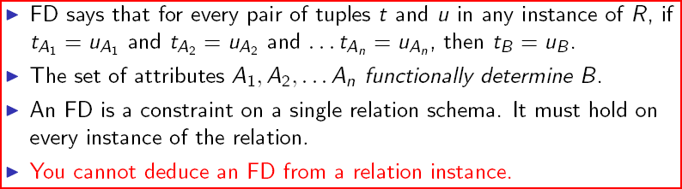
Definition of Functional Dependency
X → A is an assertion about a relation R that whenever two tuples of R agree on all the attributes of X, then they must also agree on the attribute A.
  Say “X → A holds in R.”
A functional dependency (FD) on a relation R is a statement
  If two tuples in R agree on attributes A1, A2, …, An then they agree on attribute B.
  Notation: A1 A2 … An → B

Slide 9
Functional Dependency ?
A functional dependency is a constraint between two sets of attributes in a relation
An attribute or set of attributes X is said to functionally determine another attribute Y (written X → Y) if and only if each X value is associated with at most one Y value. Customarily we call X determinant set and Y a dependent set.
So if we are given the value of X we can determine the value of Y.

Slide 10
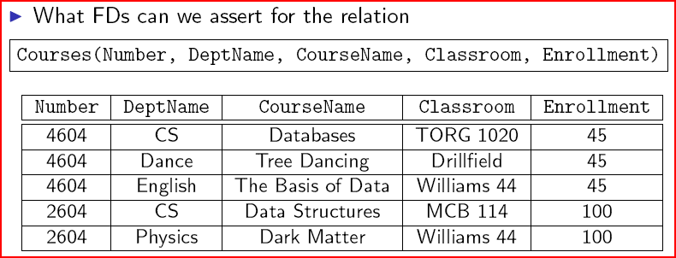
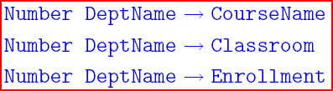
Examples of FDs
Is Number → Enrollment an FD?

Slide 11
Example
Drinkers(name, addr, beersLiked, manf, favBeer).
Reasonable FD’s to assert:
  name -> addr
  name -> favBeer
  beersLiked -> manf
name addr beersLiked manf favBeer
Janeway Voyager Bud A.B. WickedAle
Janeway Voyager WickedAle Pete’s WickedAle
Spock Enterprise Bud A.B. Bud

Slide 12
Example
name addr beersLiked manf favBeer
Janeway Voyager Bud A.B. WickedAle
Janeway Voyager WickedAle Pete’s WickedAle
Spock Enterprise Bud A.B. Bud
name -> addr
name -> favBeer
beersLiked -> manf

Slide 13
FDs With Multiple Attributes
No need for FDs with > 1 attribute on right.
  But sometimes convenient to combine FD’s as a shorthand.
  FDs: name -> addr and name -> favBeer become name -> addr favBeer
> 1 attribute on left may be essential.
  Example: bar beer -> price

Slide 14
Use of Functional Dependencies
We use functional dependencies to:
  test relations to see if they are legal under a given set of functional dependencies.
    If a relation R is legal under a set F of functional dependencies, we say that R satisfies F.
  specify constraints on the set of legal relations
    We say that F holds on R if all legal relations on R satisfy the set of functional dependencies F.

Slide 15
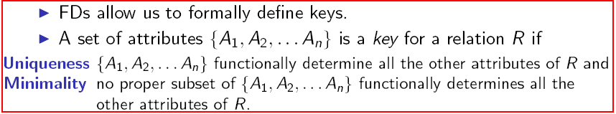
Keys of Relations
A superkey is a set of attributes that has the uniqueness property but is not necessarily minimal.

Slide 16
Example
Drinkers(name, addr, beersLiked, manf, favBeer).
{name, beersLiked} is a key because together these attributes determine all the other attributes.
  name -> addr favBeer
  beersLiked -> manf
In this example, there are no other keys, but lots of superkeys.
  Any superset of {name, beersLiked}.
name addr beersLiked manf favBeer
Janeway Voyager Bud A.B. WickedAle
Janeway Voyager WickedAle Pete’s WickedAle
Spock Enterprise Bud A.B. Bud

Slide 17
Example of Keys
What is the key for
  Courses(Number, DeptName, CourseName, Classroom, Enrollment)?
The key is {Number, DeptName}.
  These attributes functionally determine every other attribute.
  No proper subset of {Number, DeptName} has this property.
What is the key for
  Teach(Number, DepartmentName, ProfessorName, Classroom)?
The key is {Number, DepartmentName}.
  Why?

Slide 18
Keys in the Conversion from E/R to Relational Designs
If the relation comes from an entity set, the key attributes of the relation are precisely the key attributes of the entity set.

Slide 19
Keys in the Conversion from E/R to Relational Designs
If the relation comes from a binary relationship R between entity sets E and F:
  R is many-many: key attributes of the relation are the key attributes of E and of F.
  R is many-one from E to F: key attributes of the relation are the key attributes of E.
  R is one-one: key attributes of the relation are the key attributes of E or of F.

Slide 20
Keys in the Conversion from E/R to Relational Designs
If the relationship R is multi-way, we need to reason about the FDs that R satisfies.
  There is no simple rule.
  If R has an arrow towards entity set E, at least one key for the relation for R excludes the key for E.

Slide 21
FD’s From “Physics”
While most FD’s come from E/R keyness and many-one relationships, some are really physical laws.
Example: “no two courses can meet in the same room at the same time” tells us: hour room -> course.

Slide 22
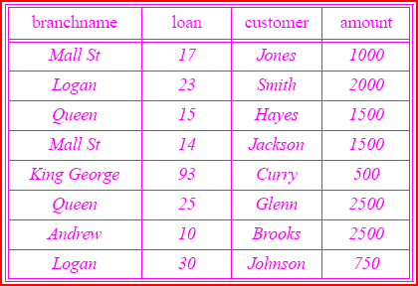
Example
Branch
Is Loan → Customer a valid FD ?
  Loan→Amount?
  Loan→Branchname?
  Loan→Customer Branchname Amount?
  Loan Branchname →Amount?

Slide 23

A → B
C → B

Slide 24

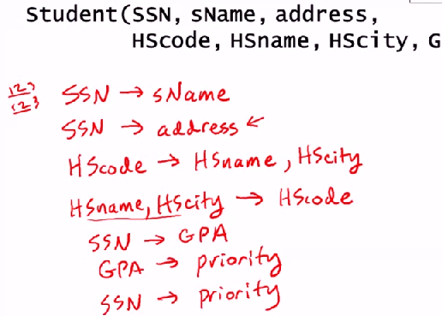


Slide 25
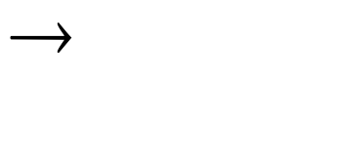
Consider relation obtained from Hourly_Emps:
  Hourly_Emps (ssn, name, lot, rating, hrly_wages, hrs_worked)
We will denote this relation schema by listing the attributes: SNLRWH
  This is really the set of attributes {S,N,L,R,W,H}.
Some FDs on Hourly_Emps:
  ssn is the key: S SNLRWH
  rating determines hrly_wages: R W
Notes:
16

Slide 26
Rules for Manipulating FDs
Learn how to reason about FDs.
Define rules for deriving new FDs from a given set of FDs.
Next class: use these rules to remove “anomalies” from relational designs.
Example: a relation R with attributes A, B, and C, satisfies the FDs
A → B and B → C. What other FDs does it satisfy?
A → C
What is the key for R ?
  A, because A → B and A → C

Slide 27
Equivalence of FDs
An FD F follows from a set of FDs T if every relation instance that
satisfies all the FDs in T also satisfies F.
A → C follows from T = {A → B, B → C}
Two sets of FDs S and T are equivalent if each FD in S follows from T and each FD in T follows from S.
S = {A → B, B → C, A → C} and T = {A → B, B → C} are equivalent.
These notions are useful in deriving new FDs from a given set of FDs.

Slide 28
Inference Rules for FDs
A , A , … A
B , B , … B
1
2
n
1
2
m
Splitting rule
and
Combing rule
Is equivalent to
A , A , … A
B
1
2
n
1
A , A , … A
B
 | A1 | ... | Am |  | B1 | ... | Bm
1
2
n
2
…
A , A , … A
B
1
2
n
m

Slide 29
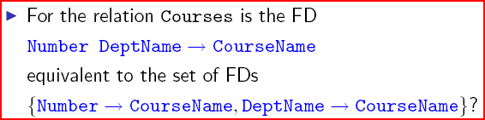
Splitting and Combining FDs
Can we split and combine left hand sides of FDs?
  No !

Slide 30



Triviality of FDs

