Slide 1
Manipulating Functional Dependencies
Dr. Bing Zhou

Slide 2
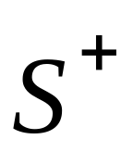
Closure of FD sets
Given a relation schema R and set S of FDs
  is the FD F logically implied by S?
Example
  R = {A,B,C,G,H,I}
  S = A →B, A → C, CG → H, CG → I, B → H
  would A → H be logically implied?
  yes (you can prove this, using the definition of FD)
Closure of S: = all FDs logically implied by S
How to compute ?
  we can use Armstrong's axioms

Slide 3
Armstrong's Axioms
Reflexivity rule
  A1 A2 ... An → a subset of A1 A2 ... An
Augmentation rule
  A1 A2 ... An → B1 B2 ... Bm
  then
  A1 A2 ... An C1 C2 ... Ck → B1 B2 ... Bm C1 C2 ... Ck
Transitivity rule
  A1 A2 ... An → B1 B2 ... Bm and
  B1 B2 ... Bm → C1 C2 ... Ck
  then
  A1 A2 ... An → C1 C2 ... Ck

Slide 4
Inferring using Armstrong's Axioms
= S
Loop
  For each F in S, apply reflexivity and augmentation rules
  add the new FDs to
  For each pair of FDs in S, apply the transitivity rule
  add the new FD to
Until does not change any further

Slide 5
Additional Rules
Union rule
  X → Y and X → Z, then X → YZ
  (X, Y, Z are sets of attributes)
Decomposition rule
  X → YZ, then X → Y and X → Z
Pseudo-transitivity rule
  X → Y and YZ → U, then XZ → U
These rules can be inferred from Armstrong's axioms

Slide 6
Example
R = (A, B, C, G, H, I)
F = { A → B A → C CG → H CG → I B → H}
some members of F⁺
  A → H
    by transitivity from A → B and B → H
  AG → I
    by augmenting A → C with G, to get AG → CG
    and then transitivity with CG → I
  CG → HI
    from CG → H and CG → I : “union rule” can be inferred from
      definition of functional dependencies, or
      Augmentation of CG → I to infer CG → CGI, augmentation of
      CG → H to infer CGI → HI, and then transitivity

Slide 7
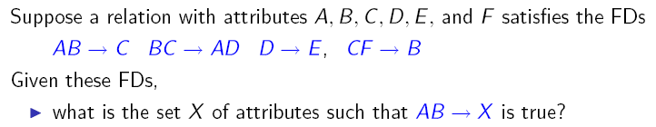

Closures of Attributes

Slide 8
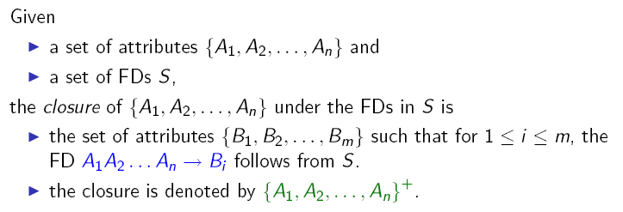
Closures of Attributes: Definition

Slide 9
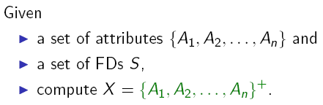
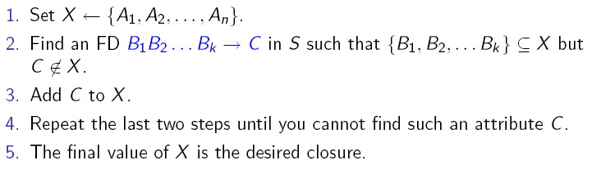
Closures of Attributes: Algorithm

Slide 10
Closures of Attributes: Algorithm
Basis: Y ⁺ = Y
Induction: Look for an FD’s left side X that is a subset of the current Y ⁺
  If the FD is X -> A, add A to Y ⁺

Slide 11
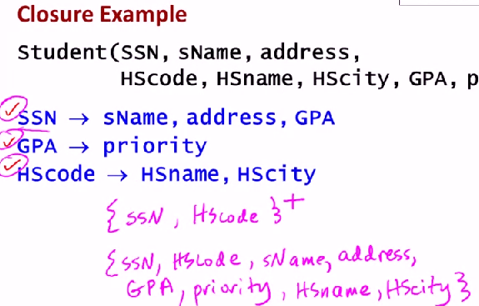


Slide 12
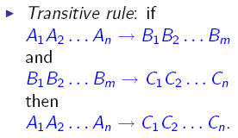

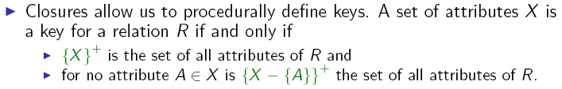
Why is the Concept of Closures Useful?

Slide 13
Uses of Attribute Closure
There are several uses of the attribute closure algorithm:
Testing for superkey:
  To test if α is a superkey, we compute α^{+,} and check if α⁺ contains all attributes of R.
Testing functional dependencies
  To check if a functional dependency α → β holds (or, in other words, is in F⁺), just check if β ⊆ α⁺.
  That is, we compute α⁺ by using attribute closure, and then check if it contains β.
  Is a simple and cheap test, and very useful
Computing closure of F
  For each γ ⊆ R, we find the closure γ⁺, and for each S ⊆ γ⁺, we output a functional dependency γ → S.

Slide 14

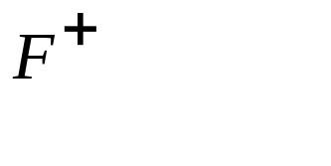

Does F = {A B, B C, C D E } imply A E?
  i.e, is A E in the closure ? Equivalently, is E in ?
Notes:
21

Slide 15
Example of Attribute Set Closure
R = (A, B, C, G, H, I)
F = {A → B A → C CG → H CG → I B → H}
(AG)⁺
  1. result = AG
  2. (A → C and A → B) result = ABCG
  3. (CG → H and CG ⊆ AGBC) result = ABCGH
  (CG → I and CG ⊆ AGBCH) result = ABCGHI
Is AG a super key?
Is AG a key?
    Does A⁺ → R?
    Does G⁺ → R?

Slide 16
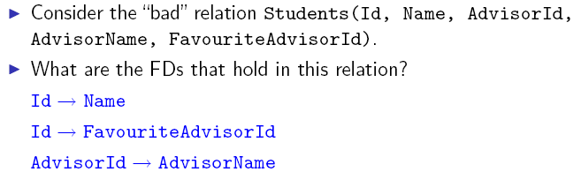
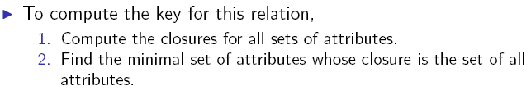
Example of Closure Computation

Slide 17
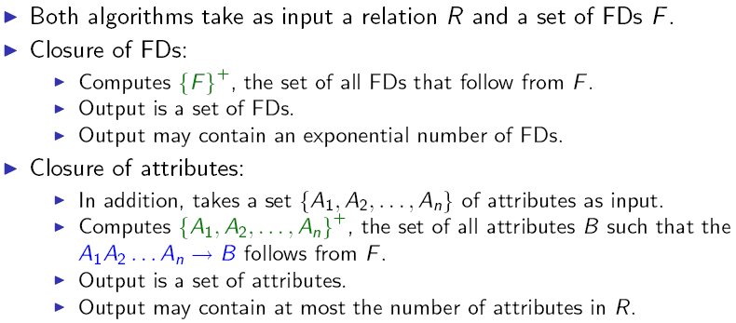
Closures of FDs vs. Closures of Attributes

