Slide 1
BCNF and Normalization
Dr. Bing Zhou

Slide 2
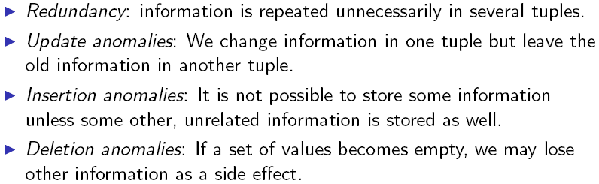
Relational Schema Design
Goal of relational schema design is to avoid redundancy and anomalies.

Slide 3
Bad Design
name addr beersLiked manf favBeer
Janeway Voyager Export Molson G.I. Lager
Janeway Voyager G.I. Lager Gr. Is. G.I. Lager
Spock Enterprise Export Molson Export
Redundancy
Update anomaly
  if Janeway is transferred to Intrepid, will we remember to change each of her tuples?
Deletion anomaly
  If nobody likes Export, we lose track of the fact that Molson manufactures Export.

Slide 4

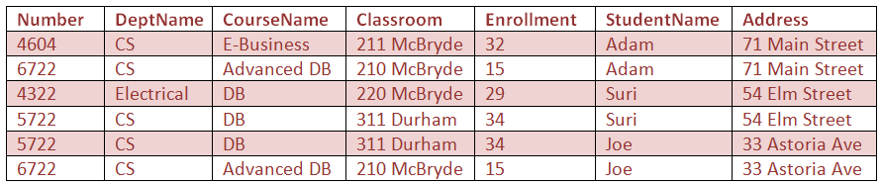
Another Example

Slide 5
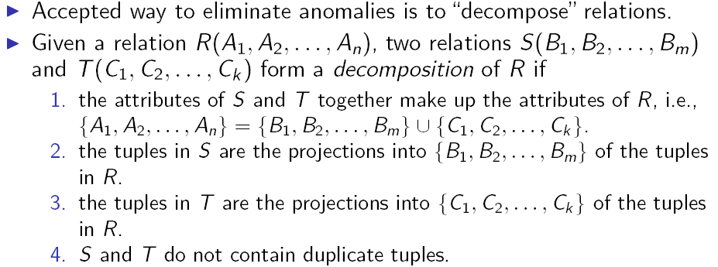
Relational Decomposition

Slide 6
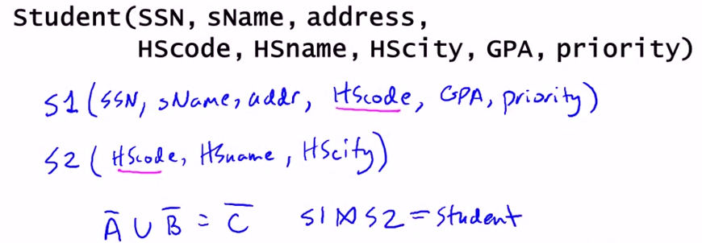

Slide 7
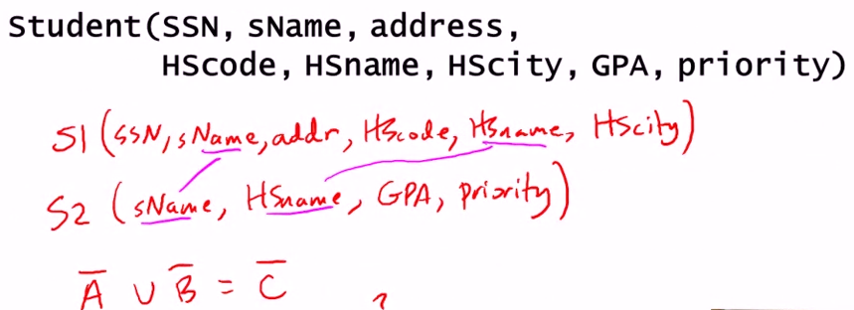


Slide 8


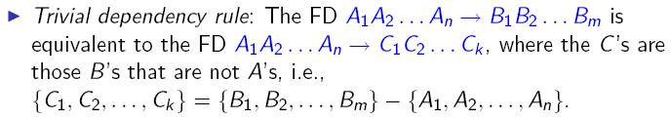

Triviality of FDs

Slide 9
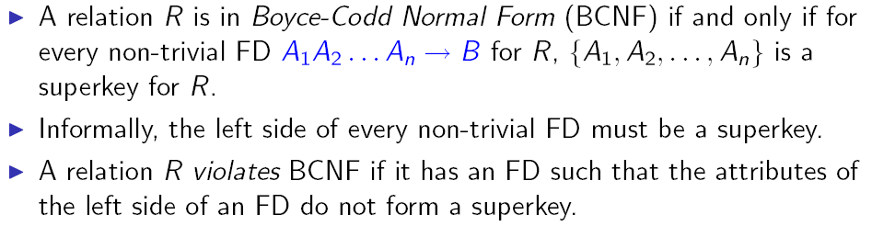
Boyce-Codd Normal Form

Slide 10
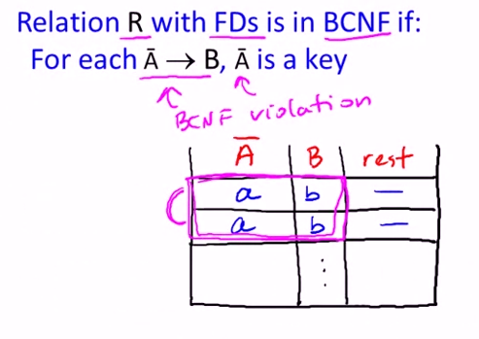
Boyce-Codd Normal Form
Super key

Slide 11
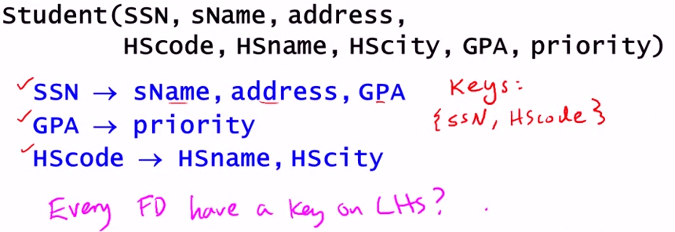

Slide 12
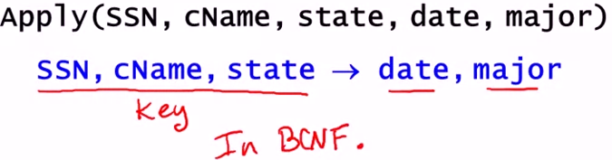

Slide 13

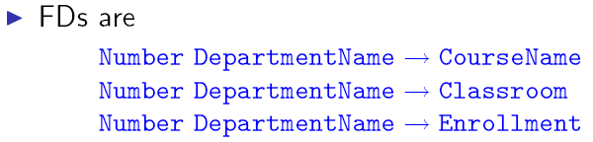

Checking for BCNF Violations

Slide 14
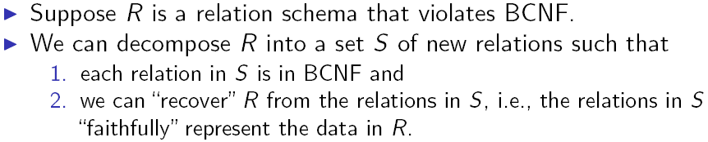

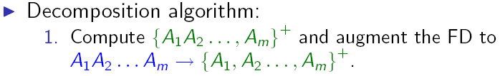
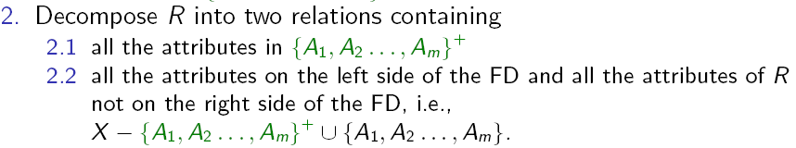
Decomposition into BCNF

Slide 15
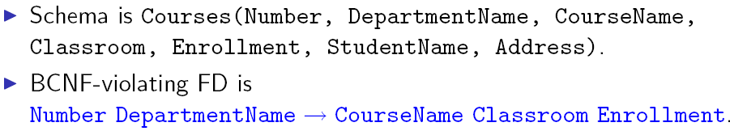
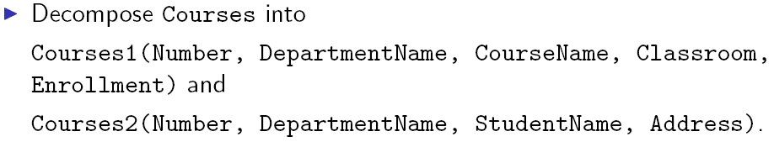
Decomposing Courses

Slide 16
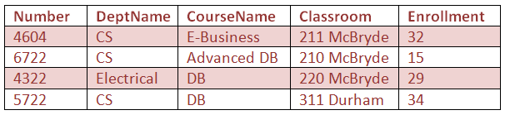
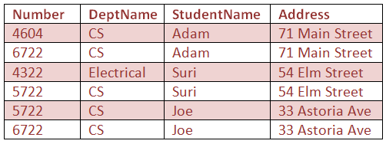
Decomposing Courses

Slide 17








Another Example of Decomposition

Slide 18
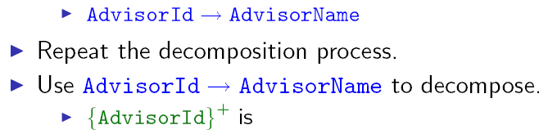


Another Example of Decomposition (2)

Slide 19
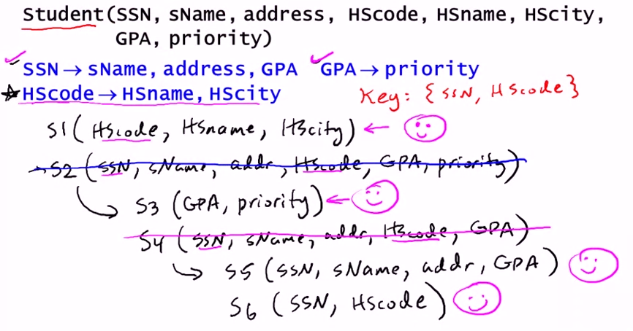

Slide 20

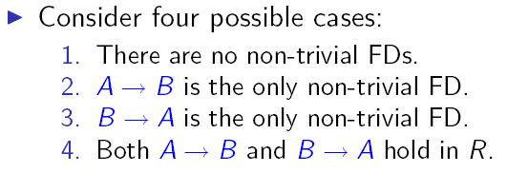
BCNFs and Two-Attribute Relationships

Slide 21
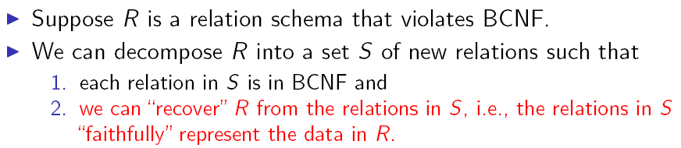
Decomposition into BCNF

Slide 22
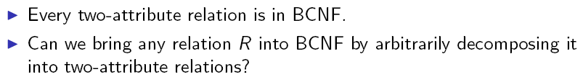
Candidate Normalization Algorithm

Slide 23
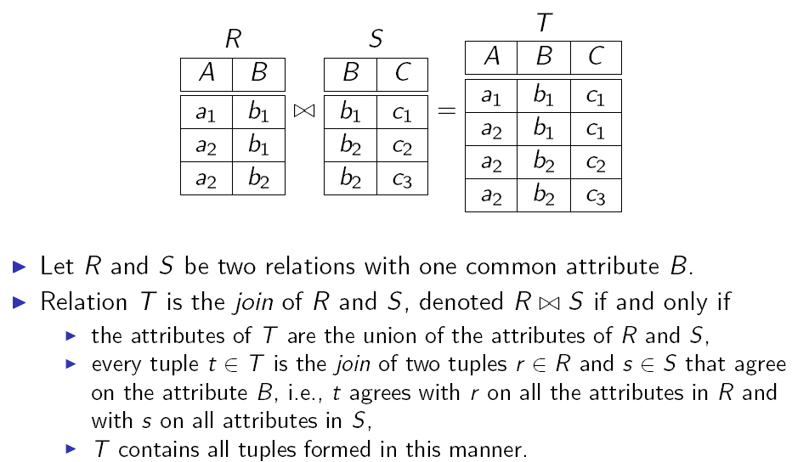
Joining Relations

Slide 24
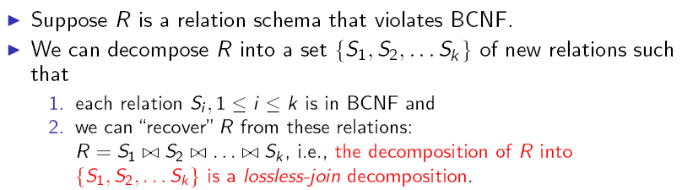
Recovering Information from a Decomposition

Slide 25
Correct Decompositions
A decomposition is lossless if we can recover:
R(A,B,C)
R1(A,B) R2(A,C)
R’(A,B,C) should be the same as
R(A,B,C)
Decompose
Recover
R’ is in general larger than R. Must ensure R’ = R

Slide 26
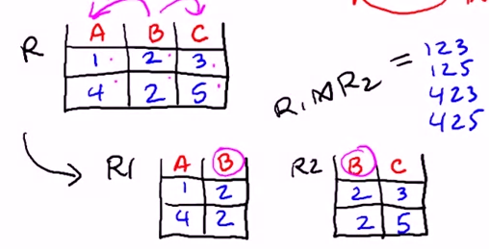
Incorrect Decompositions
R’ is in general larger than R. Must ensure R’ = R

Slide 27
Example of Lossy-Join Decomposition
Example: Decomposition of R = (A, B)
R₁ = (A) R₂ = (B)
A
B
A
B
α
α
β
1
2
1
α
β
1
2
∏_{A}(r)
∏_{B(r)}
r
∏_{A} (r) ∏_{B} (r)
A
B
α
α
β
β
1
2
1
2

Slide 28
Example: BCNF Decomposition
Drinkers(name, addr, beersLiked, manf, favBeer)
FDs = name->addr, name -> favBeer, beersLiked->manf
Pick BCNF violation name->addr.
Close the left side: {name}⁺ = {name, addr, favBeer}.
Decomposed relations:
  Drinkers1(name, addr, favBeer)
  Drinkers2(name, beersLiked, manf)

Slide 29
Example -- Continued
We are not done; we need to check Drinkers1 and Drinkers2 for BCNF.
Is Drinkers1 in BCNF ?
  For Drinkers1(name, addr, favBeer), relevant FD’s are name->addr and name->favBeer.
  Thus, {name} is the only key and Drinkers1 is in BCNF.

Slide 30
Example -- Continued
For Drinkers2(name, beersLiked, manf), the only FD is beersLiked->manf, and the only key is
{name, beersLiked}.
  Violation of BCNF ?
beersLiked⁺ = {beersLiked, manf}, so we decompose Drinkers2 into:
  Drinkers3(beersLiked, manf)
  Drinkers4(name, beersLiked)

Slide 31
Example -- Concluded
The resulting decomposition of Drinkers :
  Drinkers1(name, addr, favBeer)
  Drinkers3(beersLiked, manf)
  Drinkers4(name, beersLiked)
Note:
  Drinkers1 tells us about drinkers,
  Drinkers3 tells us about beers, and
  Drinkers4 tells us the relationship between drinkers and the beers they like.

Slide 32
Summary of BCNF Decomposition
Find a dependency that violates the BCNF condition:
A , A , … A
B , B , … B
1
2
n
1
2
m
Decompose:
Continue until
there are no
BCNF violations
left.
Others
A’s
B’s
Is there a
2-attribute
relation that is
not in BCNF ?
R1
R2

Slide 33
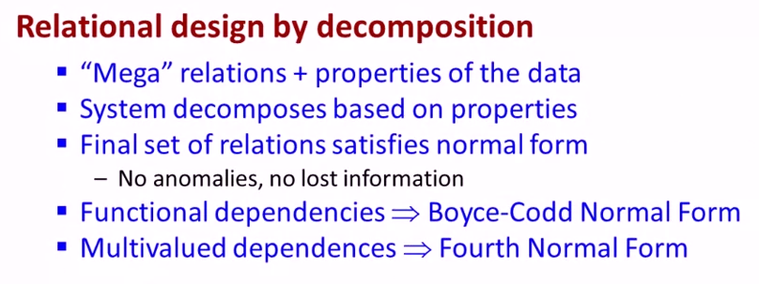
Relational design by decomposition

