Slide 1
Third Normal Form (3NF)
Dr. Bing Zhou

Slide 2
Third Normal Form - Motivation
R (A, B, C)
AB ->C and C ->B.
  Example: A = street address, B = city, C = zipcode.
What is the key?
  There are two keys, {A,B } and {A,C }.
These (and similar) structures of FD’s cause trouble when we decompose.
C ->B is a BCNF violation, so we must decompose into AC, BC.

Slide 3
We Cannot Enforce FD’s
The problem is that if we use AC and BC as our database schema, we cannot enforce the FD AB ->C by checking FD’s in these decomposed relations.
Example with A = street, B = city, and C = zip on the next slide.

Slide 4
An Unenforceable FD
street A zip C
545 Tech Sq. 02138
545 Tech Sq. 02139
city B zip C
Cambridge 02138
Cambridge 02139
Join tuples with equal zip codes.
street A city B zip C
545 Tech Sq. Cambridge 02138
545 Tech Sq. Cambridge 02139
Although no FD’s were violated in the decomposed relations,
FD street city -> zip (AB ->C) is violated by the database as a whole.

Slide 5
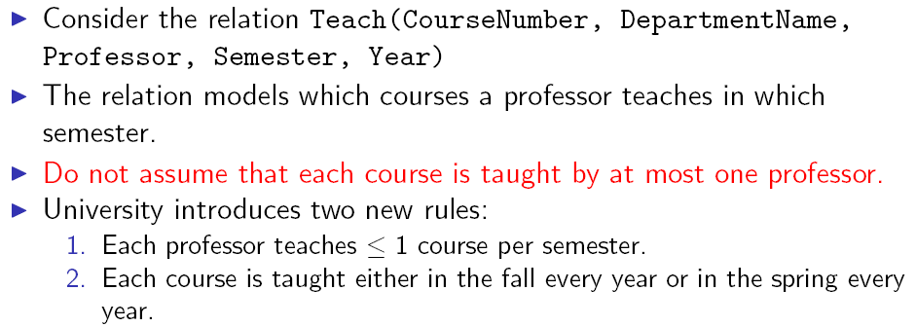





Preserving FDs in a Decomposition

Slide 6
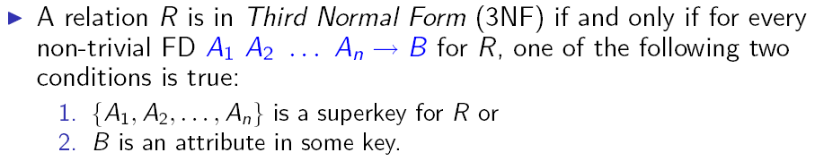
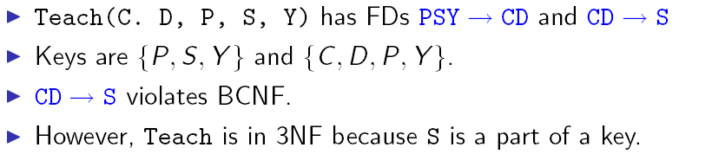
Third Normal Form (3NF)

Slide 7
3NF Let’s Us Avoid the FD Problem
3rd Normal Form (3NF) modifies the BCNF condition so we do not have to decompose in this problem situation.
An attribute is prime if it is a member of any key.
X ->A violates 3NF if and only if X is not a superkey, and also A is not prime.

Slide 8
Example
In our problem situation with FD’s AB ->C and C ->B, we have keys AB and AC.
Thus A, B, and C are each prime.
Although C ->B violates BCNF, it does not violate 3NF.

Slide 9
What 3NF and BCNF Give You
There are two important properties of a decomposition:
  Recovery : it should be possible to project the original relations onto the decomposed schema, and then reconstruct the original.
  Dependency preservation : it should be possible to check in the projected relations whether all the given FD’s are satisfied.

Slide 10
3NF and BCNF, Continued
We can get (1) with a BCNF decompsition.
We can get both (1) and (2) with a 3NF decomposition.
But we can’t always get (1) and (2) with a BCNF decomposition.
  street-city-zip is an example.

Slide 11
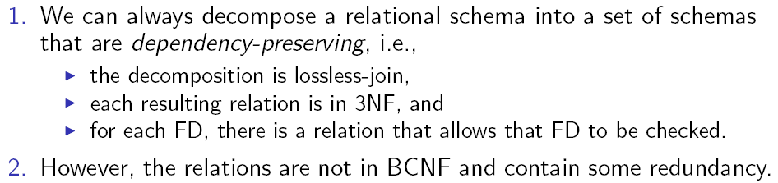
Decomposition into 3NF

Slide 12
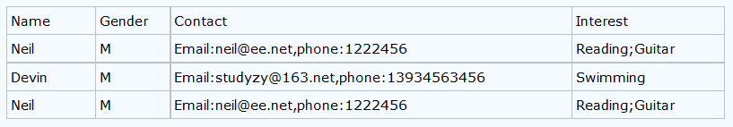
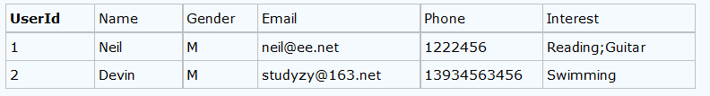
First Normal Form
Table faithfully represents a relation, primarily meaning it has at least one candidate key, and each attribute is atomic

Slide 13
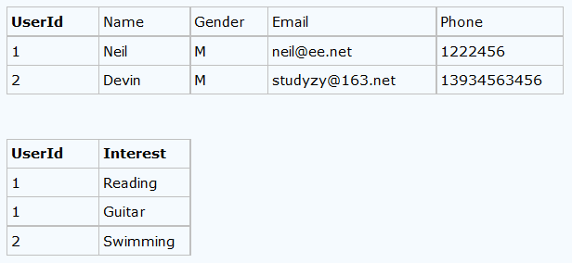
First Normal Form
Table faithfully represents a relation, primarily meaning it has at least one candidate key, and each attribute is atomic

Slide 14
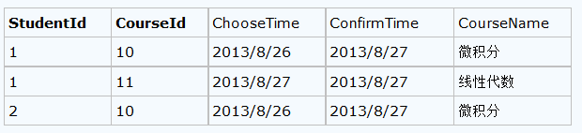

Second Normal Form
It has to be in the first normal form + No non-prime attribute in the table is functionally dependent on a proper subset of any candidate key

Slide 15
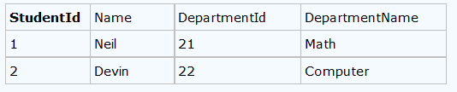
Third Normal Form
It has to be in the second normal form + the left hand side is a super key OR the right hand side is prime
StudentId -> Name DepartmentID DepartmentName
DepartmentId -> DepartmentName
T1={DepartmentId, DepartmentName}
T2={StudentID, Name, DepartmentID}

Slide 16
BCNF
The left hand side of every non-trivial functional dependency must be a superkey

Slide 17
Fourth Normal Form
The left hand side of every non-trivial Multi-valued dependency must be a superkey

Slide 18
Fifth Normal Form
Beyond the scope of this class
Every relation can be further decomposed into smaller relations unless the decomposed relation will have the same key as the original table
Notes:
E

Slide 19
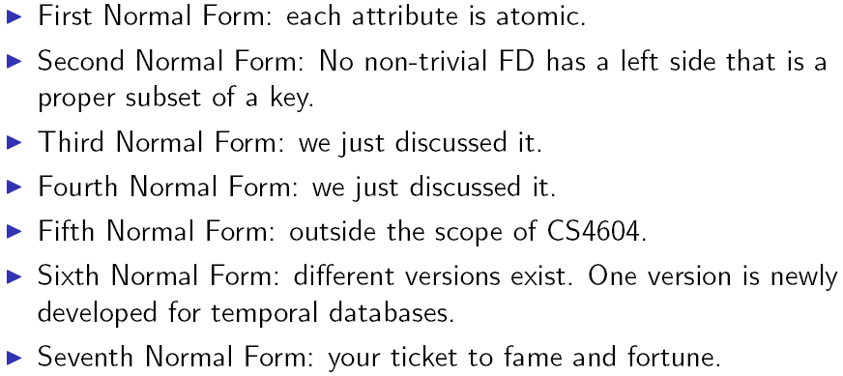
kNFs

Slide 20
