Slide 1

Coffee Shop Database – Stage 1 Presentation
Roles: DB Architect - Aibekov Erturan
DB Analyst - Ormonbekov Baiel
Dataset: Online Coffee Shop

Slide 2
Problem Statement
Build a relational database for a coffee shop to analyze customer behavior, product sales, delivery performance, and reviews.
Optimization problems considered:
- Fast querying of orders and reviews (indexes added)
- Scaling dataset with >1000 rows per table
- Ensuring clean structure for AI-powered analysis

Slide 3
Dataset Overview
Tables:
- customers (3200 customers)
- products (120 products)
- orders (6500 orders)
- order_items (~ 20000 order items)
- deliveries (6500 deliveries)
- reviews (4800 reviews)
Business domain: retail coffee sales + delivery analytics

Slide 4
DB Architect Deliverables
✔ Required dataset found and expanded to a relational model
✔ Ensured minimum 5+ tables (we have 6)
✔ Designed schema for future scalability
✔ Identified fields for indexing:
- orders(order_date)
- orders(customer_id)
- deliveries(order_id)
- reviews(rating)

Slide 5
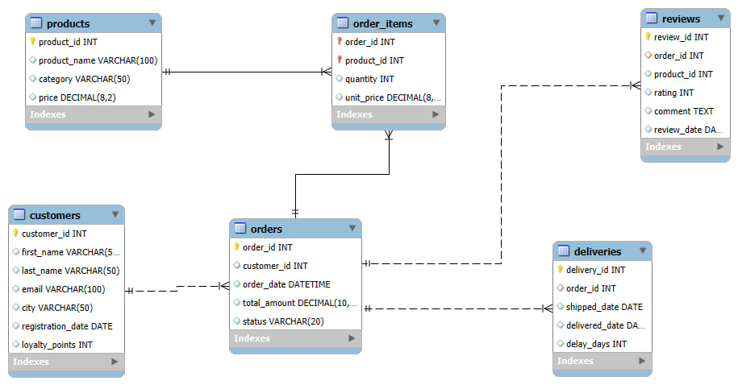
Entity‑Relationship Diagram (ERD)
Core relationships:
- customers 1—∞ orders
- orders 1—∞ order_items
- products 1—∞ order_items
- orders 1—1 deliveries
- orders 1—∞ reviews
- products 1—∞ reviews

Slide 6
DB Analyst Deliverables
✔ Verified relational integrity (PK/FK)
✔ Defined relation types (1‑M, 1‑1, M‑M resolved via junction table)
✔ Ensured normalization:
- No repeating groups
- Each entity has atomic fields
- Referential integrity preserved

Slide 7
Future Dataset Extensions
Planned extensions:
- payment transactions
- promo codes
- barista performance metrics
- customer segmentation for loyalty program
Architecture supports painless scaling.

Slide 8
Conclusion
Dataset is fully ready for Stage 2.
Schema is normalized, indexed, and well‑designed for AI analysis.
Next steps:
- Populate data
- Connect to Python
- Build AI text‑to‑SQL agent
Roles:
SQL developer:
Arslan Sopakunov
AI engineer:
Makhkambaev Munarbek

