Slide 1

Jianfeng Liu, eBay
Justin Early, Avantsoft
@earlyster
eclipse.org/vjet/

Slide 2

Global
Pollution
Portability
{types} in
JsDoc !checked
Lack of structure
Never upgrade
syndrome
not able to use
multiple
libraries
JS errors

Slide 3
VJET’s Journey
  2005 - VJET started it’s life inside ebay. Based on Eclipse platform to work with Java and Web-tools development environment.
  April 2011 - VJET open sourced as part of ebayopensource.org
  2011-2012 - VJET + Sencha work to make VJET more extensible to support adopters type systems. Sencha sells extensions for VJET.
Notes:
2005 - VJET started it’s life inside ebay as a JS type editor and code-gen to provide Java API for JS code.
Nov 2012 - VJET renamed to org.eclipse.vjet

Slide 4
VJET’s Journey at Eclipse Foundation
  June 2012 - VJET proposed as an Eclipse project
  Nov 2012 - VJET sourced added to git.eclipse.org after IP review
  Jan 2013 - VJET 0.9 initial contribution
  Feb 2013 - VJET 0.9.1 bug fix release
  March 2013 - VJET 0.10

Slide 5
What has been delivered?
Eclipse VJET JS IDE
VJET ANVILS
vjo.js - a js library for defining types
Eclipse Java 2 Js Code Gen
Eclipse Js 2 Java Code Gen
VJET Java based DOM construction kit

Slide 6
Training Tools
Automatic Inferencing
VJETDoc - you can type all js constructs
vjo.js - a js library for defining types
VJET ANVILS - HelloWorld and 3rd party JS
VJET Code generation

Slide 7
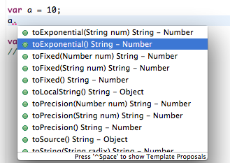
Inferencing based on literal

Slide 8
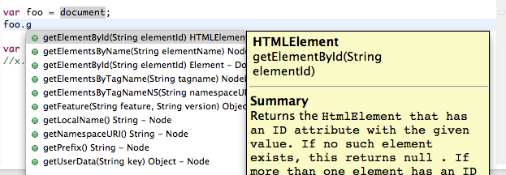
Inferencing based on assignment

Slide 9
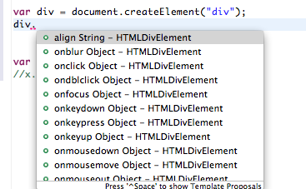
Inferencing based on known first arguments

Slide 10
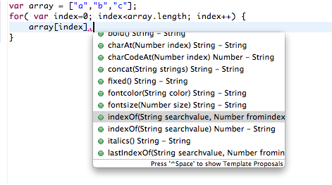
Inference of array types

Slide 11
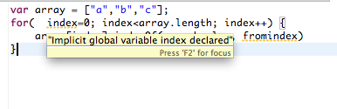
Flagging inferred accidental global vars

Slide 12
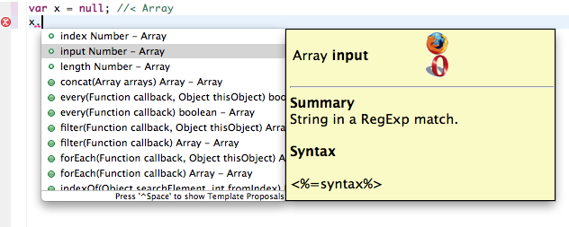
VJETDoc for vars

Slide 13
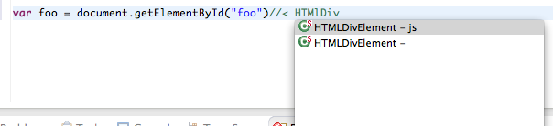
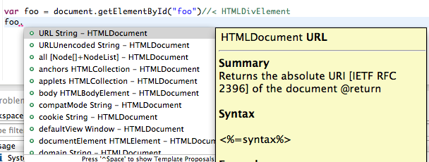
VJETDoc for DOM types

Slide 14
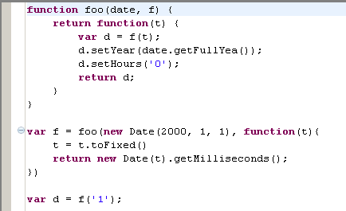
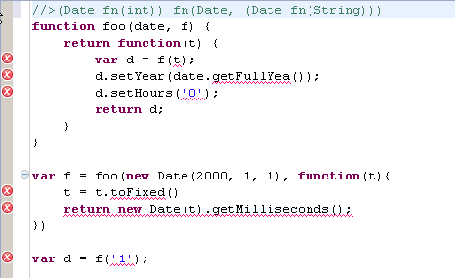
VJETDoc for functions

Slide 15
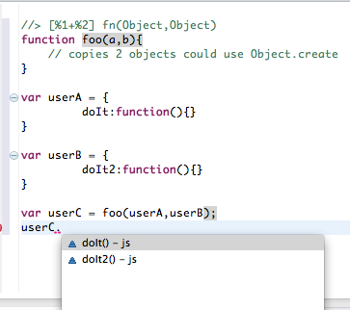
VJETDoc for functions and literals

Slide 16
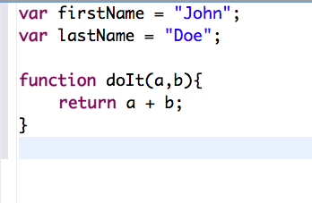
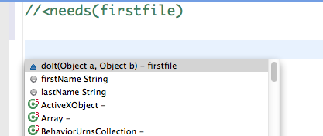
VJETDoc for dependencies
firstfile.js

Slide 17
VJETDoc - more
Learn more about VJETDoc here
eclipse.org/vjet/ -> Documentation

Slide 18
VJET vjo.js - a javascript functional library
JS does not have a formal definition format for classes,enums,interfaces.
These are very powerful definitions which help build large java libraries.
If I am going to build a large JS library it would be great if there was a build, IDE support, JDT support so I know my structure is ok.
Notes:
There are many options for constructing a “class” today in JS since JS doesn’t have class construct by default.
function Person(){}
Person.prototype.method = function(){}
Person.prototype.prop = 20;
Multiple issues with this:
1. no namespace
2. can mix execution code + definition code
3. !nested classes
4. how to handle java concepts such as enum, interfaces,

Slide 19
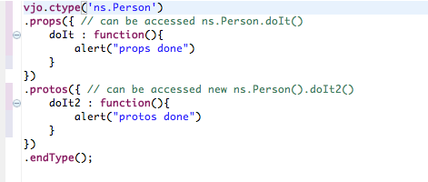
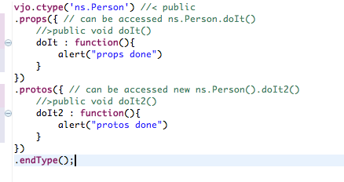
vjojs - defining types
Text
+VJETDoc
Notes:
Example:
load vjo bootstrap.js on the page
then load
vjo.ctype('ns.Person') //< public
.props({ // can be accessed ns.Person.doIt()
//>public void doIt()
doIt : function(){
alert("props done")
}
})
.protos({ // can be accessed new ns.Person().doIt2()
//>public void doIt2()
doIt2 : function(){
alert("protos done")
}
})
.endType();
Then you can call methods in the class.

Slide 20
vjojs -kinds of types
Class
Enum
Interface
Mixin
Object Literal
Function
Notes:
Class, Enum and Interface are to match types found in Java
Object literal and Function are to match types found in JavaScript
Mixin is a concept found in Ruby

Slide 21
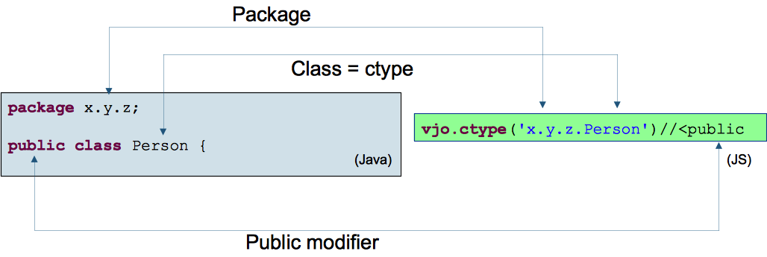
vjojs - side by side with Java

Slide 22
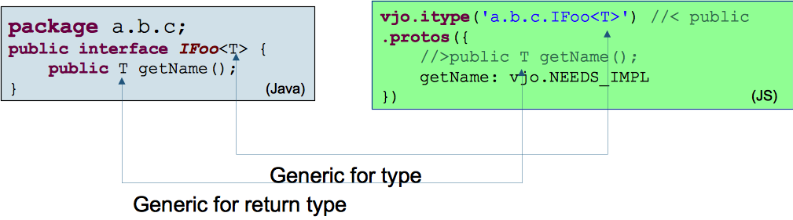
vjojs - side by side with Java

Slide 23
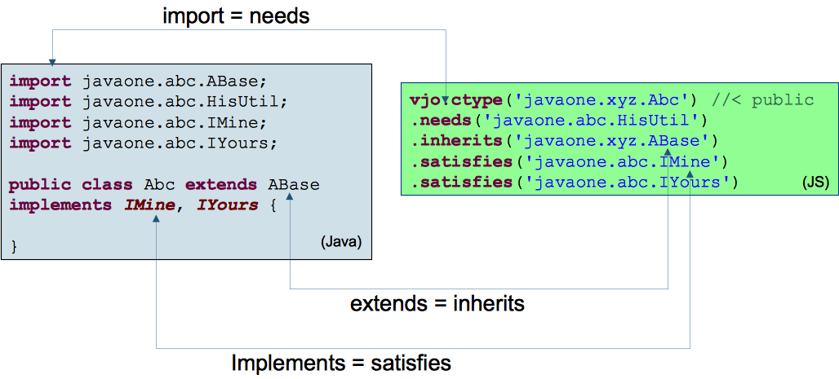
vjojs - side by side with Java

Slide 24
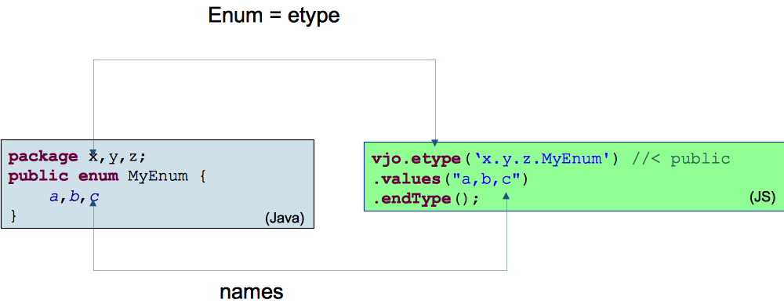
vjojs - side by side with Java

Slide 25
vjojs - more info
There is more information about vjojs
http://eclipse.org/vjet -> documentation

Slide 26
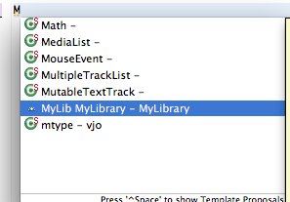
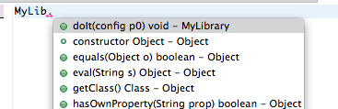
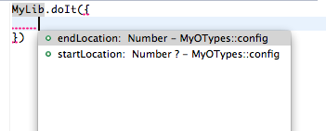
VJET creating type libraries using vjojs

Slide 27
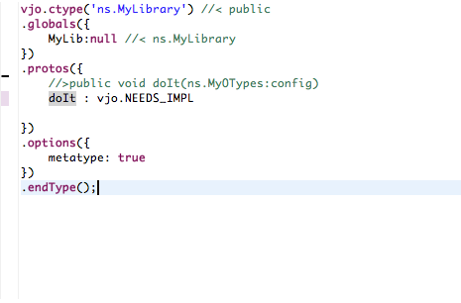
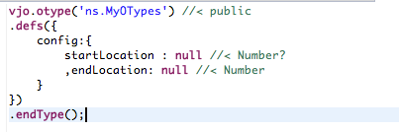
vjojs -for type libraries

Slide 28

VJET ANVILS
Authoring
Navigation
Validation
Instruction
Library
http://wiki.eclipse.org/VJET/ANVILS
Notes:
These are written in JavaScript

Slide 29
Using Existing ANVILs
DOM + JavaScript apis + vjojs - built in
EcmaScript Ed 5 api updates - add on
JSON - add on
HTML Canvas 2D API - add on

Slide 30
Using 3rd party JS library ANVILs
You can use type libraries in multiple ways:
  For JS authoring
  For authoring JavaScript with Java

Slide 31
VJET Mix n Match Code Gen
You can generate a Java API from vjojs
You can also generate vjojs code from Java

Slide 32
Demo
Notes:
First show js examples that were in slides
Show a change to VJET ANVIL

Slide 33
Tame JavaScript Monster with VJET
Automatic Inferencing
VJETDoc - you can type all js constructs
vjojs - a js library for defining types
VJET ANVILS - HelloWorld and 3rd party JS
VJET Code generation

Slide 34
VJET.next
AMD, commonjs module dependency understanding
ANVIL documentation/videos and possible standardization for multiple JS tools
VJET Graduation to 1.0 release
Increase # of contributors
VJET Core + Orion
NodeJS ANVIL 0.10 + 10x10 NodeJs module ANVIL
Google SoC -JQuery UI ANVIL + Testing of NodeJS ANVILs
Support for Google Closure library

Slide 35
Thanks
Please visit eclipse.org/vjet/
Jobs at Avantsoft
Training and Support for VJET
Contribute to VJET -- helpwanted bugs
Follow Justin on twitter @earlyster

