Slide 1

Eclipse Tips and Tricks - Eclipse Kepler 4.3 RC3 -
Rabea Gransberger
Dipl.-Inf.
@rgransberger

Slide 2
Rabea Gransberger
Speaker Bio
Diploma in Computer Science 2009 (University Bremen, Germany)
Developer, Project and Department Lead at MEKO-S GmbH, Bremen, Germany
Mainly working with eclipse Technology (RCP, RAP, Tabris)
Developing OTIS (Oil Trading and Information System)
Passionate Java developer with focus on clean code

Slide 3
Agenda
General IDE Setup
Settings & Menus
Editor Basics & Features
Navigation Basics & Important Shortcuts
Syntax Coloring, Templates & Formatting
Content Assist & Refactoring
Code Analysis, Console & External Tools
Debugger
Q&A

Slide 4
Sharing Settings: Eclipse
File → Export: General → Preferences and choose desired options
Save to a file, e.g. test1.epf
Change the option you are looking for, export to test2.epf
Do a diff between test1.epf and test2.epf Copy change to new file, remove the \instance\ qualifier in front
Save file as plugin_customization.ini on network drive
Add lines to <installdir>\eclipse.ini:
-pluginCustomization
<pathTo…>plugin_customization.ini
Notes:
Demo!

Slide 5
Working with Project Sets
Working for different customers or in different teams
Open multiple IDE instances with different project sets
Create links on the desktop to start the IDE with a project set
Workspace
-data D:\workspaces\DemoCamp -showlocation "DemoCamp"
General → Workspace → Workspace Name
Change Workspace Apperance (Color/Theme):
General → Appearance

Slide 6
Upgrading
Auto-Update for plugins and minor versions available
Upgrading IDE to new version while preserving installed plugins
Only upgrade to minor version possible, for major
Install Software Items from File: File → Export/Import → Install
Download + re-install + zip for team members
Install from command line or Yoxos Profile

Slide 7
Settings & Menus

Slide 8
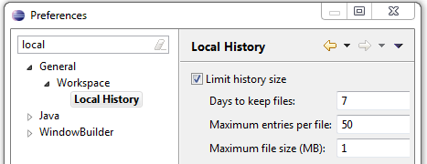
Local History
IDE keeps local history of files
Get back a revision not in version control
Restore when deleted (context menu, parent)
Check settings of version history size
General → Workspace → Local History

Slide 9
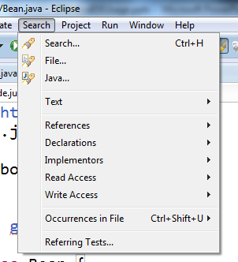
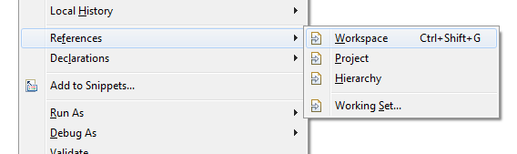
Explore the Menus
Some commands have no (default) shortcut but are in the menu
Examples:
Search menu has more options then context menu:
Referring tests, read / write access, implementors
Navigate:
Open (super) implementation

Slide 10
Editor Basics & Features

Slide 11
Editor Basics
Double click tab to maximize or use shortcuts
Show line numbers General → Editors → Text Editors
Compare two files Context Menu: Compare
Move to new window, drag & drop, align multiple editors alongside
Paste text on package creates Java file automatically
Column/Block selection mode, e.g. for creating maps
Auto close editors tabs
Task Tags like TODO and FIXME can be used
Go to line Ctrl+L

Slide 12
Editor Features
Escape paste into String Java →Editor →Typing
Mark Occurrences: e.g. highlights selected variable in file
Show matching brackets / Highlight current scope
Java →Editor →Bracket-Highlighting: Enclosing
Folding of certain areas in editor, e.g. hide comments
Java →Editor →Folding
Copy qualified name Context Menu
Put Semicolon at end of line
Java → Editor → Typing
Completion Overwrites instead of Insert:
Java → Editor → Content Assist

Slide 13
Navigation Basics & Important Shortcuts

Slide 14
Navigation Basics
Open Type/Resource: With CamelCase search Alt+Shift+T/Alt+Shift+R
Quick Open Type/Hierarchy F3/F4
Next/Prev match Ctrl+./Ctrl+,
Last edit location Ctrl+Q
Breadcrumbs Alt+Shift+B
Notes:
DEMO

Slide 15
Important Shortcuts
Content Assist: Ctrl+Space
Quick fix: Ctrl+1
Quick Access: Ctrl+3
Find editor: Ctrl+E
Incr. Search: Ctrl+J / K
Run: Ctrl+F11
Format: Ctrl+Shift+F
Delete Line: Ctrl+D
Comment: Ctrl+Shift+C
Notes:
DEMO

Slide 16
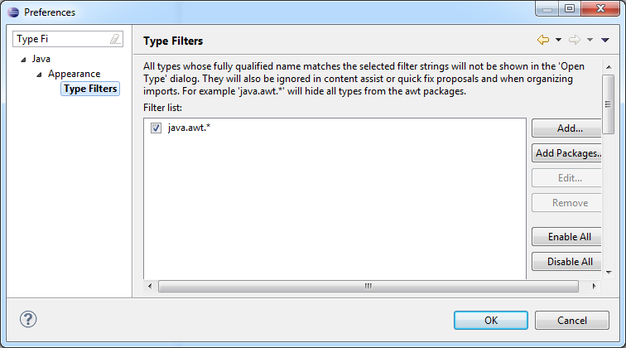
Imports
Number of imports for * for normal and static imports
Exclude e.g. java.awt.* from import proposals
Java → Appearance → Type Filters

Slide 17
Syntax Coloring, Templates & Formatting

Slide 18
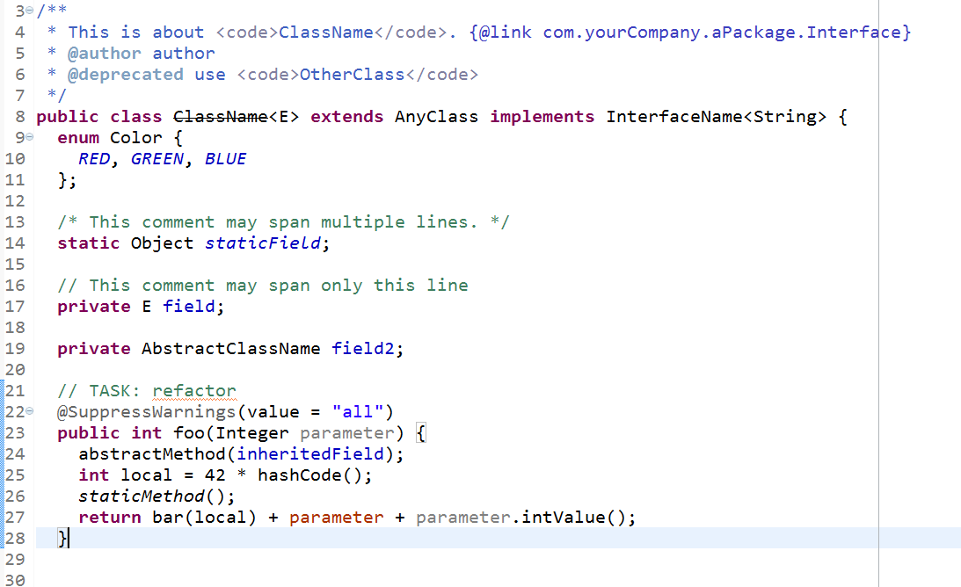
Syntax Coloring
See possible issues immediately by coloring or font settings
Examples:
Java → Editor → Syntax Coloring
Mark Boxing/Unboxing expressions in red

Slide 19
Formatting
Team should work with same settings for code style
May set pre-/suffix for variables, e.g. m_field
Detailed formatting options for code: braces, line wraps, spaces, etc.
Java → Code Style → Formatter
Format on save for edited lines only
Java → Editor → Save Actions: Format edited lines

Slide 20
Templates
Use templates to generate expressions and blocks
Create your own: e.g. Exceptions to slf4j instead of console
Java → Code Style → Code Templates
Structure, comments, copyright
Java → Editor → Templates: smart code snippets
Notes:
DEMO

Slide 21
Save Actions
Actions which can be applied on save
In Eclipse, e.g.:
Java → Editor → Save Actions
Format + Organize imports
Use parentheses in statements
Use qualified access with this
Add @Override and @Deprecated
Additional Clean-Up profile which can be triggered manually
Menu: Source → Clean Up

Slide 22
Content Assist & Refactoring

Slide 23
Content Assist
Let the IDE generate code, don‘t type yourself
Constructors/Fields/Getters/Setters/toString/equals/hashCode
Override/Implement methods
Call API which does not exist
Call method and generate assignment
Create fields from parameters
Use quick fixes / intentions when shown by IDE
Can use abbreviations of type name for completion
Completion overwrites, best guessed arguments, trigger = 50ms
Notes:
DEMO

Slide 24
Refactoring
Refactoring is a safe operation to restructure the code
Common: Rename, Move, change signature
Extract variable, method, constant
Create superclass, interface, pull up, push down
Safe delete is not present in but can be simulated:
Empty the body of the method to delete
Inline the method, which results in replacing it with nothing
NetBeans provides additional transformation to Java 7

Slide 25
Code Analysis, Console & External Tools

Slide 26
Static code analysis
Find potential errors before running
Plugins for PMD/FindBugs
Eclipse
ECJ: incremental compiler with additional warnings/errors
Java → Compiler → Errors / Warnings
Plugin: CodePro Analytix

Slide 27
Console
Settings for Console
Run/Debug → Console
Change character limit of console
Change Colors & Fonts
Show on output and/or error
StackTrace Console (Console Toolbar), paste trace from log

Slide 28
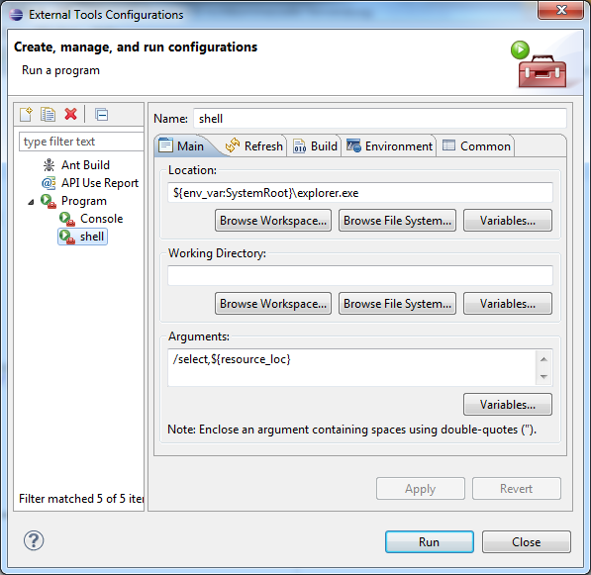
External Tools
Menu Run → External Tools- → External Tools Configuration:
Create new Progam: Shell
Location: ${env_var:SystemRoot}\explorer.exe
Arguments: /select,${resource_loc}
Common: Display in Favorites Menu.
Mark File, select Shell from Menu
For Console:
Location: ${env_var:SystemRoot}\system32\cmd.exe
Working Dir: ${container_loc}
Common: Allocation Console + Display in Favorites

Slide 29
Debugger

Slide 30
Debugger
If HotSwap enabled when debugging, changes applied immediately
Breakpoints can be set on class, methods, fields and exceptions too
Conditional breakpoints
Step-Filters: Skip simple getters, setters, certain classes
Java → Debug → Step Filters
Shortcuts: Step over, Step into, Step return, Continue
F6/F5/F7/F8
Notes:
DEMO

Slide 31
Debugger II
Pause Debugger to find current execution location
Formatting for variables view
Java → Debug → Detail Formatters
Different view for collections and default view toString()
Toolbar: Debug → Variables: Show Logical Structure

Slide 32
Debugger III
Evaluate Expression
Ctrl+Shift+I
Recall previous method
Context Menu: Drop to frame
References / Labels
Variables View menu
Monitors and Thread Groups
Debug View menu

Slide 33
Miscellaneous

Slide 34
Eclipse Misc
Working Sets to group projects and use as top-level in navigation
Run/Debug → Launching: Always Launch Previous
If a command doesn‘t work, look at the Error View (Ctrl+Shift+V)
Breakpoints-View allows to group by project
Search View allows deleting and pinning

Slide 35
More Information
Did you know your IDE has a lot of build-in help pages?
http://help.eclipse.org
Look for sections like
"Getting started"
"Tips and Tricks"
"Important Shortcuts"
Read the Release Notes which mention new features

Slide 36
Bugs & "Missing" Features
Eclipse can be extended via plugins
File a feature request in the respective issue tracker
Have a look at the API and develop your own plugin
If you find a bug in the IDE, please report it:
http://bugs.eclipse.org

Slide 37
Summary
Explore the features of your favorite IDE: Know your Tools!
Be lazy, let the IDE do the work with Content Assist / Templates
Create settings and share for the Team
Do “Learning shortcuts”-sessions in regular time intervals

