Slide 1










Eclipse Foundation
While most people think about Eclipse as IDE,
Eclipse as Foundation is
191 member companies and institutions
Strategic members are Actuate, Bredex, CA, Google, IBM, Innoopract, Itemis, Obeo, Oracle, SAP, Talend.

Slide 2



Eclipse Foundation Projects
and 227 software projects
a row of IDE for different languages
Orion in browser IDE
Jetty web server,
Hudson CI server,
vert.x framework

Slide 3
As Platform
As Platform for products like
IBM Rational,
SAP NetWeaver Developer Studio,
Talend Open Studio,
SpringSource STS,
Aptana.

Slide 4
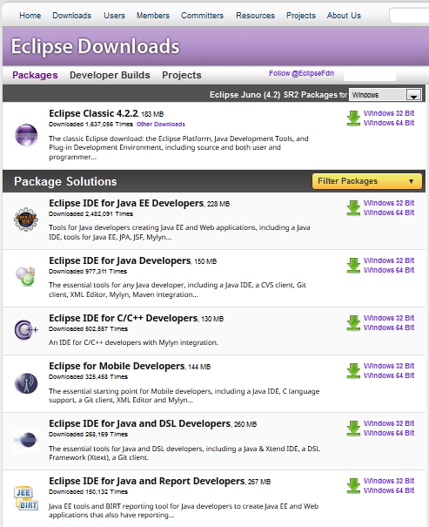

Slide 5
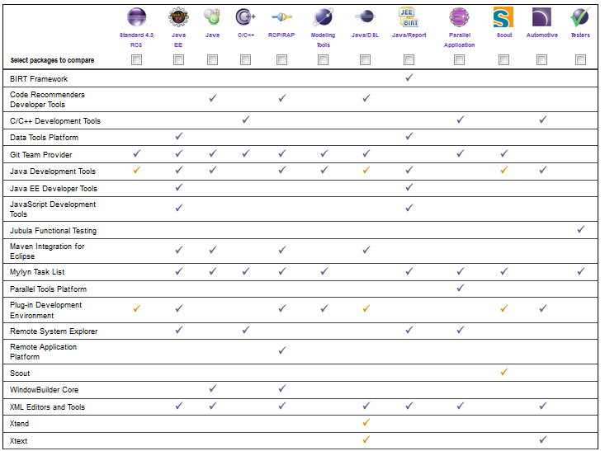

Slide 7
Links
http://www.eclipse.org/membership/showAllMembers.php
http://projects.eclipse.org/list-of-projects

