Slide 1
Jinying Yu, Sebastian Lehrig & Steffen Becker
Demo: CloudScale Method for Analyzing Scalability, Elasticity, and Efficiency Engineering

Slide 2






EU FP7 project CloudScale
Eclipse based tools
4.7M euros funding from EU
10.2012- 12.2015

Slide 3







Setting: A concerned manager
«uses»
«uses»
Consumer
Online
Book Shop
Cloud Computing
Environment
«suggests»
Management concerns
Avoid disappointments
Response times
Operation costs
Cloud Computing
Architect
Operation
Cost
«assigns»
«requires»
Manager
#Consumer
Notes:
Setting: put the reviewers in the position of a manager of a company offering a book store as a SaaS solution.
It has been used for 15 years.
An increase in load is now expected as a consequence of a new business strategy of selling novel cloud scalability books.
The manager wants the architect to ensure that the system - after modernisation - can sustain this increased load.
The architect suggest the manager a modern cloud computing solution.
However, the manager has heard of others that were disappointed by migrating to the cloud;
He is concerned about short term issues (such as unacceptable response times).
In addition he wants to know what the new system’s operation will cost (in the long term, which depends on capacity).
he has heard that CloudScale might have some useful tools to reduce such unpleasant surprises.

Slide 4
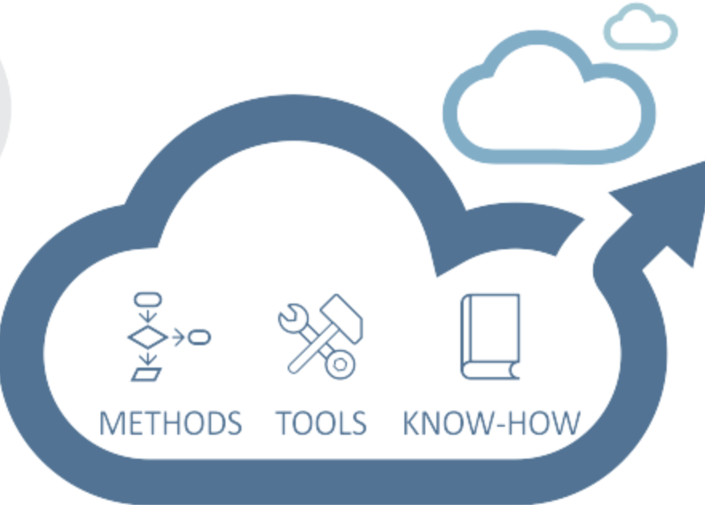
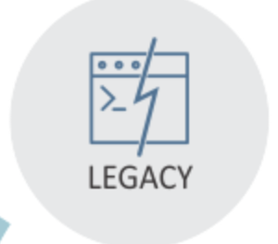
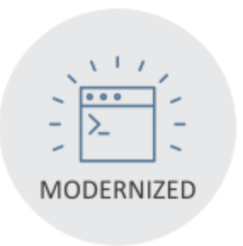
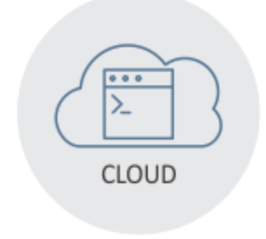
EU FP7 project CloudScale
Optimization
Modernization
Migration

Slide 5
CloudScale Tools
Extractor: extracts models
Analyzer: analyzes quality based on analytical solvers and/or simulations at design time
Static Spotter: detects potential scalability anti-patterns from model
Dynamic Spotter: detects software performance problems through measurement

Slide 6




1
(Re-)Engineer ScaleDL Model
2
Analyze, Detect, and Resolve Quality Issues
3
(Re-)Implement, Deploy, and
Test
…
«uses»
«uses»
WWW
Logic
DB
DB
Book Shop
Consumer Model
Book Shop
Software Model
Cloud
Environment Model

Slide 7
Management concerns
Avoid disappointments
Response times
Operation costs
Analyzer →
Operation Cost
#Consumer
2
Analyze,
Detect, and Resolve Quality Issues
…
«uses»
«uses»
WWW
Logic
DB
DB
Book Shop
Consumer Model
Book Shop
Software Model
Cloud
Environment Model
Notes:
-> constructive approach (instead of reengineering)

Slide 8

Analyze: Live Demo
http://www.cloudscale-project.eu/results/screencasts
Screencasts
Available!

Slide 9

Existing
Service
Operation Cost
Scalable
Service
#Consumer
Architect
Quality Analysis
1
(Re-)Engineer ScaleDL Model
2
Analyze, Detect, and Resolve Quality Issues
3
(Re-)Implement, Deploy, and
Test
…
«uses»
«uses»
WWW
Logic
DB
DB
Book Shop
Consumer Model
Book Shop
Software Model
Cloud
Environment Model
www.CloudScale-project.eu
Twitter @CloudScaleEU

