Slide 1








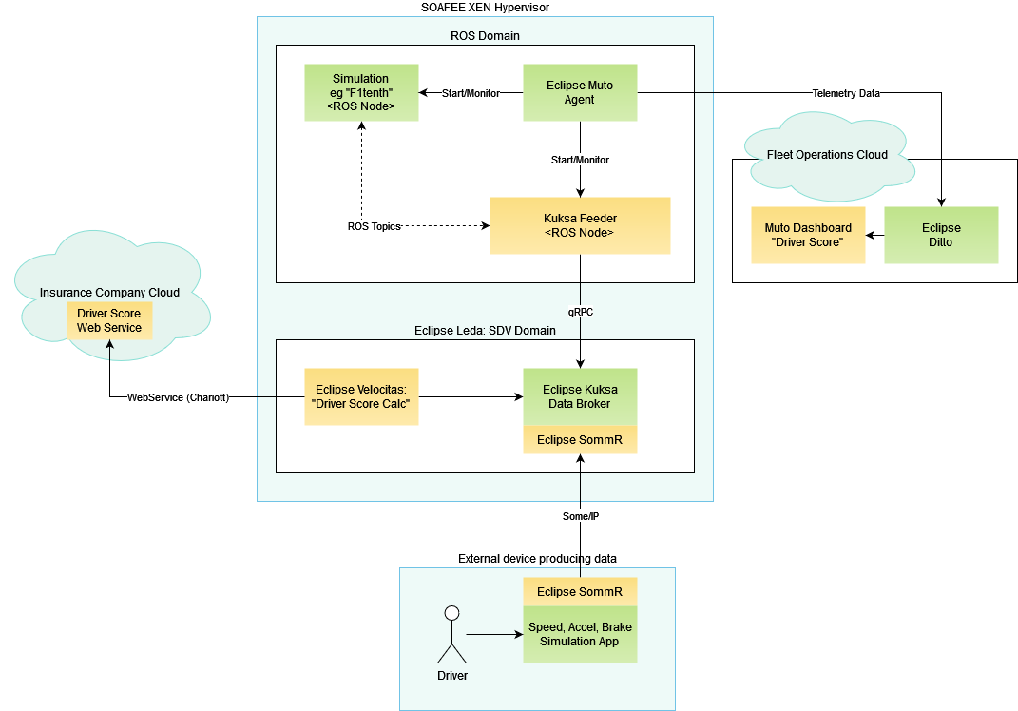





{hackathon}
Driving Score
BCX Challenge 2
Goal of the challenge:
Measure the quality of driving by calculating a score of the driving style.
Implement a vehicle app to calculate the score and visualize it.
Data source & actuators:
Throttle & Steering
Example hacks:
Use simulated data to focus on exploring the SDV components, Vehicle Twin and Vehicle Signals catalog
Run your app on the SDV Fleet racers and challenge other teams
Digital Twin
Vehicle Signals
Example architecture:
Projects involved:

