Slide 1





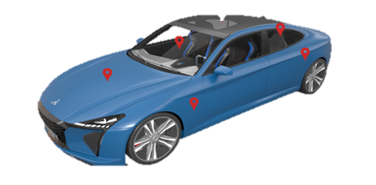



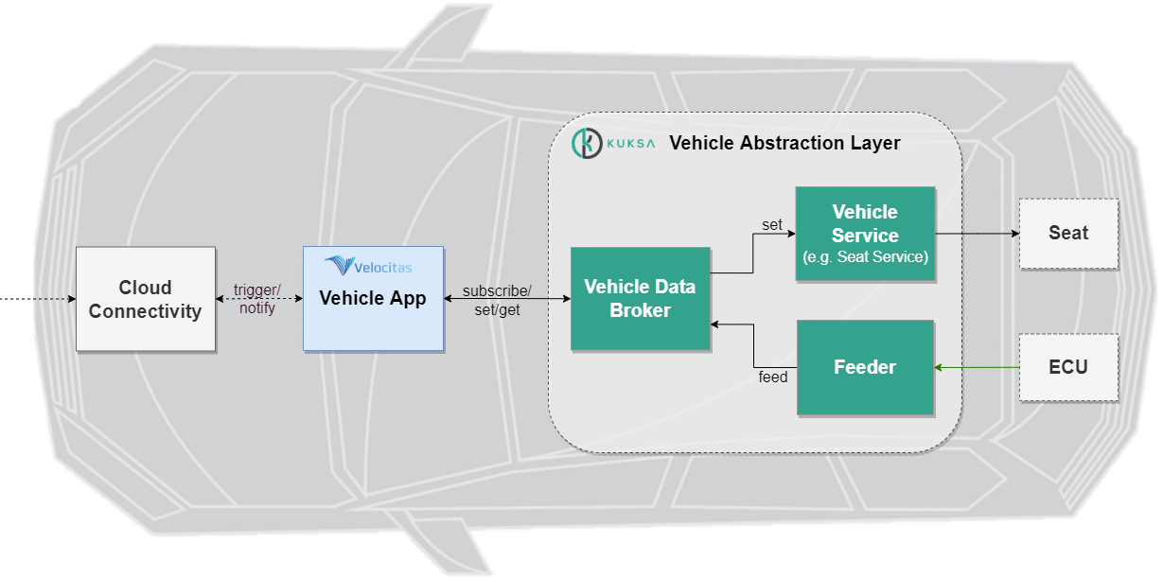



{hackathon}
Passenger Welcome
BCX Challenge 2
Goal of the Challenge
How should your own car or a carsharing car behave when you approach it to feel comfortable entering and using it?
This hack challenge focuses on encouraging creativity by ideate ideas in the form of rapid prototyping in a playground, transfer them easily to a working vehicle application and trying them out on a device.
Data Source & Actuators
Vehicle.Windshield
Vehicle.Cabin
Vehicle.Body
Vehicle.Chassis
Example Hacks
Adjust the seat position or steering wheel position
Adjust the cabin temperature
Open the door or the trunk
Special lighting sequence
Vehicle.Powertrain
Example Architecture
Projects Involved

