Slide 1



Eclipse SDV Hackathon Chapter 4
Bare-Metal-Mafia
Guardian Loop · swap the car, keep the brain
October 6-8 2026
COPYRIGHT (C) 2026, ECLIPSE FOUNDATION
Notes:
(~20 s) Hi, we're Bare-Metal-Mafia. In the next nine minutes we'll show you Guardian Loop: a child presence safety feature that doesn't care what hardware sits underneath it. You can swap the car out from under it, and the brain stays the same.

Slide 2

The Plan
Problem
Solution
👶
🌡️
Sense
child · temp
Guardian
decide
Act
cool · window · alarm
+
left behind
hot cabin
One rule: swap the hardware, never the logic.
Copyright© Eclipse Foundation AISBL and contributors. Made available under CC-BY-SA 4.0 International.
Notes:
(~60 s) Every summer, children die in parked cars. A closed car in the sun heats up fast, and a small child can't open a door or a window.
The fix sounds simple. Notice the child, watch the cabin temperature, decide how dangerous it is, and act: cool the cabin, open a window, raise the alarm. Sense, decide, act.
The real challenge: software-defined vehicles keep changing underneath. Today a simulator, tomorrow a dev board, next year another supplier's ECU. So we set one rule: swap the hardware, never the logic. If changing a sensor forces a change in the Guardian, the design is wrong.

Slide 3
Team
D
Dimitri
E
Elias
K
Katharina
Bachelor Student
Bachelor Student
Bachelor Student
L
Lars
P
Priya
T
Terra
Bachelor Student
Master Student
Bachelor Student
Copyright© Eclipse Foundation AISBL and contributors. Made available under CC-BY-SA 4.0 International.
Notes:
(~25 s) We're six students, five Bachelor and one Master: Dimitri, Elias, Katharina, Lars, Pria and Terra.
Lars led the team and the AutoSD deployment, together with Dimitri, who also brought up the S32K148 and AZ3166 boards. Terra built the Telegram notification service. Elias built the Gazebo cabin and the ROS 2 to uProtocol bridge. Katharina owns the brain: the Guardian Loop logic. [Pria: add contribution]

Slide 4
The Product
Sense
AutoSD HPC
Actuate
Child presence
sim / Gazebo
Guardian Loop
guardian.rs
OpenSOVD CDA
sim
Window
S32K148 · OpenBSW
uProtocol →
HVAC
ROS 2 · Muto
RPC
Temperature
AZ3166 · ThreadX
Actuation Adapter
Alarm
Telegram
CLEAR
MONITORING
WARNING
CRITICAL
MITIGATING
Copyright© Eclipse Foundation AISBL and contributors. Made available under CC-BY-SA 4.0 International.
Notes:
(~75 s) Left to right.
The senses: child presence and cabin temperature. They publish events over Eclipse uProtocol, the only language the Guardian speaks.
In the middle the Guardian Loop, one container image. It runs inside AutoSD in a VM on our Raspberry Pi HPC; for the real-hardware demo the same container runs on the bare Pi.
It's a small state machine: no child means CLEAR. Child at a comfortable temperature means MONITORING. 25 degrees is WARNING, 28.5 is CRITICAL. We lowered those from 32 and 40 so a hairdryer can drive the demo. CRITICAL triggers MITIGATING.
The Guardian never touches hardware. It sends one RPC to the Actuation Adapter, which drives the ROS 2 air conditioning and, through the diagnostic adapter, today still simulated,, the OpenBSW window controller. If the AC doesn't fix it within 12 seconds, or reports a fault, the Guardian escalates: window 25 percent open, plus the alarm.

Slide 5
The Swap
🔒 Guardian Loop · 0 lines of hardware code
uProtocol
Visual
Dashboard
ROS 2 · Gazebo
Temperature
Simulated
ThreadX · Renode
✅ AZ3166
real hardware
Window
Simulated
✅ S32K148 · OpenBSW
real hardware
Copyright© Eclipse Foundation AISBL and contributors. Made available under CC-BY-SA 4.0 International.
Notes:
(~90 s) This is the slide that matters. We swapped three things underneath the Guardian.
Visualisation: the dashboard, or a 3D Gazebo cabin with real physics, picked by a compose profile.
Temperature: simulator, then the same sensor code on Eclipse ThreadX emulated in Renode, then a real AZ3166 board running ThreadX, over USB serial, bridged into uProtocol.
Window: simulated controller, then a real NXP S32K148 running Eclipse OpenBSW. Real UDS WriteDataByIdentifier over DoIP and automotive Ethernet, with our own WindowPosition DID added to the firmware.
And the Guardian? Not one hardware commit touched guardian.rs. It has zero lines of serial, CAN, DoIP or UDS code. It only knows uProtocol services. The golden rule held.
The Guardian did get smarter during the hackathon, but only in its logic, never in its wiring. So the logic team and the hardware team never had to wait for each other.

Slide 6
Anomaly Detection and abnormal Temperature predictions
Temperature Simulator
Window Simulator
Child Presence Simulator
HVAC Simulator
Guardian
Docker Simulators
Data Cleaning
Publishes Real-time data as uProtocol data
Feature Engineering
Zenoh Route
Python subscribes to those events
Anamoly detection
Temperture predictions
Python Data Collector
Write CSV
HVAC Anamolies
Temperature Anamolies
Child Safety Anamolies
How the temperature is likely to behave within the next 10 minutes.”

Slide 7
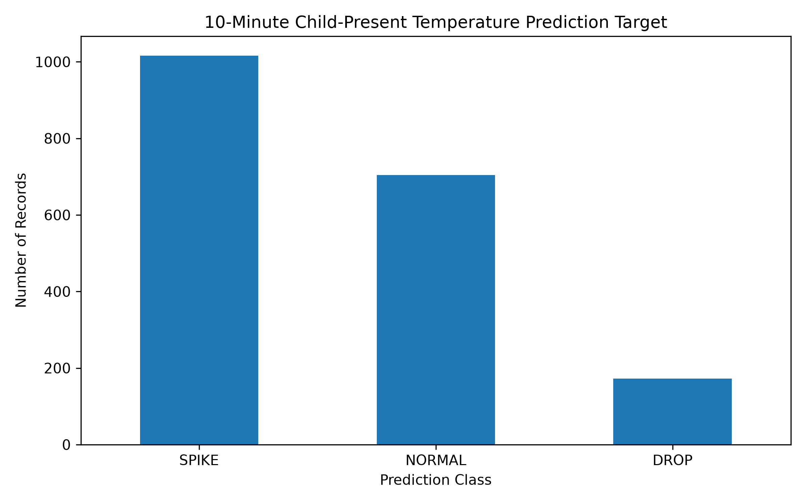
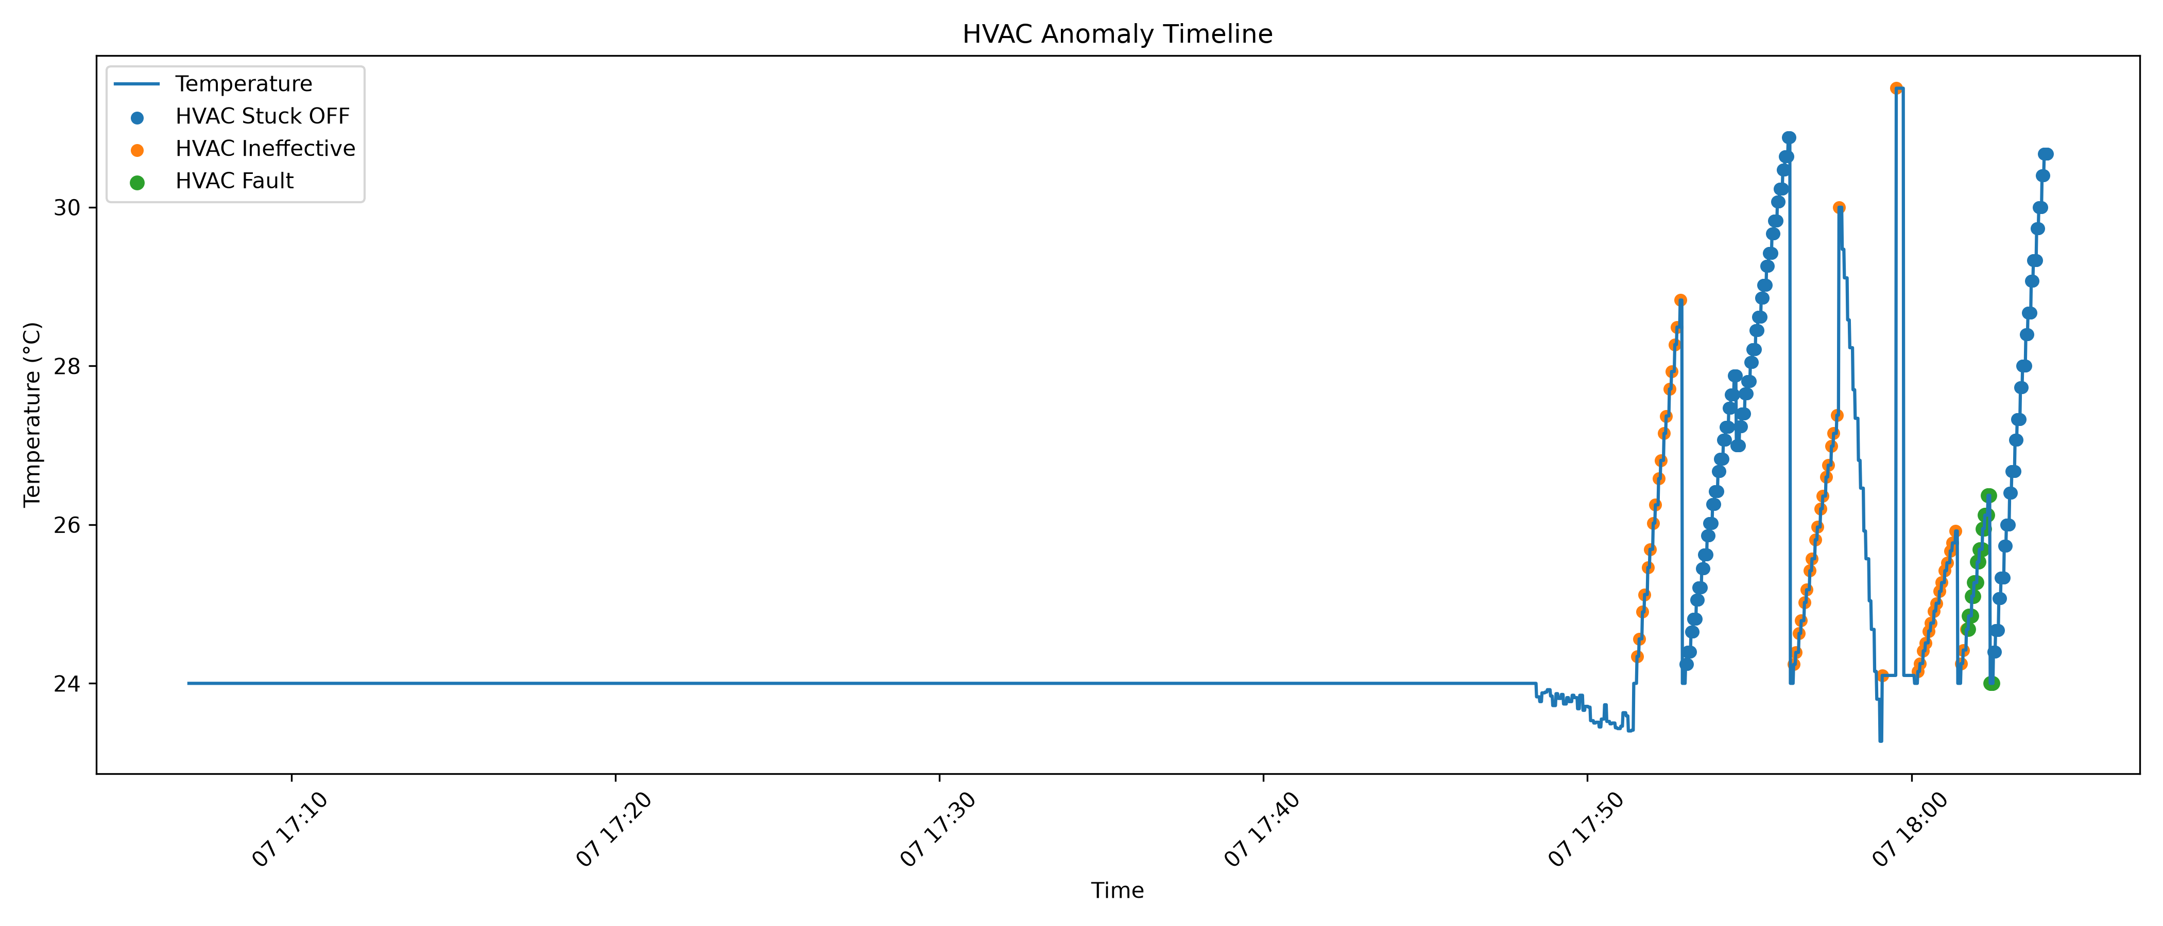
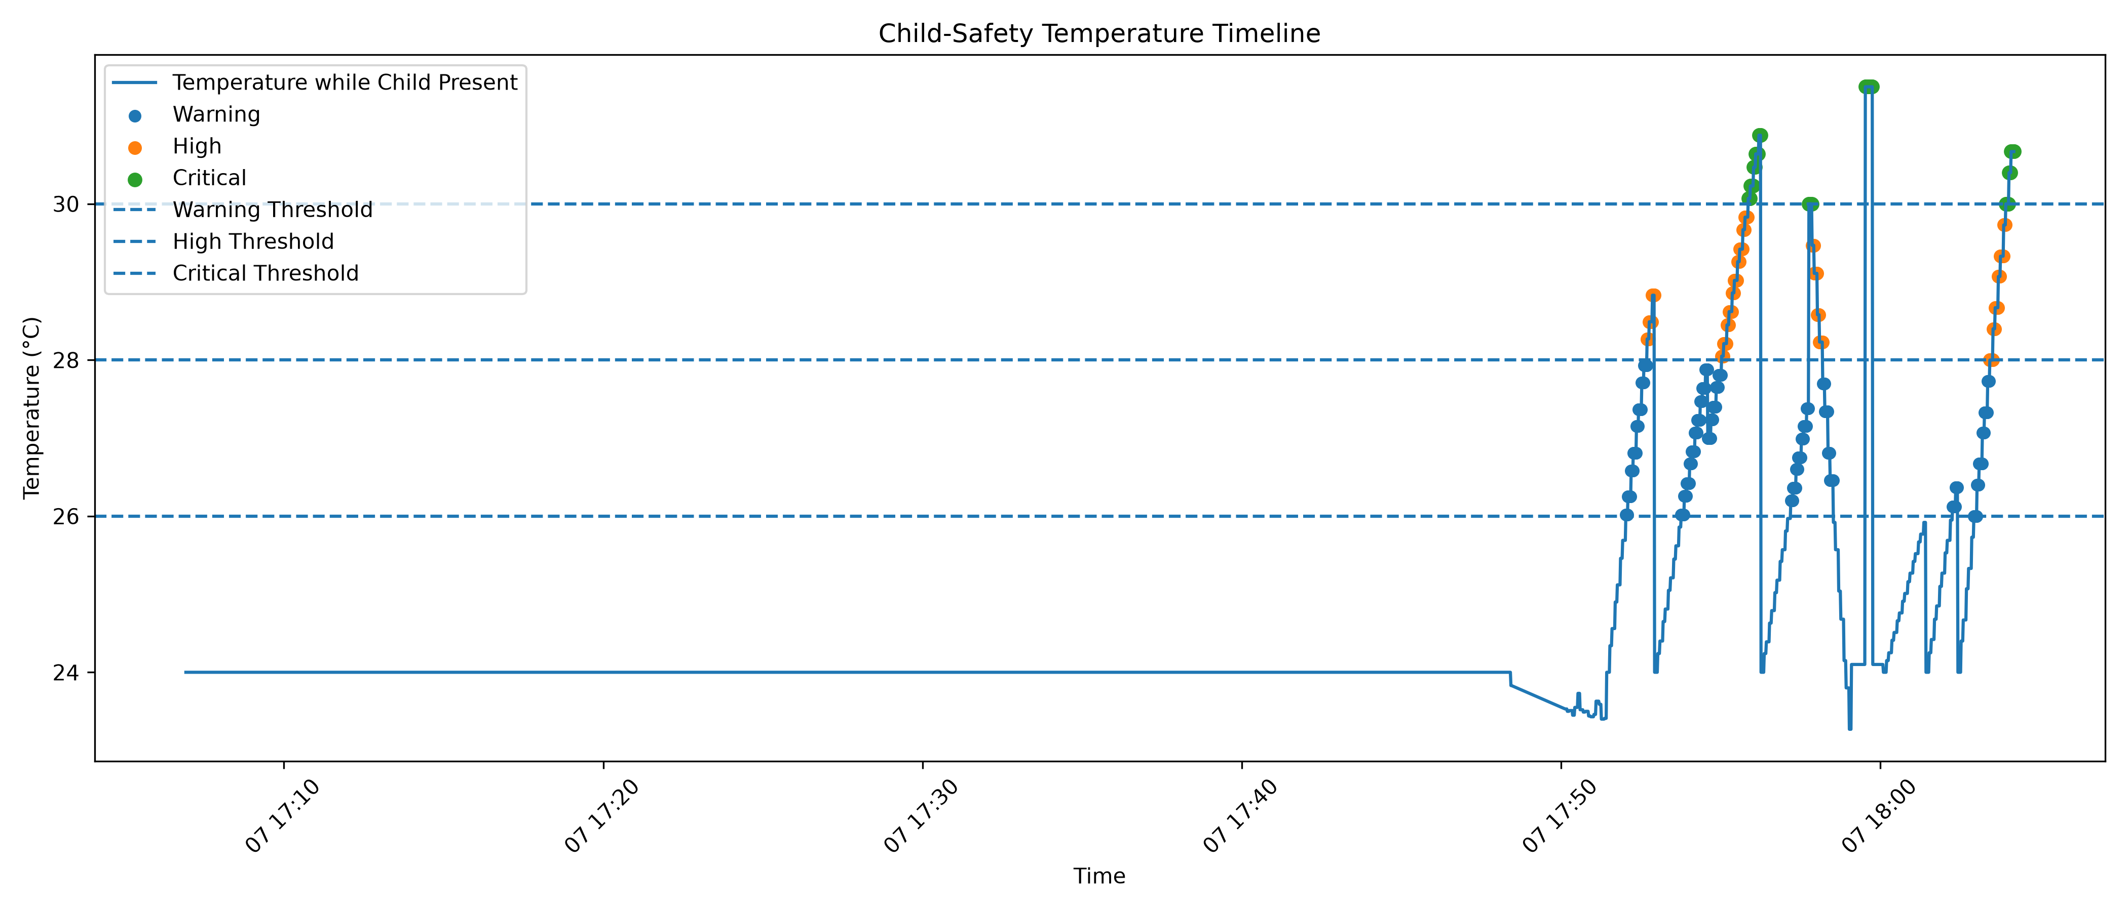
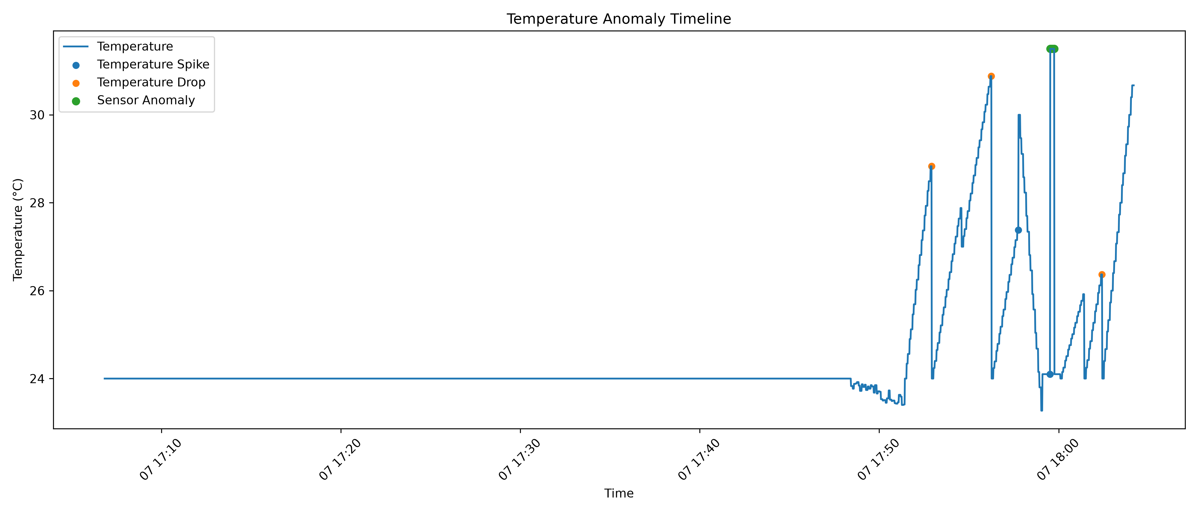
Anomaly Detection Observations

Slide 8
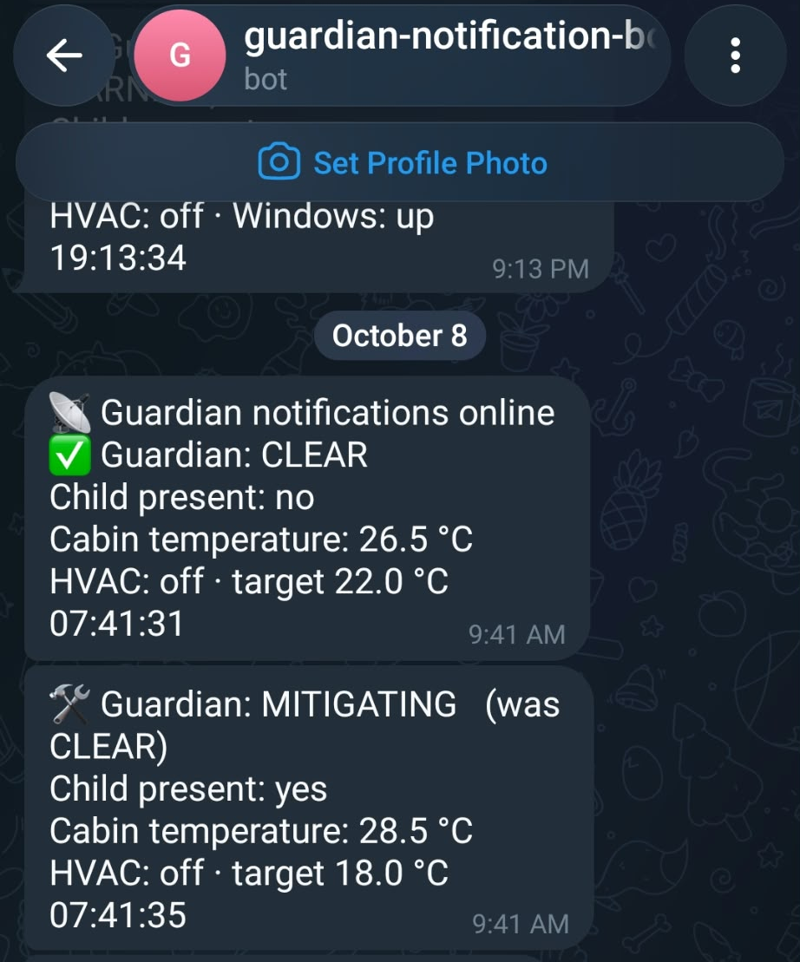

Slide 9
The Added Value
🔌
🛡️
🧪
🌐
HW-agnostic
Fail-safe
Sim-first
Open stack
swap sensors,
keep the logic
sensors disagree?
cool anyway
test without
hardware
Eclipse SDV
inside
Copyright© Eclipse Foundation AISBL and contributors. Made available under CC-BY-SA 4.0 International.
Notes:
(~55 s) Why does this matter beyond a hackathon?
Hardware-agnostic: OEMs can change suppliers or chips without touching the safety logic.
Fail-safe: we added a second temperature sensor. If two sensors disagree by more than 5 degrees, both are marked broken. If every sensor is broken, the Guardian doesn't go quiet. It cools anyway, full fan, window open, alarm on. A missing sensor is not a safe cabin.
Sim-first: every scenario runs in simulation first, so we tested the full escalation chain before a single board was flashed.
Open stack: all Eclipse. uProtocol, ThreadX, OpenBSW, OpenSOVD, Muto, plus AutoSD. No vendor lock-in.

Slide 10
The Market & Competition
Why now
They sell sensor systems
~37
kids / year die in
hot cars (US)
IEE
Vayyar
Valeo
Continental
Infineon
2025
Euro NCAP: only direct
sensing scores
We sell the logic
any sensor → decide → mitigate
$2B
CPD market
by 2034*
* analyst estimate (GM Insights), estimates vary
Copyright© Eclipse Foundation AISBL and contributors. Made available under CC-BY-SA 4.0 International.
Notes:
(~40 s) Why now? On average about 37 children die in hot cars in the US every year (noheatstroke.org, since 1998).
In Europe, Euro NCAP rewards child presence detection, and since 2025 only direct sensing scores. So every car that wants five stars needs this.
Analysts put the CPD market at around 2 billion dollars by 2034. Estimates vary a lot.
Who is doing it? IEE, Vayyar, Valeo, Continental, Infineon. They sell sensor systems, mostly radar, tied to their own hardware.
We don't sell a sensor. We sell the logic that works with any sensor, and that actually mitigates: cooling, window, alarm.

Slide 11
The Business Model
1 Open core
2 Integrate
3 Update
Eclipse SDV
free to adopt
OEM / Tier-1 porting
& NCAP validation
OTA features
& licensing
Copyright© Eclipse Foundation AISBL and contributors. Made available under CC-BY-SA 4.0 International.
Notes:
(~40 s) Three steps.
One: the core stays open source in the Eclipse SDV ecosystem, free to adopt. That builds trust and reach.
Two: we earn on integration. OEMs and Tier-1s pay for porting to their sensors and ECUs and for Euro NCAP validation support.
Three: once in the car, we deliver new features over the air, new mitigation actions or bus and fleet variants, as licensed upgrades.

Slide 12
Where We Stand
Done
Next
✓ Real sensor · AZ3166
→ openDuT topology switch
✓ Real window · S32K148
→ Real OpenSOVD CDA
✓ Guardian in AutoSD VM · Pi
→ Cold warning (branch)
✓ Fail-safe logic
→ Humidity in decision
✓ Dashboard · Telegram · Gazebo
→ Confidence & trend
Copyright© Eclipse Foundation AISBL and contributors. Made available under CC-BY-SA 4.0 International.
Notes:
(~50 s) Honest status.
Done: a real temperature sensor, a real window ECU, the Guardian running in AutoSD on a Pi, the fail-safe logic, dashboard and Telegram alerts.
Next: openDuT, which switches the topology from simulation to hardware at the push of a button. That's the one Definition-of-Done item we didn't reach. Replacing our CDA simulator with the real OpenSOVD CDA. A cold warning: implemented on a branch, not merged yet. Humidity in the decision: we already measure it, and a body overheats faster in humid air. And sensor confidence plus rate of rise, so we escalate before the threshold.

Slide 13

Contact
Bare-Metal-Mafia
Elias · Lars · Terra · Dimitri · Katharina · Priya
github.com/Eclipse-SDV-Hackathon-Chapter-Four/Bare-Metal-Mafia
scan for the repo
Copyright© Eclipse Foundation AISBL and contributors. Made available under CC-BY-SA 4.0 International.
Notes:
(~15 s) Everything is open source on GitHub. Scan the code. Come find us and we'll run the hairdryer demo live.

Slide 14
Thank you!
Questions? Come see the demo.
October 6-8 2026
COPYRIGHT (C) 2026, ECLIPSE FOUNDATION
Notes:
(~10 s) Thank you. Questions?

