Slide 1


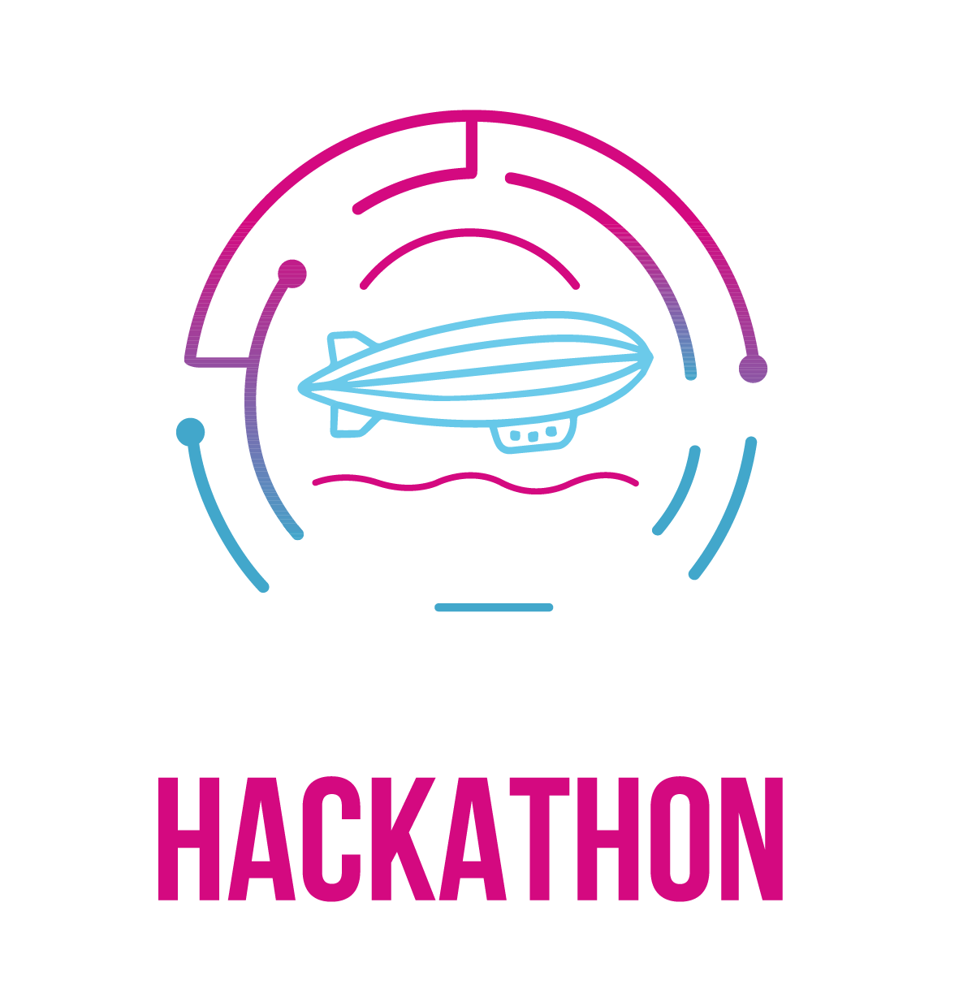
Thinking CAPs
Drive. Diagnose.
Verify. Contribute.
Freestyle / HackFest | Eclipse SDV Hackathon 2026
October 6-8 2026
COPYRIGHT (C) 2026, ECLIPSE FOUNDATION
Notes:
We are Thinking CAPs: five contributors working across vehicle architecture, middleware, diagnostics, simulation and testing. Our goal is to make Eclipse SDV integration observable and leave useful contributions that the community can review and continue. We will show our upstream changes, their validation, and the connected vehicle evidence. Some core work was prepared on 4 October; the hardware and gateway work includes 6–7 October results. The repository separates prepared assets from event work.
Evidence:
Team repository: https://github.com/Eclipse-SDV-Hackathon-Chapter-Four/Thinking_CAPs
Prepared-work inventory: https://github.com/Eclipse-SDV-Hackathon-Chapter-Four/Thinking_CAPs/blob/38fbb58b4420365a8c02de1552ed983d51e9a499/docs/prepared-work.md

Slide 2

CONTRIBUTION VALUE | 25%
Existing needs. Reviewable contributions.
We advance project issues with working code, tests and reusable integration.
SUBMITTED
SUBMITTED
LOCAL / VERIFIED
COM reliability
S-CORE to SOVD
Diagnostic routing
Repeated offer, stop, discovery and subscription integration tests.
Expose diagnostic data resources through an OpenSOVD provider.
Route UDS by logical address from DoIP to CAN targets.
Supporting work: lifecycle #704, SOME/IP #84 and native fault-storage persistence.
COM PR #1335
Diagnostics PR #40
OpenBSW contribution
Copyright© Eclipse Foundation AISBL and contributors. Made available under CC-BY-SA 4.0 International.
THINKING CAPs
Notes:
Our contribution portfolio starts with existing project needs. Communication issue 1167 lacked dedicated integration coverage for repeated COM API calls. PR 1335 adds that coverage without changing production APIs. Diagnostics issue 16 needs S-CORE diagnostic resources exposed through OpenSOVD; PR 40 adds the provider adapter. OpenBSW lacked logical-address routing between DoIP and CAN targets; our local transportRouter contribution adds it with tests and a maintainer-facing packet. These are three distinct reviewable scopes. Submitted means open for upstream review, not accepted or merged. Lifecycle configuration deduplication, the SOME/IP registration fix and the fault-storage write-through patch are supporting contributions, with separate records.
Evidence:
COM PR #1335: https://github.com/eclipse-score/communication/pull/1335
Diagnostics PR #40: https://github.com/eclipse-score/inc_diagnostics/pull/40
OpenBSW contribution: https://github.com/Eclipse-SDV-Hackathon-Chapter-Four/Thinking_CAPs/blob/38fbb58b4420365a8c02de1552ed983d51e9a499/contributions/openbsw-transport-router/README.md

Slide 3
TECHNICAL QUALITY & MATURITY | 25%
Measured quality, with explicit boundaries.
Native tests, source identities and review packets accompany the selected changes.
COMMUNICATION #1167
LIFECYCLE #704
OPENBSW ROUTER
503 passed
113 passed
46 unit tests
6 skipped; inherited copyright findings retained.
Native cases for shared configuration generation.
2 Bazel tests and 28 host integration tests passed.
Remaining gates: author/ECA where applicable, native CI, maintainer review and platform coverage.
COM validation
Lifecycle #704
OpenBSW native gates
Copyright© Eclipse Foundation AISBL and contributors. Made available under CC-BY-SA 4.0 International.
THINKING CAPs
Notes:
The numbers here are retained measurements on explicitly recorded baselines, not new executions during presentation creation. Communication 1167 records 503 passing tests and six skipped platform or configuration targets. Its measured copyright result retains 204 inherited findings with no added findings; these still need upstream disposition. Lifecycle 704 records 113 passing native cases. The OpenBSW contribution packet records 46 passing unit tests, two Bazel tests and 28 passing host gateway integration tests. Its larger application report still has a bus-load failure and unrun integration campaigns. Our software-factory workflows produce patches and evidence; deterministic checks decide results and human acceptance remains explicit. PR 40 still needs author/ECA resolution and native published-revision validation. We do not infer production qualification, full platform coverage or upstream acceptance from these results.
Evidence:
COM validation: https://github.com/Eclipse-SDV-Hackathon-Chapter-Four/Thinking_CAPs/blob/38fbb58b4420365a8c02de1552ed983d51e9a499/contributions/communication-1167/README.md
Lifecycle #704: https://github.com/Eclipse-SDV-Hackathon-Chapter-Four/Thinking_CAPs/blob/38fbb58b4420365a8c02de1552ed983d51e9a499/contributions/issues/eclipse-score/lifecycle/704/README.md
OpenBSW native gates: https://github.com/Eclipse-SDV-Hackathon-Chapter-Four/Thinking_CAPs/blob/38fbb58b4420365a8c02de1552ed983d51e9a499/contributions/openbsw-transport-router/validation.md

Slide 4
ECLIPSE SDV ECOSYSTEM IMPACT | 20%
Connect projects through observable behavior.
Reusable integration paths link vehicle state, receiver diagnosis and embedded actuation.
RECEIVER / DIAGNOSIS
CARLA + X-Verse
→
S-CORE receiver
→
OpenSOVD
openDuT-managed SOME/IP path; receiver freshness and fault-history observations.
ZONAL LIGHTING
X-Verse status
→
ThreadX AZ3166
→
CARLA lamps
AutoSD: separately verified lighting deployment, native diagnosis and disturbance/recovery.
Receiver campaign
Physical ThreadX
AutoSD guest evidence
Copyright© Eclipse Foundation AISBL and contributors. Made available under CC-BY-SA 4.0 International.
THINKING CAPs
Notes:
Follow the first integration: CARLA and the existing X-Verse vehicle bridge feed the actual S-CORE receiver. The openDuT-managed path carries the selected SOME/IP traffic. Receiver instrumentation and a separate OpenSOVD provider expose the accepted state, freshness and native fault history through a labelled App-data fallback. The project campaign controls disturbances; we do not claim native VIPER execution. In the separate lighting integration, X-Verse carries vehicle status to actual ThreadX on an AZ3166 board using UART/SLCAN, and the board decision returns to CARLA lamps. AutoSD is a separately verified guest target for the Linux ThreadX lighting runtime, bridge and native OpenSOVD provider. These are distinct tested configurations, not a claim that all components form one simultaneously validated chain. The reusable value is the contracts, deployment patterns and evidence linking observations to behavior.
Evidence:
Receiver campaign: https://github.com/Eclipse-SDV-Hackathon-Chapter-Four/Thinking_CAPs/blob/38fbb58b4420365a8c02de1552ed983d51e9a499/docs/reproduction.md
Physical ThreadX: https://github.com/Eclipse-SDV-Hackathon-Chapter-Four/Thinking_CAPs/blob/38fbb58b4420365a8c02de1552ed983d51e9a499/ThreadX/az3166/README.md
AutoSD guest evidence: https://github.com/Eclipse-SDV-Hackathon-Chapter-Four/Thinking_CAPs/blob/38fbb58b4420365a8c02de1552ed983d51e9a499/AutoSD/artifacts/README.md

Slide 5
REUSABILITY & MAINTAINABILITY | 10%
A contributor can pick up the next step.
Pinned inputs and portable records make the work understandable and repeatable.
01 / IDENTIFY
02 / EXECUTE
03 / CONTINUE
Pinned inputs
Repeatable checks
Explicit handover
Source revisions, dependencies, configuration and executable hashes.
Native regressions, campaign verdicts and owned teardown.
Patches, PR links, known gaps and maintainer-facing next steps.
Reference-host self-run demonstrated; independent operator and cold-machine reproduction pending.
Reproduction guide
Contribution registry
AutoSD verification
Copyright© Eclipse Foundation AISBL and contributors. Made available under CC-BY-SA 4.0 International.
THINKING CAPs
Notes:
Our handover includes source and tool pins, configuration, manifests, expected verdicts, teardown instructions, and known limitations. A contributor can inspect the patch, rebuild on the documented baseline, run the selected campaign and compare results. The current reference-host instructions still require adapting local paths and acquiring some cached images. Source-clean self-reproduction shares this host, images and LLVM; independent human and cold-machine reproduction remain unattested. The contribution hash verifier currently finds a working-tree mismatch in the 1261 README, which must be reconciled on the final submission revision. AutoSD artifact and current-source verification passed during this review. Hash integrity proves identity, not functional correctness. We provide both patch-level follow-up and integration-level continuation.
Evidence:
Reproduction guide: https://github.com/Eclipse-SDV-Hackathon-Chapter-Four/Thinking_CAPs/blob/38fbb58b4420365a8c02de1552ed983d51e9a499/docs/reproduction.md
Contribution registry: https://github.com/Eclipse-SDV-Hackathon-Chapter-Four/Thinking_CAPs/blob/38fbb58b4420365a8c02de1552ed983d51e9a499/contributions/README.md
AutoSD verification: https://github.com/Eclipse-SDV-Hackathon-Chapter-Four/Thinking_CAPs/blob/38fbb58b4420365a8c02de1552ed983d51e9a499/AutoSD/artifacts/README.md

Slide 6
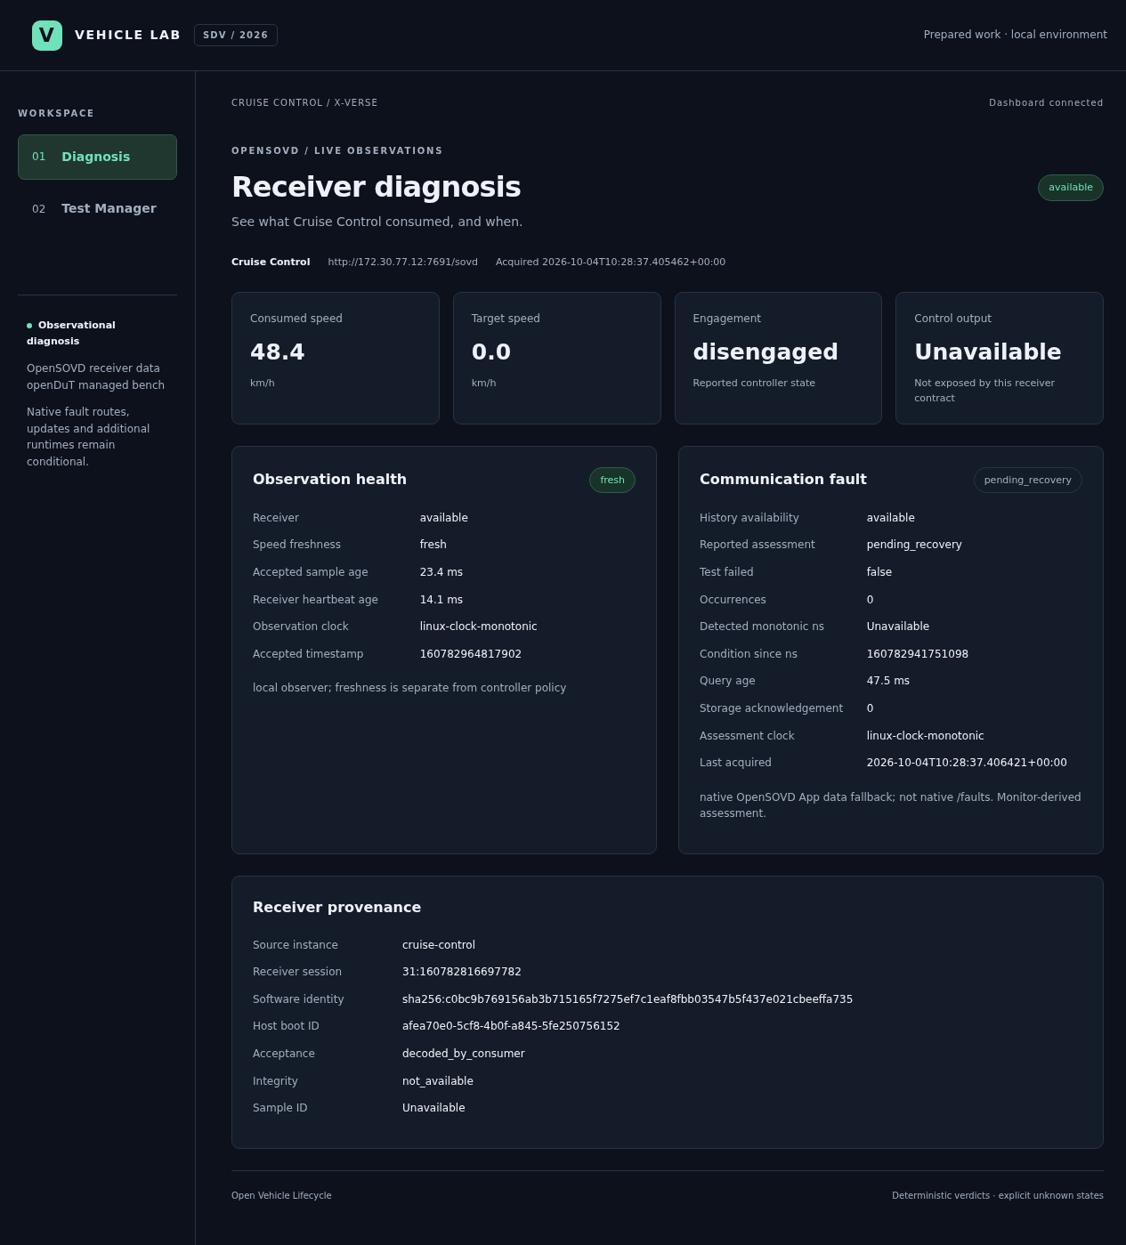
PITCH & HANDOVER CLARITY | 8%
One failure story. Traceable evidence.
Show what the receiver consumed, what failed, and what recovered.
01 Fresh receiver observations
02 Managed communication loss
03 Fault activation and diagnosis
04 Recovery with history retained
PR / patch → test record → reproducible next step
Recorded native campaign / 4 October 2026
Physical verdicts
Dashboard evidence
Saved physical replay
Copyright© Eclipse Foundation AISBL and contributors. Made available under CC-BY-SA 4.0 International.
THINKING CAPs
Notes:
For the demonstration, show four transitions: fresh accepted receiver data; managed communication interruption; stale input and activated fault history while diagnosis remains reachable; then restored traffic, recovery and retained history. Use a current live run only after the environment is ready. If it is not ready, identify the saved physical replay as a recorded 4 October run. The image on this slide is historical evidence from that recorded native campaign. Fault history uses a labelled App-data fallback, not native faults routing. Monitor recovery does not imply automatic cruise re-engagement. The screenshot does not claim exposed control output or E2E sample integrity. After the flow, open a selected PR or patch and its native test record so the handover is concrete.
Evidence:
Physical verdicts: https://github.com/Eclipse-SDV-Hackathon-Chapter-Four/Thinking_CAPs/blob/38fbb58b4420365a8c02de1552ed983d51e9a499/evidence/f009-reproduction-physical/results.json
Dashboard evidence: https://github.com/Eclipse-SDV-Hackathon-Chapter-Four/Thinking_CAPs/blob/38fbb58b4420365a8c02de1552ed983d51e9a499/evidence/f010-live/verification.json
Saved physical replay: https://github.com/Eclipse-SDV-Hackathon-Chapter-Four/Thinking_CAPs/tree/38fbb58b4420365a8c02de1552ed983d51e9a499/evidence/f009-recorded-replay-final

Slide 7
COMMUNITY BENEFIT & CONTINUATION STORY | 7%
Useful to maintainers, integrators and testers.
Leave reviewable building blocks for the community to adopt and extend.
MAINTAINERS
INTEGRATORS
TEST ENGINEERS
Review and adopt
Reuse the pattern
Repeat the evidence
Bounded fixes and tests with recorded baselines and limitations.
Diagnostic adapters, vehicle contracts and deployment examples.
Fault campaigns, recovery checks and inspectable verdict artifacts.
Next: resolve native gates → obtain project review → repeat with another contributor.
Maintainer PR
Integration handover
Router continuation
Copyright© Eclipse Foundation AISBL and contributors. Made available under CC-BY-SA 4.0 International.
THINKING CAPs
Notes:
Maintainers can review bounded patches with native measurements instead of reverse engineering a broad demo. Integrators can reuse diagnostic resource adapters, receiver observation contracts, CAN lighting contracts and the managed testbench pattern. Test engineers can reproduce interruption and recovery with machine-readable verdicts and labelled historical evidence. Our next steps are concrete: validate and resolve remaining upstream gates on the selected PRs; coordinate the OpenBSW router issue and contribution; then have another contributor exercise the integration path. We propose reuse through a Blueprint-style integration pattern, but do not claim an accepted Blueprint or quantified engineering savings. The benefit is a practical review and reproduction path across projects.
Evidence:
Maintainer PR: https://github.com/eclipse-score/communication/pull/1335
Integration handover: https://github.com/Eclipse-SDV-Hackathon-Chapter-Four/Thinking_CAPs/blob/38fbb58b4420365a8c02de1552ed983d51e9a499/docs/handover.md
Router continuation: https://github.com/Eclipse-SDV-Hackathon-Chapter-Four/Thinking_CAPs/blob/38fbb58b4420365a8c02de1552ed983d51e9a499/contributions/openbsw-transport-router/README.md

Slide 8
CONTRIBUTION FOCUS & INITIATIVE | 5%
Existing project work, moved forward.
Each selected contribution has an issue, an artifact and a concrete next action.
COM #1167
DIAGNOSTICS #16
LIFECYCLE #704
PR #1335
PR #40
Verified patch
Integration coverage submitted. Next: CI and maintainer review.
Provider adapter submitted. Next: author/ECA and native validation.
Configuration deduplication. Next: native upstream submission.
Prepared core: 4 Oct. Hardware and gateway evidence: 6–7 Oct. Attribution stays explicit.
Existing COM issue
Existing diagnostics issue
Lifecycle #704
Copyright© Eclipse Foundation AISBL and contributors. Made available under CC-BY-SA 4.0 International.
THINKING CAPs
Notes:
We deliberately connect our work to existing Eclipse project needs. Communication 1167 moved from a test gap to submitted PR 1335; the next step is native CI and maintainer review. Diagnostics 16 moved to submitted PR 40 with an OpenSOVD provider adapter; remaining author agreement and functional validation are explicit. Lifecycle 704 has a measured configuration-generation patch with 113 native passing cases and a prepared upstream submission. OpenBSW logical-address routing emerged from our integration need and has a verified local module plus an issue draft for approach agreement. Jefferson owns architecture, factory work and ECU contributions; Bruno owns S-CORE and X-Verse integration; Puru owns diagnostic adapters and the dashboard path; Yasser supports OpenSOVD, review and documentation; Siva supports openDuT and test evidence. Prepared core work dates to 4 October; the hardware and gateway have event-time results on 6–7 October. The final event delta and the actual day-one declaration must be recorded, rather than inferred.
Evidence:
Existing COM issue: https://github.com/eclipse-score/communication/issues/1167
Existing diagnostics issue: https://github.com/eclipse-score/inc_diagnostics/issues/16
Lifecycle #704: https://github.com/Eclipse-SDV-Hackathon-Chapter-Four/Thinking_CAPs/blob/38fbb58b4420365a8c02de1552ed983d51e9a499/contributions/issues/eclipse-score/lifecycle/704/README.md

Slide 9
EXTRA TECHNOLOGY POINTS
Technology evidence, ready for inspection.
Three bonus technologies have meaningful runtime or testbench evidence.
openDuT / +0.10
THREADX / +0.10
AUTOSD / +0.10
Managed bench
Actual RTOS
Real guest
Real receiver traffic, communication interruption and recovery.
Linux simulation and physical AZ3166 lighting-controller evidence.
Deployment, diagnosis, managed disturbance and reboot evidence.
Potential +0.30, subject to evaluation. Java/Jakarta is not claimed; final score is capped at 5.00.
openDuT testbench
ThreadX hardware
AutoSD VM
Copyright© Eclipse Foundation AISBL and contributors. Made available under CC-BY-SA 4.0 International.
THINKING CAPs
Notes:
openDuT is used in the managed network and disturbance campaign. ThreadX is actual runtime code in both Linux simulation and the AZ3166 embedded target. AutoSD is a real QEMU/KVM deployment target with build, diagnostics, interruption, recovery and reboot evidence. Under the official scorecard each meaningful technology can add 0.10, subject to evaluator acceptance and the final score cap. This supports asking evaluators to inspect three technologies, not claiming a bonus already awarded. Java/Jakarta has not been established as a qualifying implemented component by this review. No extra runtime was introduced merely as a slide label.
Evidence:
openDuT testbench: https://github.com/Eclipse-SDV-Hackathon-Chapter-Four/Thinking_CAPs/blob/38fbb58b4420365a8c02de1552ed983d51e9a499/OpenDut/README.md
ThreadX hardware: https://github.com/Eclipse-SDV-Hackathon-Chapter-Four/Thinking_CAPs/blob/38fbb58b4420365a8c02de1552ed983d51e9a499/ThreadX/artifacts/az3166-uart-can/results.json
AutoSD VM: https://github.com/Eclipse-SDV-Hackathon-Chapter-Four/Thinking_CAPs/blob/38fbb58b4420365a8c02de1552ed983d51e9a499/AutoSD/artifacts/vehicle-computer/results.json

Slide 10
Built to be continued.
Review the patches.
Run the evidence.
github.com/Eclipse-SDV-Hackathon-Chapter-Four/Thinking_CAPs
October 6-8 2026
COPYRIGHT (C) 2026, ECLIPSE FOUNDATION
Notes:
Our handover is code, evidence and a next step. Review the selected contributions, repeat the campaign and help make this integration easier for the next Eclipse SDV contributor. Thank you.
Evidence:
Repository: https://github.com/Eclipse-SDV-Hackathon-Chapter-Four/Thinking_CAPs

Slide 11
APPENDIX / EVIDENCE
Evidence index for the technical interview.
Each link identifies a bounded contribution or a recorded integration result.
COM #1167 / native evidence
Lifecycle #704 / 113 cases
Open source / evidence record
Open source / evidence record
OpenBSW router / native gates
Receiver / physical verdicts
Open source / evidence record
Open source / evidence record
Dashboard / API and browser checks
ThreadX / hardware and CARLA
Open source / evidence record
Open source / evidence record
AutoSD / guest and source identities
Fault storage / regression and patch
Open source / evidence record
Open source / evidence record
Copyright© Eclipse Foundation AISBL and contributors. Made available under CC-BY-SA 4.0 International.
THINKING CAPs
Notes:
Use this slide for questions. The contribution and evidence links are pinned to inspected origin/main revision 38fbb58b. PR links are live and their status can change. Measurements are retained original records. The current deck was authored from inspected local work and origin/main; it is not an attestation that every latest working-tree update is published. Check the final submission revision before presenting.
Evidence:
COM #1167 / native evidence: https://github.com/Eclipse-SDV-Hackathon-Chapter-Four/Thinking_CAPs/blob/38fbb58b4420365a8c02de1552ed983d51e9a499/contributions/communication-1167/README.md
Lifecycle #704 / 113 cases: https://github.com/Eclipse-SDV-Hackathon-Chapter-Four/Thinking_CAPs/blob/38fbb58b4420365a8c02de1552ed983d51e9a499/contributions/issues/eclipse-score/lifecycle/704/README.md
OpenBSW router / native gates: https://github.com/Eclipse-SDV-Hackathon-Chapter-Four/Thinking_CAPs/blob/38fbb58b4420365a8c02de1552ed983d51e9a499/contributions/openbsw-transport-router/validation.md
Receiver / physical verdicts: https://github.com/Eclipse-SDV-Hackathon-Chapter-Four/Thinking_CAPs/blob/38fbb58b4420365a8c02de1552ed983d51e9a499/evidence/f009-reproduction-physical/results.json
Dashboard / API and browser checks: https://github.com/Eclipse-SDV-Hackathon-Chapter-Four/Thinking_CAPs/blob/38fbb58b4420365a8c02de1552ed983d51e9a499/evidence/f010-live/verification.json
ThreadX / hardware and CARLA: https://github.com/Eclipse-SDV-Hackathon-Chapter-Four/Thinking_CAPs/blob/38fbb58b4420365a8c02de1552ed983d51e9a499/ThreadX/artifacts/az3166-xverse-carla/results.json
AutoSD / guest and source identities: https://github.com/Eclipse-SDV-Hackathon-Chapter-Four/Thinking_CAPs/blob/38fbb58b4420365a8c02de1552ed983d51e9a499/AutoSD/artifacts/README.md
Fault storage / regression and patch: https://github.com/Eclipse-SDV-Hackathon-Chapter-Four/Thinking_CAPs/blob/38fbb58b4420365a8c02de1552ed983d51e9a499/OpenSOVD/contributions/fault-storage-write-through/README.md

Slide 12
APPENDIX / TEAM & SOURCES
Team, scope and template attribution.
Five contributors; clear ownership; preserved preparation and event-work boundaries.
Jefferson Nascimento — architecture, factory, ECU contributions
Bruno Campos — S-CORE application and X-Verse integration
Puru — OpenSOVD / CDA adapters and dashboard
Yasser — OpenSOVD, review and documentation
Siva — openDuT and integration-test evidence
Template: Eclipse Foundation AISBL and contributors / adapted under CC-BY-SA 4.0.
Official slide template
Pitching-session guide
Freestyle scorecard
Copyright© Eclipse Foundation AISBL and contributors. Made available under CC-BY-SA 4.0 International.
THINKING CAPs
Notes:
The official native template is [EF_SDV_Hackathon_2026] - Pitching Slides Template, linked from page five of the pitching-session PDF. We retained its cover, closing, branding, white content family and copyright footers, and adapted its narrative content for Freestyle. The source attribution and CC-BY-SA 4.0 notice are preserved. This adaptation is also made available under CC-BY-SA 4.0. Prepared-code disclosure is a separate organizer record; this slide does not attest it. The pitch target is 9 minutes 30 seconds; appendix slides are for questions.
Evidence:
Official slide template: https://docs.google.com/presentation/d/1LxFKeG0z-uxOMgOhZX4OWIPQG5Vmeo1Tptall_lJ0_Y/edit
Pitching-session guide: https://github.com/Eclipse-SDV-Hackathon-Chapter-Four/.github/blob/main/profile/SDV%20Hackathon%202026_Pitching%20Session.pdf
Freestyle scorecard: https://github.com/Eclipse-SDV-Hackathon-Chapter-Four/.github/blob/main/profile/Eclipse_SDV_Hackathon_2026_EvaluationForms.pdf

