Slide 1

Target ECU to Host / Linux: communication flow
01
One implemented path: ThreadX sensor ECU over Wi-Fi UDP to the OTA Outlaws campaign runner.
MXChip ThreadX Target ECU
Host PC: Windows + WSL2 Linux
ThreadX + NetX Duo
Sensor sample ~100 ms
Button A sends campaign request
OLED displays scenario + verdict
Wi-Fi AP
Windows PowerShell relay: Wi-Fi UDP :30502 <-> WSL2
WSL2 Python bridge: listens :30502; runs Rust campaign CLI
OTA Outlaws: campaign run --all; Docker Compose scenarios
DHCP + IP
routing only
Host destination: 192.168.104.185:30502
Windows Wi-Fi example: 192.168.104.185
RETURN UDP: campaign results
Template: Eclipse SDV Hackathon 2026 Pitching Session (CC BY-SA 4.0) | Project: AZ3166 / OTA Outlaws

Slide 2
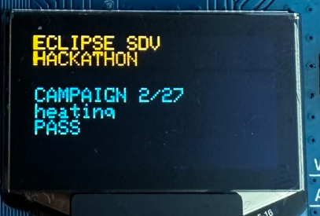
Button A -> live campaign verdicts on the OLED
02
The host streams results per scenario; the board returns to sensor pages when the run completes.
1
Button A
ThreadX sends a campaign request + ID to host UDP :30502.
MXChip OLED: campaign test result on displayed
2
Campaign runs
WSL2 bridge starts campaign run --all on OTA Outlaws.
3
Verdicts stream
Each CLI scenario verdict is sent as campaign_result UDP.
4
OLED updates
Board matches the request ID, shows scenario + PASS/FAIL, then resumes sensors.
Template: Eclipse SDV Hackathon 2026 Pitching Session (CC BY-SA 4.0) | Project: AZ3166 / OTA Outlaws

