Slide 1


Pitching Session
Team ASAP
20-22 November, Karlsruhe, Germany
An Eclipse SDV Event

Slide 2
Forget the Conventional – Shift to SDV
rapid OTA deployment
live OTA monitoring
scalability

Slide 3
The Team
Emre: Azure, Tests
Marvin: WebUI Frontend
Nils: WebUI Backend
Philipp: Feature Speed Limit Assist
Tobias: MQTT Connectivity Ankaios

Slide 4
Initial Situation
Goals:
1. Implement a way to update software OTA
2. Deploy a real app on a physical vehicle

Slide 5
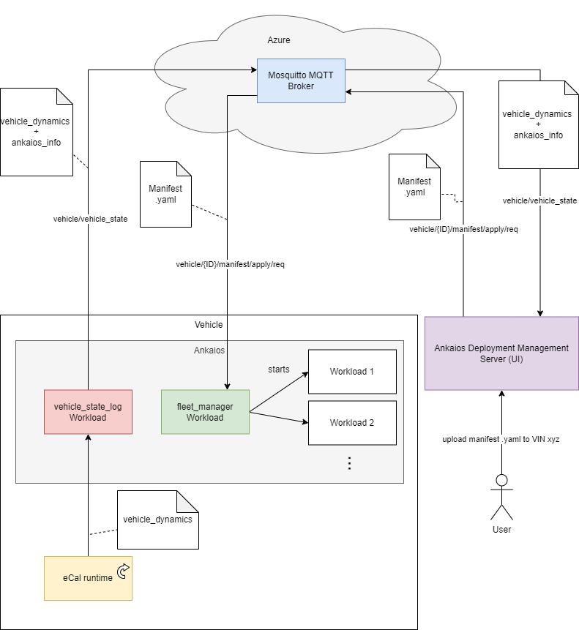
Architecture

Slide 6
Demo
<Video here>

Slide 7
Contact
List the contact details of the people in charge of the different aspects of the “business”.

Slide 8
Thank You!
Any questions?
20-22 November, Karlsruhe, Germany
An Eclipse SDV Event

