Slide 1


Pitching Session
Team ASAP
20-22 November, Karlsruhe, Germany
An Eclipse SDV Event

Slide 2
Forget the Conventional – Shift to SDV
Why SDV?
    - rapid OTA deployment
    - live OTA monitoring
    - scalability

Slide 3
Initial Situation
Goals:
1. Implement a way to update software OTA
2. Deploy a real app on a physical vehicle

Slide 4

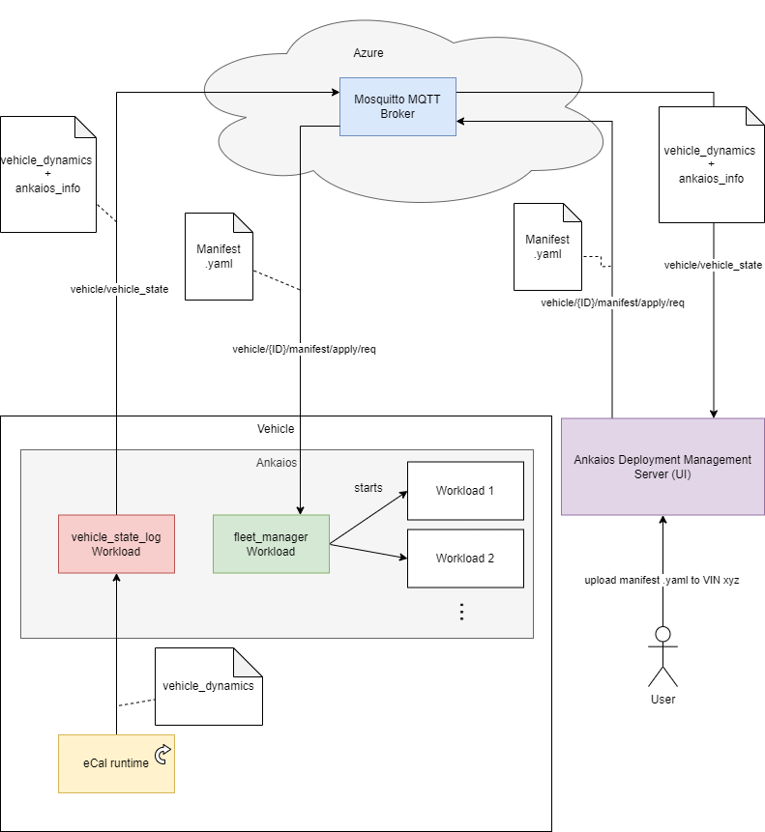



Architecture

Slide 5
Demo
Video!

Slide 6
The Team
Emre: Azure, Tests
Marvin: WebUI Frontend
Nils: WebUI Backend
Philipp: Feature Speed Limit Assist
Tobias: MQTT Connectivity Ankaios

Slide 7
Thank You!
Any questions?
20-22 November, Karlsruhe, Germany
An Eclipse SDV Event

Slide 8
Contact
Interested in the other projects that we’re working on?
Management Contact Partner
Fabian Donath
fabian.donath@asap.de

