Slide 1


Pitching Session
Caliper Kings
20-22 November, Karlsruhe, Germany
An Eclipse SDV Event

Slide 2
Our Challange
We decided to take over the “Shift to SDV” challenge!
We could chose either “Feature Path” or “Connectivity Path”...
But we did both!!
Notes:
Feature path: develop innovative containerized applications managed by Ankaios using real data from the test vehicle.
Connectivity path: Manage your fleet from the cloud turning feature upgrades into a seamless day-to-day business​.​

Slide 3

Initial Situation
A construction sign makes your car leave autonomous driving?
A pond of water makes your car drift away?
The car suddenly goes in emergency break with no clear explanation?

Slide 4
Initial Situation
Wouldn’t it be nice if the car manufacturers could get fast and descriptive reports describing these unwanted events?

Slide 5
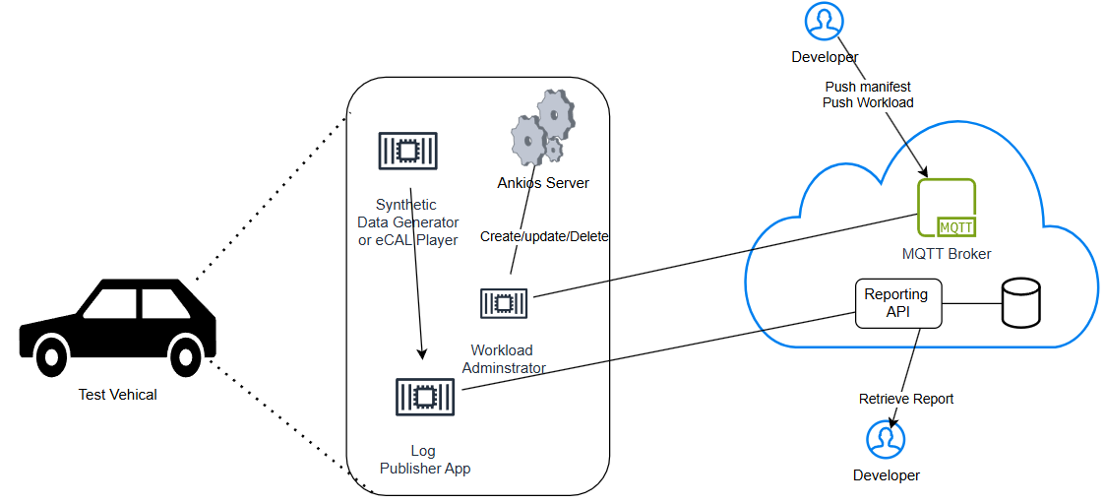
Solution - Auto Guard!
Here comes “Auto Guard”, our solution that promises to automate and simplify the reporting of unwanted car behaviour!

Slide 6
Solution - Auto Guard!
This is accomplished with our “Log Publisher App” which has 2 responsibilities:
Detect if a “Critical Event” happens
Publish a “report” to a “Reporting API” service in case of a “Critical Event”

Slide 7
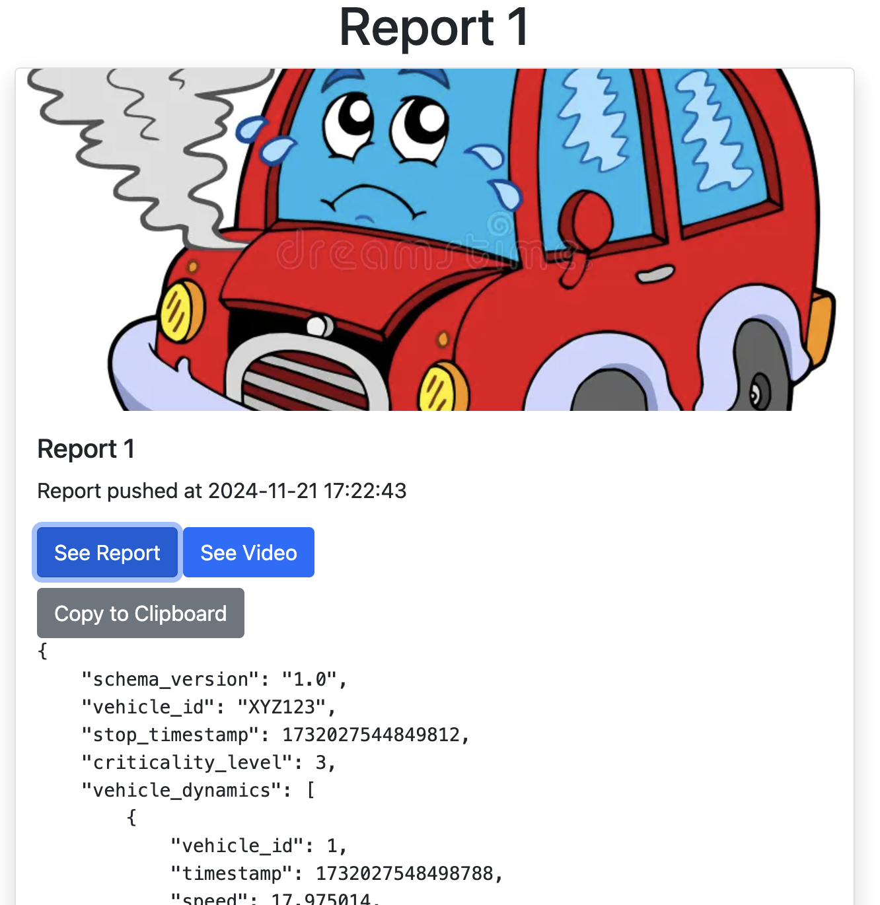
Solution - Auto Guard!
The car manufacturers will be able to leverage the generated report in various way
to further investigate the issue
to improve the model for autonomous driving

Slide 8
Auto Guard (Demo!)

Slide 9
Solution - Auto Guard!
What is purpose of reporting and improving the car algorithms… If there is no way to ship those to the car?

Slide 10
Now the Connectivity Path
This is where “Workload Administrator” comes into play!

Slide 11
Now the Connectivity Path
Workload Administrator is an application that lives within the car and is capable of deploying Ankaios Workloads on the fly

Slide 12
Now the Connectivity Path
How does it happen?
- Messages can be delivered to Workload Administrator through MQTT
- Workload Administrator will act upon this messages by calling the Ankaios API

Slide 13


Title
Text
20-22 November, Karlsruhe, Germany
An Eclipse SDV Event

Slide 14
Auto Guard (Demo!)

Slide 15
Thank You
Credits to the team:
Francesco Scala
Sebastian Böttigheimer
Sachin Kumar
Zaheer Ahmed
Giovanni Barbar
20-22 November, Karlsruhe, Germany
An Eclipse SDV Event

