Slide 1



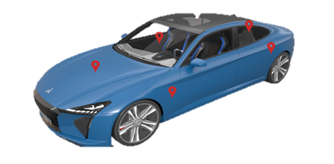

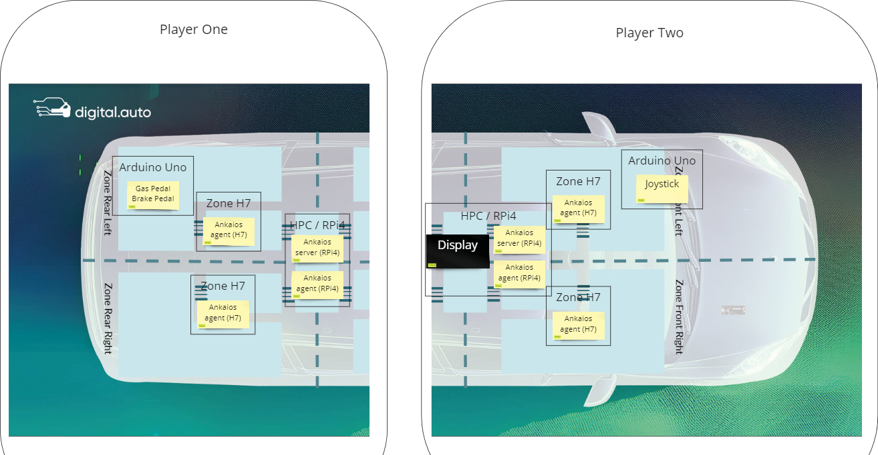





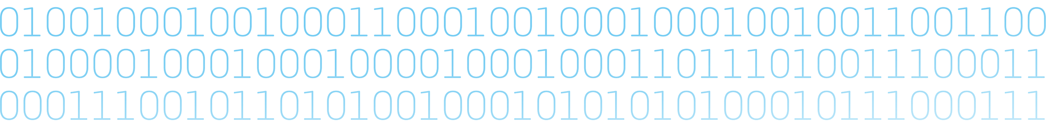
{[“Eclipse SDV”],
[“Hackathon”],
[“Chapter Two”]}
Play by Wire
Goal of the Challenge
Run any Game on an HPC with Display and receive the input signals from a controller that is connected to an ECU and sends its signals via a Zone Controller to the HPC using Eclipse Kuksa and optionally Open1722. Everything should be orchestrated via Eclipse Ankaios, monitored by the Ankaios Dashboard and can run on the upcoming Digital.auto E2E Makerkit.
Test the full functionality of the Game input with digital.auto playground.
Use Arduino Devices to execute your code and Inputs.
Use Raspberry Pis with Displays to show and run your games.
Data Source & Actuators
Vehicle.Windshield
Vehicle.Cabin
Vehicle.Body
Vehicle.Chassis
Vehicle.Powertrain
Example Hacks
Play Flappy Bird with a Joystick
Play Pong with Multiplayer (Player One input via Arduino Uno Joystick, Player Two with Keyboard)
Use UDP Telemetry information of Forza Horizon (Xbox) for Player Input
Example Architecture
Involved Projects

