Slide 1
2021/05/020 GFP Cooling System Update
Jiancheng Zeng
Northeastern University

Slide 2
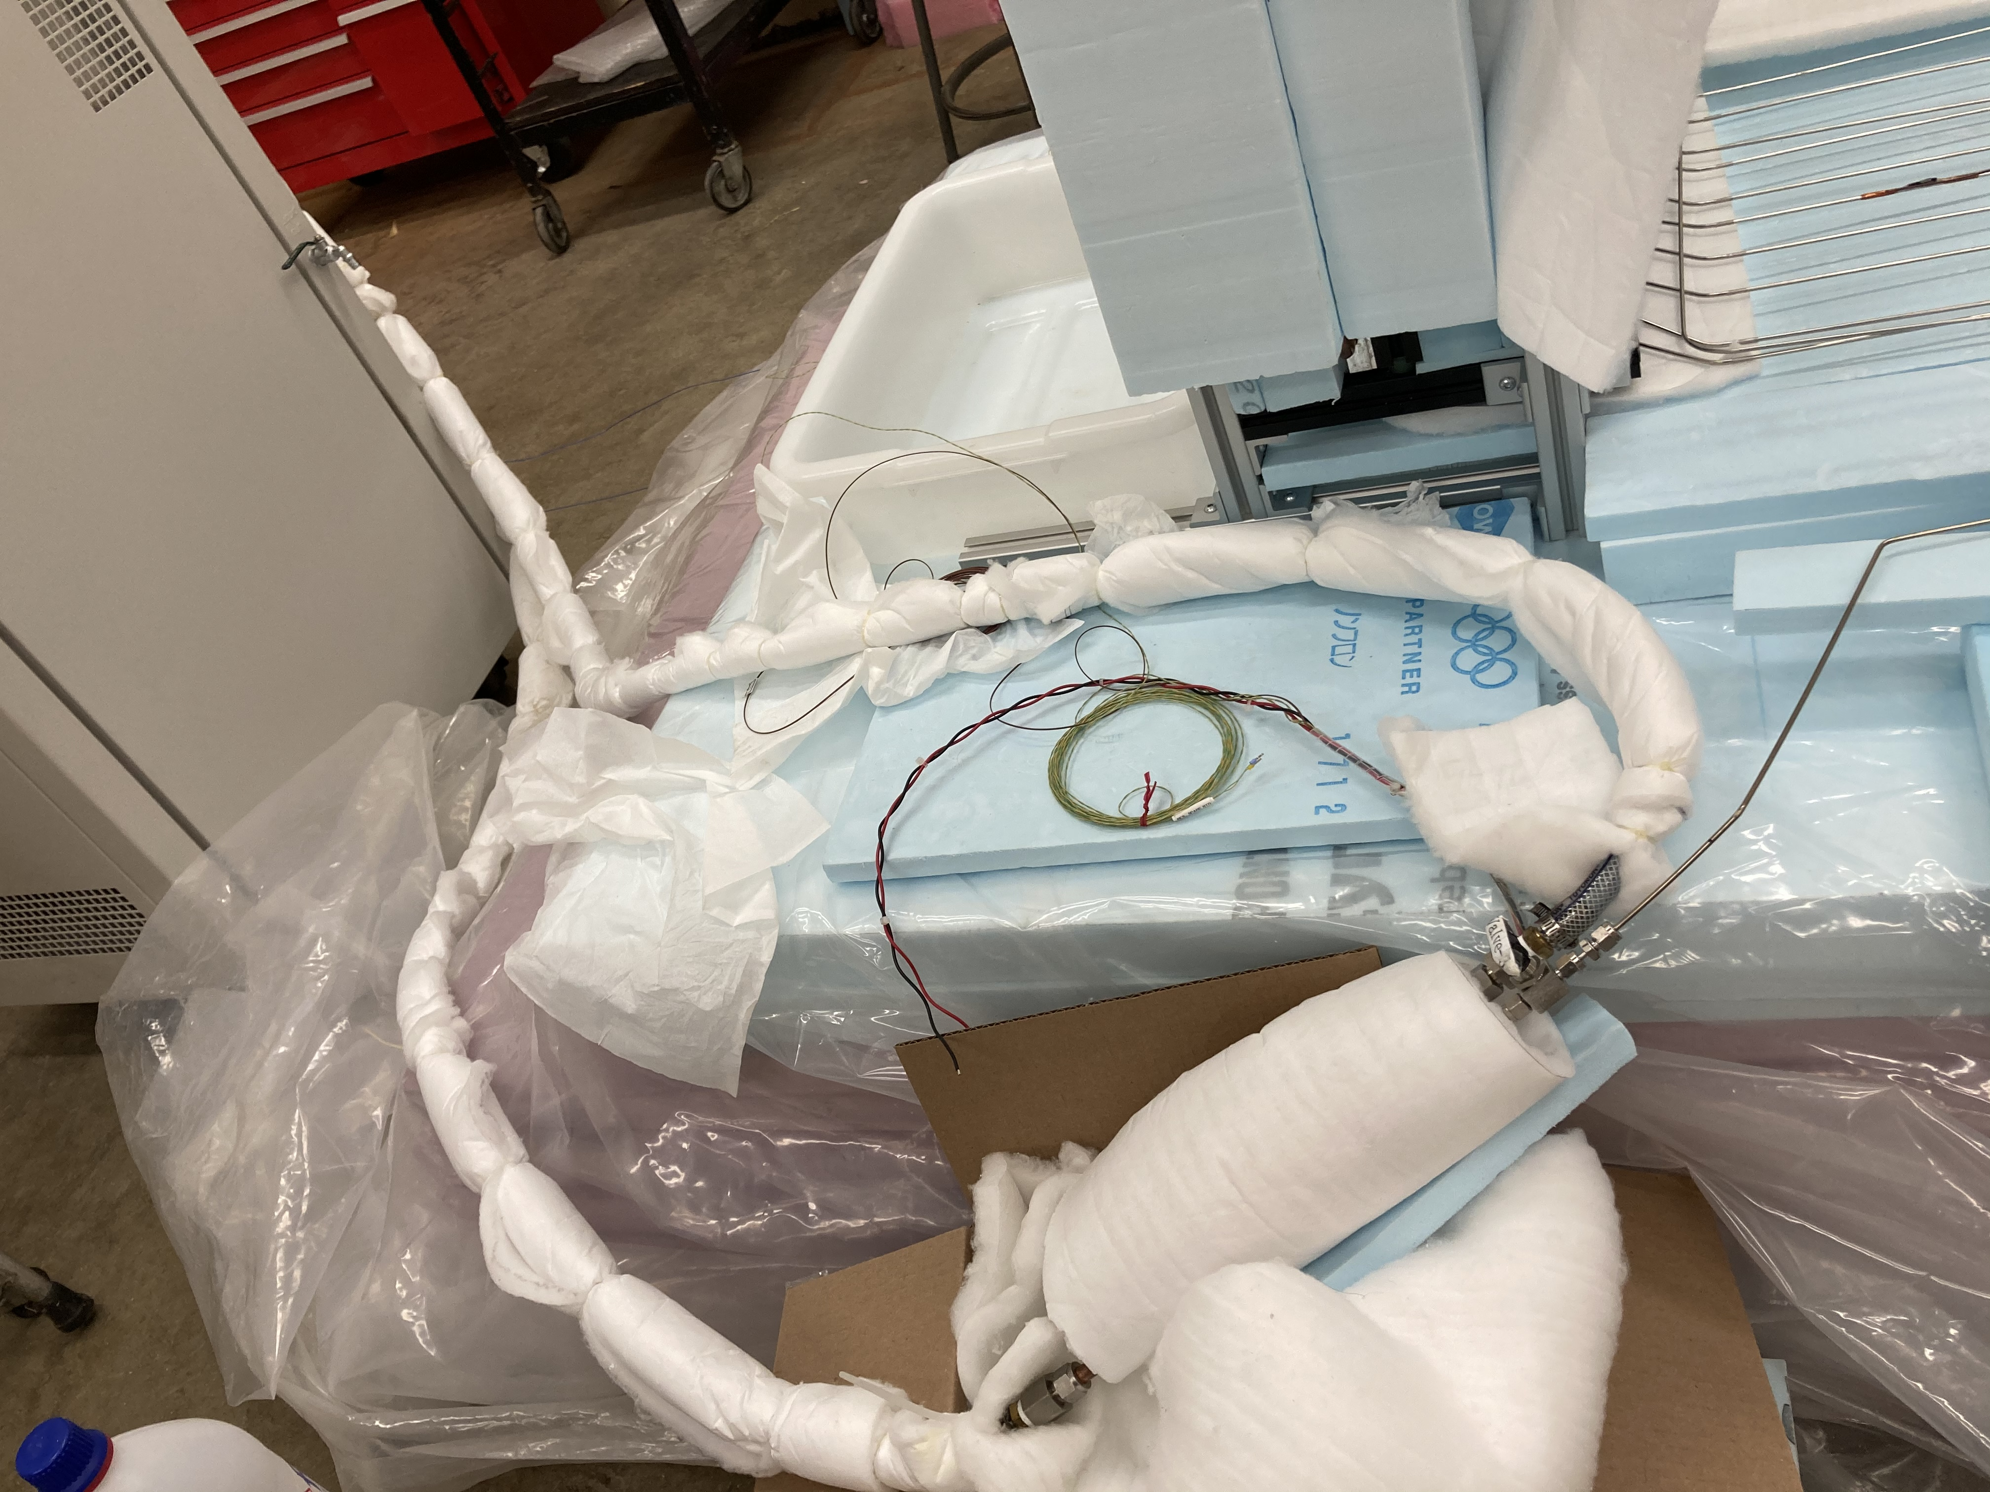
Leak Check
Procedure to check the leak rate: 1. Weigh the reservoir (m0);
2. Connect back reservoir, pump, and fill the coolant to OHP ( close valve-2, open valve-3, and valve-1);
3. Wait for next time, connect reservoir tube directly to the chiller(and RTD for the reservoir), turn down the temperature to -30 degree/keep valve3 open all the time. Once done with the experiment, close the valve for the reservoir and OHP, try to vent the tee region to see whether it still maintains high pressure. (if it&#39;s high pressure then just pump out of the Tee region again and try the collection process again)
4. Measure the wright(m1) and estimate the leakage rate.
gas mass in the connection tube between reservoir and OHP and gas in OHP is lost. But it will be a very small portion. the gas mass lost due to system leakage: (m1-m0)
Jon and I set up procedures to estimate the leak rate

Slide 3
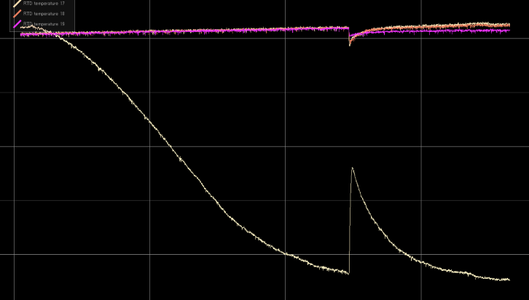
Leak check
reservoir temperature change. That sudden peak is the place where the valve for the reservoir is open.
Empty Reservoir weight 1687g
May 10th:1894g
May 17th:1895g
Scaler actually fluctuate 1 or 2 grams when you put reservoir on different position, that might be the cause. In general we lost less than 1 gram in 7 days which means less than 48 grams per year.
There was no cooling test performed so it might be slightly different when we run the chiller. Will perform long term leak checks in the future

Slide 4
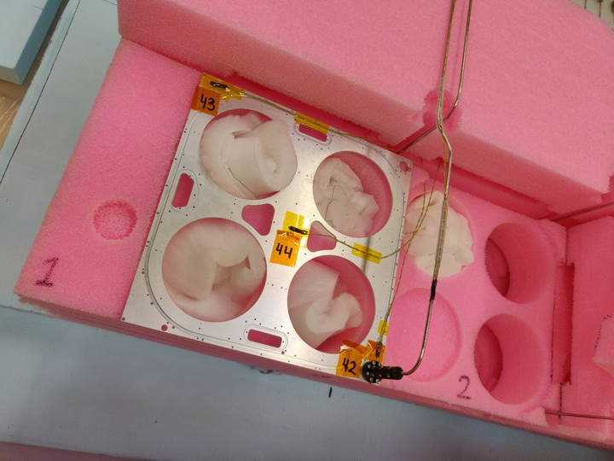
Next test
Three thermocouples placed on detector frame in the top most position of loop 1. Using Kapton tape for now, will find out if epoxy is needed before the detector run. Numbers indicate the RTD channel. RTD wiring is done, and all 3 are reading out correctly.

Slide 5
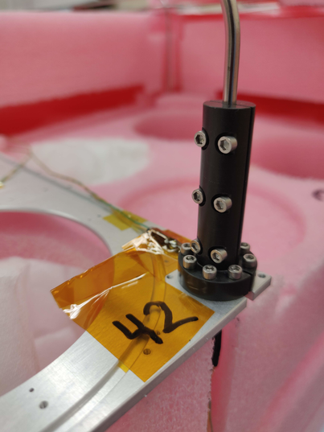
Next test
Coupler attached using all Allen socket bolts. Need to see drawing from Jerry. Also might need to order small wrench for the other variety of hex head bolts.

Slide 6
Thank you

