Slide 2

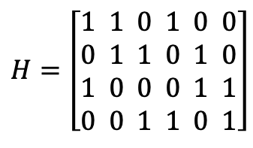

$$H=\left[\begin{aligned}1 1 0 1 0 0 \\ 0 1 1 0 1 0 \\ 1 0 0 0 1 1 \\ 0 0 1 1 0 1\end{aligned}\right]$$
, : $u_{v→c}$
, : $u_{c→v}$

Slide 3
$$H=\left[\begin{aligned}1 1 0 1 0 0 \\ 0 1 1 0 1 0 \\ 1 0 0 0 1 1 \\ 0 0 1 1 0 1\end{aligned}\right]$$

Slide 4



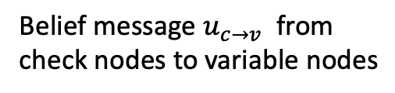
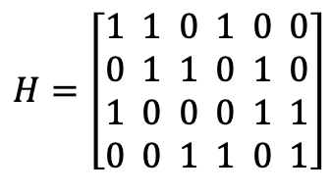

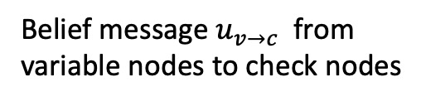




Belief message $u_{v→c}$ from
variable nodes to check nodes
Belief message $u_{c→v}$ from
check nodes to variable nodes
$$v_{1}$$
$$v_{2}$$
$$v_{3}$$
$$v_{4}$$
$$v_{5}$$
$$v_{6}$$
$$v_{1}$$
$$v_{2}$$
$$v_{3}$$
$$v_{4}$$
$$v_{5}$$
$$v_{6}$$
Parity Check Matrix
$$c_{1}$$
$$c_{2}$$
$$c_{3}$$
$$c_{4}$$
$$c_{1}$$
$$c_{2}$$
$$c_{3}$$
$$c_{4}$$
$$H=\left[\begin{aligned}1 1 0 1 0 0 \\ 0 1 1 0 1 0 \\ 1 0 0 0 1 1 \\ 0 0 1 1 0 1\end{aligned}\right]$$
$$v_{1}$$
$$v_{2}$$
$$v_{3}$$
$$v_{4}$$
$$v_{5}$$
$$v_{6}$$
$$v_{1}$$
$$v_{2}$$
$$v_{3}$$
$$v_{4}$$
$$v_{5}$$
$$v_{6}$$
, : $u_{v→c}$
, : $u_{c→v}$

