Slide 1
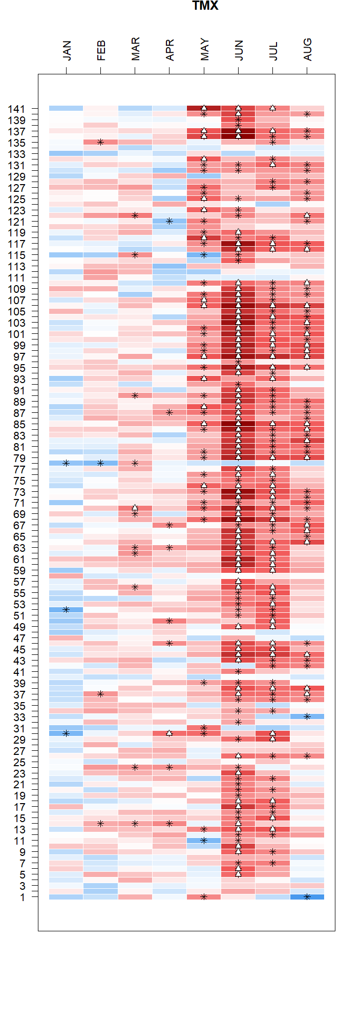
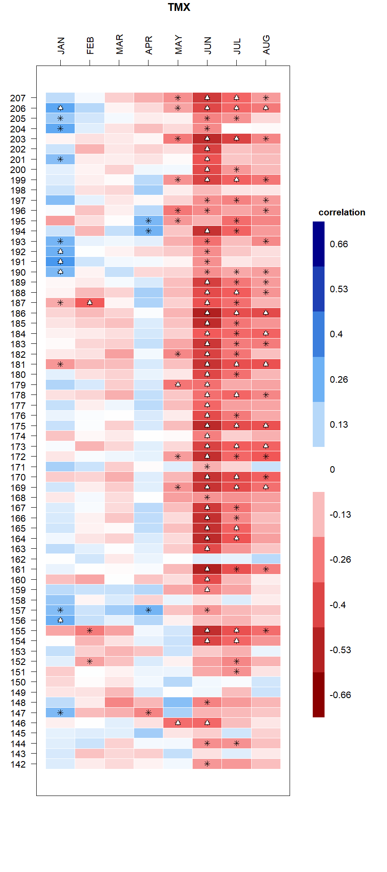

Ring porous
Diffuse porous
April T_{max}
+
SCBI
SCBI
Chronology number
HF
HF
*

Slide 2
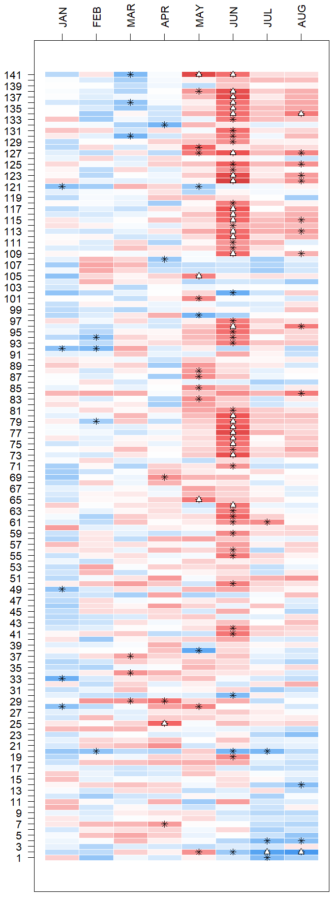
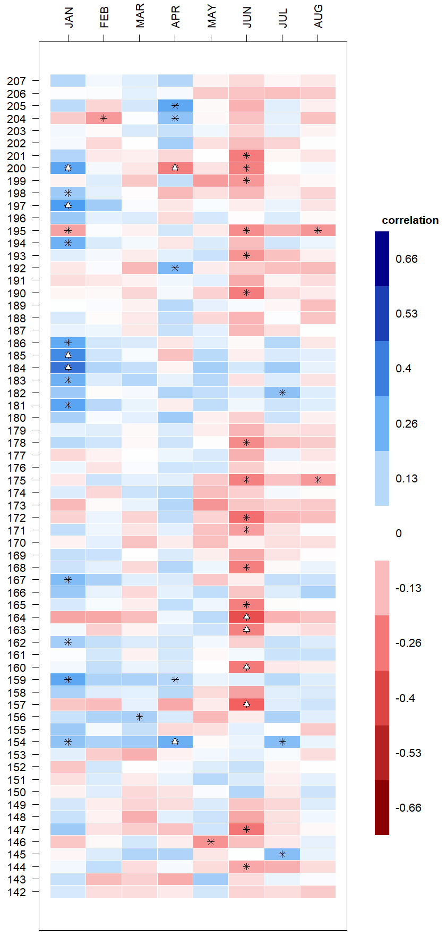
Ring porous
Diffuse porous
April T_{max}
+
SCBI
SCBI
Chronology number
HF
HF
*
-
Notes:
Tmin

Slide 3
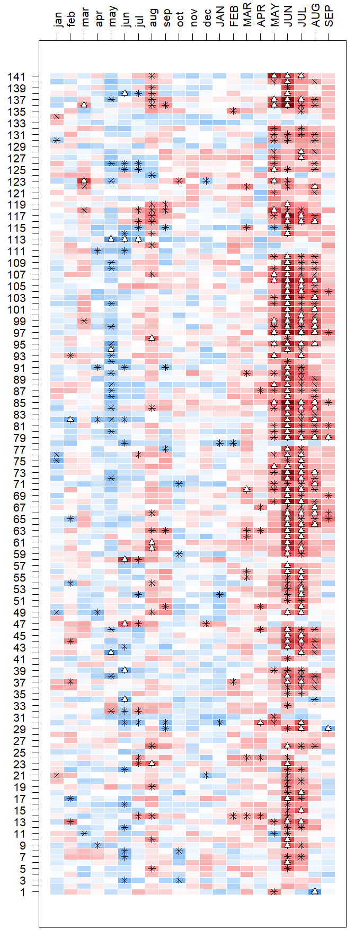
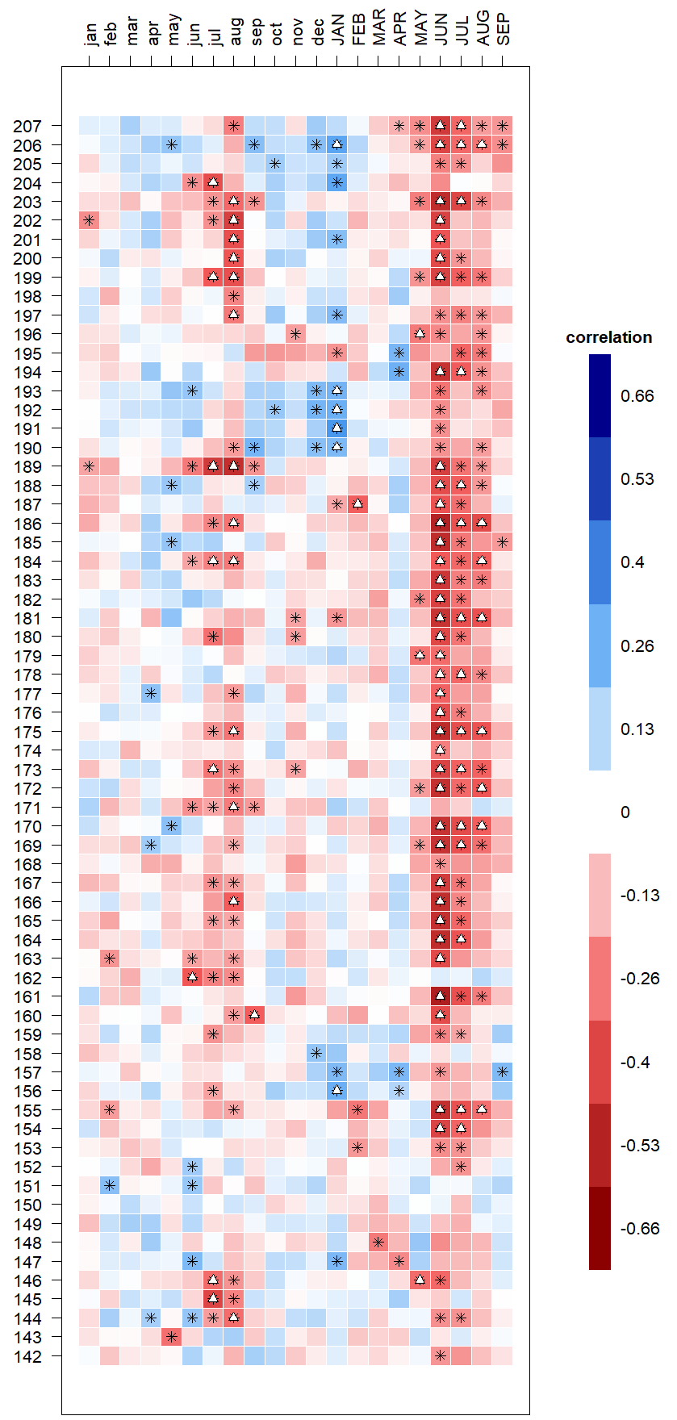
Ring porous
Diffuse porous
April T_{max}
+
SCBI
SCBI
Chronology number
HF
HF
*
-
Notes:
Tmin

