Slide 1
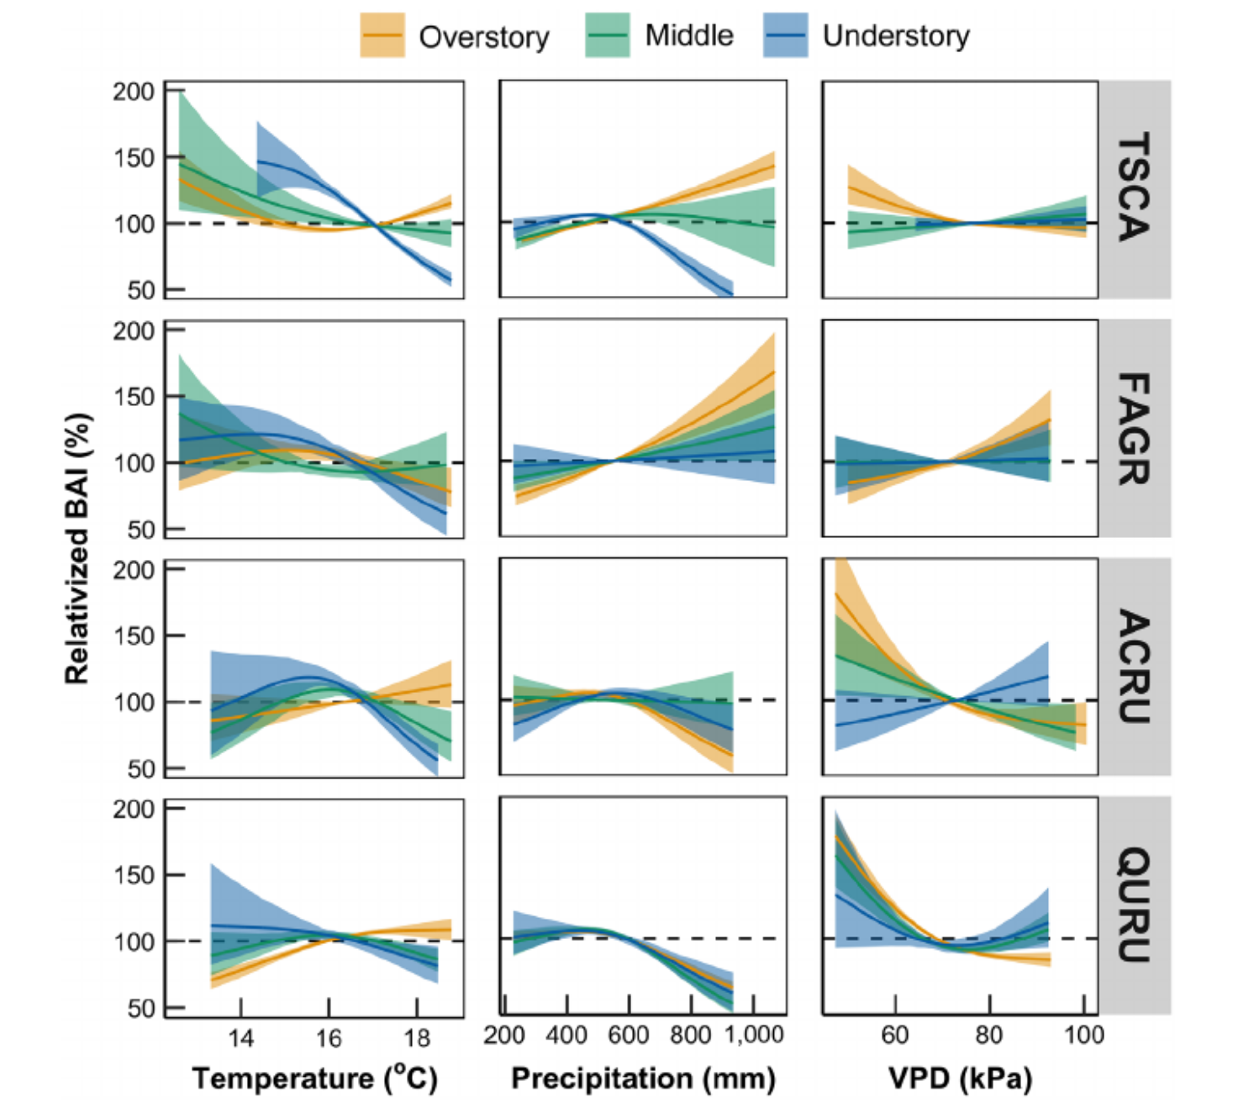
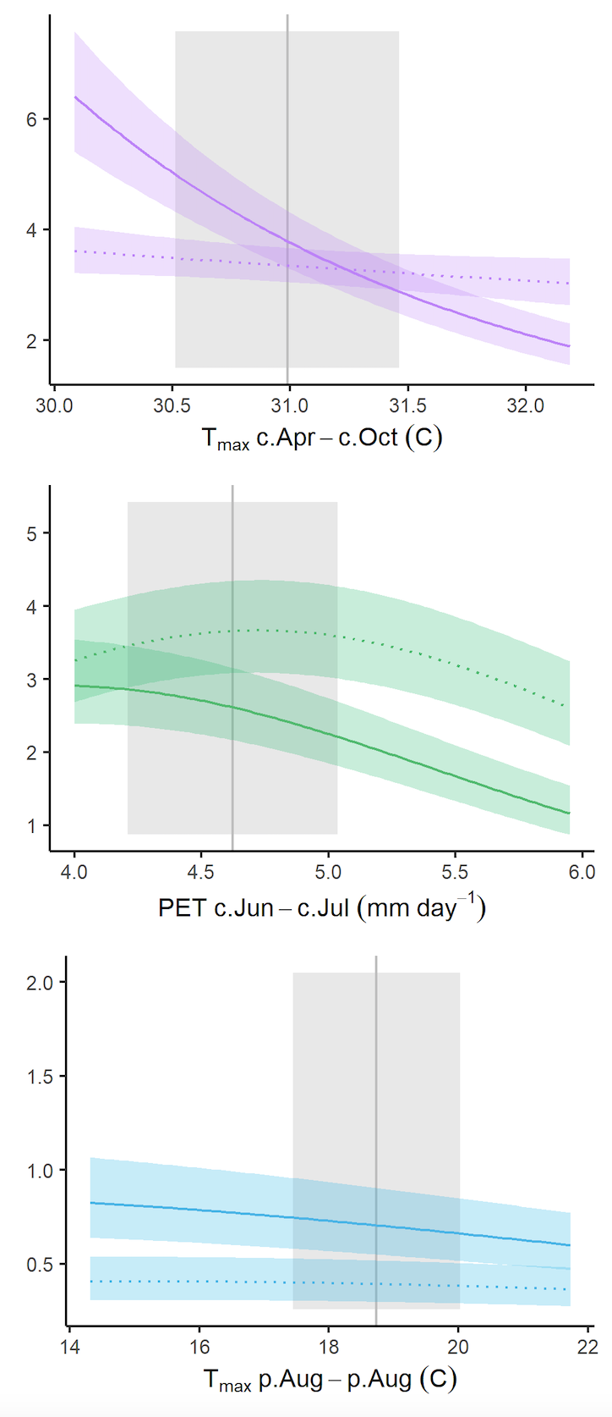
(a)
(b)
Toona ciliata
(Huai Kha Khaeng, Thailand)
Ring width (mm)
Tsuga canadensis
Fagus grandifolia
Liriodendron tulipifera (Lilly Dickey Woods, Indiana, USA)
Acer rubrum
Picea pugens (Cedar Breaks, Utah, USA)
Quercus rubra

