Slide 1
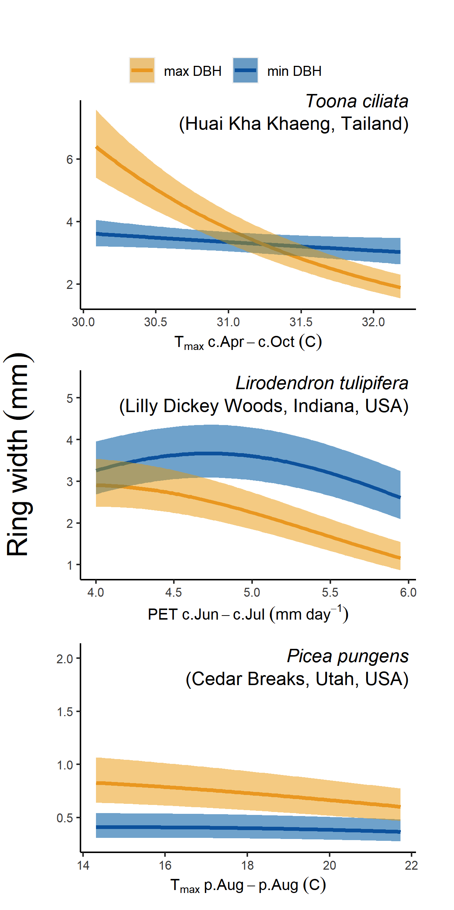
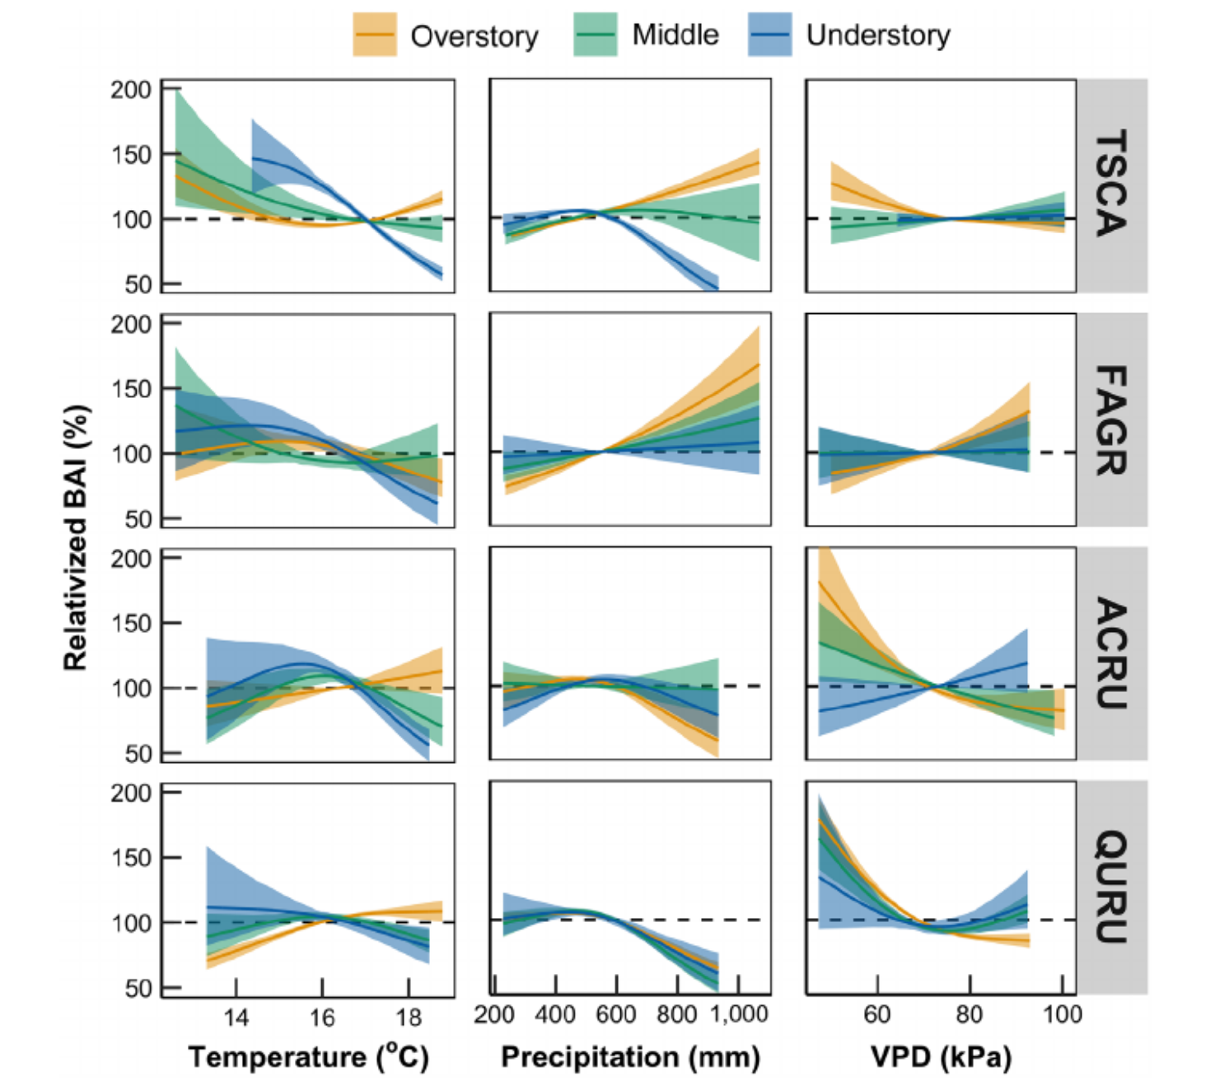
(a)
(b)
Tsuga canadensis
Fagus grandifolia
Acer rubrum
Quercus rubra

Slide 2
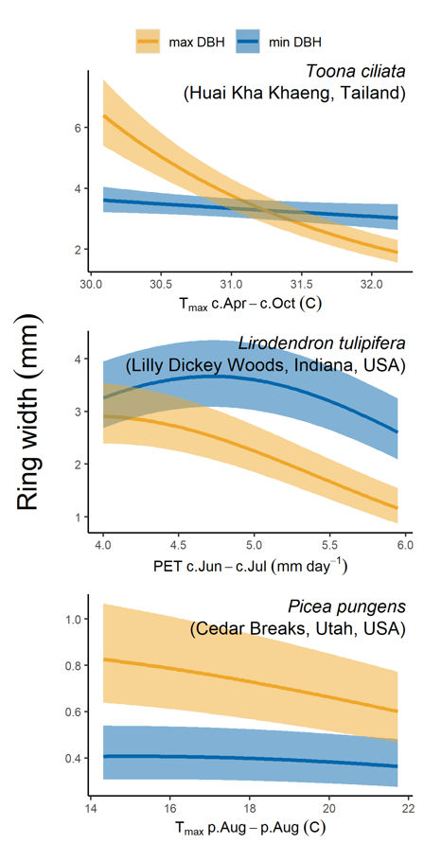
(a)
(b)
Tsuga canadensis
Fagus grandifolia
Acer rubrum
Quercus rubra

