Slide 1
Reality/
Perfect Individual-Based Model
Cohort-Based Model
Big Leaf Model
Heterogeneous
Homogeneous
Local-scale
Large-scale
baseline
drought/ disturbance

Slide 2
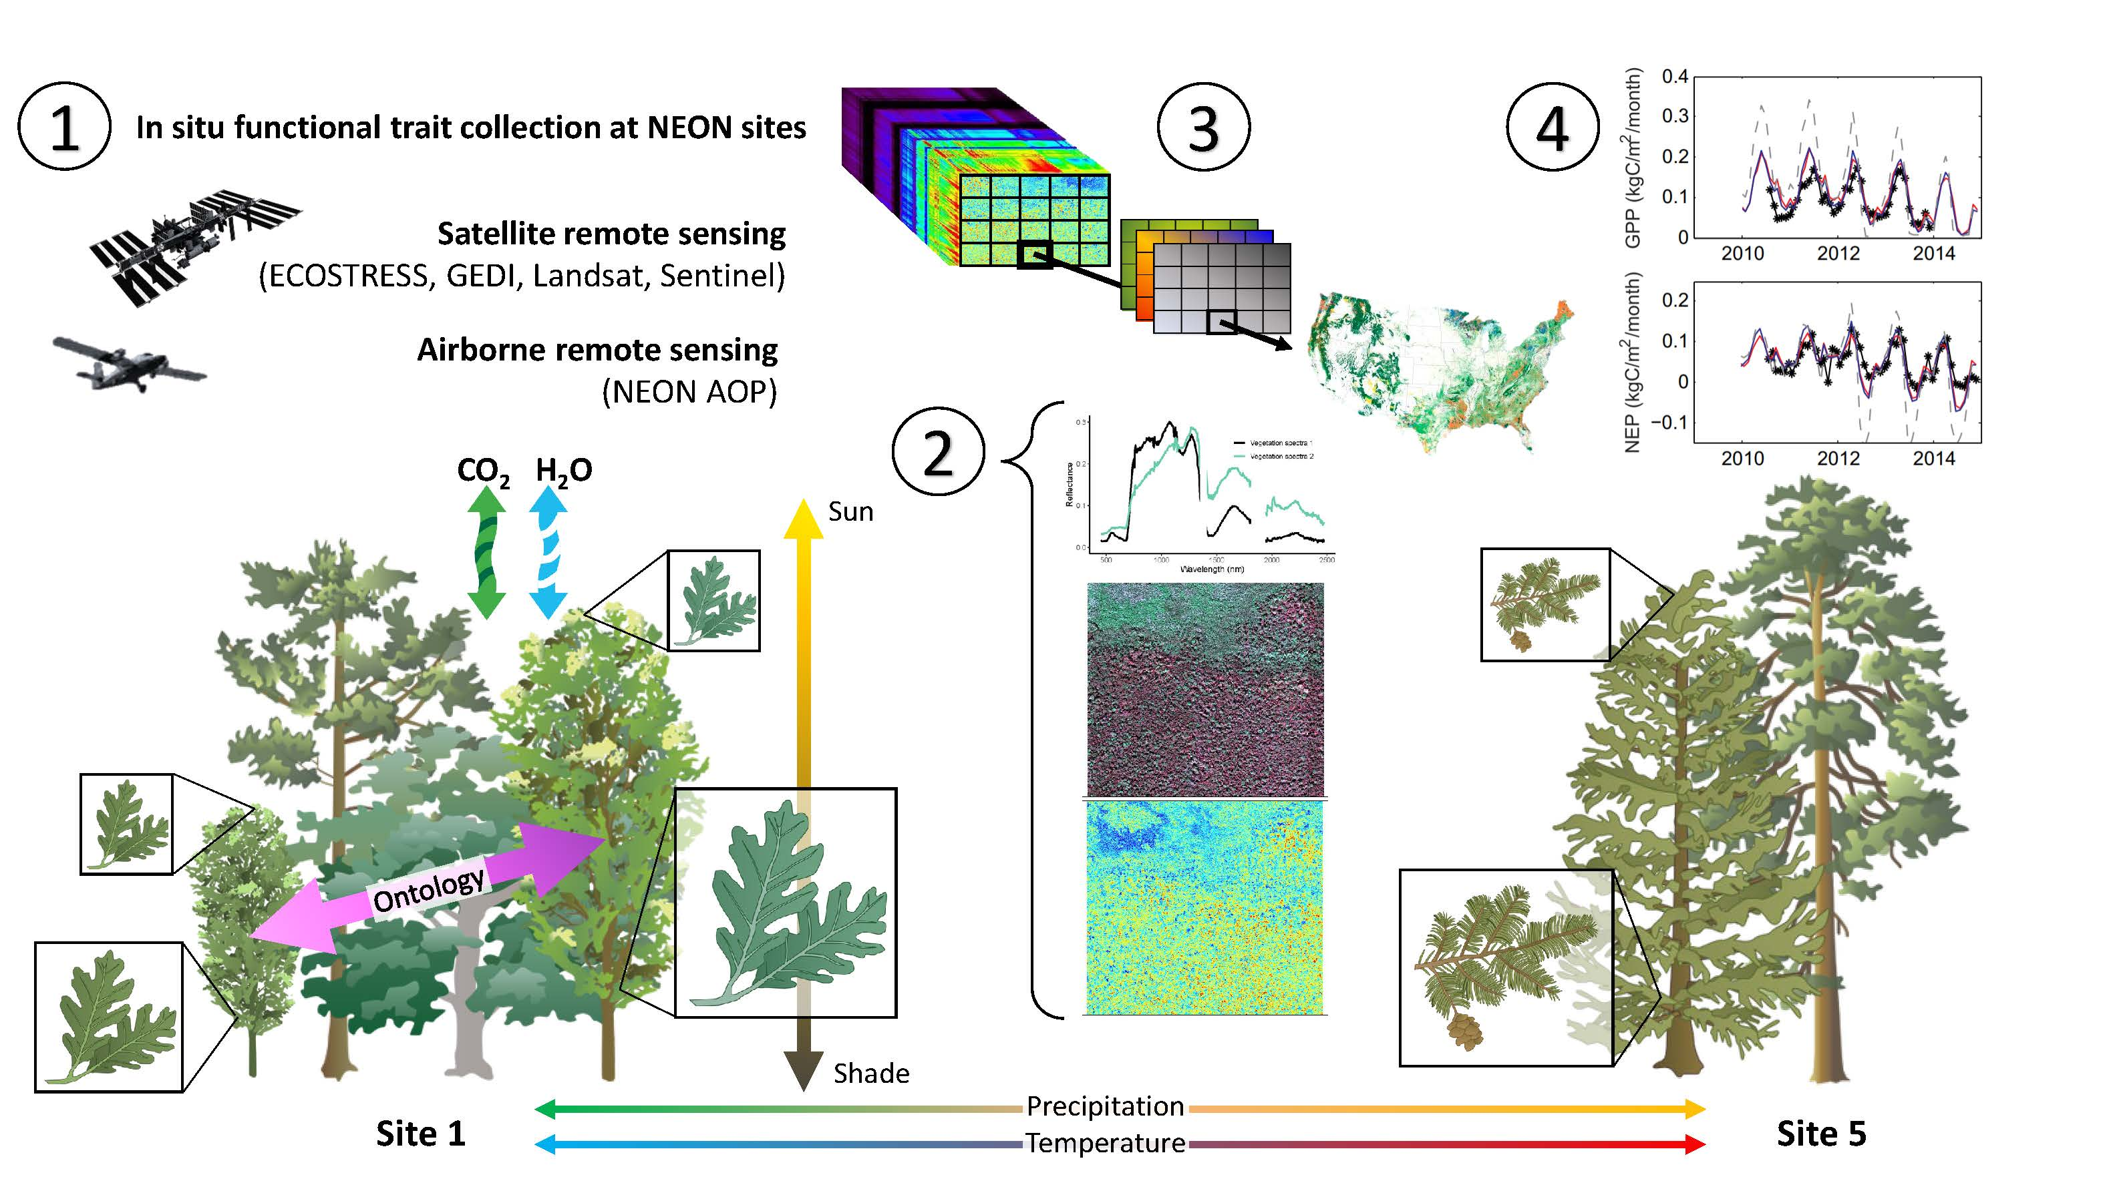

Slide 3
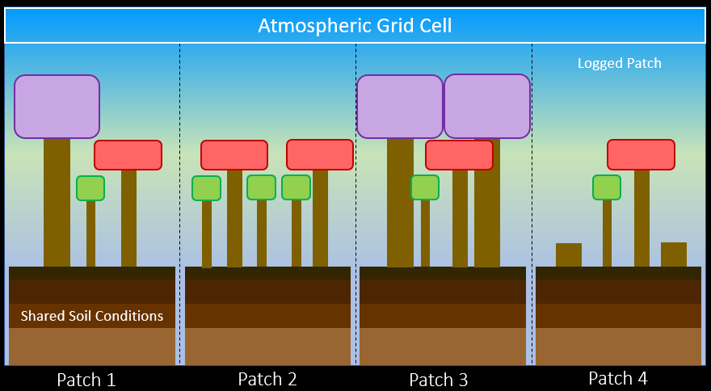
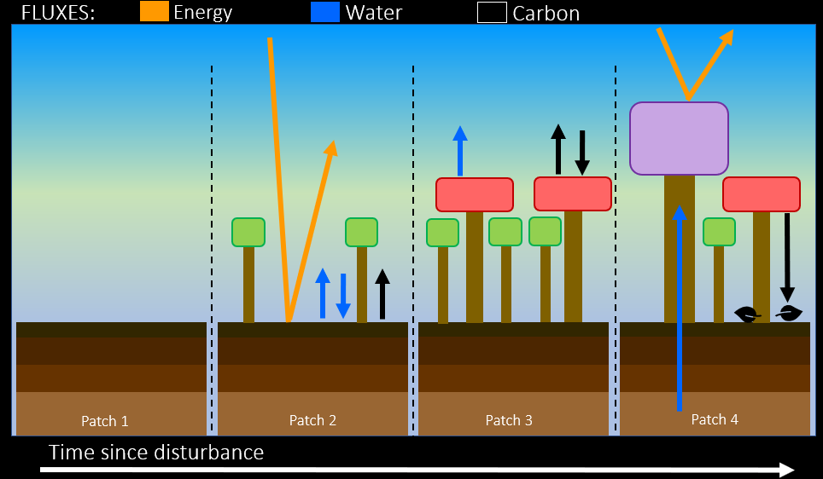
Ecosystem Demography Model v2.2 (ED-2.2)
Size- and age-structured approximation of an individual tree-based model
Characterizes vertical structure & function of plant communities, and the horizontal heterogeneity of terrestrial ecosystems
Tracks fine-scale ecosystem dynamics at individual plant & patch scales that share meteorology and soil conditions
Fully coupled carbon-water-energy dynamics
Moorcroft et al. 2001 Ecological Monographs, Medvigy et al. 2009 JGR
Notes:
ED2 is a cohort-based model, which is an intermediate solution between unstructured, “big-leaf” models and stochastic individual-based models.
Each land-atmospheric grid cell of a cohort model is divided into multiple patches with different forest stand structures.
Fluxes of water, energy, and carbon are calculated for each cohort and patch and aggregated to the grid cell.
Vegetation dynamics of recruitment, growth, and mortality transform individual patches through time, for example, regenerating a forest following disturbance by fire
This type of model simulates the C cycle and vegetation dynamics

Slide 4
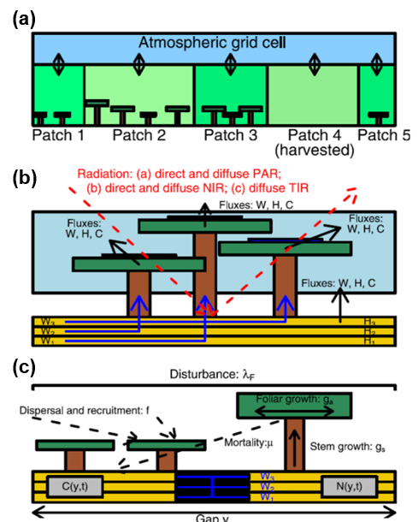
Another schematic version of the ED2 model

Slide 5
Terrestrial biosphere models
Ecosystem Demography
Model (ED2)
(deterministic)
Big Leaf Model
Gap Dynamics Model
(stochastic)
Homogeneous
Heterogeneous
Large-scale
Local-scale

