Slide 1
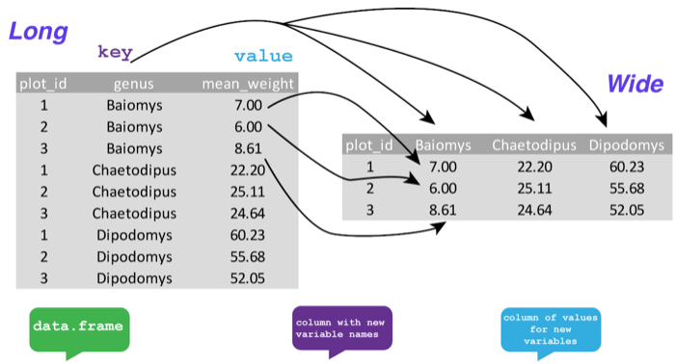
names_from
values_from
surveys_gw %>% pivot_wider(names_from = genus, values_from = mean_weight)

Slide 2
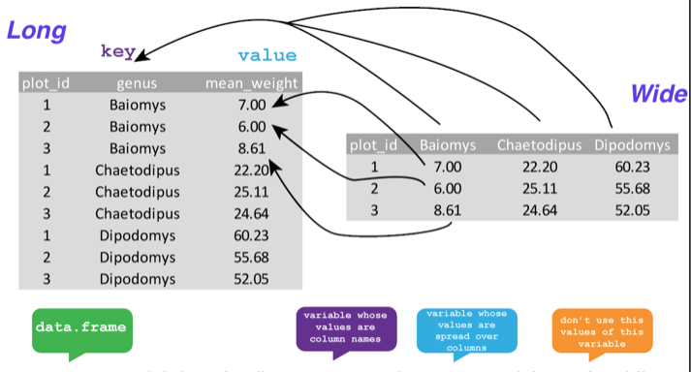
names_to
values_to
surveys_wider %>% pivot_longer(cols = -plot_id, names_to = “genus”, values_to = “mean_weight”)

