Slide 1




Project EDDIE: Water Quality
Devin Castendyk, D. and C. Gibson. April 2016. Project EDDIE: Water Quality. Project EDDIE Module 6, Version 1.
http://cemast.illinoisstate.edu/data-for-students/modules/water-quality.shtml
Module development was supported by NSF DEB 1245707.
Notes:
Cover slide

Slide 2
Outline
Chemistry Review
Nutrients vs. Toxins
Nitrogen Cycle
Impacts of excess nitrate
Human Health
Ecosystems
Sources of Nutrients
Management
Notes:
Overview: This presentation will provide a brief review of aqueous chemistry, define nutrients and their importance, discuss impacts of nutrients, sources of nutrients, and the management of nutrients

Slide 3
I. Chemistry Review Questions:
What is a solution?
How do you imagine a substance dissolved in a liquid?
How does dissolution occur?
Notes:
Some general questions for the class to identify existing knowledge. Use this time to gauge your students’ experience.

Slide 4
Water - The Universal Solvent
δ⁺
H
δ⁺
O
H
Water is called a “universal solvent”
H₂O is a “V-shaped,” polar molecule
Unequal sharing of electrons results in partial charges (δ)
The O has δ⁻ and the two H have a δ⁺
Dissolution occurs when:
The negative end of H₂O surrounds positively charged ions called “cations” (Ca²⁺, NH₄⁺, K⁺)
The positive end of H₂O surrounds negatively charged ions called “anions” (NO₂⁻, NO₃⁻, PO₄³⁻)
δ⁻
Notes:
Water is a v-shaped polar molecule with a + end and a – end. Dissolution occurs when: The negative end of H2O surrounds positively charged ions called “cations” (Ca2+, NH4+, K+)
The positive end of H2O surrounds negatively charged ions called “anions” (NO2-, NO3-, PO43-)

Slide 5
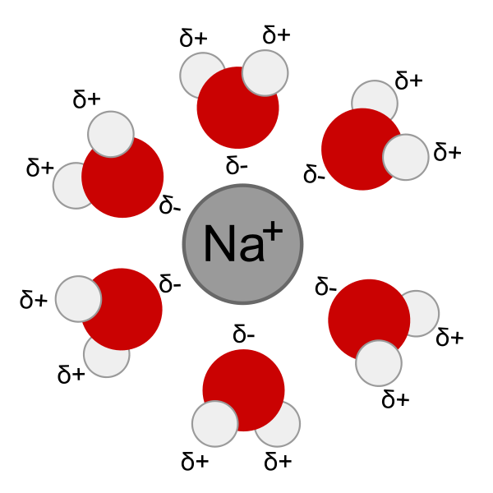
Water – The Universal Solvent
Water can dissolve other polar molecules and gases
Solids: Salts such as NaCl
Liquids: Ethanol (C₂H₆O)
Gases: O₂, CO₂, CH₄
Water cannot dissolve non-polar molecules
Hydrocarbons (motor oils, gasoline, diesel)
Glass (SiO2)
Plastics (long chains of H, O, and C)
Notes:
Image shows how negative ends of water surround a positively charged sodium ion to keep it in solution. Note, this process does not work on non-polar molecules, like petroleum, which is why oil and water do not mix.

Slide 6
Concentration
The mass of a substance (solute) dissolved in either a volume of water (solvent), or dissolved in a mass of water.
Common concentration units by volume:
Parts Per Thousand (ppt) = grams per liter (g/L)
Parts Per Million (ppm) = milligrams per liter (mg/L)
Parts Per Billion (ppb) = micrograms per L (µg/L)
Notes:
Provide a working definition of concentration. This would be good to write down in notes.

Slide 7
Common Nitrogen Species in Solution
Species: Oxidation state:
Ammonia: NH3 (N=3- H=1+)
Ammonium: NH4+ (N=3- H=1+)
Dissolved Nitrogen: N2 (N=0)
Nitrite: NO2- (N=3+ O=2-)
Nitrate: NO3- (N=5+ O=2-)
Notes:
Each element on the periodic table can occur in different combinations with other elements in solution. We call these combinations “species.” Nitrogen commonly occurs in several species based on the oxidation state and the pH of the solution, including: ammonia NH3 (the cleaning product), ammonium NH4+ (found in human urea), dissolved nitrogen gas N2 (80% of Earth’s atmosphere, responsible for the diving accident, “the bends”), nitrite (NO2-), nitrate (NO3-). Here, we are most interested in ammonium, nitrite and nitrate.

Slide 8
Ways to Report Nitrate Concentrations (units)
Nitrate (ppm)
This mass expression states the parts of nitrate present in one million parts of solution: 2 mg in 1 kg of water would be 2 ppm Nitrate.
Nitrate (mg/L)
This value represents the mass of one nitrogen atom PLUS the mass of 3 oxygen atoms (which make up the nitrate molecule) found in one liter of water
Nitrate-Nitrogen (NO3-N) (mg/L)
This term represents the mass of ONLY nitrogen in the nitrate molecules found in one liter of water.
Because there is three times more oxygen than nitrogen in nitrate, concentrations of “nitrate” are larger than concentrations of “nitrate-nitrogen” for the same sample.
The U.S. EPA regulations are based on this value.
Nitrate+Nitrite Nitrogen (NO3+NO2-N) (mg/L)
This is the mass of nitrogen from both nitrate and nitrite. Nitrite is typically very small in surface water as it rapidly oxidizes to nitrate.
This value is reported by the USGS.
Notes:
Depending on the instrument used to measure concentrations, Nitrate and Nitrite may be reported in different ways, shown here. We could report in terms of mass, where 1 mg is dissolved in one kilogram of solution. Because 1 kg of solution is 1 million mg of solution, this mass measurement is called “parts per million” (ppm). We could also report dissolves species as milligrams (mg), or one thousandth of a gram, present in a volume of one liter of solution (mg/L). For dilute solutions, like most natural waters, ppm is assumed to equal mg/L. It is important to know how nitrogen is reported before comparing concentrations from different sources. For example, concentrations of Nitrate-Nitrogen in mg/L cannot be directly compared to concentrations of Nitrate in mg/L. We must first convert Nitrate-Nitrogen (mg/L) into Nitrate (milli moles/L) and then back to Nitrate (mg/L) to make this comparison.

Slide 9
2. Nutrients vs Toxins: Questions
What are nutrients?
Where do you find nutrients?
Are nutrients always “good”?
Can you every have too much?
What are toxins?
Notes:
Transition to the topic of Nutrients: Ask class new questions to gauge their knowledge and to break up the lecture.

Slide 10
Nutrients
Nutrients are chemicals that plants and animals need to grow and survive.
Because water is a universal solvent, all life on Earth utilizes liquid water to obtain and circulate nutrients
Young men are 64% water by weight
Young women are 53% water by weight
The search for extra terrestrial life is focused on finding planets that have liquid water
For plants:
Primary macronutrients include carbon (C), nitrogen (N), phosphorous (P), and potassium (K).
Secondary macronutrients include calcium (Ca), magnesium (Mg) and sulfur (S)
Micronutrients include copper (Cu), iron (Fe), manganese (Mn), molybdenum (Mo), zinc (Zn) and nickel (Ni), and sometimes boron (B), silicon (Si), cobalt (Co).
Notes:
This slide gives a brief description of nutrients.

Slide 11
Nutrients vs. Toxins
Micronutrient: a small amount is needed for biological function
Plants: Copper
Humans: Cadmium, selenium
Toxin: a chemical, physical, or biological agent that causes disease or some alteration of the normal structure and function of an organism.
Acute toxicity: Immediate impact
Chronic toxicity: Impact after a long period of exposure
When does a nutrient become a toxin???
A few elements are toxic at all concentrations
Mercury, arsenic, lead, thallium
For most, concentration dictates toxicity
Notes:
Here we try to differentiate between nutrients and toxins. The key message is that the concentration dictates toxicity. The same element can be a nutrient at low concentrations and a toxin at high concentrations. Cadmium and selenium are good examples. Here we explore nitrogen.

Slide 12
Nitrogen: A Nutrient or Toxin?
Nitrogen is used by organisms to produce amino acids, proteins, and nucleic acids.
80% of the atmosphere is nitrogen gas (N₂)
Most plants can only take up nitrogen in two forms from soil water, making nitrogen a limiting nutrient in plant growth:
Ammonium (NH₄⁺ )
Extremely toxic to plants at high concentrations
Component of animal waste
Nitrate (NO₃⁻ )
Toxic to humans in drinking water above 10 mg/L NO₃-N
Blue baby syndrome (NO₃ binds to hemoglobin = asphyxiation)
Notes:
In low concentrations, ammonium and nitrate are essential nutrients for plants. Ammonium is toxic to plants and human at high concentrations. Nitrate is toxic to humans in high concentrations and may cause blue baby syndrome, where nitrate from drinking water binds to hemoglobin in the blood of infants and causes asphyxiation.

Slide 13
3. Impacts of Excess Nitrate
“Nutrient pollution is one of America's most widespread, costly and challenging environmental problems, and is caused by excess nitrogen and phosphorus in the air and water” (US EPA)
Examples:
In rivers and lakes, growth of cyanobacteria blooms
In drinking water resources, blue baby syndrome and cyanotoxins
In estuaries, hypoxic zones
Notes:
Transition to impacts. Read quote from EPA website. The main impact we will focus on is Cyanobacteria blooms. Other impacts include blue baby syndrome and hypoxic zones.

Slide 14
Summary of Impacts of Nutrients
Blooms
Ugly and smelly
Affect tourism, recreation, and ecosytem
Drinking water risks
Blue Baby Syndrome
Cyanotoxins
Accelerated eutrophication
Lakes fill to form wetlands at faster rates
Hypoxia
Low oxygen leads to fish kills
Notes:
This summarizes the impacts of nutrients on lake and river systems.

Slide 15
4. Sources of Nutrients
Notes:
Transition to discuss sources of nutrients. Ask class for sources.

Slide 16
Sources of Excess Nutrients
Fertilizer
Any material of natural or synthetic origin applied to soils or to plant tissues (leafs) to supply one or more plant nutrients essential to the growth of plants.
More fertilizer addition = Higher crop yield = More $$$
No incentive to conserve
Runoff (Non-point Source) from agricultural fields, lawns, golf courses
Waste Water Effluent
Contains excess C, N and P not used by animals
Direct input (Point Source) from waste water treatment plants and/or septic systems
Runoff (Non-point Source) from high-density animal feedlots and mega farms (cows, chickens, other)
Notes:
Two major sources of nutrients are fertilizers and municipal waste water.

Slide 17
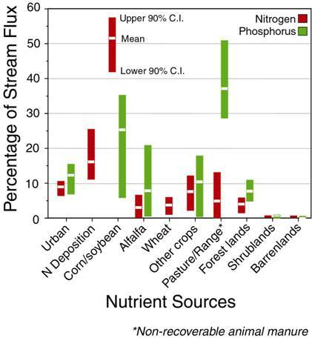
Source: U.S. Geological Survey http://http://water.usgs.gov/nawqa/sparrow/gulf_findings/sparrow.barchart.sources.jpg
Notes:
This slide shows a map of the Mississippi River catchment and identifies the kilograms of Nitrogen applied to each hectare (100 m x 100 m) parcel of land. This drives the hypoxic zone in the Gulf of Mexico.

Slide 18
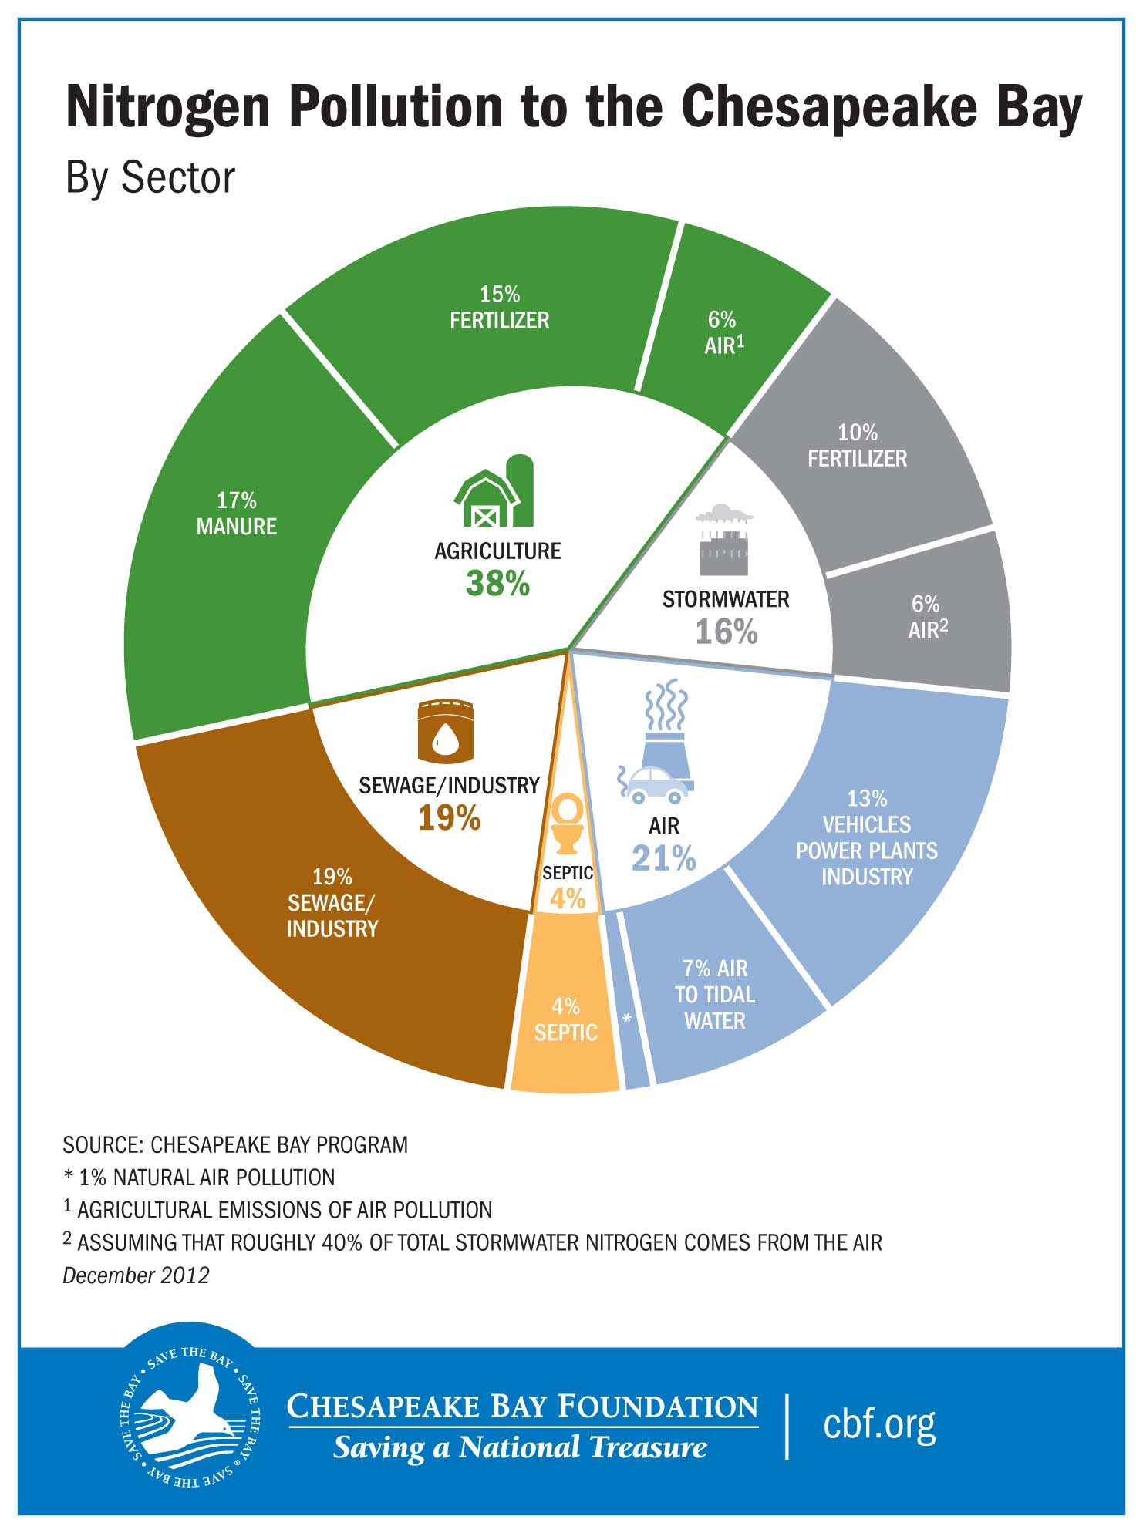
Notes:
This slide shows the breakdown of sources of nitrogen to the Chesapeake Bay which drives the hypoxic zone there. Ask students, what are the largest sources?

Slide 19
5. Management
How would you manage these impacts?
What challenges can you imagine?
Notes:
Here we transition to our final topic management. Ask students these lead in questions

Slide 20
The Clean Water Act
The U.S. Clean Water Act (CWA) is a series of federal legislative acts that form the foundation for protection of U.S. water resources:
Water Quality Act of 1965,
Federal Water Pollution Control Act of 1972,
Clean Water Act of 1977, and
Water Quality Act of 1987.
The goal of the Clean Water Act (CWA) is "to restore and maintain the chemical, physical, and biological integrity of the Nation's waters"
Notes:
Introduce the Clean Water Act. This law dictates national priorities for water quality.

Slide 21
State 303(d) Lists
Under section 303(d) of the CWA, states, territories, and authorized tribes, collectively referred to in the act as "states," are required to develop lists of impaired and threatened waters (stream/river segments, lakes)
These are waters for which technology-based regulations and other required controls are not stringent enough to meet the water quality standards set by states.
The law requires that states establish priority rankings for waters on 303(d) lists
All states to submit 303(d) lists for EPA approval every two years on even-numbered years.
Notes:
All states are required to compile a list of impaired streams and lakes, called the 303(d) list. An effort must be made to clean these streams over time.

