Slide 1
New data science skills

Slide 2
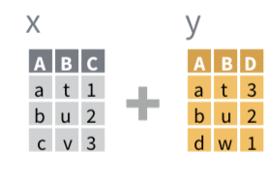





Joins

Slide 3
Joins
NULL will find the columns with the same name

