Slide 1
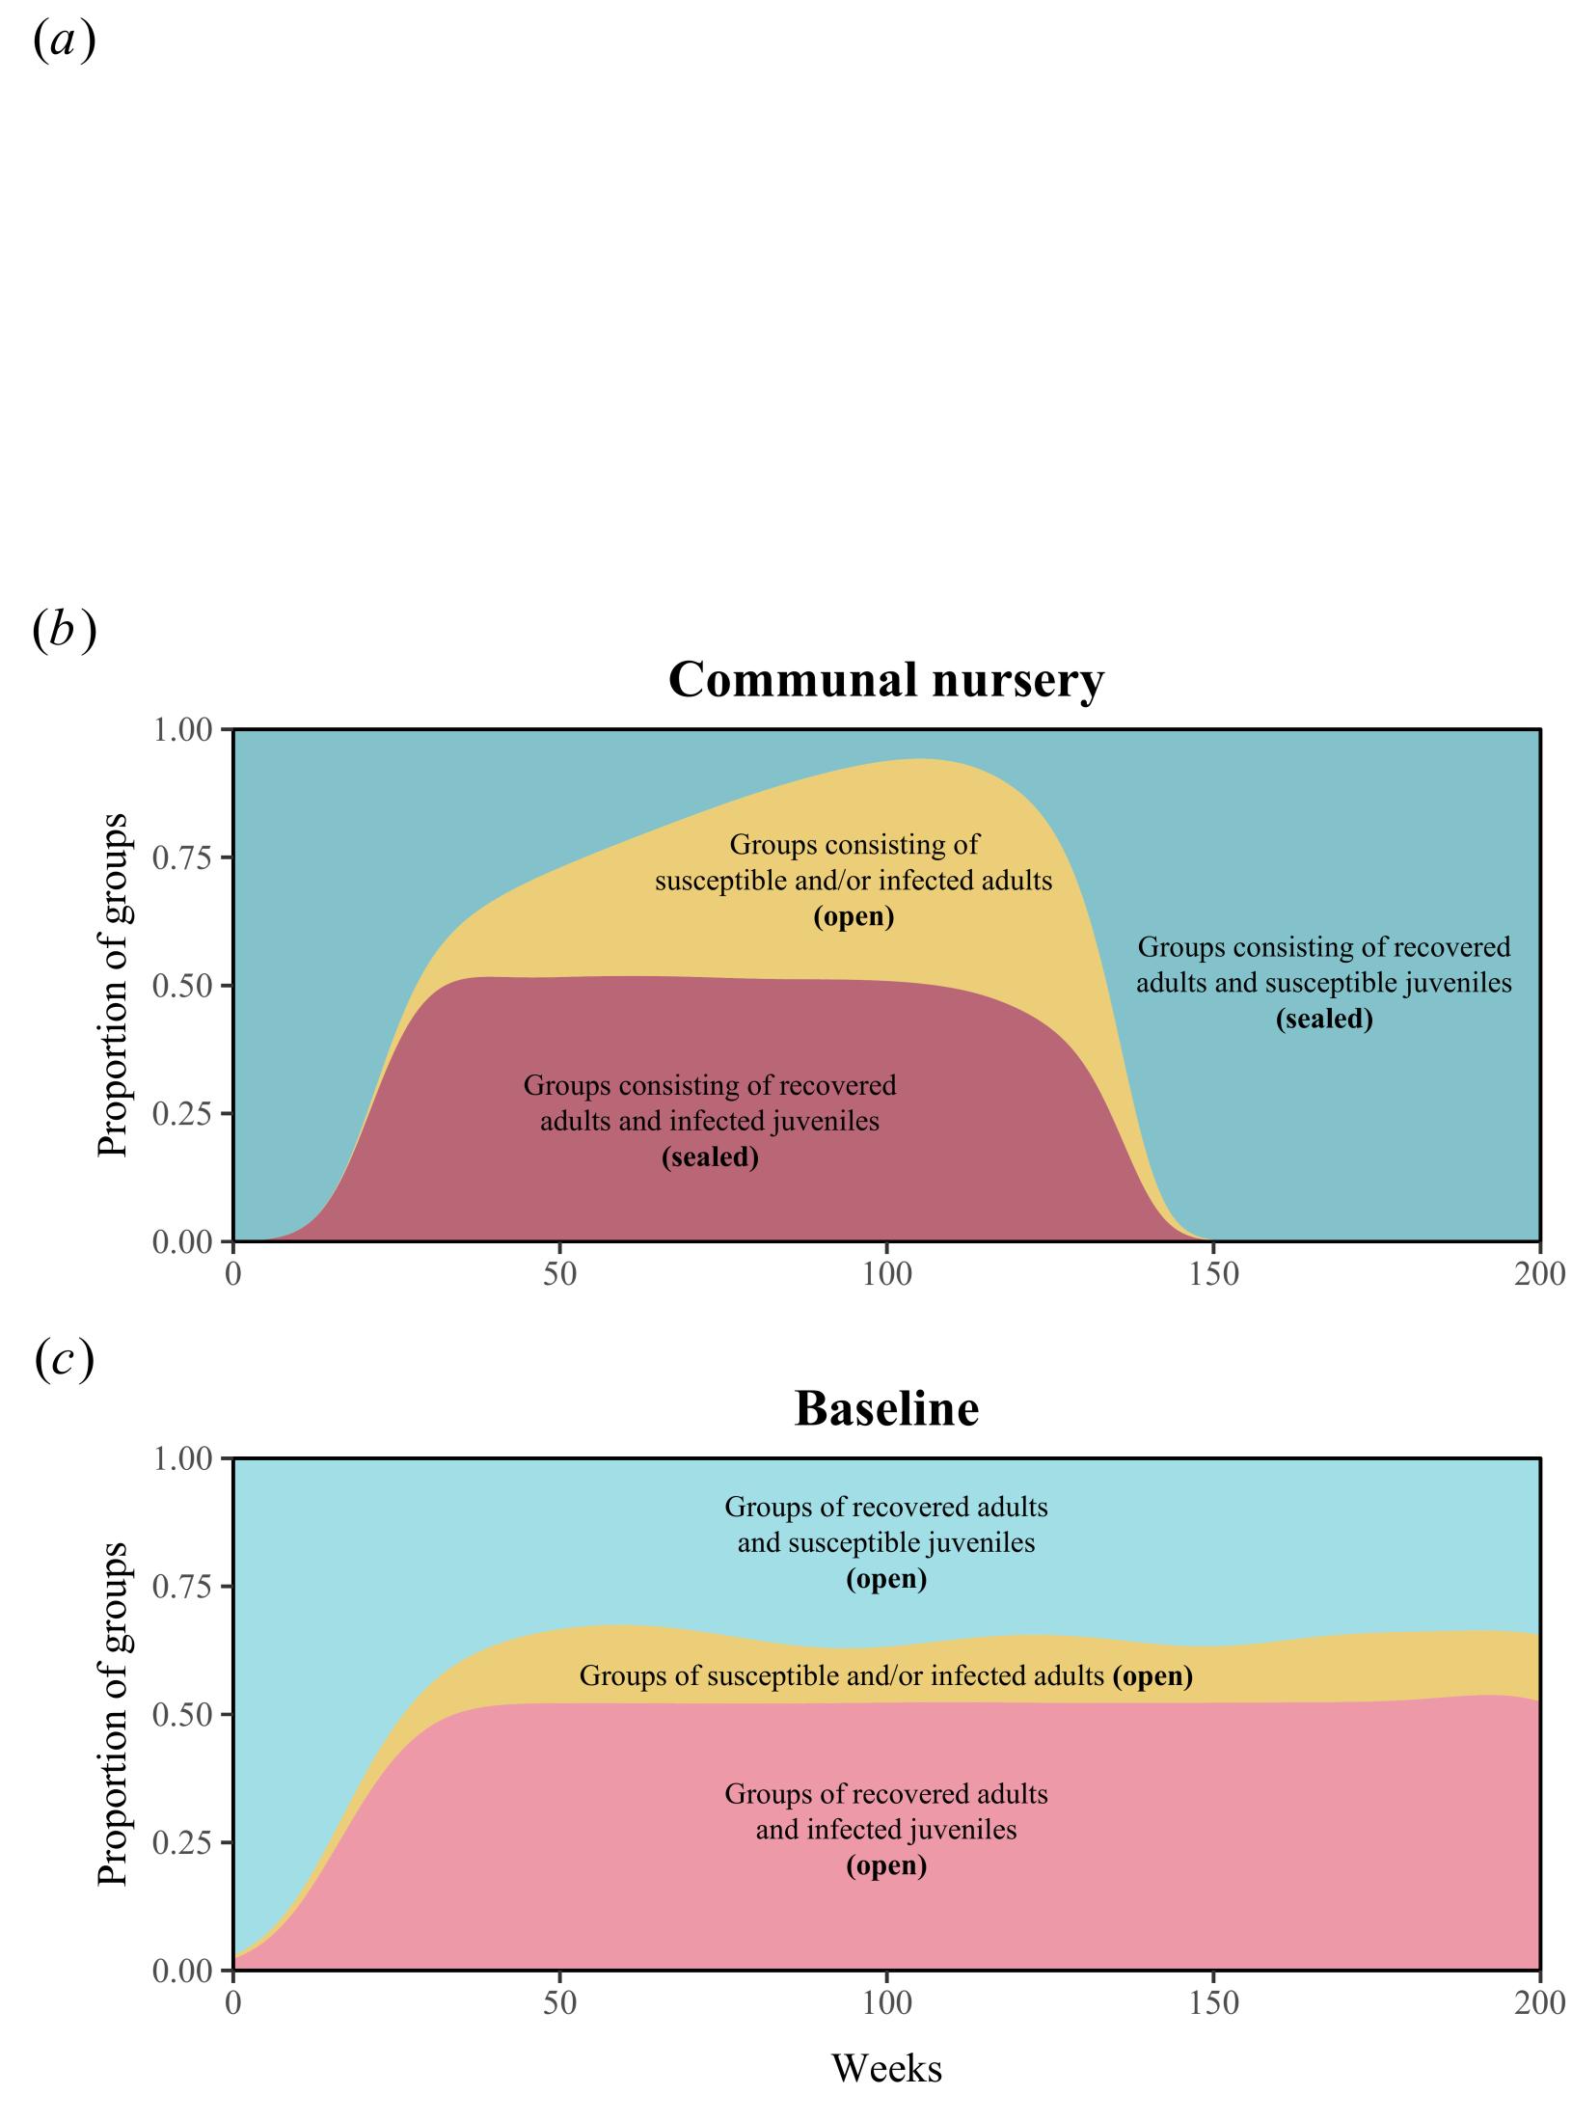
Communal nursery
S
S
I
I
I
R
R
R
R
S
S
S
S
S
S
I
S
I
I
R
I
R
S
S
S
S
S
I
I
R
S
S
R
S
S
S
S
I
I
R
R
R
R
open group
with S and/or I adults
sealed group
with I juveniles
sealed group
R adults protect S juveniles
Time

