Slide 1

An R package with the aim to
simplify workflows of D6 research projects
Cédric Scherer

Slide 2
An R package with the aim to
simplify workflows of D6 research projects
Cédric Scherer
AND MAKE THEM REPRODUCIBLE

Slide 3
4 Main Functionalities (so far)
Create standardized project directories
Provide standardized Rmarkdown templates
Rendering of all Rmarkdown reports
Install a set of common packages

Slide 4
4 Main Functionalities (so far)
Create standardized project directories
Provide standardized Rmarkdown templates
Rendering of all Rmarkdown reports
Install a set of common packages

Slide 5
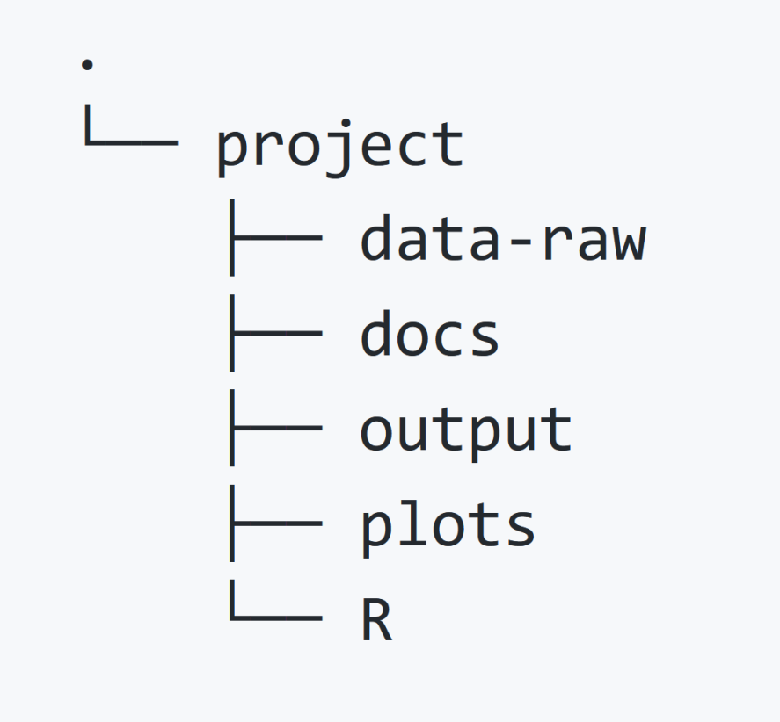
standardized project directories
new_project(“project”)

Slide 6
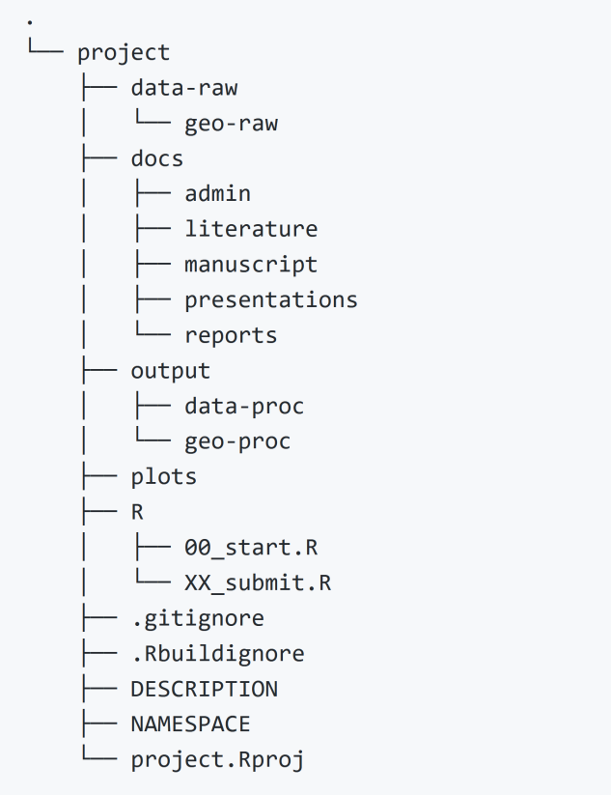
standardized project directories
new_project(“project”)

Slide 7
standardized project directories
new_project(“project”,
path = “C:/Users/Cedric”,
github = TRUE,
private_repo = TRUE,
geo = TRUE)

Slide 8
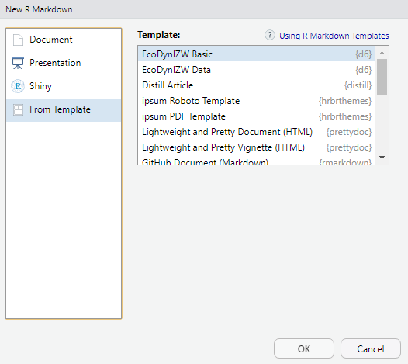
standardized project directories
standardized RMARKDOWN TEMPLATES
File > New File > Rmarkdown... > From Template

Slide 9
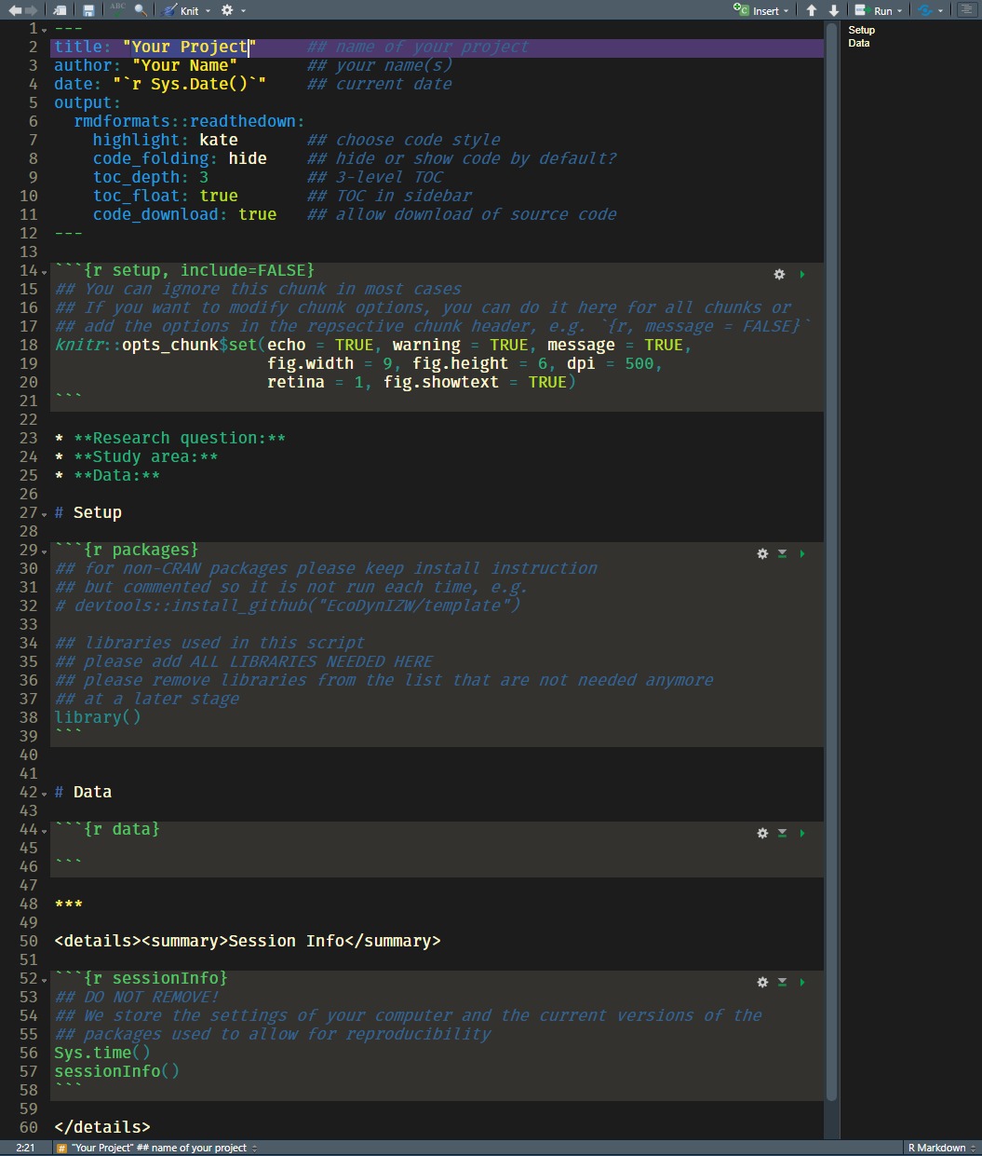

standardized RMARKDOWN TEMPLATES
File > New File > Rmarkdown... > From Template

Slide 10
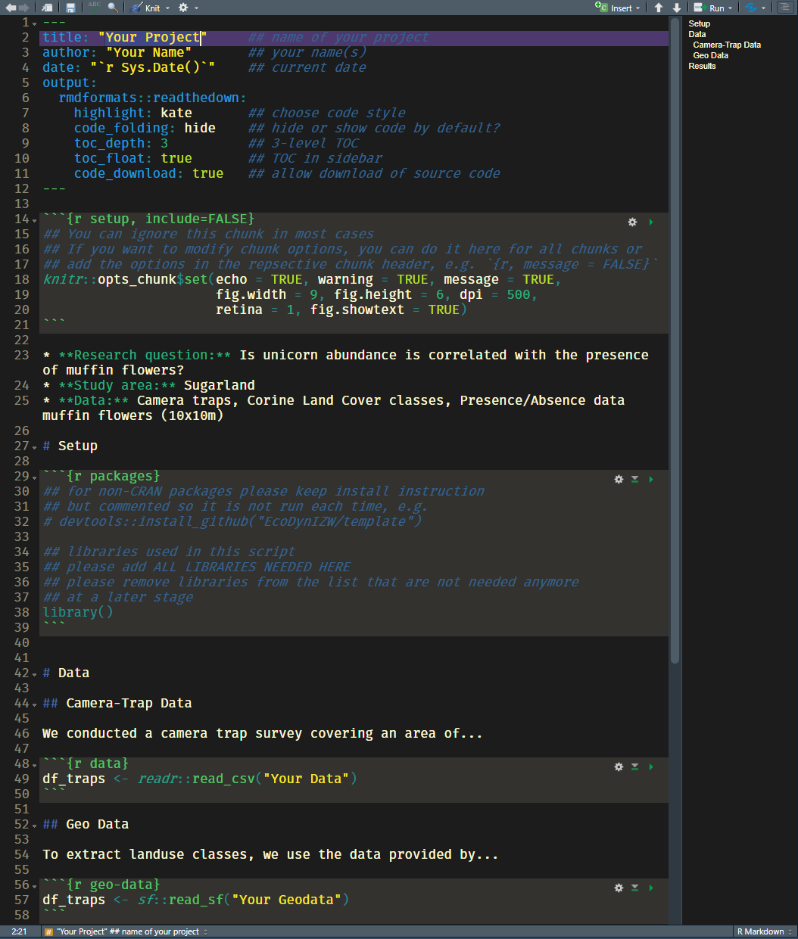
standardized RMARKDOWN TEMPLATES
File > New File > Rmarkdown... > From Template

Slide 11
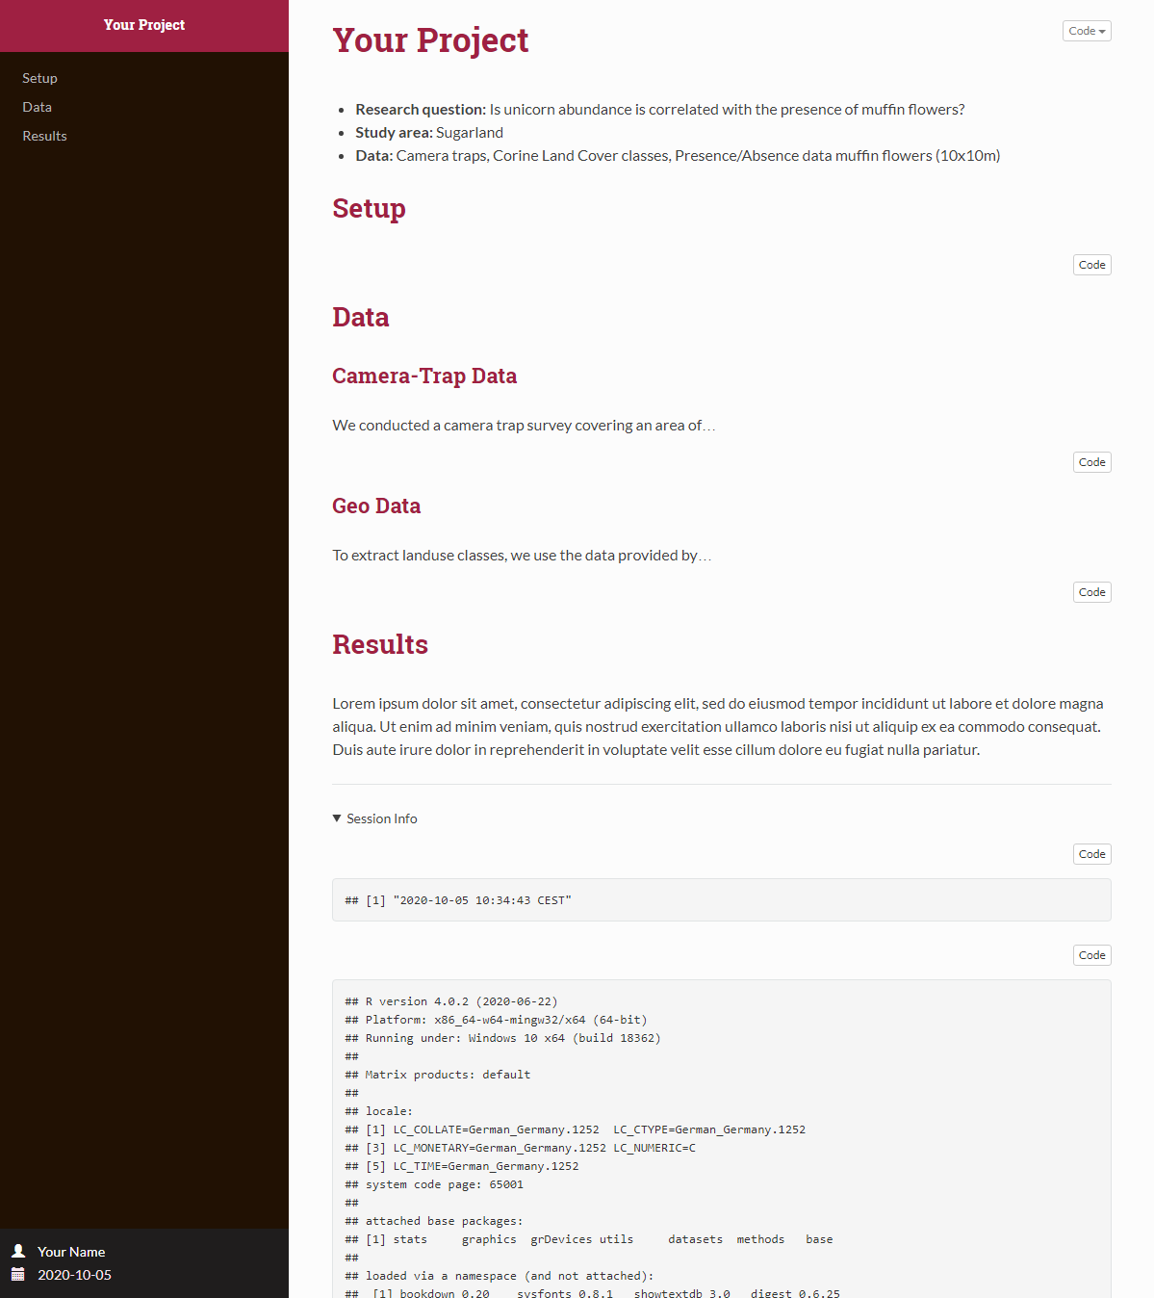
standardized project directories
standardized RMARKDOWN TEMPLATES

Slide 12
standardized RMARKDOWN TEMPLATES

Slide 13
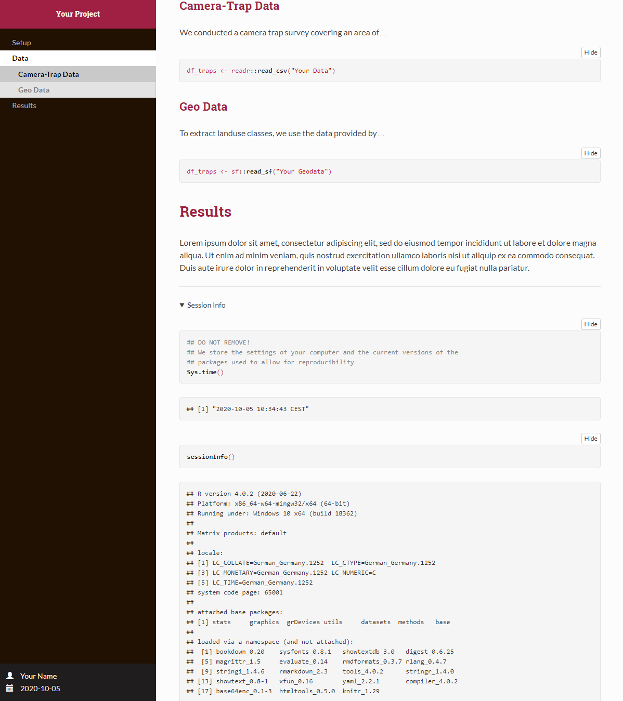
standardized RMARKDOWN TEMPLATES

Slide 14

Rendering of (all) reports into the correct folder
render_all_reports() render_report(“x.rmd”)

Slide 15

PROJECT WORKFLOW WORKSHOP
Monday, October 12 2020, 2pm

Slide 16
PROJECT WORKFLOW WORKSHOP
Monday, October 12 2020, 2pm
TOPICS:
Project Organisation
R Projects and Rmarkdown
Version Control with GitHub

Slide 17

PROJECT WORKFLOW WORKSHOP
Monday, October 12 2020, 2pm

