Slide 1



Anna Mitra
Food Redistribution Platform
Team EcoVision | Group 6 | November 2025

Slide 2









Team Details
Product Owner
Solution Architect
DevOps
Kashish Sorathiya 202412035
Anirudh Lohiya 202412074
Mohit Pipaliya 202412072
UI/UX Designers
Business Analyst
Frontend Developers
Rajvi Dhameliya 202412018
Kashish Khubchandani 202412034
Honey Patel 202412067
Kashish Khubchandani 202412034
Bhumi Vyas 202412123
Backend Developers
Scrum Master
Technical Writer
Hardip Muliyashiya 202412021
Mohit Pipaliya 202412072
Rajvi Dhameliya 202412018
Aakash Odedara 202412053
Kashish Sorathiya 202412035

Slide 3






Project Overview
Problem Statement
Motivation
Objectives
Edible food discarded while nearby communities face food insecurity
Create single coordinated system connecting all stakeholders
Fast, reliable matching of surplus food with nearby NGOs/volunteers
No central platform to announce surplus food
Provide end-to-end donation lifecycle management
End-to-end visibility, food safety, trust & accountability
Coordination gaps between donors, NGOs, volunteers
Actionable insights via dashboards and reports

Slide 4







Target Users and System Environment
Target Users
Donor
Individuals or businesses offering surplus food.
NGO
Non-Governmental Organizations facilitating food distribution.
Volunteer
Individuals assisting with pickups and distribution.
Admin
Monitor donations, manage users, moderate content, track metrics
System Environment
Web-based platform supporting multiple devices
Role-specific access with different features per user type
Responsive design for different screen sizes
Real-time notification system

Slide 5


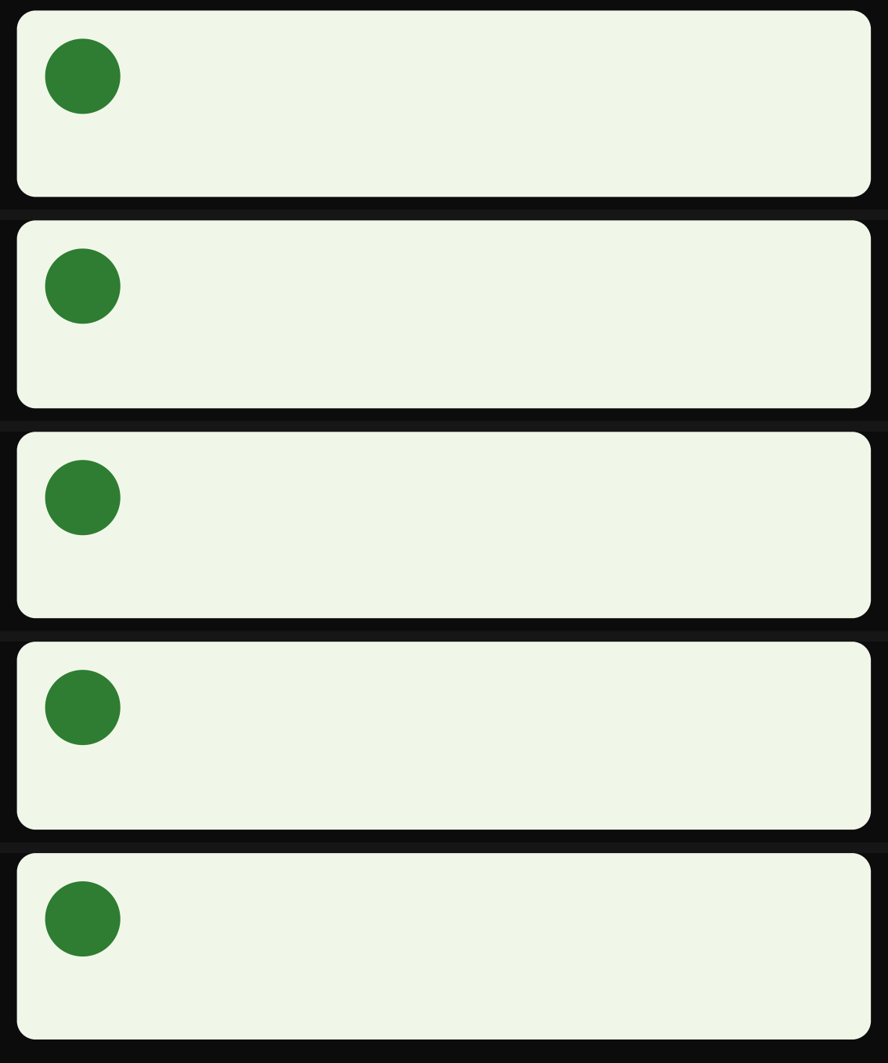
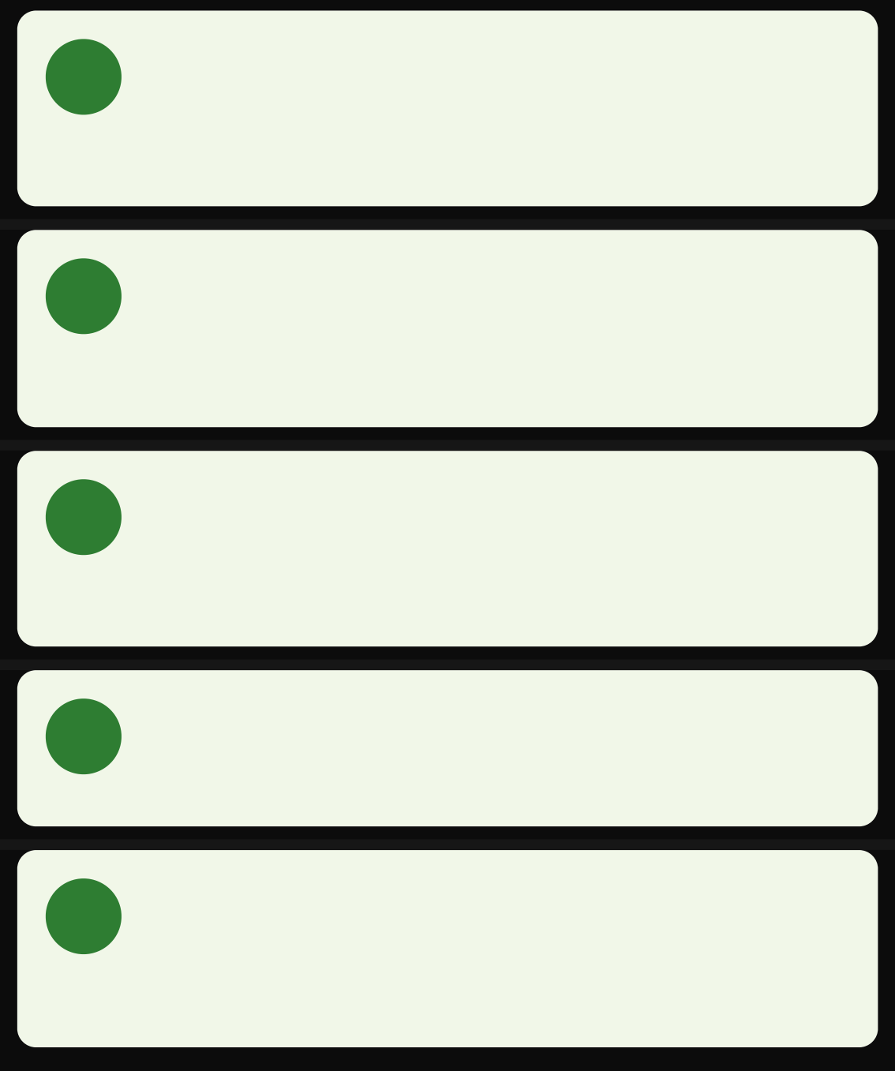










Requirement Specification
Functional Requirements
Non-Functional Requirements
User Registration & Authentication
Email/OTP registration • Role selection • Secure authentication
Donation Management
Create donations • Assign to NGO • Receive notifications • Rate NGOs
NGO Management
View nearby donations • Request/claim • Assign volunteers
Confirm delivery
Volunteer Management
View assigned donations • Complete pickups • Update status • Upload proof
Admin Dashboard
Verify NGOs/users • Monitor donations • Handle disputes • View metrics
Performance
Publish→notify latency < 5s • Support 100+ concurrent users
Security & Privacy
Passport authentication • Password hashing • Encrypted data
Usability & Accessibility
Simple UI • Large buttons • Readable contrast • Mobile- friendly layout
Localization
Support for English, Hindi, Gujarati
Scalability & Maintainability
Modular backend architecture • Separate frontend/backend repositories

Slide 6




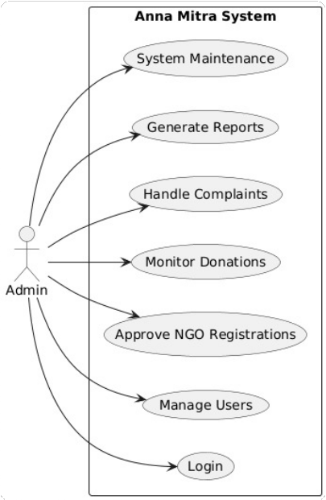
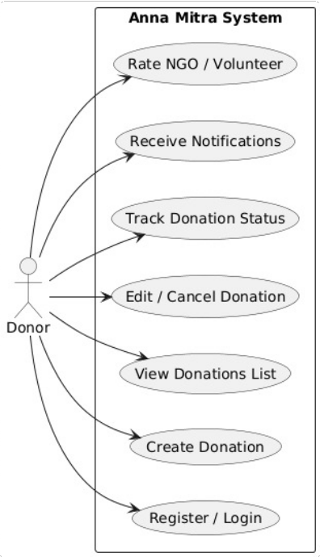
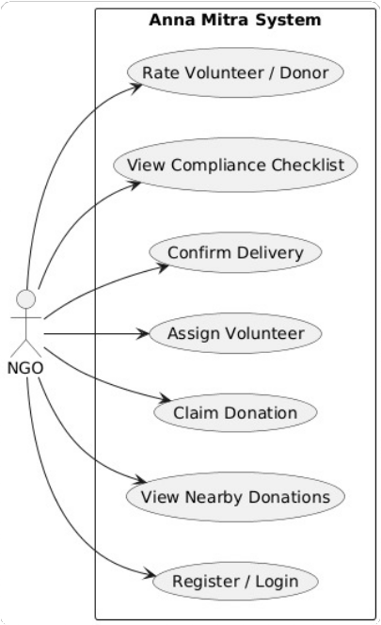
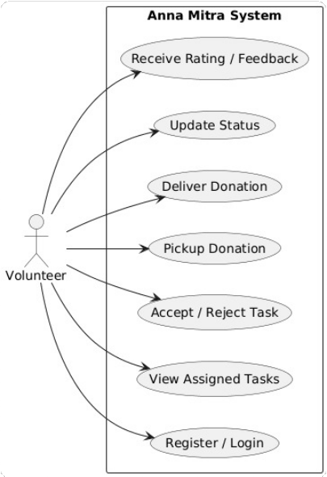
Use Case Diagrams
Admin Use Case
Donor Use Case
NGO Use Case
Volunteer Use Case

Slide 7





User Stories
User Stories
Donor
As a Donor, I want to create a donation post so that nearby NGOs can request it
NGO
As an NGO, I want to view nearby open donations so that I can claim them
Volunteer
As a Volunteer, I want to see my assigned pickup points on a map so I can plan efficient routes
Admin
As an Admin, I want to verify NGOs and manage users to ensure platform security and reliability

Slide 8








Technology Stack
Technology Choices
Frontend: React
Component-based
Backend: Node.js + Express
JavaScript full-stack High-performance
Efficient rendering
Rich ecosystem
Lightweight
Database: MongoDB
Flexible document model
Authentication: Passport.js
Modular auth middleware Multiple strategies
Easy scaling
Node.js integration
Easy integration
System Architecture Benefits
Responsive design Modular architecture
Full-stack JavaScript
RESTful API
Cloud deployment

Slide 9


Conclusion
Project Strengths & Challenges
Strengths
Potential Challenges
End-to-end solution - Complete donation lifecycle
Volunteer shortage - May affect pickup efficiency
Multi-role coordination - Connects all stakeholders
Food safety risks - Requires strict monitoring
Transparency & accountability - Ratings & delivery proof
Scalability issues - Challenges with user growth
Food safety - Time windows & safety checklists

Slide 10




"
When we give cheerfully and accept gratefully, everyone is blessed.
Thank You
Maya Angelou
Thank You

