Slide 1
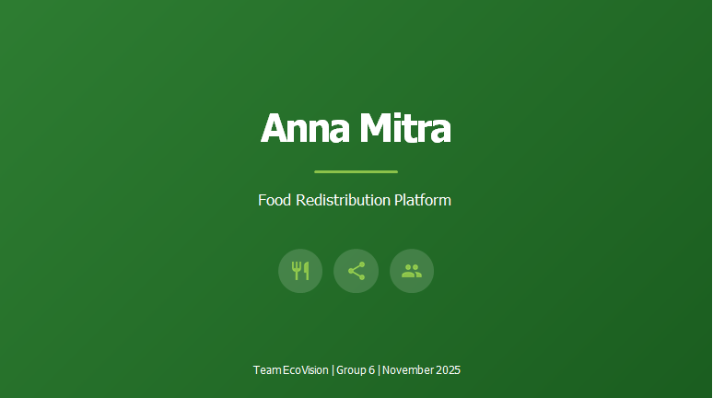










Annamitra
Anna Mitra
Team Details
UI/UX Designers
Business Analyst
Team Leader & Scrum Master
Rajvi Dhameliya (202412018)
Kashish Khubchandani (202412034)
Mohit Pipaliya (202412072)
Kashish Khubchandani (202412034)
Product Owner
Kashish Sorathiya (202412035)
Solution Architect
Anirudh Lohiya (202412074)
DevOps Engineer
Mohit Pipaliya (202412072)
Frontend Developers
Backend Developers
Technical Writer
Honey Patel (202412067)
Hardip Muliyashiya (202412021)
Rajvi Dhameliya (202412018)
Bhumi Vyas (202412123)
Aakash Odedara (202412053)
Kashish Sorathiya (202412035)
Group 6

Slide 2
Introduction
A digital platform connecting donors, NGOs, and administrators to streamline
food donation.
Ensures efficient food distribution by reducing wastage and feeding those in need.
Provides real-time donation tracking and status updates to all users.
Supports role-based access for donors, NGOs, and admins with secure authentication.
Automates notifications for donation status, approvals, and feedback.
Includes feedback and inquiry modules to improve transparency and engagement.
Built with a focus on scalability, usability, and social impact.

Slide 3
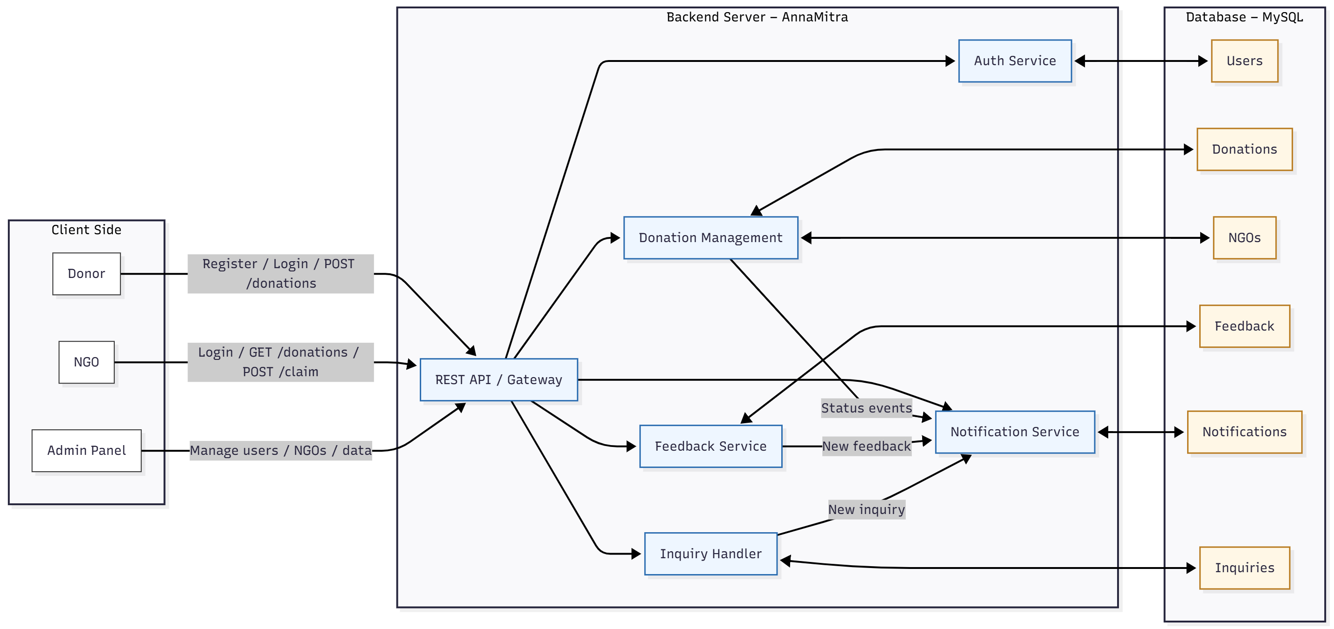
System Design

Slide 4
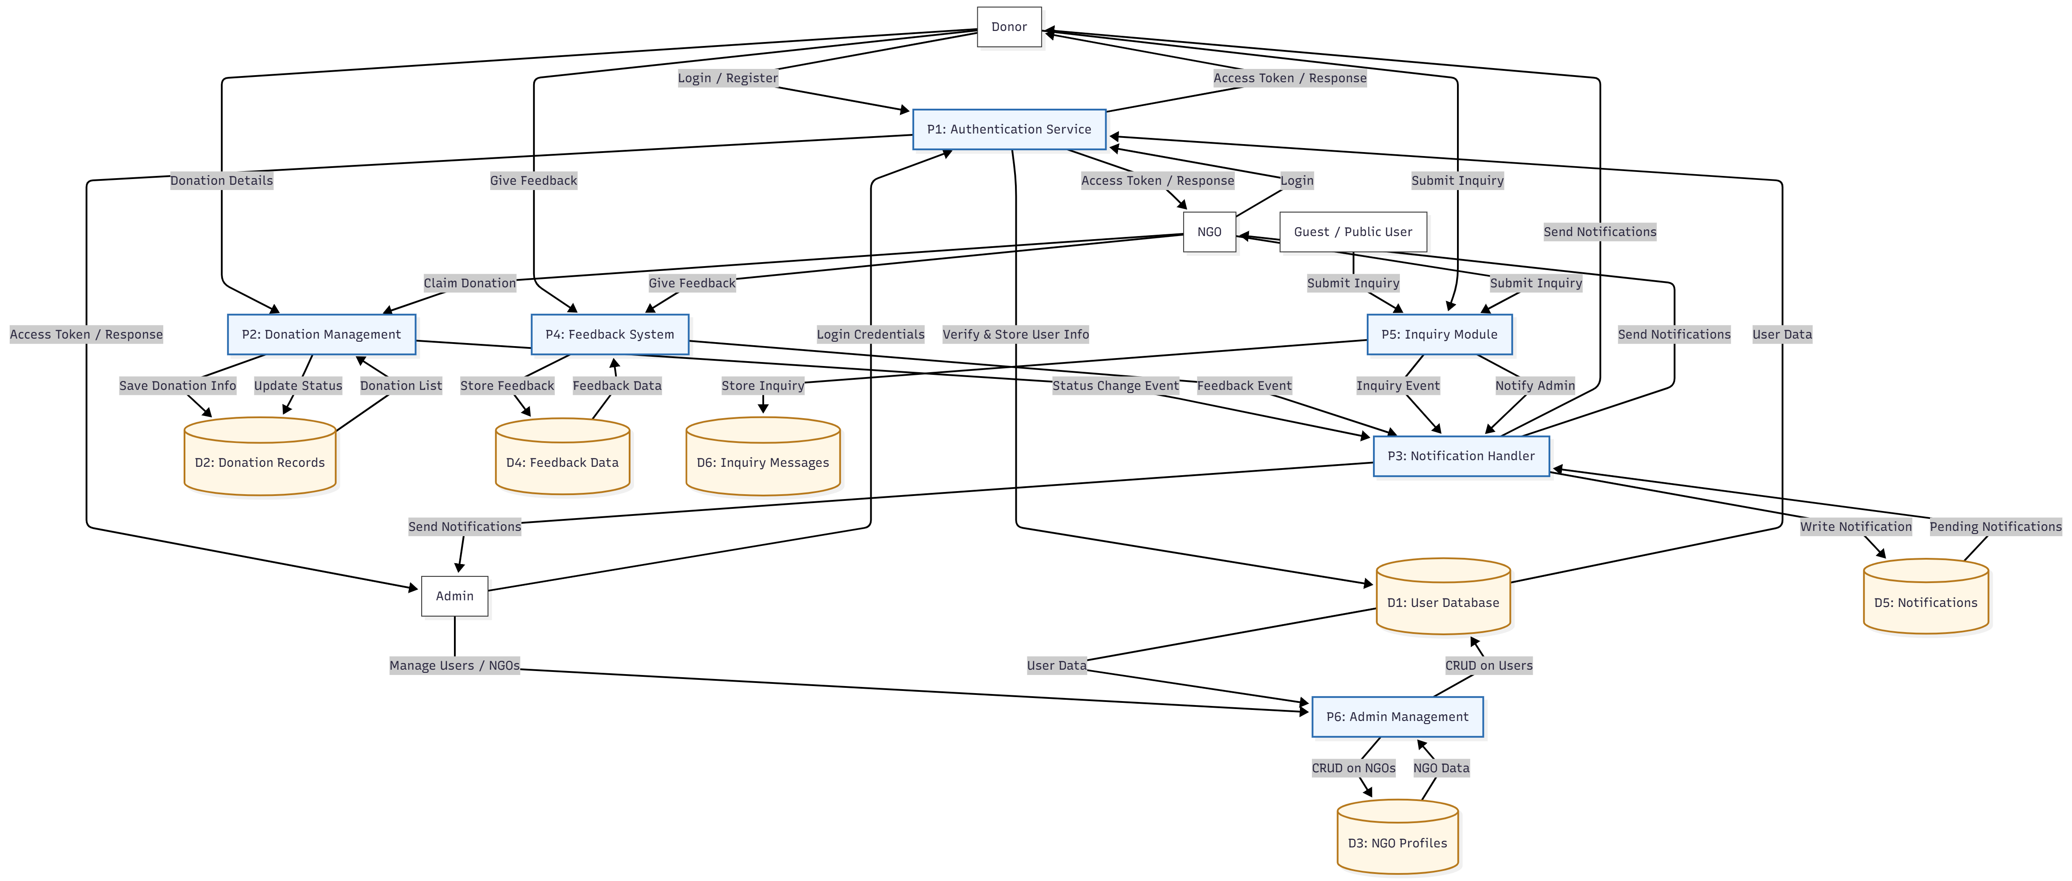
Data Flow Diagram

Slide 5
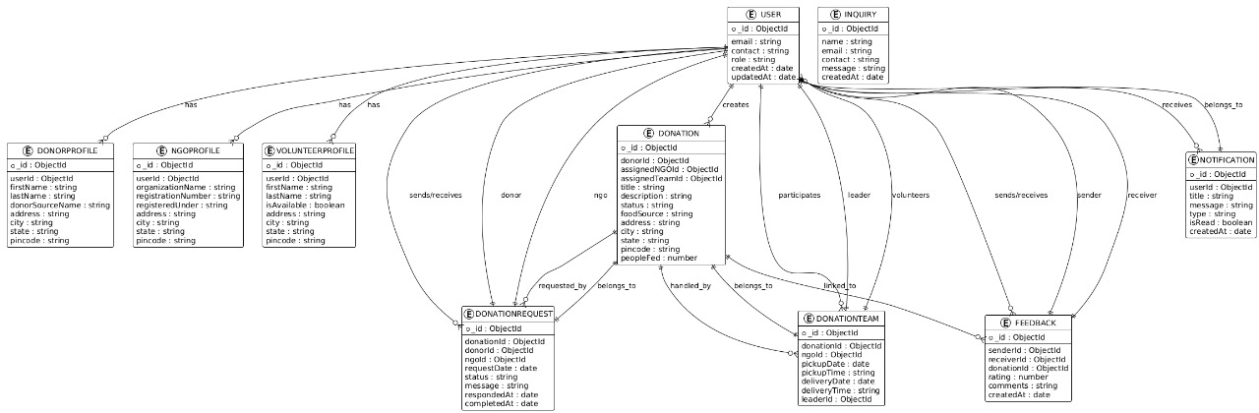
ER Diagram

Slide 6
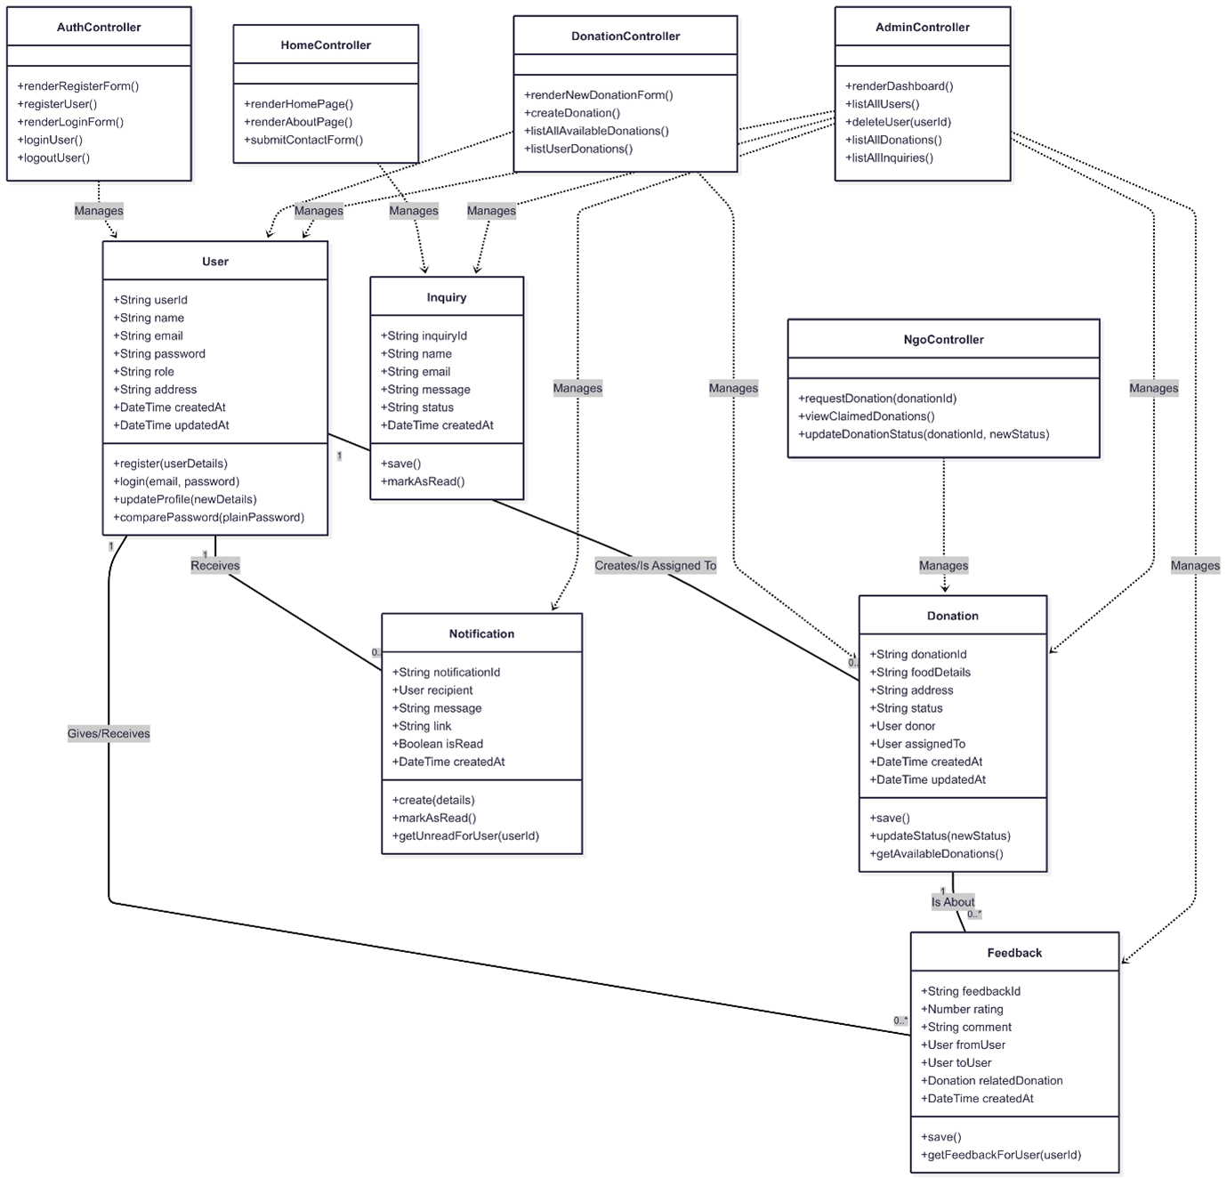
Class Diagram

Slide 7



Schema Design
Core Relationships
Key Entities
Design Principles
User: donors, NGOs, admins (role-based)
User creates Donation (1:N)
3NF: attributes depend on the key, the whole key, and nothing but the key
NGO: organizational profile (optionally mapped to a User)
NGO assigned to Donation (1:N; nullable until claimed)
Status enums: Donation(AVAILABLE,REQUESTED,PICKED_UP,COMPLETED,CANCELLED)
Donation: food listing + lifecycle status
Status enums: Inquiry(OPEN,RESOLVED,CLOSED)
User writes Feedback for Donation to another User
Timestamps: created_at, updated_at; server-generated
Feedback: rating/comment from one user to another for a donation
FK rules: ON UPDATE CASCADE; deletes restricted if historical data exists
User receives Notifications (1:N)
Indexes: users.email (unique), donations.status, donations.created_at, notifications.user_id,is_read, feedback.donation_id, ngo.name
Notification: system messages to users
User submits Inquiry (1:N; allow guest rows if needed)
Inquiry: contact/support requests

Slide 8
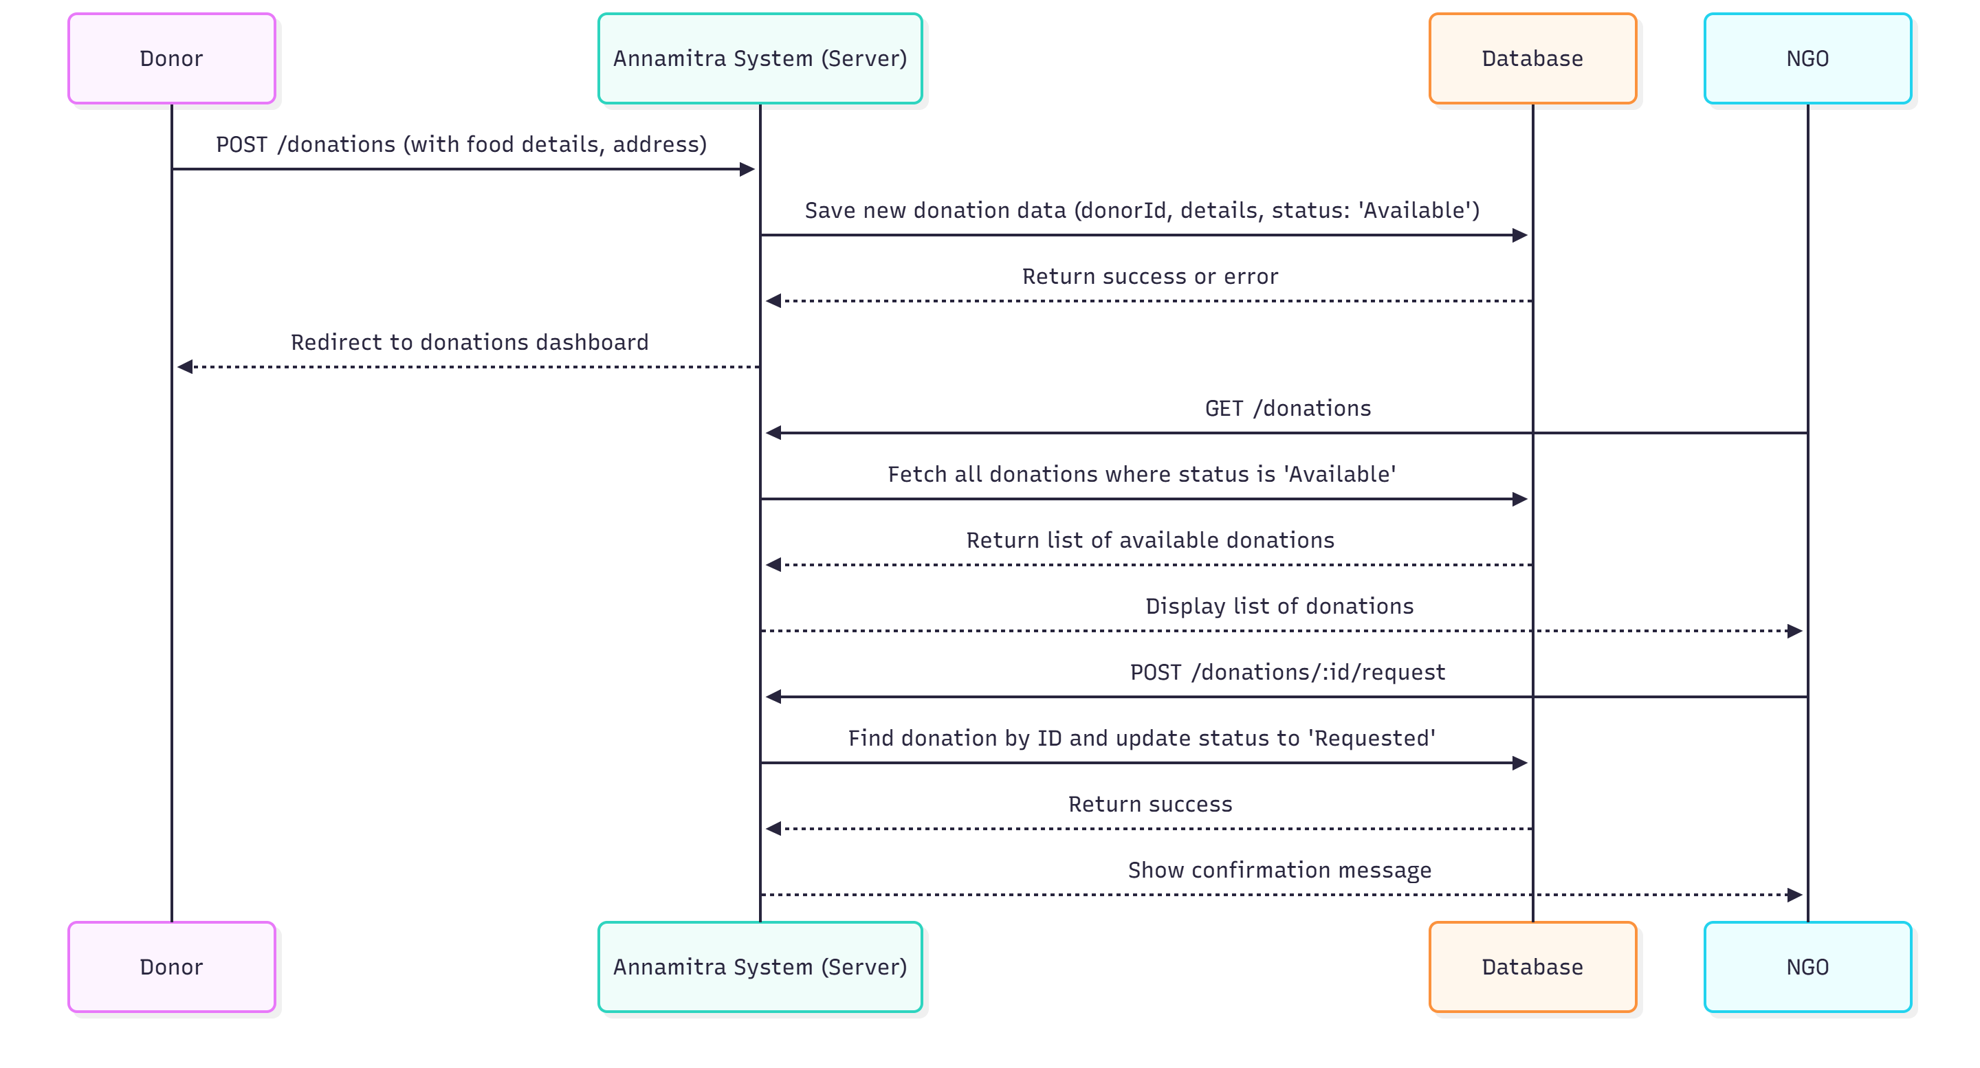
Sequence Diagram

Slide 9


Design Patterns
Builder Pattern
Prototype Pattern
Creates complex objects step by step, allowing flexibility in construction
Creates new objects by copying existing ones instead of creating from scratch
Usage in AnnaMitra:
Usage in AnnaMitra:
Building donation forms with multiple optional fields (food type, quantity, expiry time, pickup address) before creating the final donation object
When a donor wants to "repeat" or "clone" a previous donation entry — system duplicates old donation data and allows modification of small details (like pickup time)

Slide 10


Design Patterns
Facade Pattern
Observer Pattern
Provides a simplified interface to complex subsystems
Defines one-to-many relationship for automatic notifications when state changes
Usage in AnnaMitra:
Usage in AnnaMitra:
Backend services like NotificationService that hide complexity of sending emails, in-app alerts, and database updates through a single unified interface
When a donor updates donation status or NGO accepts a request, all related users (volunteers, NGOs, donors) receive real-time updates automatically

Slide 11



Thank You
"
Alone we can do so little; together we can do so much.
Helen Keller
Thank You

