Slide 1
Towards a common OMG Risk Metamodel
Input to Threat Modeling Project discussion 21-04-2014
Dr. Nikolai Mansourov, CTO KDM Analytics

Slide 2
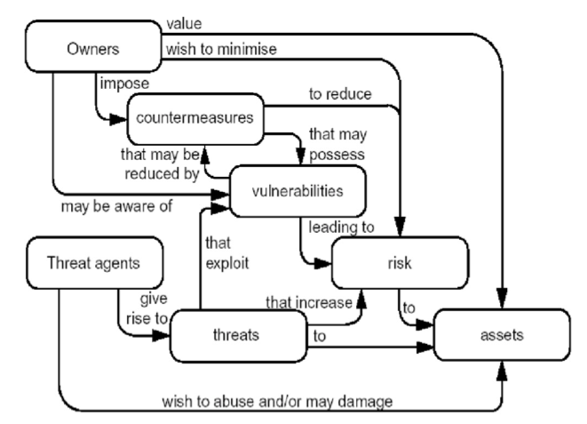
What is security risk ? (ISO 15408)

Slide 3
Justifiable Risk Assurance
Assurance Case is related to the level of risk
System Model
e.g. DoDAF views
Observations
Assurance Case is structured according to
System Model
System Model constrains evidence
Assurance Case is structured according
to Risk Metamodel
Risk Report / Risk Manage-ment
Plan
Risk Metamodel describes evidence
Assurance Case
Evidence
Risk Metamodel
Assurance Case
structures
report
Evidence justifies claims
Assurance Process defines
the steps to collect
evidence
Assurance Process delivers assurance case
(argument + evidence)
Assurance Process
Risk Metamodel provides guidance
on how to collect evidence
Assurance Case
provides guidance on how to collect evidence
Assurance Process
Generic
guidance & tool
Report
Data specific to system

Slide 4
Overview of the Risk Metamodel
Who cares ?
To what ?
Owners and criteria
Assets and Targets
Identified Risks
How severe/ So what ?
How likely ?
Undesired events
Attack scenarios
What to do about it ?
Controls, mitigation options

Slide 5
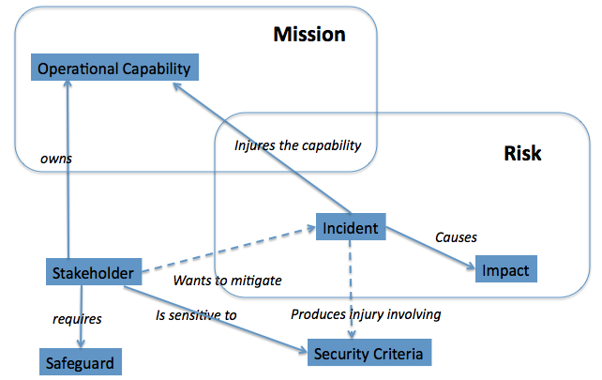
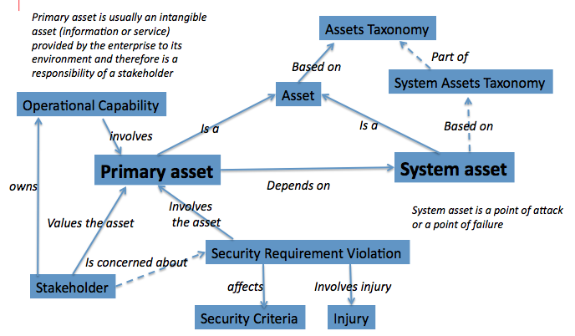
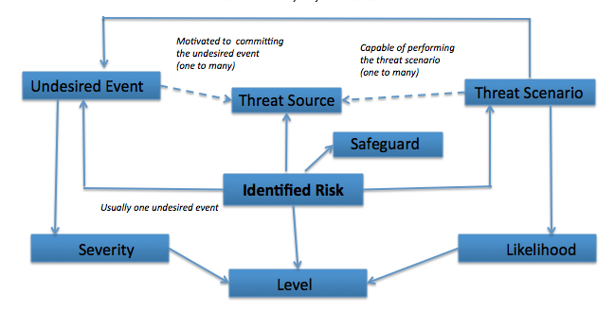
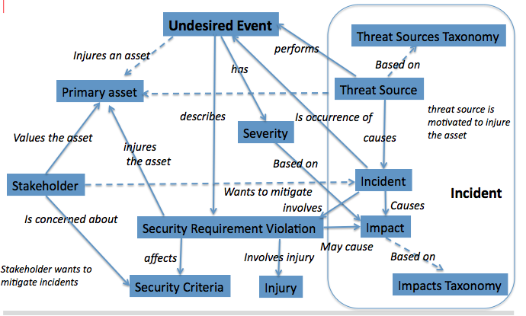
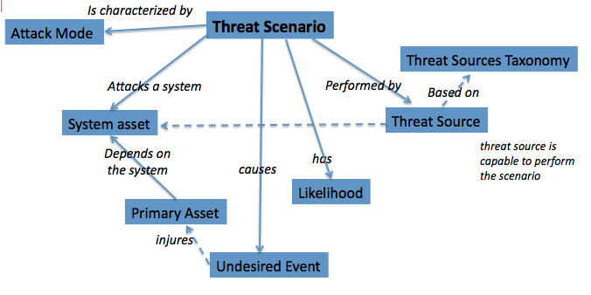
Overview of the Risk Metamodel
Owners and criteria
Assets and Targets
Identified risks
Controls,
Mitigation options
Undesired events
Attack scenarios

Slide 6
Analysis of Risks is based on the following model
has
Disposition

Slide 7
Analysis of the operational context is based on the following model
Mission
Operational Capability
Injures the capability
owns
Threat Source
causes
Risk
Incident
aka “Owner”
Causes
Stakeholder
Impact
Wants to mitigate
requires
Is sensitive to
Produces injury involving
Safeguard
Security Criteria

Slide 8
Analysis of System Facts is aligned with Business Models
Mission
Enterprise
provides
consists of
Operational Capability
Performer
implements
implements
P01 – Wireshark Node
P02 - Analyst
P03 – Network
P04 – Network User
P05 – Stored capture files
P06 - Admin
Operational Activity
OA01 – Configure Network Interfaces
OA02 - Start Capture
OA03 – Stop Capture
OA04 – Save Capture Trace
OA05 – Analyze Trace
OA06 – Open Capture Trace
OA07 – Annotate Trace
OA08 – Send Network Packet
OA09 – Receive Network Packet
OA10 – Tap Network Packet
OA11 – Dissect Network Packet
OA12 – Add Network Packet to Trace
OA13 – Manage Network

Slide 9
Analysis of Assets is based on the following model
Primary asset is usually an intangible asset (information or service) provided by the enterprise to its environment and therefore is a responsibility of a stakeholder
Assets Taxonomy
Part of
Based on
System Assets Taxonomy
Asset
Operational Capability
Is a
Is a
Based on
involves
Primary asset
System asset
owns
Depends on
Involves the asset
System asset is a point of attack or a point of failure
Values the asset
Sensitivity
Is concerned about
Stakeholder
affects
Involves injury
Security Criteria
Injury

Slide 10
Analysis of the operational context is based on the following model
Mission
Operational Capability
OC1 - Capture packets
OC2 - Analyze & display packets
OC3 – Export & import packets
OC4 – Exchange packets
OC5 – Manage network
Injures the capability
owns
Threat Source
causes
Risk
Incident
Causes
ST1 – Chief Security Officer
ST2 - Law Enforcement Officer
ST3 – Chief Information Officer
ST4 – Network Manager
Impact
Stakeholder
Wants to mitigate
requires
Is sensitive to
Produces injury involving
Confidentiality
Integrity
Availability
Safeguard
Security Criteria

Slide 11
Analysis of Undesired Events is based on the following model
Undesired Event
Threat Sources Taxonomy
Injures an asset
performs
has
Based on
Primary asset
Threat Source
describes
Is occurrence of
threat source is motivated to injure the asset
Values the asset
Severity
causes
injures the asset
Based on
Stakeholder
Incident
Wants to mitigate
Incident
Causes
Is concerned about
involves
Sensitivity
Impact
involves
affects
Involves injury
Based on
Stakeholder wants to mitigate incidents
Security Criteria
Injury
Impacts Taxonomy

Slide 12
Analysis of Attack Groups is based on the following model
Is characterized by
Attack Mode
Threat Scenario
Threat Sources Taxonomy
Attacks a performer
Performed by
Based on
Performer
Threat Source
Depends on the performer
has
threat source is capable to perform the scenario
causes
Attack Group
Likelihood
Primary Asset
injures
Undesired Event
Attack Group considers a single entry point; This is a class of attacks
Threat Scenarios within the Attack Group describe various multi-stage attacks;
In a simple case Attack Group involves a single Threat Scenario

Slide 13
Analysis of Safeguards is based on the following model
reduces
Risk
Safeguard
has
mitigates
Confidence Level
System Vulnerability
involves
Performer
is a
reduces
Existing Safeguard
Original Risk
Threat Scenario within an Attack Group describes a multi-stage attack that involves multiple Performers;
A Safeguard prevents an attack from succeeding;
A System Vulnerability is a condition involving a certain Performer that
enables the attack and permit it to propagate and eventually cause an undesired event

Slide 14
Analysis of System Vulnerabilities is based on the following model
System Vulnerability
involves
exploits
Performer
Threat Source
threat source is capable to perform the scenario
has
enables
Vulnerability Level
Threat Scenario
Threat Scenario within an Attack Group describes a multi-stage attack that
involves multiple Performers;
A System Vulnerability is a condition involving a certain Performer that
enables the attack and permit it to propagate and eventually cause an undesired event

Slide 15
Risk Mitigation Analysis is based on the following model
reduces
Risk
Safeguard
has
mitigates
Confidence Level
has
System Vulnerability
Cost
is a
involves
reduces
Residual Risk
Performer
Recommended Safeguard
part of
Mitigation Option
Threat Scenario within an Attack Group describes a multi-stage attack that involves multiple Performers;
A Safeguard prevents an attack from succeeding;
A System Vulnerability is a condition involving a certain Performer that
enables the attack and permit it to propagate and eventually cause an undesired event

Slide 16
Taxonomy of threat sources in scope
Threat Sources
Human
Non-Human
Malicious
Non-Malicious
Malicious
Non-Malicious
Internal
External
Internal
External
Limited
Capability
Unlimited
Capability
Limited
Capability
Unlimited
Capability
Limited
Capability
Unlimited
Capability
Limited Capability
Unlimited
Capability
High Capability
High Capability
High Capability
High Capability

Slide 17
Taxonomy of Assets
Asset
Tangible Assets
People
Intangible Assets
Facilities
Negotiable Instruments
Materials
Hardware
Firmware
Software
Processes
Information
Security Devices
Others
Services
External
Internal
Competitive Advantage
Organization Credibility
Product Identity
Public Confidence & Trust
Morale
Management Credibility
Employee Confidence & Trust
Based on HTRA

Slide 18
Analysis of Assets is based on the following model
Primary asset is usually an intangible asset (information or service) provided by the enterprise to its environment and therefore is a responsibility of a stakeholder
Assets Taxonomy
Part of
Based on
System Assets Taxonomy
Asset
Operational Capability
Is a
Is a
Based on
involves
Primary asset
System asset
owns
Depends on
Involves the asset
CA1 - Network packets
CA2 - Wireshark node
CA3 – Network
CA4 – Other information assets
CA5 – Knowledge of the capture
SS1 – Wireshark executable
SS2 - Wireshark code
SS3 – Wireshark COTS
SS4 – System software
SS5 – Stored files
SS6 - Network
System asset is a point of attack or a point of failure
Values the asset
Sensitivity
Is concerned about
Stakeholder
affects
Involves injury
Security Criteria
Injury

Slide 19
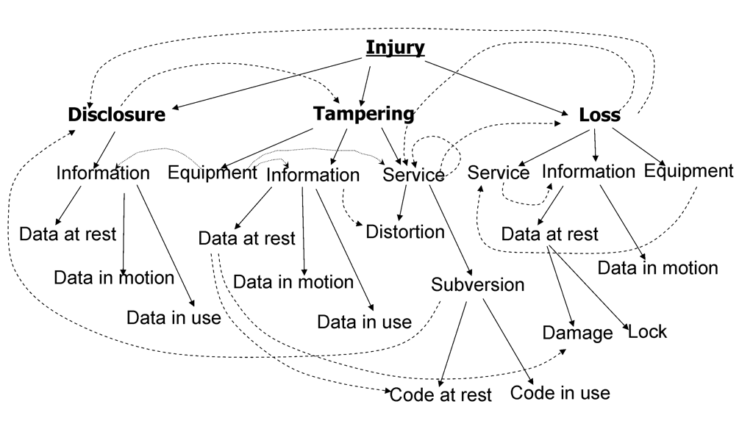
Taxonomy of injuries for cyber security
Data in use

Slide 20
Analysis of Undesired Events is based on the following model
Undesired Event
Threat Sources Taxonomy
Injures an asset
performs
has
Based on
UE1 – Loss of availability of network
UE2 - Disclosure of other assets
UE3 - Subversion of Wireshark node
UE4 - Loss of availability of packets
UE5 – Disclosure of packet data
UE6 – Disclosure of capture
UE7 – Loss of availability of other assets
Primary asset
Threat Source
describes
Is occurrence of
threat source is motivated to injure the asset
Values the asset
Severity
causes
injures the asset
Based on
Stakeholder
Incident
Wants to mitigate
Incident
Causes
Is concerned about
involves
Sensitivity
Impact
involves
affects
Involves injury
Based on
Stakeholder wants to mitigate incidents
Security Criteria
Injury
Impacts Taxonomy

Slide 21
Cause and effect in a risk statement
Loss of confidentiality of confidential assets
What?
Security criterion
Primary asset: sensitivity subject &
attack goal
Undesired event
Threat source
Injury
R01 Hacker gains access to confidential assets by information gathering on stored files
Threat scenario
information gathering on stored files
How?
Attack mode
System asset: attack target

Slide 22
Attack Groups
Attack Groups
Abuse of Wireshark node
Damage to the Wireshark node
Exceeding capacity of the Wireshark Node
Modification of the Wireshark Code
Information Gathering on Wireshark Code
Information Gathering on Stored Files
…
Attack modes
Abuse
Exceeding capacity
Damage
Loss
Modification
Information Gathering
Note: Attack Groups can be systematically enumerated as a product of attack modes and systems (performers, entry points);
this is a controlled brainstorming approach

Slide 23
Analysis of Threat Scenarios is based on the following model
Is characterized by
Attack Mode
Threat Scenario
Threat Sources Taxonomy
Attacks a performer
Performed by
Based on
Performer
Threat Source
Depends on the performer
has
threat source is capable to perform the scenario
causes
Attack Group
Likelihood
Primary Asset
injures
Undesired Event
Attack Group considers a single entry point; This is a class of attacks.
Threat Scenarios within the Attack Group describe various multi-stage attacks;
Analysis of Threat Scenarios is about connecting to impacts ( the “How” to the “What”)

Slide 24
Analysis of Threat Scenarios is based on the following model
Is characterized by
Attack Mode
Threat Scenario
Threat Sources Taxonomy
TS1.1 - Loss of stored files
TS1.2 – Local damage to system software
TS1.3 – Remote damage to system software
TS1.4 – Local damage to Wireshark code
TS1.5 – Remote damage to Wireshark code
TS1.6 – Local damage to Wireshark COTS
TS1.7 – Damage to Wireshark executable
TS2.1 – Modification of stored files
TS2.2 – Local abuse of system software
TS2.3 – Remote abuse of system software
TS2.4 – Local abuse of Wireshark software
TS2.5 – Remote abuse of Wireshark software
TS2.6 – Local abuse of Wireshark COTS
TS2.7 – Remote abuse of Wireshark COTS
TS2.8 – Modification of Wireshark executable
TS3.1 – Information gathering on Wireshark code
TS3.2 – Information gathering on stored files
Attacks a system
Performed by
Based on
Performer
Threat Source
Depends on the system
threat source is capable to perform the scenario
has
causes
Attack Group
Likelihood
Primary Asset
injures
Undesired Event

Slide 25
Results of justifiable risk analysis (1 of 2)
ID | Description | Severity | Likeli-hood | Level | Resi-dual | Confi-dence
R01 | Hacker gains access to confidential assets by information gathering on stored files | high | high | high | low | 80%
R02 | Targeted virus or timebomb affects integrity or availability of network by attacking wireshark executable | high | high | high | low | 80%
R03 | Hacker subverts wireshark node by remote attack exploiting vulnerabilities in Wireshark code | high | medium | high | low | 80%
R04 | Hacker subverts wireshark node by remote attack exploiting vulnerabilities in system software on wireshark node | high | medium | medium | low | 80%
R05 | Criminal leans about forensic activity by attacking wireshark executable | medium | high | medium | low | 80%
R06 | Targeted virus or timebomb affects availability of other assets by attacking wireshark executable | medium | high | medium | low | 80%
R07 | Malicious user subverts wireshark node by locally attacking wireshark code | medium | low | medium | low | 70%
R08 | Malicious user subverts wireshark node by locally attacking system software on wireshark node | medium | low | medium | low | 70%
R09 | Criminal forces wireshark to miss packets by attacking wireshark executable | medium | high | medium | low | 70%

Slide 26
Anatomy of a risk statement
Threat source
Primary asset (attack goal)
Injury
Undesired event
R01 Hacker gains access to confidential assets by information gathering on stored files
Threat scenario
Attack mode
System asset (attack target)

Slide 27
Cause and effect in a risk statement
Loss of confidentiality of confidential assets
What?
Security criterion
Primary asset: sensitivity subject &
attack goal
Undesired event
Threat source
Injury
R01 Hacker gains access to confidential assets by information gathering on stored files
How?
Attack mode
System asset (attack target)
Threat scenario

Slide 28
Risk analysis
What?
High
Med
High
High
Impact Rating
Risk Level
Med
Med
Med
High
Low
Low
Med
Med
Low Med High
Likelihood Rating
How?
Risk= ∫(Severity, Likelihood)

