Slide 1
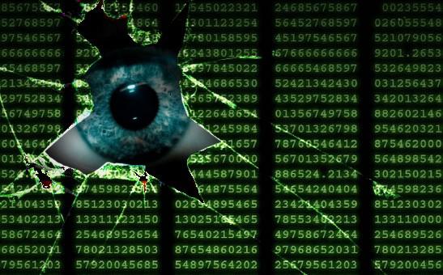
UNCLASSIFIED
The Need: Thwarting the adversary by analyzing Cyber behaviors
UNCLASSIFIED

Slide 2
Why Cyber is Integral?
Unclassified
President’s Comprehensive National Cybersecurity Initiative
Develop and implement a government-wide cyber counterintelligence (CI) plan
ONCIX CI Strategy: Detect and Counter FISS Cyber
Unifying Intelligence Strategy for Cyber, 11 Mar 2013
Cyber Intelligence must be presented in a holistic fashion (threat, vulnerability and value)
All-Source
Defense Science Board
Defense only is a failed strategy
Threat, Vulnerability and Consequence cannot be managed in isolation
Threat is broken into two categories: adversaries intent and their capabilities
Mr Clapper:
“In this [Cyber] threat environment, the importance and urgency of intelligence integration cannot be overstated.”
Gen Alexander:
“The theft of intellectual property is the biggest transfer of wealth in history, from this nation to others."
UNCLASSIFIED

Slide 3
(U) Cyber Espionage
UNCLASSIFIED
Communications
Email
Social Networking
Online Phone Calls
Blog and Vlog
Online Forums
Collection
Targeted Cyber Attack
Network Attack
Social Engineering
Cyber
Espionage
Techniques
Used
Spear Phishing
Malware
Spoofed Websites or Emails
Motivation
Saves Money in R&D
Technology Advancement
Profit
Power
UNCLASSIFIED
UNCLASSIFIED

Slide 4
Anatomy of the Acquisition Cycle
Planning
Targeting
Design
Logistics
Weaponization
Exercise
Plan on how to act on their motivation and intent.
Target victims, whether by sector, or technology hardware or software, or some combination of factors.
Design tactics, techniques, and procedures they will employ during their attack.
Logistics for acquiring funding for time and resources, leveraged infrastructures, and other supporting elements such as people or technology needed for the attack.
Weaponization is the act of developing a set of weapons
Exercise to test and practice to ensure it actually works with at least some degree of certainty.
HUMINT
Cyber
Blended
Financial
Supply Chain
Cleared Contractor
Sub Contractor
Research Lab
Academia
Spear Phishing
Malware
Spoofed Websites or Emails
Knowledge
Manpower
TIME
Exploit the vulnerability
Network
Extranet
VPN
Human
Sandbox
Third Party/ private user
40%
30%
20%

Slide 5
Mutually Supportive Missions
Counterintelligence
Defense
Cyber Intel (CI)
Network Defense (IA)
Cyber-Informed Intel
Network Defense (IA)

Slide 6
(U) Using Cyber to our Advantage
UNCLASSIFIED
(U) Landscape:
(U) Network defense is one part of the strategy
(U) Threats begin and end with a human
(U) Cyber intelligence must be presented in a holistic fashion (threat, vulnerability and value)
(U) 70% of all counterintelligence case referrals by DSS involve cyber activity
(U) Anticipatory Analysis:
(U) Left of the cyber “boom;” get ahead of the threat
(U) The infectious spread? The “spider web” in cyberspace interconnected
(U) Indicators begin with: cyber incident and/or consequence/value
(U) Many Sensors/Many data elements
UNCLASSIFIED

Slide 7

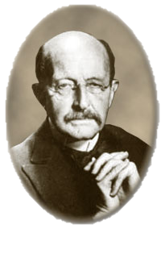
UNCLASSIFIED
Questions?
When you change the way you look at things, the things you look at change.
– Max Planck (Nobel Physicist)
UNCLASSIFIED

Slide 8
UNCLASSIFIED
Questions
UNCLASSIFIED

