Slide 1



Object Management Group Technical Meeting
Managing Security Risk
In a World of Complex Systems and IT Infrastructures

Slide 2
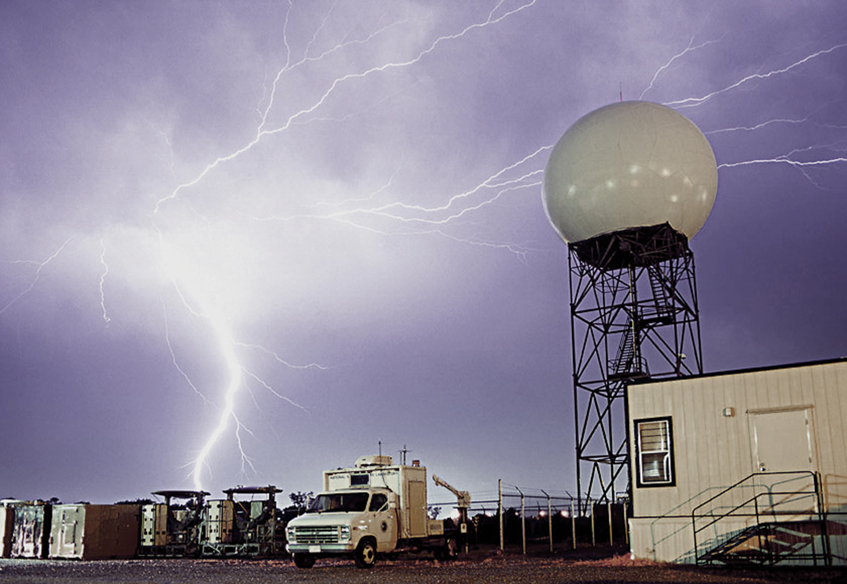
Classes of Vulnerabilities
A 2013 Defense Science Board Report described—
Tier 1: Known vulnerabilities.
Tier 2: Unknown vulnerabilities (zero-day exploits).
Tier 3: Adversary-created vulnerabilities (APT).
A significant number of vulnerabilities
are “off the radar”
of many organizations…

Slide 3

Which Road to Follow?
Good cyber hygiene
is necessary…
But not sufficient.
You can’t count, configure, or patch your way out of this problem space.
Difficult decisions ahead.

Slide 4

The hard cybersecurity problems are buried below the water line…
In the hardware, software, and firmware.

Slide 5

The argument for building stronger, more resilient
information systems…
Software assurance.
Systems security engineering.
Supply chain risk management.

Slide 6

Getting the attention of the C-Suite.
If you are not solving the right problems, you cannot effectively manage security risk.

Slide 7

TACIT Security
Threat
Assets
Complexity
Integration
Trustworthiness
merriam-webster dictionary
tac.it adjective
: expressed or understood
without being directly stated

Slide 8

Threat
Develop a better understanding of the modern threat space, including the capability of adversaries to launch sophisticated, targeted cyber-attacks that exploit specific organizational vulnerabilities.
Obtain threat data from as many sources as possible.
Include external and insider threat analysis.

Slide 9
Assets
Conduct a comprehensive criticality analysis of organizational assets including information and information systems.
Focus on mission/business impact.
Use triage concept to segregate assets by criticality.

Slide 10
Complexity
Reduce the complexity of the information technology infrastructure including IT component products and information systems.
Employ enterprise architecture to consolidate, optimize, and standardize the IT infrastructure.
Adopt cloud computing architectures to reduce the number of IT assets through on-demand provisioning of services.

Slide 11
Integration
Integrate information security requirements and the security expertise of individuals into organizational development and management processes.
Embed security personnel into enterprise architecture, systems engineering, SDLC, and acquisition processes.
Coordinate security requirements with mission/business owners; become key stakeholders.

Slide 12
Trustworthiness
Invest in more trustworthy and resilient information systems supporting organizational missions and business functions.
Isolate critical assets into separate enclaves.
Implement solutions using modular design, layered defenses, component isolation.

Slide 13
Summary – TACIT Security
Understand the cyber threat space.
Conduct a thorough criticality analysis of organizational assets.
Reduce complexity of IT infrastructure.
Integrate security requirements into organizational processes.
Invest in trustworthiness and resilience of IT components and systems.

Slide 14
Risk Management Approach Frame – Assess – Respond – Monitor
Communicating and sharing risk-related information from the strategic to tactical level, that is from the executives to the operators.
Communicating and sharing risk-related information from the tactical to strategic level, that is from the operators to the executives.
TIER 1
Organization
(Governance)
TIER 2
Mission / Business Process
(Information and Information Flows)
TIER 3
Information Systems
(Environment of Operation)

Slide 15
Risk Management Framework
Starting Point
CATEGORIZE Information System
Define criticality/sensitivity of information system according to potential worst-case, adverse impact to mission/business.
MONITOR
Security Controls
SELECT Security Controls
Continuously track changes to the information system that may affect security controls and reassess control effectiveness.
Select baseline security controls; apply tailoring guidance and supplement controls as needed based on risk assessment.
Security Life Cycle
AUTHORIZE Information System
IMPLEMENT Security Controls
Determine risk to organizational operations and assets, individuals, other organizations, and the Nation;
if acceptable, authorize operation.
Implement security controls within enterprise architecture using sound systems engineering practices; apply security configuration settings.
ASSESS
Security Controls
Determine security control effectiveness
(i.e., controls implemented correctly, operating as intended, meeting security requirements for information system).

Slide 16
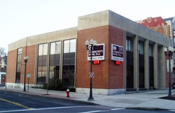



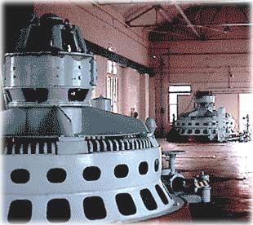
Joint Task Force Risk Management Toolset
NIST Special Publication 800-39
Managing Information Security Risk:
Organization, Mission, and Information System View
NIST Special Publication 800-30
Guide for Conducting Risk Assessments
NIST Special Publication 800-37
Applying the Risk Management Framework
to Federal Information Systems
NIST Special Publication 800-53
Security and Privacy Controls for Federal
Information Systems and Organizations
NIST Special Publication 800-53A
Guide for Assessing the Security Controls
in Federal Information Systems and Organizations

Slide 17

On the Horizon…
NIST Special Publication 800-160
Systems Security Engineering
An Integrated Approach to Building Trustworthy Resilient Systems

Slide 18
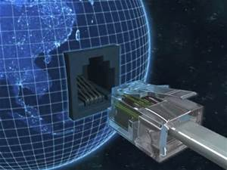
Building on International Standards
Stakeholder requirements definition.
Requirements analysis.
Architectural design.
Implementation.
Integration.
Verification.
Transition.
Validation.
Operation.
Maintenance.
Disposal.
Integrating the RMF and security concepts, principles, and best practices into IEEE/ISO/IEC 15288
Systems and software engineering — System life cycle processes

Slide 19
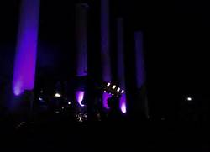
Security must be a by-product of good design and development practices.

Slide 20
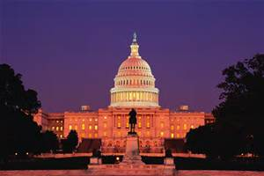
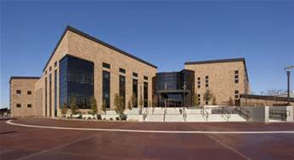

Government
Academia
Cybersecurity is a team sport.
Industry

Slide 21
Contact Information
100 Bureau Drive Mailstop 8930
Gaithersburg, MD USA 20899-8930
Project Leader Administrative Support
Dr. Ron Ross Peggy Himes
(301) 975-5390 (301) 975-2489 ron.ross@nist.gov peggy.himes@nist.gov
LinkedIn
http://www.linkedin.com/in/ronrossnist
Senior Information Security Researchers and Technical Support
Pat Toth Kelley Dempsey
(301) 975-5140 (301) 975-2827
patricia.toth@nist.gov kelley.dempsey@nist.gov
Web: csrc.nist.gov Comments: sec-cert@nist.gov

