Slide 1
Towards a common OMG Risk Metamodel
Input to Threat Modeling Project discussion 21-04-2014
Dr. Nikolai Mansourov, CTO KDM Analytics

Slide 2
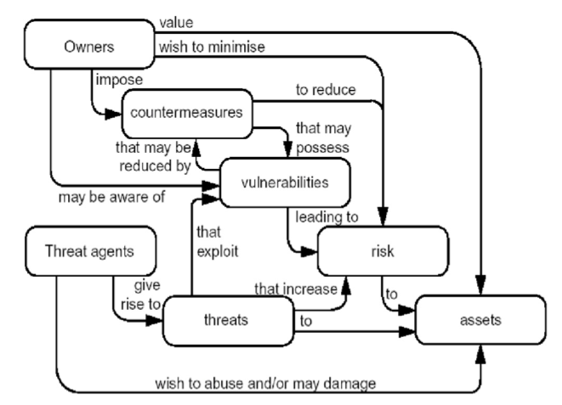
What is security risk ? (ISO 15408)

Slide 3
Existing Threat and Risk Analysis methodologies
ISO/IEC 13335
ISO/IEC 15408
ISO/IEC 15443
ISO/IEC 27001
CRAMM (UK)
EBIOS (France)
Mehari (France)
Magerit (Spain)
HTRA (Canada)
NIST SP-800-30 (US)
Octave (SEI CMU)
RiskAn (Czech Rep)
Microsoft Threat Analysis Methodology
Open Group FAIR
& others
Challenges:
no interoperability;
few approaches deal with discernable concepts
3) few approaches are systematic enough
to provide assurance

Slide 4
Claude Langton: But I haven’t heard anything about a murder.
Hercule Poirot: No, you would not have heard of it. Because, as yet, it has not taken place. You see, if one can investigate a murder before it happens, then one might even, well, a little idea . . . prevent it?
Agatha Christie, Poirot: The Wasp’s Nest

Slide 5
Sharing for reactive improvements of security
Past
Future
1
Now
Attack
Creating sharable content
system
2
Similar attack is mitigated
3
Indicators,
Patterns,
Courses of actions,
Other useful knowledge
4
Sharing
Mitigation

Slide 6
Sharing for proactive improvements of security
Past
Future
Now
1
Risk Assessment
system
Mitigation
Class of attacks is prevented
(hopefully before they have
ever happened)
2
3
Risk Assessment
Creating sharable content
4
5
Indicators,
Patterns,
Courses of actions,
Other useful knowledge
6
Mitigation
Sharing

Slide 7
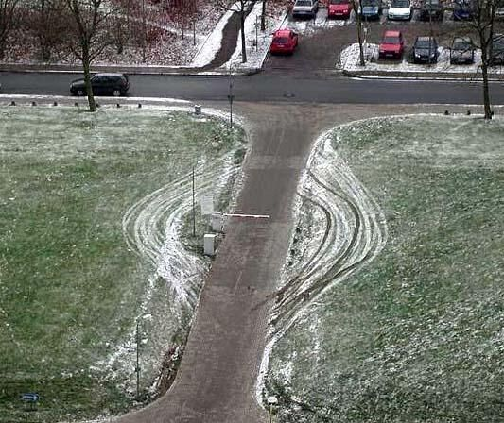
Failing to understand ALL risks …

Slide 8
3 types of useful shareable content
Assurance case templates,
Risk Metamodel,
Standard taxonomy of impacts, assets, threat agents, attacks, mitigations
UPDM
STIX
CVE
???
KDM
CAPEC
CWE
SFP
CybOX
Concrete, actionable
Knowledge of past incidents
Must be timely, latest-greatest,
Case-based
Concrete knowledge related to systems and their operational context
Generic, analytical knowledge related to
Security risk assessments
- Must be comprehensive, helping identify ALL risks in a given system

Slide 9
Justifiable risk assurance = risk management + assurance case
Brief first pass, more details later, time permitting

Slide 10
Justifiable Risk Assurance
Assurance Case is related to the level of risk
Assurance Case is structured according
to Risk Metamodel
Assurance Case
Risk Metamodel
Assurance Process delivers assurance case
(argument + evidence)
Assurance Process
Risk Metamodel provides guidance
on how to collect evidence
Assurance Case
provides guidance on how to collect evidence
Assurance Process
Generic
guidance & tool
Report
Data specific to system

Slide 11
Justifiable Risk Assurance
Assurance Case is related to the level of risk
System Model
e.g. DoDAF views
Observations
Assurance Case is structured according to
System Model
System Model constrains evidence
Assurance Case is structured according
to Risk Metamodel
Risk Report / Risk Manage-ment
Plan
Risk Metamodel describes evidence
Assurance Case
Evidence
Risk Metamodel
Assurance Case
structures
report
Evidence justifies claims
Assurance Process defines
the steps to collect
evidence
Assurance Process delivers assurance case
(argument + evidence)
Assurance Process
Risk Metamodel provides guidance
on how to collect evidence
Assurance Case
provides guidance on how to collect evidence
Assurance Process
Generic
guidance & tool
Report
Data specific to system

Slide 12
Risk Report / Risk Manage-ment
Plan
Courses of Actions
Assurance Case

Slide 13
Tools, Interoperability, “Automated Everything”
Risk Management Vocabulary
Assurance Vocabulary
Risk Metamodel
Risk
Claim
CVE, CWE, CAPEC
Asset
Argument
Vulnerability Detection Vocabulary
Threat
Vulnerability
Evidence Item
SACM
Facts & Findings
Threat
Capability
Function
Module
Performer
Code
Vocabulary
Statement
System Architecture Vocabulary
Information Exchange
Router
Firewall
Network
Vocabulary
Host
UPDM
KDM, CybOX

Slide 14
Overview of the risk metamodel for justifiable risk assurance

Slide 15
Overview of the Risk Metamodel
Who cares ?
To what ?
Owners and criteria
Assets and Targets
Identified Risks
How severe/ So what ?
How likely ?
Undesired events
Attack scenarios
What to do about it ?
Controls, mitigation options

Slide 16
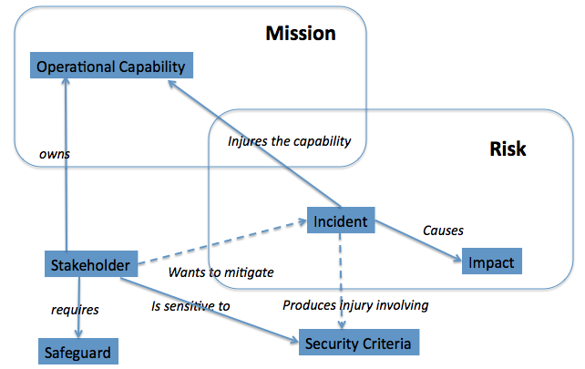
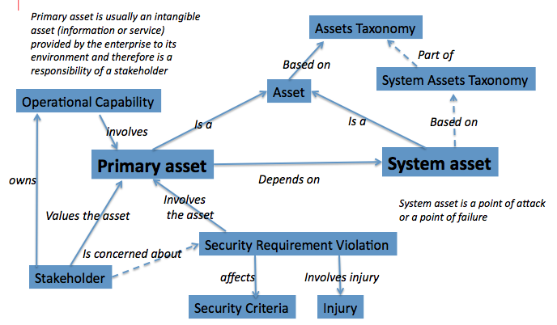
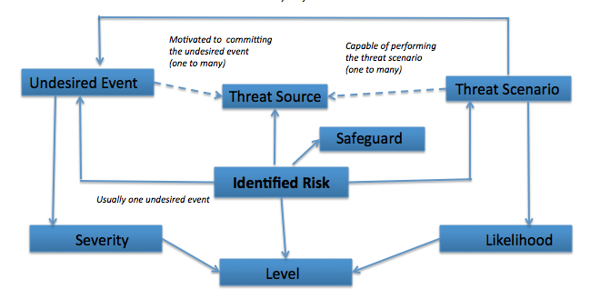
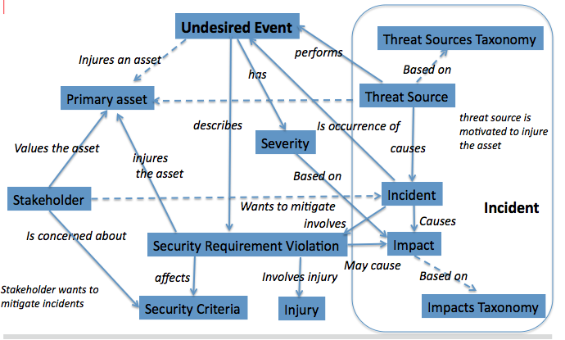
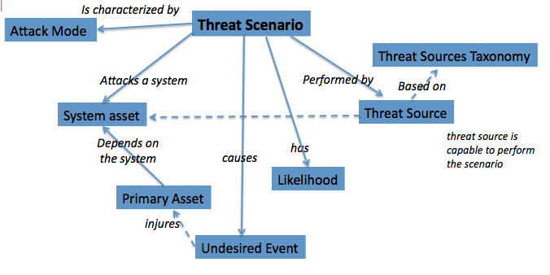
Overview of the Risk Metamodel
Owners and criteria
Assets and Targets
Identified risks
Controls,
Mitigation options
Undesired events
Attack scenarios

Slide 17
Our FORSA methodology
FORSA STEPS
FORSA:
- Fact Oriented
- Repeatable
- Security
- Assessment
Operational Context Identification
System Facts
Asset Identification
Undesired Event Identification
Attack Group Identification
Threat Scenario Analysis
Safeguard Identification
Vulnerability Analysis
Risk Identification
Risk Analysis
The sequence of
steps is designed to
increase confidence,
and therefore
increase assurance

Slide 18
Part 1: The Operational Context

Slide 19
FORSA STEPS
Operational Context Identification
System Facts
Asset Identification
Undesired Event Identification
Attack Group Identification
Threat Scenario Analysis
Safeguard Identification
Vulnerability Analysis
Risk Identification
Risk Analysis

Slide 20
Analysis of the operational context is based on the following model
Mission
Operational Capability
Injures the capability
owns
Threat Source
causes
Risk
Incident
aka “Owner”
Causes
Stakeholder
Impact
Wants to mitigate
requires
Is sensitive to
Produces injury involving
Safeguard
Security Criteria

Slide 21
Analysis of the operational context is based on the following model
Mission
Operational Capability
OC1 - Capture packets
OC2 - Analyze & display packets
OC3 – Export & import packets
OC4 – Exchange packets
OC5 – Manage network
Injures the capability
owns
Threat Source
causes
Risk
Incident
Causes
Stakeholder
Impact
Wants to mitigate
requires
Is sensitive to
Produces injury involving
Safeguard
Security Criteria

Slide 22
Analysis of the operational context is based on the following model
Mission
Operational Capability
OC1 - Capture packets
OC2 - Analyze & display packets
OC3 – Export & import packets
OC4 – Exchange packets
OC5 – Manage network
Injures the capability
owns
Threat Source
causes
Risk
Incident
Causes
ST1 – Chief Security Officer
ST2 - Law Enforcement Officer
ST3 – Chief Information Officer
ST4 – Network Manager
Impact
Stakeholder
Wants to mitigate
requires
Is sensitive to
Produces injury involving
Safeguard
Security Criteria

Slide 23
Analysis of the operational context is based on the following model
Mission
Operational Capability
OC1 - Capture packets
OC2 - Analyze & display packets
OC3 – Export & import packets
OC4 – Exchange packets
OC5 – Manage network
Injures the capability
owns
Threat Source
causes
Risk
Incident
Causes
ST1 – Chief Security Officer
ST2 - Law Enforcement Officer
ST3 – Chief Information Officer
ST4 – Network Manager
Impact
Stakeholder
Wants to mitigate
requires
Is sensitive to
Produces injury involving
Confidentiality
Integrity
Availability
Safeguard
Security Criteria

Slide 24
“Standard” Taxonomy of Impacts
Impact
Environmental
Financial
Legal
On Safety
On Mission
On Compliance
On Intellectual Property
On Image
On Morale
On Decision-making
Impacts are related to:
Identification of the primary assets
Injury and undesired events
Based on EBIOS and HTRA

Slide 25
Taxonomy of Impacts in scope
Impact
Environmental
Financial
Legal
On Safety
On Mission
On Compliance
On Intellectual Property
On Image
On Morale
On Decision-making
Impacts are related to:
Identification of the primary assets
Injury and undesired events

Slide 26
“Standard” Taxonomy of threat sources
Threat Sources
Human
Non-Human
Malicious
Non-Malicious
Malicious
Non-Malicious
Internal
External
Internal
External
Limited
Capability
Unlimited
Capability
Limited
Capability
Unlimited
Capability
Limited
Capability
Unlimited
Capability
Limited Capability
Unlimited
Capability
High Capability
High Capability
High Capability
High Capability
Based on EBIOS and HTRA

Slide 27
Taxonomy of threat sources in scope
Threat Sources
Human
Non-Human
Malicious
Non-Malicious
Malicious
Non-Malicious
Internal
External
Internal
External
Limited
Capability
Unlimited
Capability
Limited
Capability
Unlimited
Capability
Limited
Capability
Unlimited
Capability
Limited Capability
Unlimited
Capability
High Capability
High Capability
High Capability
High Capability

Slide 28
FORSA STEPS
Operational Context Identification
System Facts
Asset Identification
Undesired Event Identification
Threat Scenario Identification
Threat Scenario Analysis
Risk Identification
Safeguard Identification
Vulnerability Analysis
Risk Analysis

Slide 29
Analysis of System Facts is aligned with Business Models
Mission
Enterprise
provides
consists of
Operational Capability
Performer
implements
implements
Operational Activity

Slide 30
Analysis of System Facts is aligned with Business Models
Mission
Enterprise
provides
consists of
Operational Capability
Performer
implements
implements
P01 – Wireshark Node
P02 - Analyst
P03 – Network
P04 – Network User
P05 – Stored capture files
P06 - Admin
Operational Activity

Slide 31
Analysis of System Facts is aligned with Business Models
Mission
Enterprise
provides
consists of
Operational Capability
Performer
implements
implements
P01 – Wireshark Node
P02 - Analyst
P03 – Network
P04 – Network User
P05 – Stored capture files
P06 - Admin
Operational Activity
OA01 – Configure Network Interfaces
OA02 - Start Capture
OA03 – Stop Capture
OA04 – Save Capture Trace
OA05 – Analyze Trace
OA06 – Open Capture Trace
OA07 – Annotate Trace
OA08 – Send Network Packet
OA09 – Receive Network Packet
OA10 – Tap Network Packet
OA11 – Dissect Network Packet
OA12 – Add Network Packet to Trace
OA13 – Manage Network

Slide 32
Part 2: The Effect analysis

Slide 33
FORSA STEPS
Operational Context Identification
System Facts
Asset Identification
Undesired Event Identification
Attack Group Identification
Threat Scenario Analysis
Safeguard Identification
Vulnerability Analysis
Risk Identification
Risk Analysis

Slide 34
Analysis of Assets is based on the following model
Primary asset is usually an intangible asset (information or service) provided by the enterprise to its environment and therefore is a responsibility of a stakeholder
Assets Taxonomy
Part of
Based on
System Assets Taxonomy
Asset
Operational Capability
Is a
Is a
Based on
involves
Primary asset
System asset
owns
Depends on
Involves the asset
System asset is a point of attack or a point of failure
Values the asset
Sensitivity
Is concerned about
Stakeholder
affects
Involves injury
Security Criteria
Injury

Slide 35
Taxonomy of Assets
Asset
Tangible Assets
People
Intangible Assets
Facilities
Negotiable Instruments
Materials
Hardware
Firmware
Software
Processes
Information
Security Devices
Others
Services
External
Internal
Competitive Advantage
Organization Credibility
Product Identity
Public Confidence & Trust
Morale
Management Credibility
Employee Confidence & Trust
Based on HTRA

Slide 36
Taxonomy of Assets in scope
Asset
Tangible Assets
People
Intangible Assets
Facilities
Negotiable Instruments
Materials
Hardware
Firmware
Software
Processes
Information
Security Devices
Others
Services
External
Internal
Competitive Advantage
Organization Credibility
Product Identity
Public Confidence & Trust
Morale
Management Credibility
Employee Confidence & Trust

Slide 37
Analysis of Assets is based on the following model
Primary asset is usually an intangible asset (information or service) provided by the enterprise to its environment and therefore is a responsibility of a stakeholder
Assets Taxonomy
Part of
Based on
System Assets Taxonomy
Asset
Operational Capability
Is a
Is a
Based on
involves
Primary asset
System asset
owns
Depends on
Involves the asset
CA1 - Network packets
CA2 - Wireshark node
CA3 – Network
CA4 – Other information assets
CA5 – Knowledge of the capture
System asset is a point of attack or a point of failure
Values the asset
Sensitivity
Is concerned about
Stakeholder
affects
Involves injury
Security Criteria
Injury

Slide 38
Analysis of Assets is based on the following model
Primary asset is usually an intangible asset (information or service) provided by the enterprise to its environment and therefore is a responsibility of a stakeholder
Assets Taxonomy
Part of
Based on
System Assets Taxonomy
Asset
Operational Capability
Is a
Is a
Based on
involves
Primary asset
System asset
owns
Depends on
Involves the asset
CA1 - Network packets
CA2 - Wireshark node
CA3 – Network
CA4 – Other information assets
CA5 – Knowledge of the capture
SS1 – Wireshark executable
SS2 - Wireshark code
SS3 – Wireshark COTS
SS4 – System software
SS5 – Stored files
SS6 - Network
System asset is a point of attack or a point of failure
Values the asset
Sensitivity
Is concerned about
Stakeholder
affects
Involves injury
Security Criteria
Injury

Slide 39
FORSA STEPS
Operational Context Identification
System Facts
Asset Identification
Undesired Event Identification
Attack Group Identification
Threat Scenario Analysis
Safeguard Identification
Vulnerability Analysis
Risk Identification
Risk Analysis

Slide 40
Analysis of Undesired Events is based on the following model
Undesired Event
Threat Sources Taxonomy
Injures an asset
performs
has
Based on
Primary asset
Threat Source
describes
Is occurrence of
threat source is motivated to injure the asset
Values the asset
Severity
causes
injures the asset
Based on
Stakeholder
Incident
Wants to mitigate
Incident
Causes
Is concerned about
involves
Sensitivity
Impact
involves
affects
Involves injury
Based on
Stakeholder wants to mitigate incidents
Security Criteria
Injury
Impacts Taxonomy

Slide 41
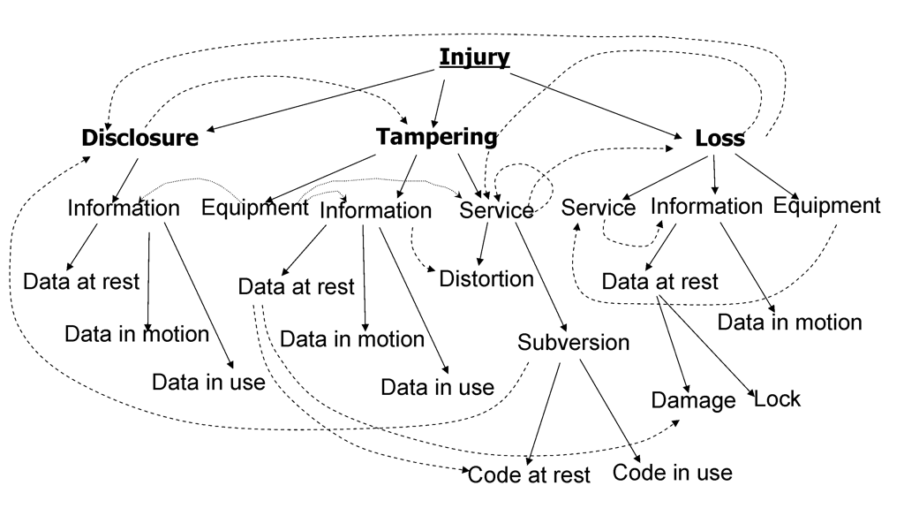
Taxonomy of injuries for cyber security
Data in use

Slide 42
Analysis of Undesired Events is based on the following model
Undesired Event
Threat Sources Taxonomy
Injures an asset
performs
has
Based on
UE1 – Loss of availability of network
UE2 - Disclosure of other assets
UE3 - Subversion of Wireshark node
UE4 - Loss of availability of packets
UE5 – Disclosure of packet data
UE6 – Disclosure of capture
UE7 – Loss of availability of other assets
Primary asset
Threat Source
describes
Is occurrence of
threat source is motivated to injure the asset
Values the asset
Severity
causes
injures the asset
Based on
Stakeholder
Incident
Wants to mitigate
Incident
Causes
Is concerned about
involves
Sensitivity
Impact
involves
affects
Involves injury
Based on
Stakeholder wants to mitigate incidents
Security Criteria
Injury
Impacts Taxonomy

Slide 43
FORSA: The Effect analysis
FORSA STEPS
Operational Context Identification
System Facts
Asset Identification
Undesired Event Identification
Attack Group Identification
Threat Scenario Analysis
Safeguard Identification
Vulnerability Analysis
Risk Identification
Risk Analysis
Mostly import (if possible)
or interviews
+ validation & verification
+ validation & verification
At this point we can justify
that we understand ALL
classes of Undesired Events
that can occur, and
justify their severity

Slide 44
Part 3: The Cause Analysis

Slide 45
Cause and effect in a risk statement
Loss of confidentiality of confidential assets
What?
Security criterion
Primary asset: sensitivity subject &
attack goal
Undesired event
Threat source
Injury
R01 Hacker gains access to confidential assets by information gathering on stored files
Threat scenario
information gathering on stored files
How?
Attack mode
System asset: attack target

Slide 46
The corresponding FORSA steps
FORSA STEPS
FORSA STEPS
Operational Context Identification
System Facts
Asset Identification
Undesired Event Identification
Attack Group Identification
Threat Scenario Analysis
Safeguard Identification
Vulnerability Analysis
Risk Identification
Risk Analysis
What?
Analysis of valuables,
sensitivities and
Impacts
=> severity
How?
Analysis of targets,
Entries and
attacks
=> likelihood

Slide 47
FORSA STEPS
Operational Context Identification
System Facts
Asset Identification
Undesired Event Identification
Attack Group Identification
Threat Scenario Analysis
Safeguard Identification
Vulnerability Analysis
Risk Identification
Risk Analysis

Slide 48
Analysis of Attack Groups is based on the following model
Is characterized by
Attack Mode
Threat Scenario
Threat Sources Taxonomy
Attacks a performer
Performed by
Based on
Performer
Threat Source
Depends on the performer
has
threat source is capable to perform the scenario
causes
Attack Group
Likelihood
Primary Asset
injures
Undesired Event
Attack Group considers a single entry point; This is a class of attacks
Threat Scenarios within the Attack Group describe various multi-stage attacks;
In a simple case Attack Group involves a single Threat Scenario

Slide 49
Attack Groups
Attack Groups
Abuse of Wireshark node
Damage to the Wireshark node
Exceeding capacity of the Wireshark Node
Modification of the Wireshark Code
Information Gathering on Wireshark Code
Information Gathering on Stored Files
…
Attack modes
Abuse
Exceeding capacity
Damage
Loss
Modification
Information Gathering
Note: Attack Groups can be systematically enumerated as a product of attack modes and systems (performers, entry points);
this is a controlled brainstorming approach

Slide 50
FORSA STEPS
Operational Context Identification
System Facts
Asset Identification
Undesired Event Identification
Attack Group Identification
Threat Scenario Analysis
Safeguard Identification
Vulnerability Analysis
Risk Identification
Risk Analysis

Slide 51
Analysis of Threat Scenarios is based on the following model
Is characterized by
Attack Mode
Threat Scenario
Threat Sources Taxonomy
Attacks a performer
Performed by
Based on
Performer
Threat Source
Depends on the performer
has
threat source is capable to perform the scenario
causes
Attack Group
Likelihood
Primary Asset
injures
Undesired Event
Attack Group considers a single entry point; This is a class of attacks.
Threat Scenarios within the Attack Group describe various multi-stage attacks;
Analysis of Threat Scenarios is about connecting to impacts ( the “How” to the “What”)

Slide 52
Analysis of Threat Scenarios is based on the following model
Is characterized by
Attack Mode
Threat Scenario
Threat Sources Taxonomy
TS1.1 - Loss of stored files
TS1.2 – Local damage to system software
TS1.3 – Remote damage to system software
TS1.4 – Local damage to Wireshark code
TS1.5 – Remote damage to Wireshark code
TS1.6 – Local damage to Wireshark COTS
TS1.7 – Damage to Wireshark executable
TS2.1 – Modification of stored files
TS2.2 – Local abuse of system software
TS2.3 – Remote abuse of system software
TS2.4 – Local abuse of Wireshark software
TS2.5 – Remote abuse of Wireshark software
TS2.6 – Local abuse of Wireshark COTS
TS2.7 – Remote abuse of Wireshark COTS
TS2.8 – Modification of Wireshark executable
TS3.1 – Information gathering on Wireshark code
TS3.2 – Information gathering on stored files
Attacks a system
Performed by
Based on
Performer
Threat Source
Depends on the system
threat source is capable to perform the scenario
has
causes
Attack Group
Likelihood
Primary Asset
injures
Undesired Event

Slide 53

The Yin and Yang of Security Assurance
Confidence
Identify Mishaps, Attacks
Mine pattern
Build assurance case
Define pattern
Evaluate facts
Normal Use
Abuse / Failure / Attack
Collect data
Find new argument
Find data source
Collect evidence
Build business model
/ operational model
Facts

Slide 54
FORSA STEPS
Operational Context Identification
System Facts
Asset Identification
Undesired Event Identification
Attack Group Identification
Threat Scenario Analysis
Safeguard Identification
Vulnerability Analysis
Risk Identification
Risk Analysis

Slide 55
Analysis of Safeguards is based on the following model
reduces
Risk
Safeguard
has
mitigates
Confidence Level
System Vulnerability
involves
Performer
is a
reduces
Existing Safeguard
Original Risk
Threat Scenario within an Attack Group describes a multi-stage attack that involves multiple Performers;
A Safeguard prevents an attack from succeeding;
A System Vulnerability is a condition involving a certain Performer that
enables the attack and permit it to propagate and eventually cause an undesired event

Slide 56
FORSA STEPS
Operational Context Identification
System Facts
Asset Identification
Undesired Event Identification
Attack Group Identification
Threat Scenario Analysis
Safeguard Identification
Vulnerability Analysis
Risk Identification
Risk Analysis

Slide 57
Analysis of System Vulnerabilities is based on the following model
System Vulnerability
involves
exploits
Performer
Threat Source
threat source is capable to perform the scenario
has
enables
Vulnerability Level
Threat Scenario
Threat Scenario within an Attack Group describes a multi-stage attack that
involves multiple Performers;
A System Vulnerability is a condition involving a certain Performer that
enables the attack and permit it to propagate and eventually cause an undesired event

Slide 58
FORSA: The Cause analysis
FORSA STEPS
At this point we can justify
that we understand ALL
classes of attacks on the system
and justify their likelihood;
and justify the level of
vulnerability
Operational Context Identification
System Facts
Asset Identification
Undesired Event Identification
Attack Group Identification
Threat Scenario Analysis
Safeguard Identification
Vulnerability Analysis
Risk Identification
Risk Analysis
+validation & verification
+validation & verification
+validation & verification
+validation & verification

Slide 59
Part 4: risk analysis & mitigation

Slide 60
FORSA STEPS
Operational Context Identification
System Facts
Asset Identification
Undesired Event Identification
Attack Group Identification
Threat Scenario Analysis
Safeguard Identification
Vulnerability Analysis
Risk Identification
Risk Analysis
Analytics, recommendations,
Mitigation option analysis

Slide 61
Analysis of Risks is based on the following model
has
Disposition

Slide 62
Risk Mitigation Analysis is based on the following model
reduces
Risk
Safeguard
has
mitigates
Confidence Level
has
System Vulnerability
Cost
is a
involves
reduces
Residual Risk
Performer
Recommended Safeguard
part of
Mitigation Option
Threat Scenario within an Attack Group describes a multi-stage attack that involves multiple Performers;
A Safeguard prevents an attack from succeeding;
A System Vulnerability is a condition involving a certain Performer that
enables the attack and permit it to propagate and eventually cause an undesired event

Slide 63
Questions ?
Dr. Nikolai Mansourov
nick@kdmanalytics.com

Slide 64
Justifiable risk assurance = risk management + assurance case

Slide 65
Justifiable Risk Assurance
Assurance Case is related to the level of risk
Assurance Case is structured according
to Risk Metamodel
Assurance Case
Risk Metamodel
Assurance Process delivers assurance case
(argument + evidence)
Assurance Process
Risk Metamodel provides guidance
on how to collect evidence
Assurance Case
provides guidance on how to collect evidence
Assurance Process
Generic
guidance & tool
Report
Data specific to system

Slide 66
Justifiable Risk Assurance
Assurance Case is related to the level of risk
System Model
e.g. DoDAF views
Assurance Case is structured according to
System Model
System Model constrains evidence
Assurance Case is structured according
to Risk Metamodel
Report / Risk Manage-ment
Plan
Risk Metamodel describes evidence
Assurance Case
Evidence
Risk Metamodel
Assurance Case
structures
report
Evidence justifies claims
Assurance Process defines
the steps to collect
evidence
Assurance Process delivers assurance case
(argument + evidence)
Assurance Process
Risk Metamodel provides guidance
on how to collect evidence
Assurance Case
provides guidance on how to collect evidence
Assurance Process
Generic
guidance & tool
Report
Data specific to system

Slide 67
The key outcome is a justifiable list of risks
FORSA STEPS
Operational Context Identification
System Facts
Asset Identification
Undesired Event Identification
Attack Group Identification
Threat Scenario Analysis
Safeguard Identification
Vulnerability Analysis
Risk Identification
Risk Analysis
Steps leading to
systematic identification
of risks

Slide 68
Results of justifiable risk analysis (1 of 2)
ID | Description | Severity | Likeli-hood | Level | Resi-dual | Confi-dence
R01 | Hacker gains access to confidential assets by information gathering on stored files | high | high | high | low | 80%
R02 | Targeted virus or timebomb affects integrity or availability of network by attacking wireshark executable | high | high | high | low | 80%
R03 | Hacker subverts wireshark node by remote attack exploiting vulnerabilities in Wireshark code | high | medium | high | low | 80%
R04 | Hacker subverts wireshark node by remote attack exploiting vulnerabilities in system software on wireshark node | high | medium | medium | low | 80%
R05 | Criminal leans about forensic activity by attacking wireshark executable | medium | high | medium | low | 80%
R06 | Targeted virus or timebomb affects availability of other assets by attacking wireshark executable | medium | high | medium | low | 80%
R07 | Malicious user subverts wireshark node by locally attacking wireshark code | medium | low | medium | low | 70%
R08 | Malicious user subverts wireshark node by locally attacking system software on wireshark node | medium | low | medium | low | 70%
R09 | Criminal forces wireshark to miss packets by attacking wireshark executable | medium | high | medium | low | 70%

Slide 69
Anatomy of a risk statement
Threat source
Primary asset (attack goal)
Injury
Undesired event
R01 Hacker gains access to confidential assets by information gathering on stored files
Threat scenario
Attack mode
System asset (attack target)

Slide 70
Cause and effect in a risk statement
Loss of confidentiality of confidential assets
What?
Security criterion
Primary asset: sensitivity subject &
attack goal
Undesired event
Threat source
Injury
R01 Hacker gains access to confidential assets by information gathering on stored files
How?
Attack mode
System asset (attack target)
Threat scenario

Slide 71
The corresponding FORSA steps
FORSA STEPS
FORSA STEPS
Operational Context Identification
System Facts
Asset Identification
Undesired Event Identification
Attack Group Identification
Threat Scenario Analysis
Safeguard Identification
Vulnerability Analysis
Risk Identification
Risk Analysis
What?
Analysis of valuables,
sensitivities and
Impacts
=> severity
How?
Analysis of targets,
Entries and
attacks
=> likelihood

Slide 72
Risk analysis
What?
High
Med
High
High
Impact Rating
Risk Level
Med
Med
Med
High
Low
Low
Med
Med
Low Med High
Likelihood Rating
How?
Risk= ∫(Severity, Likelihood)

Slide 73
From risk to Claims & evidence through patterns

Slide 74
Evidence collection planning
FORSA STEPS
Operational Context Identification
System Facts
Asset Identification
Undesired Event Identification
Attack Group Identification
Threat Scenario Analysis
Safeguard Identification
Vulnerability Analysis
Risk Identification
Risk Analysis
Claims
Design
element
patterns

Slide 75
Business Models -> SysML -> Code
Capabilities
Exchange Elements
Performers
Operational Activities
Entity Items
Systems
Functions
Subsystems
Entity Items
Modules
Modules
Modules
Files
Files
Files
Procedures
Procedures
Data Elements
Blocks
Notes:
The baseline system model is expected to contain the top level system components that correspond to the physical elements, users, networks, and entire applications. This activity identifies components corresponding to the internal subsystems and layers, with the resolution commensurate with the scope and rigor of the assessment. System components are nested. The fact-oriented approach to architecture analysis is characterized by the use of the repository of facts to manage all pieces of cybersecurity information.
Integration of architecture information to the baseline system models is achieved by establishing “vertical” traceability links from architecture components to the low level system elements that implement them. Vertical traceability links are also established between the parent components and their children.

Slide 76
Evidence collection
FORSA STEPS
Operational Context Identification
System Facts
Asset Identification
Undesired Event Identification
Attack Group Identification
Threat Scenario Analysis
Safeguard Identification
Vulnerability Analysis
Risk Identification
Risk Analysis
Claims
Design
element
patterns
Findings

Slide 77
Evidence analysis
FORSA STEPS
Operational Context Identification
System Facts
Asset Identification
Undesired Event Identification
Attack Group Identification
Threat Scenario Analysis
Safeguard Identification
Vulnerability Analysis
Risk Identification
Risk Analysis
Evidence Analysis
Claims
Design
element
patterns
Evidence
Findings

Slide 78
Undesired Events -> Claims -> Patterns
We start with an enumeration of undesired events (something happens; an injury)
Usually the injury happens to an asset
There is a design element (piece of code) that causes the injury when executed
Can we identify all necessary pieces of code for the specific injury ?
We make claims regarding all possible necessary conditions of an injury
As the result we get the patterns to identify the corresponding design elements
Some patterns are common vulnerability patterns
Others are application-specific patterns

Slide 79
Assurance case for justifiable risk management
uses OMG Structured Assurance Case Metamodel (SACM)

Slide 80
Security Assurance Case (top)
CG1.1
Security criteria are defined
G1
System is acceptably
secure
CG1.4
Concept of operations
Context
Context
Goal
CG1.2
Assessment scope is defined
CG1.5
Subject to declared
assumptions and limitations
Context
G2
All threats are
identified and adequately
mitigated
Context
CG1.3
Assessment rigor is defined
Context
Goal
S1
Argument based on end-to-end risk mitigation analysis
M1
Integrated system
model
Strategy
Model
G3
All threats to the system
are identified
G4
Identified threats are
adequately mitigated by
the implementation
G5
Residual risk is
acceptable
G6
Operational
Risk Measures
are acceptable
Goal
Goal
Goal
Goal

Slide 81
Mitigation argument
G4
Identified threats are
adequately
mitigated by the
implementation
CSx1.2
All threat statements
are identified
Goal
Context
CSx1.1
Security Zones
are identified
as the result of
Architecture Risk
Analysis
Mx1
Integrated
system
model
S5
Argument based on appropriate
evidence
that implementation mitigates each threat
Context
Strategy
Model
G4.1
Safeguard SG1 is effective
against Risk R1
G4.2
Safeguard SG2 is effective
against Risk R2
G4.3
Vulnerability of Zone 3
to Risk 3
is mitigated
etc
Goal
Goal
Goal
Specific argument:
Claims and evidence
Specific argument:
Claims and evidence

Slide 82
Vulnerability Mitigation Argument
G4.3
Vulnerability of Zone 3
to Risk 3
is mitigated
Goal
CSx1.3
All Undesired Events are identified
CSx1.4
Knowledge Base of common vulnerability patterns
S6
Argument based on direct and supporting
evidence based on running trusted tools and
analyzing patterns
Context
Strategy
Context
G4.3.1
None of the tools found
relevant
vulnerabilities
based on common patterns
G4.3.2
List of patterns is
complete; no other
ways to achieve UE
G4.3.3
Tools are applied
correctly
G4.3.4
Tools did not miss
relevant vulnerabilities
Goal
Goal
Goal
Goal
E6.3
Allocation of
Common
vulnerability
Patterns to UE
E6.7
Analysis of
application
patterns
E6.2
List of UE for
Risk 3
E6.4
Build model
review
E6.5
Tool Calibration
report
E6.6
Analysis of
common
patterns
E6.1
TOIF findings
Evidence
Evidence
Evidence
Evidence
Evidence
Evidence
Evidence

Slide 83
Security Assurance Case (back to the top)
CG1.1
Security criteria are defined
G1
System is acceptably
secure
CG1.4
Concept of operations
Context
Context
Goal
CG1.2
Assessment scope is defined
CG1.5
Subject to declared
assumptions and limitations
Context
G2
All threats are
identified and adequately
mitigated
Context
CG1.3
Assessment rigor is defined
Context
Goal
S1
Argument based on end-to-end risk mitigation analysis
M1
Integrated system
model
Strategy
Model
G3
All threats to the system
are identified
G4
Identified threats are
adequately mitigated by
the implementation
G5
Residual risk is
acceptable
G6
Operational
Risk Measures
are acceptable
Goal
Goal
Goal
Goal

Slide 84
Threat identification argument
G3
All threats to the system
are identified
Goal
S2
Argument based on various confidence factors affecting
Risk identification
Strategy
G3.1
All known risk factors
related to similar systems
were applied
G3.2
All elements of risk for the system
are systematically identified
G3.3
Risk analysis team is
adequately experienced
Goal
Goal
Goal
G3.1.1
Operational
context
of the system
Is identified
G3.1.2
All assets of the system
are identified
G3.1.3
All threat sources
are identified
G3.1.4
All undesired events
are identified
G3.1.5
All threat scenarios
are identified
G3.1.6
All threat statements
are identified
Goal
Goal
Goal
Goal
Goal
Goal

Slide 85
Threat identification argument (cont’d)
CG3.1.3_3
All undesired events are
identified
CG3.1.3_1
All threat scenarios are
identified
G3.1.6
All threat statements
are identified
Context
Context
Goal
CG3.1.3_4
All entry points are
identified
CG3.1.3_2
All threat sources
are identified
S3
Argument based on various confidence factors affecting
Risk statement identification
Context
Context
Strategy
G3.1.6.4
Gaps between Entry points and identified risks
are reviewed
G3.1.6.5
Level of each identified risk is identified and reviewed by stakeholders
G3.1.6.1
Threat statements
are identified and reviewed by stakeholders
G3.1.6.2
Gaps between undesired events and identified risks reviewed
G3.1.6.3
Gaps between threat sources and identified risks are reviewed
Goal
Goal
Goal
Goal
Goal
E5.1
Identified Risk table
E5.2
Cross-correlation
review notes
E5.3
Undesired
Events table
E3.1
Threat sources
table
Evidence
E5.5
Cross-correlation review notes
Evidence
Evidence
Evidence
E1.8.5
Entry points
table
Evidence
E1.7
Stakeholder review notes
Evidence
Evidence

Slide 86
Questions ?
Dr. Nikolai Mansourov
nick@kdmanalytics.com

